Slide 1
Bit Manipulation, Bit Masking, Bitsets

Slide 2
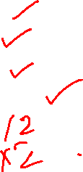
Introduction to Bit Manipulation
Binary Representation – 29 = (11101)
Boolean Operators
&& (and)
|| (or)
! (not)
Bitwise Operators
& (Bitwise And)
| (Bitwise Or)
^ (Bitwise XOR)
~ (Bitwise Inversion)
>> (Right Shift)
<< (Left Shift)

Slide 3
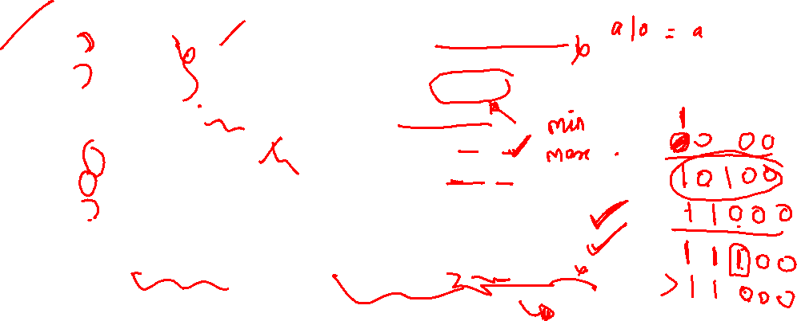
Properties of Bitwise Operations
3. Identity
a ^ 0 = 0 ^ a = a
4. Inverse
a ^ a = 0
5. Idempotent
a & a = a
a | a = a
6. Inequalities
a & b <= min(a, b)
a | b >= max(a, b)
Commutativity
a ^ b = b ^ a
a & b = b & a
a | b = b | a
Associativity
(a & b) & c = a & (b & c)
(a | b) | c = a | (b | c)
(a ^ b) ^ c=a ^ (b ^ c)

Slide 4

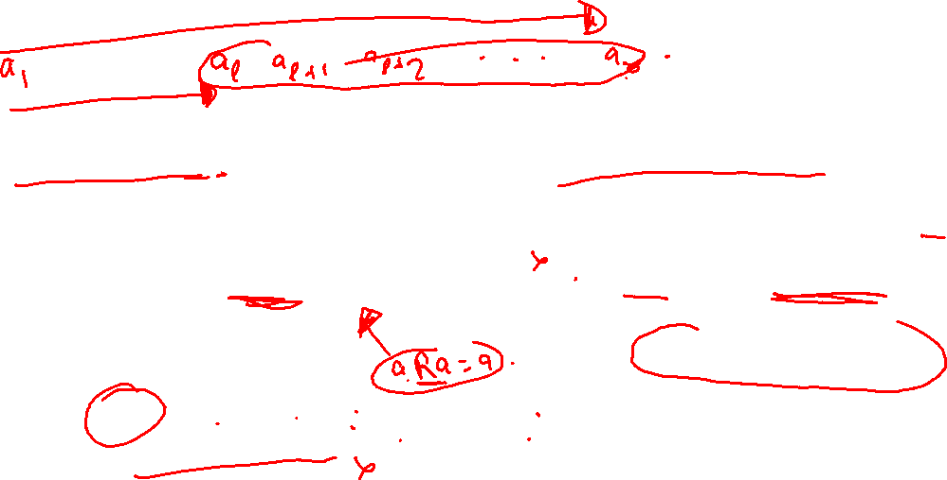
Applications
Sparse Table – Can range query from l to r in O(1)
req- Idempotent, Eg- min, max, |, &
Fenwick Tree– Can range query from l to r in O(log(n))
req- Inverse Exists, Eg- ^, +, * in mod p

Slide 5
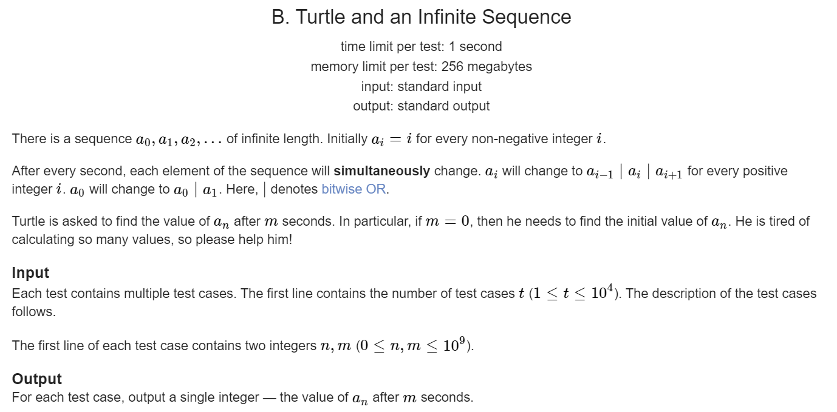
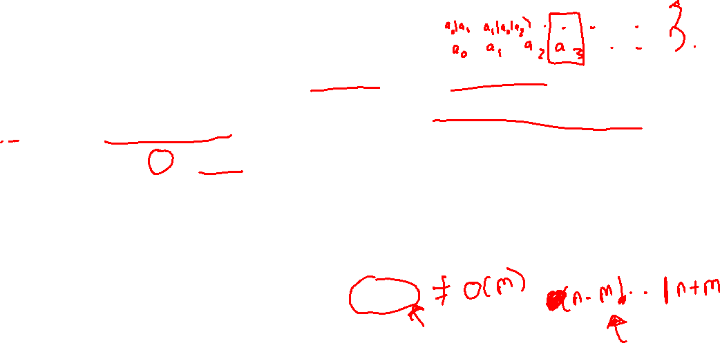

Slide 6
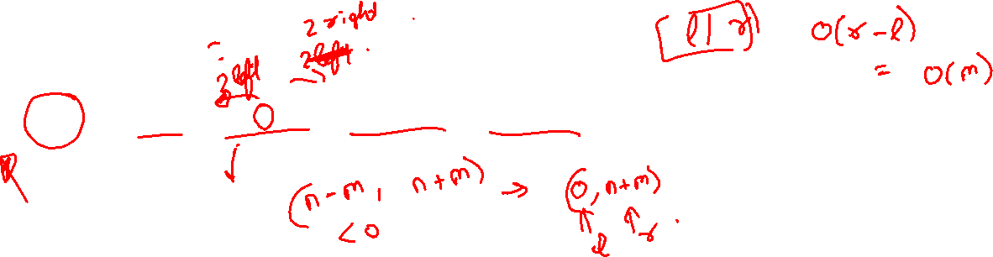

Slide 7

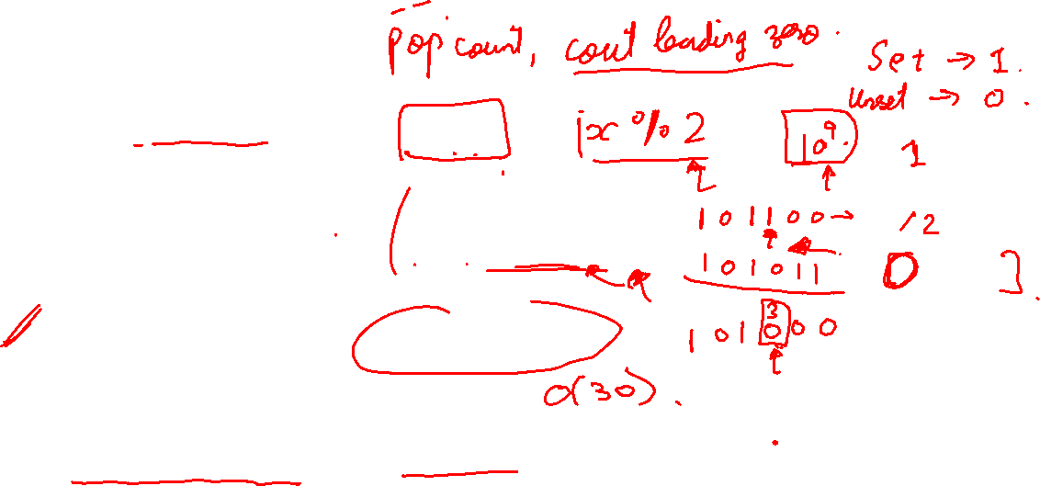
Bit Manipulations
Even or Odd.
x & 1
Unset the smallest bit
n & (n - 1)
Checking i^{th} bit is set to 1.
x & (1 << i)
Get the smallest bit.
x & -x

Slide 8
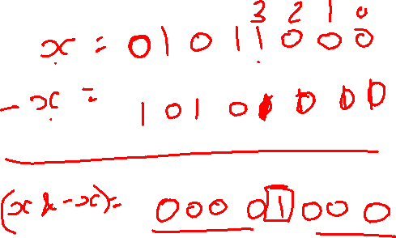

Slide 9

Bit Manipulations
https://codeforces.com/blog/entry/21858
https://codeforces.com/blog/entry/95490
https://codeforces.com/blog/entry/73490
https://codeforces.com/blog/entry/94470

Slide 10

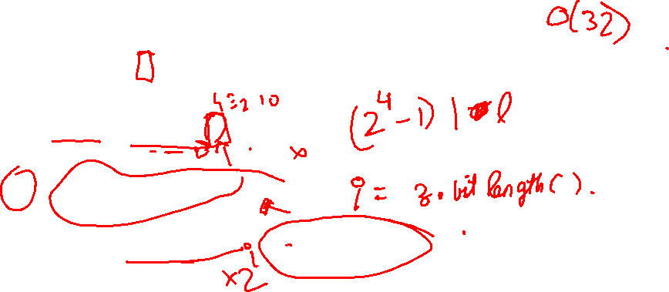
Solution to the previous question through Bit Manipulation
l = 10110100101
r = 10110110001
x = 10110101111
z = l ^ r = 00000010100
i = 32 - __builtin_clz(z)
ans = l | ((1 << i) - 1) = 10110101111

Slide 11
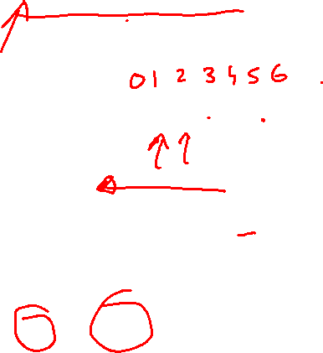
Sets represented as integers
S = {2, 3, 5}
seq = 0011010…
s = (101100)₂
s = (44)₁₀

Slide 12
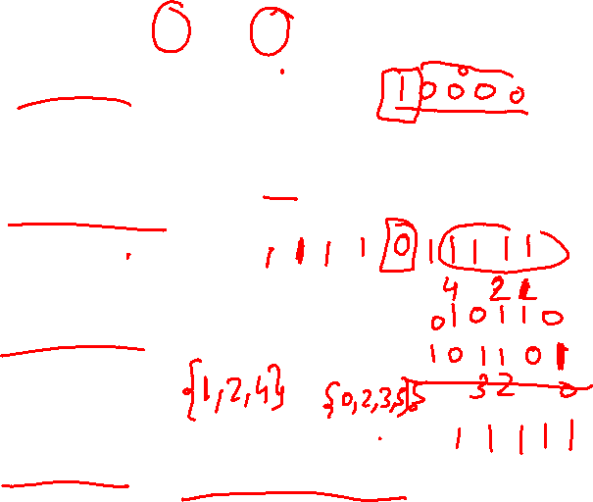
Operations on Set
S.insert(i) -> s |= 1 << i
S.erase(i) -> s &= ~(1 << i)
S1 ∪ S2 -> s1 | s2
S1 ∩ S2 -> s1 & s2

Slide 13
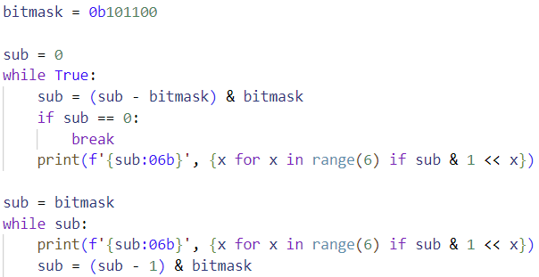
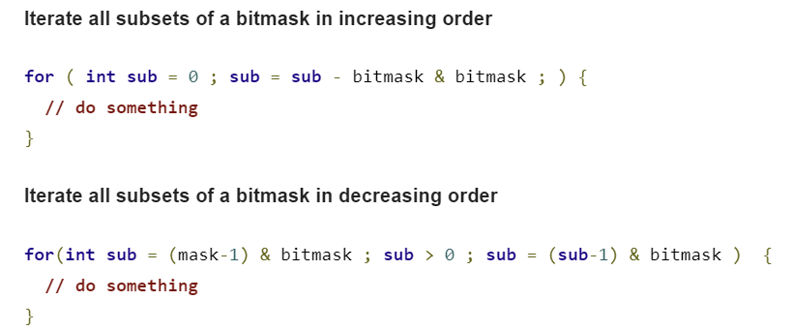
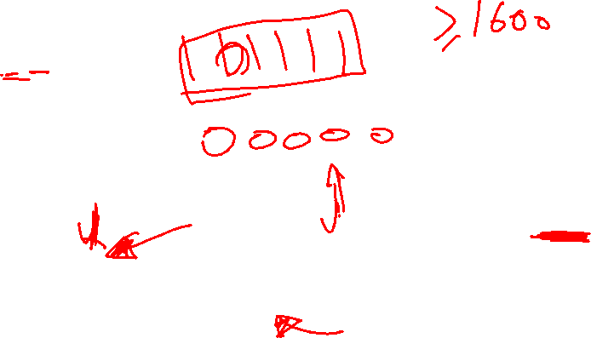
Subsets

Slide 14
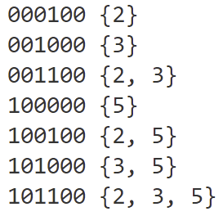
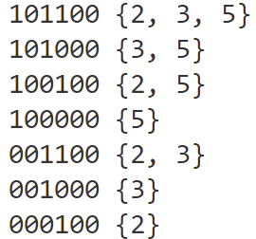
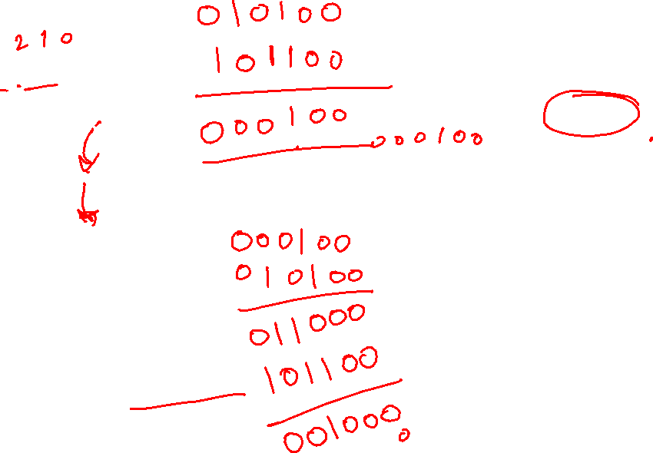

Slide 15
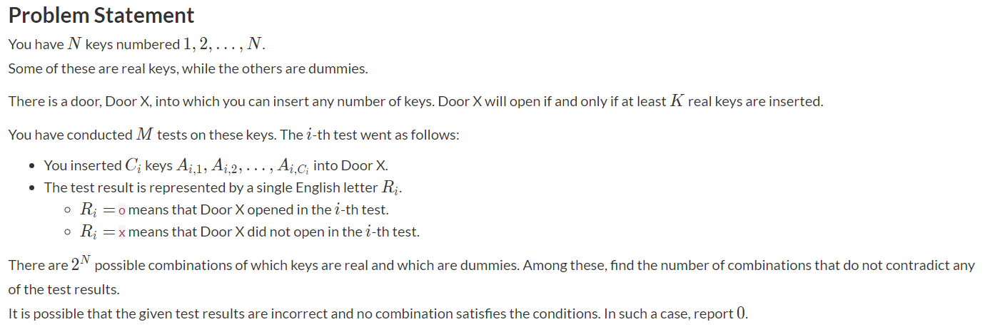
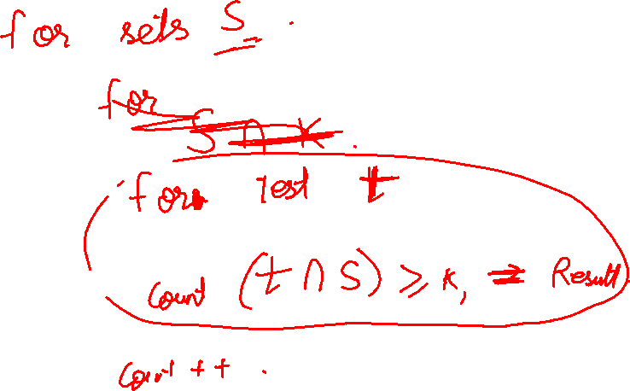

Slide 16
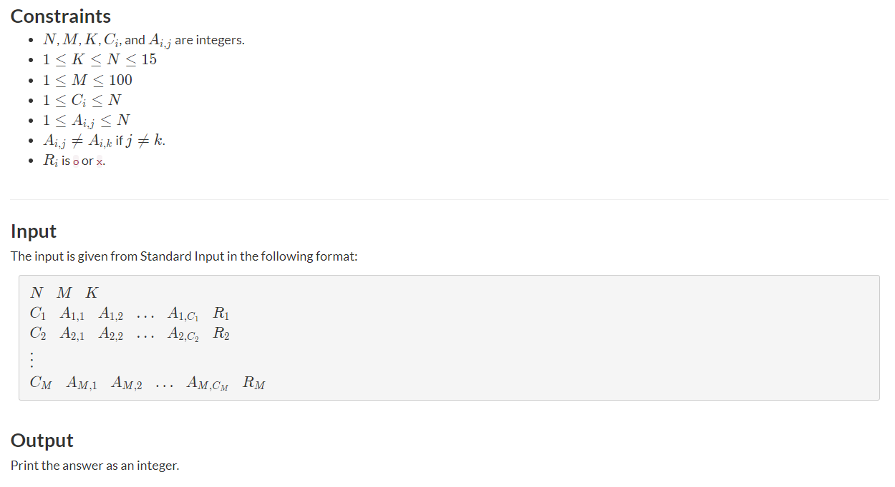


Slide 17
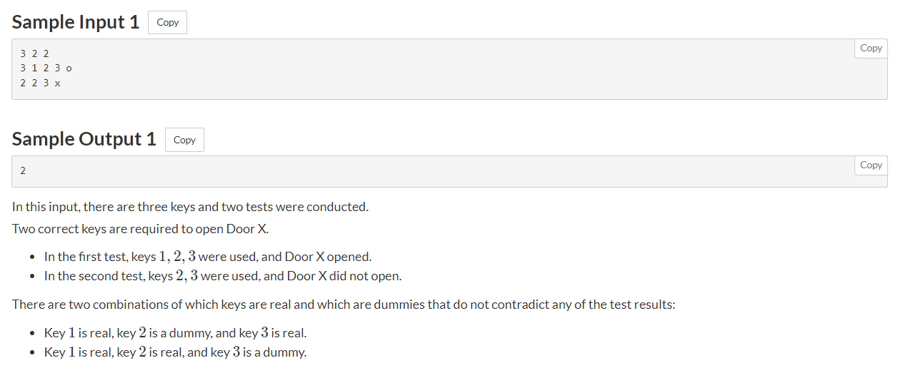
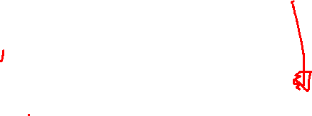

Slide 18
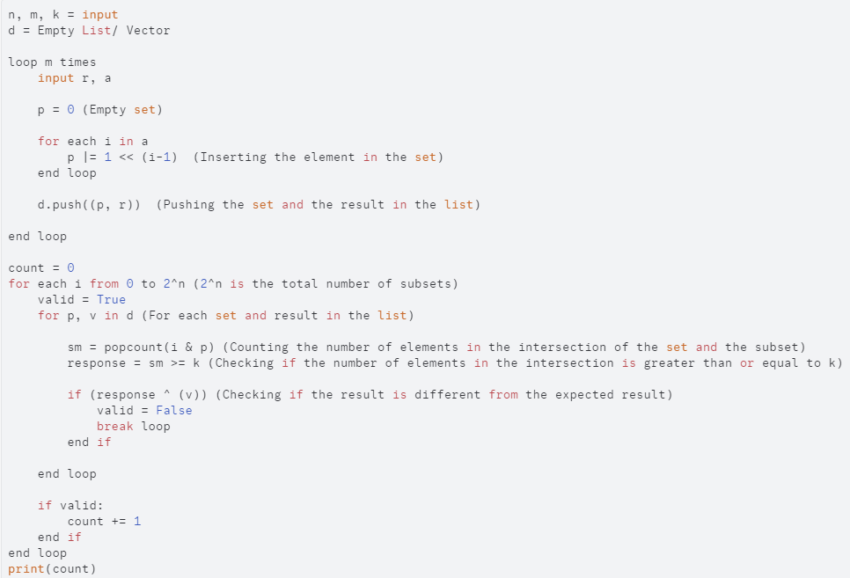
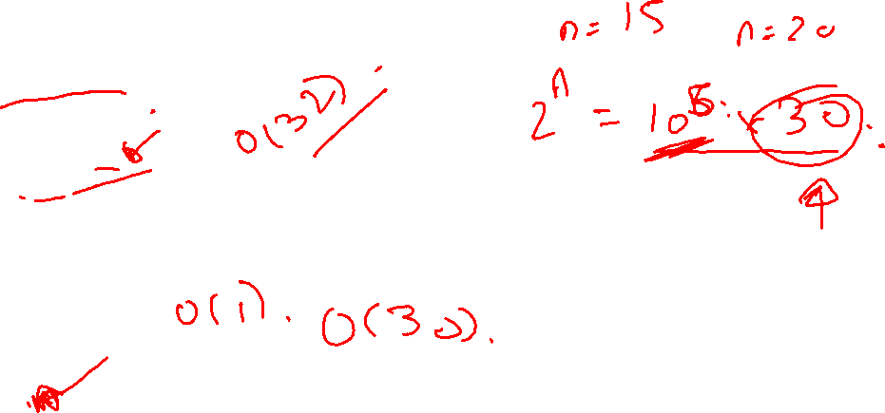

Slide 19
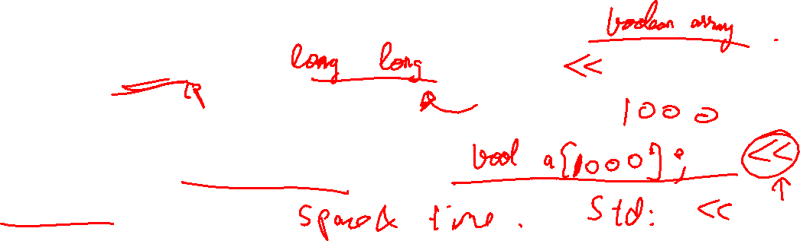
Introduction to Bitsets
What is you want to store a number >32 in the set?
What is bitset?
Difference Between Boolean Array and Bitsets

Slide 20
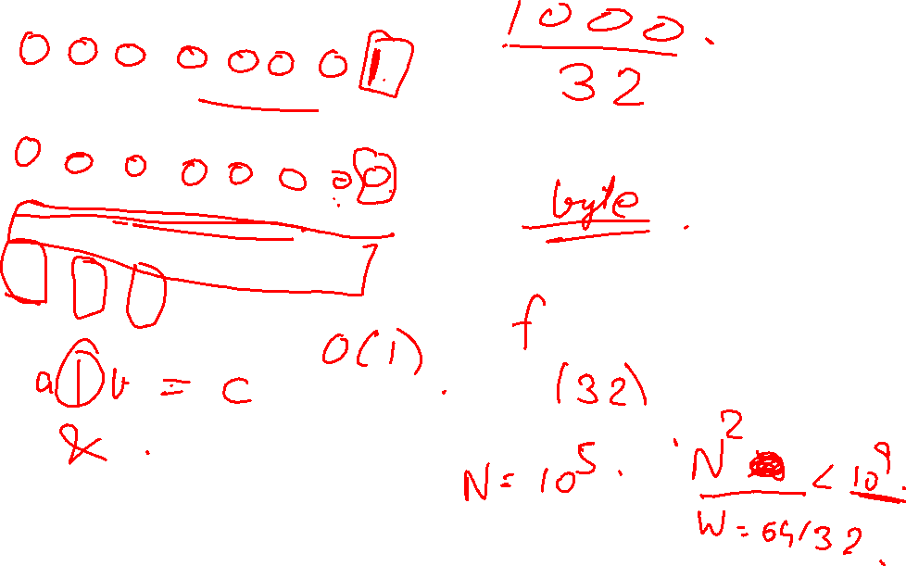

Slide 21

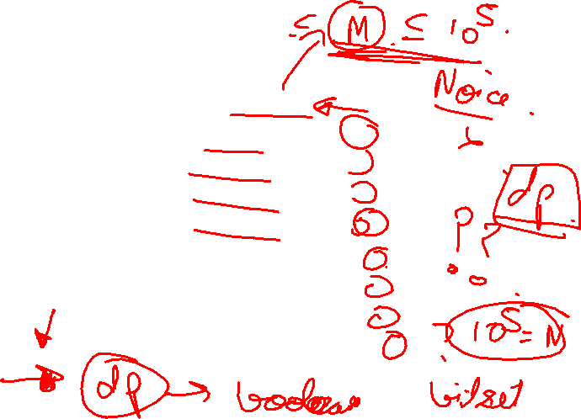
Print sums of all subsets of a given set
Example –
S = {2, 3, 5}
S0 = {}, sum = 0
S1 = {2}, sum = 2
S2 = {3}, sum = 3
S3 = {5}, sum = 5
S4 = {2,3}, sum = 5
S5 = {2,5}, sum = 7
S6 = {3,5}, sum = 8
S7 = {2,3,5}, sum = 10

Slide 22
