Slide 1

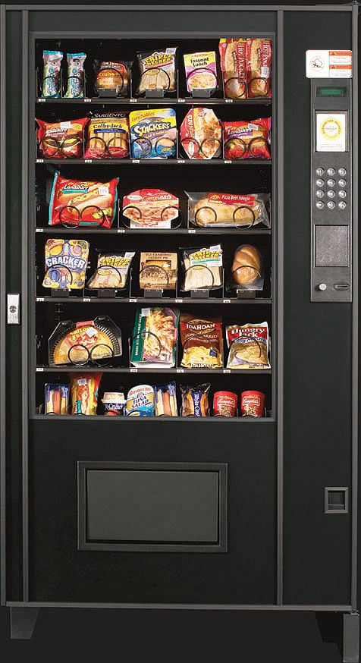
Vending Machine Using FSM
Aalapee Patel
Seth Martin

Slide 2
Objective
Dispense the product and the change if there is any depending on the customer input in terms of the money and the selected product.

Slide 3
Special Cases
Machine is out of money
Customer enters wrong product code
Any particular product is out of stock
Customer provides input in wrong order i.e. enters product code before money
Customer does not provide enough money

Slide 4
Conditions/Constraints
The vending machine will contain products worth prices that are divisible by 5 i.e. $0.70, $1.00, $1.45 etc.
Customers are allowed to enter a maximum of $5 total as input.
Denomination for input and output(change) : $0.05, $0.10, $0.25, $1.00 and $5.00.

Slide 5
Finite State Machine With Output
Definition :
Q - Set of states
S - Start state which is an element of Q
Sigma - Set of input symbols
Pi - Set of output symbols
Delta - Maps a state and a symbol from Sigma to a state and a symbol from Pi
Note : It has no set of final states but has set of output symbols.

Slide 6
Mealy and Moore Machines
In Mealy machine, the outputs are a function of the present state and the value of the input.
In Moore machine, the output depends only on the present state.

Slide 7
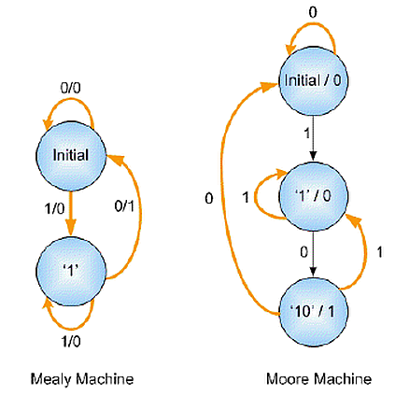
Example
Mealy and Moore state diagrams for '10' sequence detector :
Ref: faculty.kfupm.edu.sa/COE/abouh/Lesson4_5.pdf

Slide 8
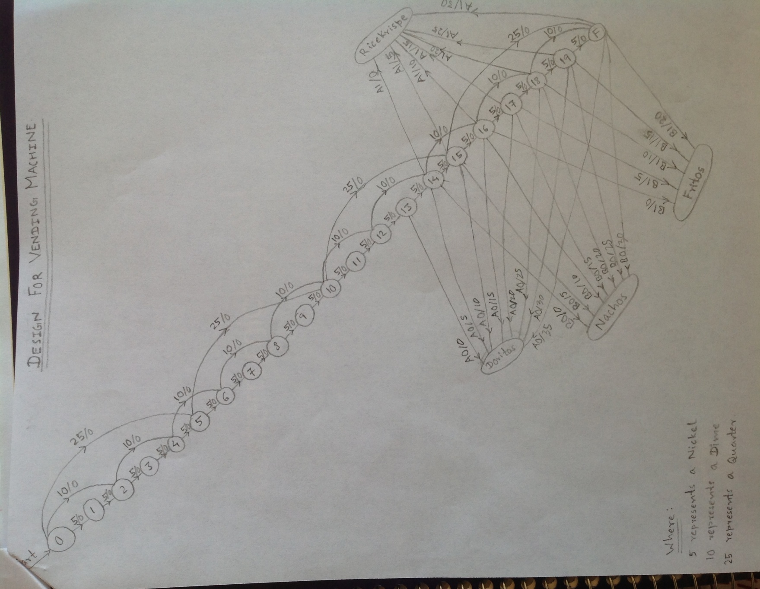
Design for vending machine
Start

Slide 9
References
1) Finite State Machines :
http://en.wikipedia.org/wiki/Finite-state_machine
2) Mealy Machine :
http://en.wikipedia.org/wiki/Mealy_machine
3) Moore Machine :
http://en.wikipedia.org/wiki/Moore_machine

Slide 10
Questions ?

