Slide 1
Computer Architecture Experiment
Topic 6. Pipelined CPU supporting
31 MIPS Instructions
浙江大学计算机学院
陈文智、王总辉
{chenwz, zhwang}@zju.edu.cn

Slide 2
Outline
Experiment Purpose
Experiment Task
Basic Principle
Operating Procedures
Precaution
Checkpoints

Slide 3
Experiment Purpose
Understand 31 MIPS instructions.
Master the design methods of pipelined CPU executing 31 MIPS instructions.
master methods of program verification of Pipelined CPU executing 31 MIPS instructions

Slide 4
Experiment Task
Design of Pipelined CPU executing 31 MIPS instructions.
Design datapath
Design CPU Controller
Verify the Pipelined CPU with program and observe the execution of program

Slide 5
Pipelined CPU supporting execution of 31 MIPS instructions
MIPS Instructions
Bit # | 31..26 | 25..21 | 20..16 | 15..11 | 10..6 | 5..0 | Operations
R-type | op | rs | rt | rd | sa | func
add | 000000 | rs | rt | rd | 00000 | 100000 | rd = rs + rt; with overflow | PC+=4
addu |  | rs | rt | rd | 00000 | 100001 | rd = rs + rt; without overflow | PC+=4
sub |  | rs | rt | rd | 00000 | 100010 | rd = rs - rt; with overflow | PC+=4
subu |  | rs | rt | rd | 00000 | 100011 | rd = rs - rt; without overflow | PC+=4
and |  | rs | rt | rd | 00000 | 100100 | rd = rs & rt; | PC+=4
or |  | rs | rt | rd | 00000 | 100101 | rd = rs | rt; | PC+=4
xor |  | rs | rt | rd | 00000 | 100110 | rd = rs ^ rt; | PC+=4
nor |  | rs | rt | rd | 00000 | 100111 | rd = ~(rs | rt); | PC+=4
slt |  | rs | rt | rd | 00000 | 101010 | if(rs < rt)rd = 1; else rd = 0; <(signed) | PC+=4
sltu |  | rs | rt | rd | 00000 | 101011 | if(rs < rt)rd = 1; else rd = 0; <(unsigned) | PC+=4
sll |  | 00000 | rt | rd | sa | 000000 | rd = rt << sa; | PC+=4
srl |  | 00000 | rt | rd | sa | 000010 | rd = rt >> sa (logical); | PC+=4
sra |  | 00000 | rt | rd | sa | 000011 | rd = rt >> sa (arithmetic); | PC+=4
sllv |  | rs | rt | rd | 00000 | 000100 | rd = rt << rs; | PC+=4
srlv |  | rs | rt | rd | 00000 | 000110 | rd = rt >> rs (logical); | PC+=4
srav |  | rs | rt | rd | 00000 | 000111 | rd = rt >> rs(arithmetic); | PC+=4
jr |  | rs | 00000 | 00000 | 00000 | 001000 |  | PC=rs

Slide 6
Pipelined CPU supporting execution of 31 MIPS instructions
MIPS Instructions
Bit # | 31..26 | 25..21 | 20..16 | 15..11 | 10..6 | 5..0 | Operations
I-type | op | rs | rt | immediate
addi | 001000 | rs | rt | imm |  |  | rt = rs + (sign_extend)imm; with overflow | PC+=4
addiu | 001001 | rs | rt | imm |  |  | rt = rs + (sign_extend)imm;without overflow | PC+=4
andi | 001100 | rs | rt | imm |  |  | rt = rs & (zero_extend)imm; | PC+=4
ori | 001101 | rs | rt | imm |  |  | rt = rs | (zero_extend)imm; | PC+=4
xori | 001110 | rs | rt | imm |  |  | rt = rs ^ (zero_extend)imm; | PC+=4
lui | 001111 | 00000 | rt | imm |  |  | rt = imm * 65536; | PC+=4
lw | 100011 | rs | rt | imm |  |  | rt = memory[rs + (sign_extend)imm]; | PC+=4
sw | 101011 | rs | rt | imm |  |  | memory[rs + (sign_extend)imm] <-- rt; | PC+=4
beq | 000100 | rs | rt | imm |  |  | if (rs == rt) PC+=4 + (sign_extend)imm <<2; | PC+=4
bne | 000101 | rs | rt | imm |  |  | if (rs != rt) PC+=4 + (sign_extend)imm <<2; | PC+=4
slti | 001010 | rs | rt | imm |  |  | if (rs < (sign_extend)imm) rt =1 else rt = 0; less than signed | PC+=4
sltiu | 001011 | rs | rt | imm |  |  | if (rs < (zero_extend)imm) rt =1 else rt = 0; less than unsigned | PC+=4
J-type | op | address
j | 000010 | address |  |  |  |  | PC = (PC+4)[31..28],address<<2
jal | 000011 | address |  |  |  |  | PC = (PC+4)[31..28],address<<2 ; $31 = PC+4

Slide 7
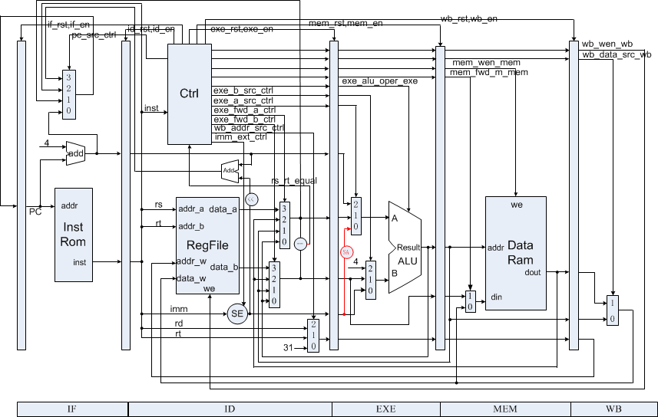
Datapath of CPU supporting 31 MIPS Instr.

Slide 8
signed and unsigned type
reg and wire are unsigned type in Default
Signed Type:
reg signed
wire signed
Type Conversion Function
$signed()
$unsiged()

Slide 9
ALU
case (oper)
EXE_ALU_SLT: begin
if (sign)
result = $signed(a) < $signed(b);
else
result = ……
EXE_ALU_LUI: begin
result = ……
end
……
EXE_ALU_SR: begin
if (sign)
……
else
……
endcase

Slide 10
Instr. Mem.(1)
0 : 3c010000; % (00) main: lui $1, 0 # address of data[0] %
1 : 34240050; % (04) ori $4, $1, 80 # address of data[0] %
2 : 0c00001b; % (08) call: jal sum # call function %
3 : 20050004; % (0c) dslot1: addi $5, $0, 4 # counter,DELYED SLOT(DS) %
4 : ac820000; % (10) return: sw $2, 0($4) # store result %
5 : 8c890000; % (14) lw $9, 0($4) # check sw %
6 : 01244022; % (18) sub $8, $9, $4 # sub: $8 <- $9 - $4 %
7 : 20050003; % (1c) addi $5, $0, 3 # counter %
8 : 20a5ffff; % (20) loop2: addi $5, $5, -1 # counter - 1 %
9 : 34a8ffff; % (24) ori $8, $5, 0xffff # zero-extend: 0000ffff %
A : 39085555; % (28) xori $8, $8, 0x5555 # zero-extend: 0000aaaa %
B : 2009ffff; % (2c) addi $9, $0, -1 # sign-extend: ffffffff %

Slide 11
Instr. Mem.(2)
C : 312affff; % (30) andi $10, $9, 0xffff # zero-extend: 0000ffff %
D : 01493025; % (34) or $6, $10, $9 # or: ffffffff %
E : 01494026; % (38) xor $8, $10, $9 # xor: ffff0000 %
F : 01463824; % (3c) and $7, $10, $6 # and: 0000ffff %
10 : 10a00003; % (40) beq $5, $0, shift # if $5 = 0, goto shift %
11 : 00000000; % (44) dslot2: nop # DS %
12 : 08000008; % (48) j loop2 # jump loop2 %
13 : 00000000; % (4c) dslot3: nop # DS %
14 : 2005ffff; % (50) shift: addi $5, $0, -1 # $5 = ffffffff %
15 : 000543c0; % (54) sll $8, $5, 15 # <<15 = ffff8000 %
16 : 00084400; % (58) sll $8, $8, 16 # <<16 = 80000000 %
17 : 00084403; % (5c) sra $8, $8, 16 # >>16 = ffff8000 (arith) %

Slide 12
Instr. Mem.(3)
18 : 000843c2; % (60) srl $8, $8, 15 # >>15 = 0001ffff (logic) %
19 : 08000019; % (64) finish: j finish # dead loop %
1A : 00000000; % (68) dslot4: nop # DS %
1B : 00004020; % (6c) sum: add $8, $0, $0 # sum function entry %
1C : 8c890000; % (70) loop: lw $9, 0($4) # load data %
1D : 01094020; % (74) add $8, $8, $9 # sum, PIPELINE STALLS %
1E : 20a5ffff; % (78) addi $5, $5, -1 # counter - 1 %
1F : 14a0fffc; % (7c) bne $5, $0, loop # finish? %
20 : 20840004; % (80) dslot5: addi $4, $4, 4 # address + 4, DS %
21 : 03e00008; % (84) jr $ra # return %
22 : 00081000; % (88) dslot6: sll $2, $8, 0 # move result to $v0, DS %

Slide 13
Data Mem.
0 : BF800000; % 1 01111111 00..0 fp -1 %
14 : 000000A3; % (50) data[0] %
15 : 00000027; % (54) data[1] %
16 : 00000079; % (58) data[2] %
17 : 00000115; % (5C) data[3] %

Slide 14
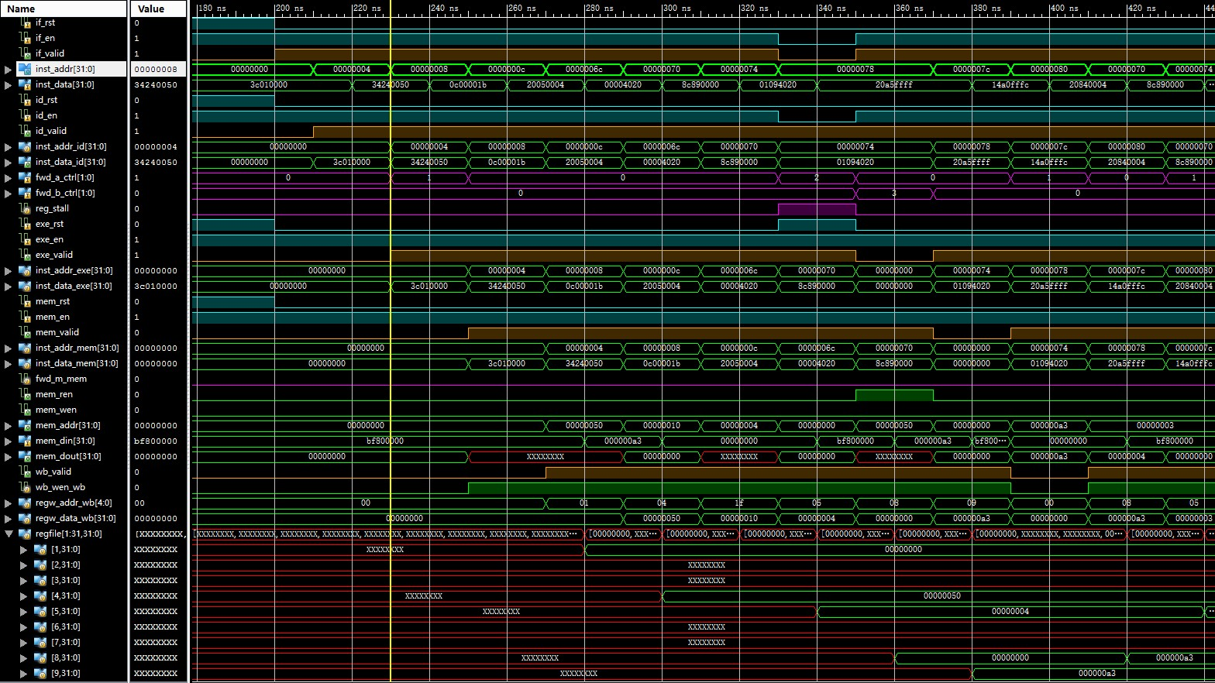
Simulation (1)

Slide 15
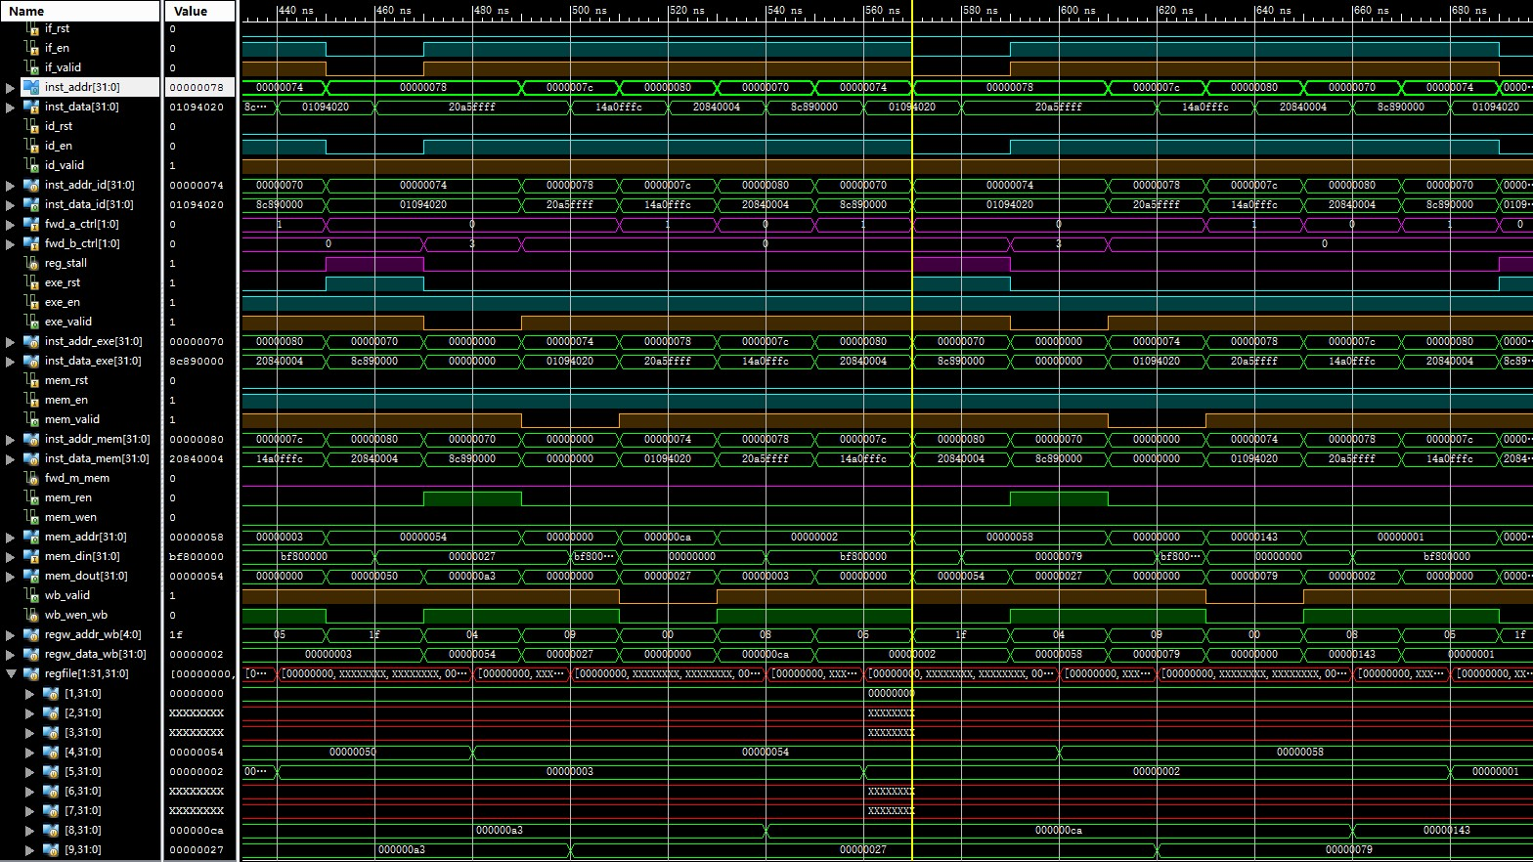
Simulation (2)

Slide 16
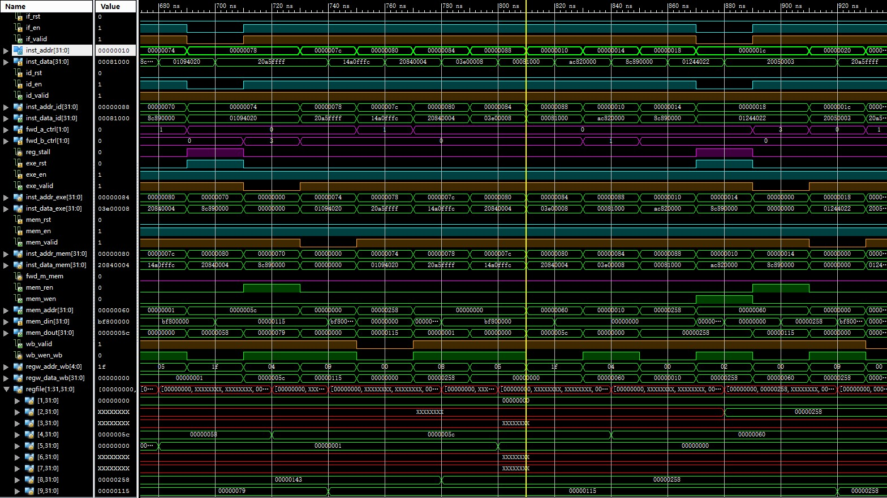
Simulation (3)

Slide 17
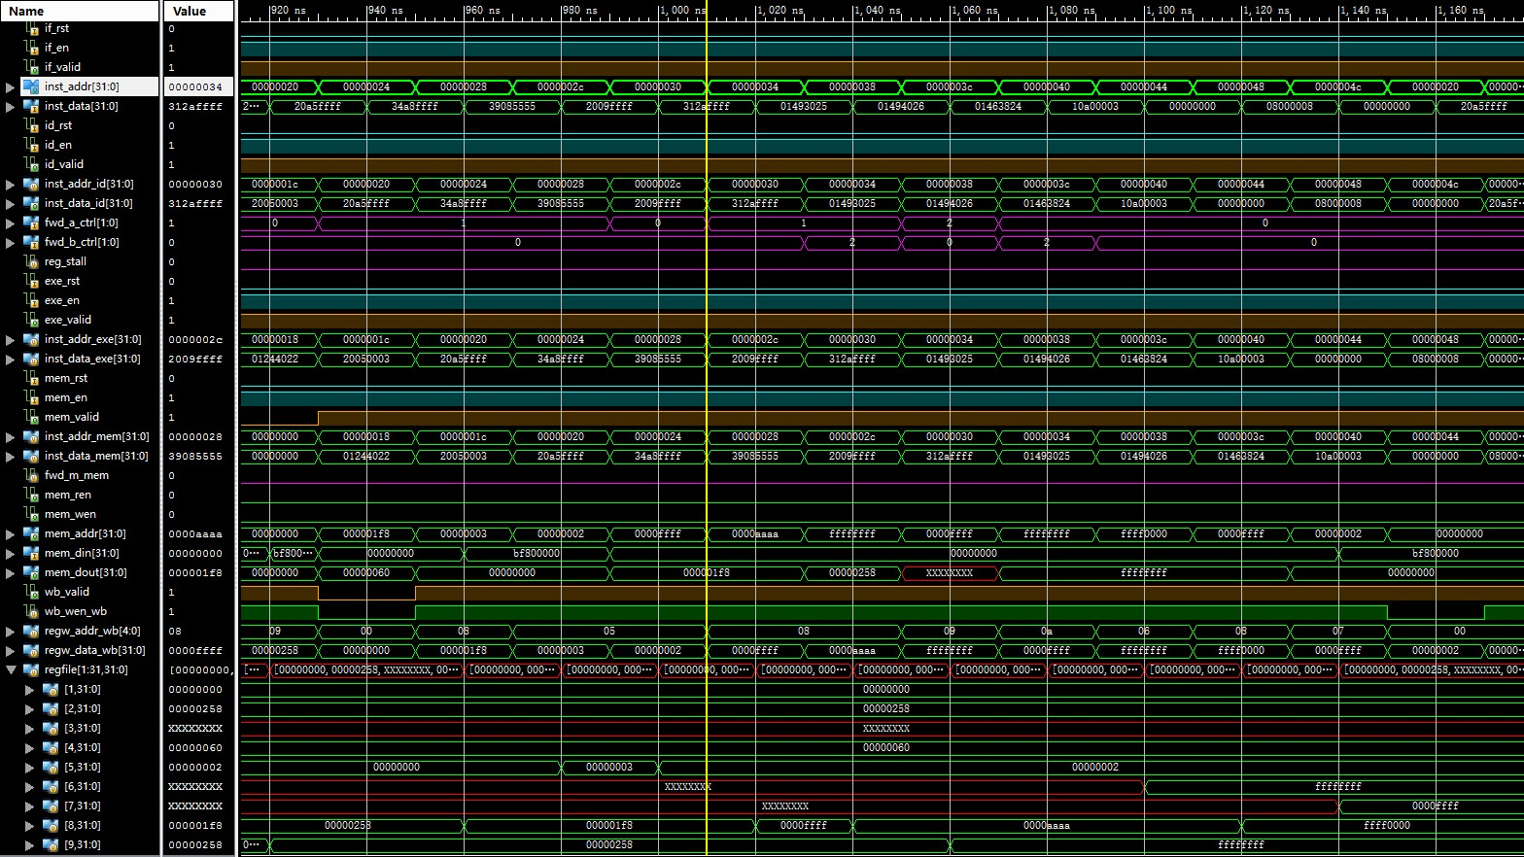
Simulation (4)

Slide 18
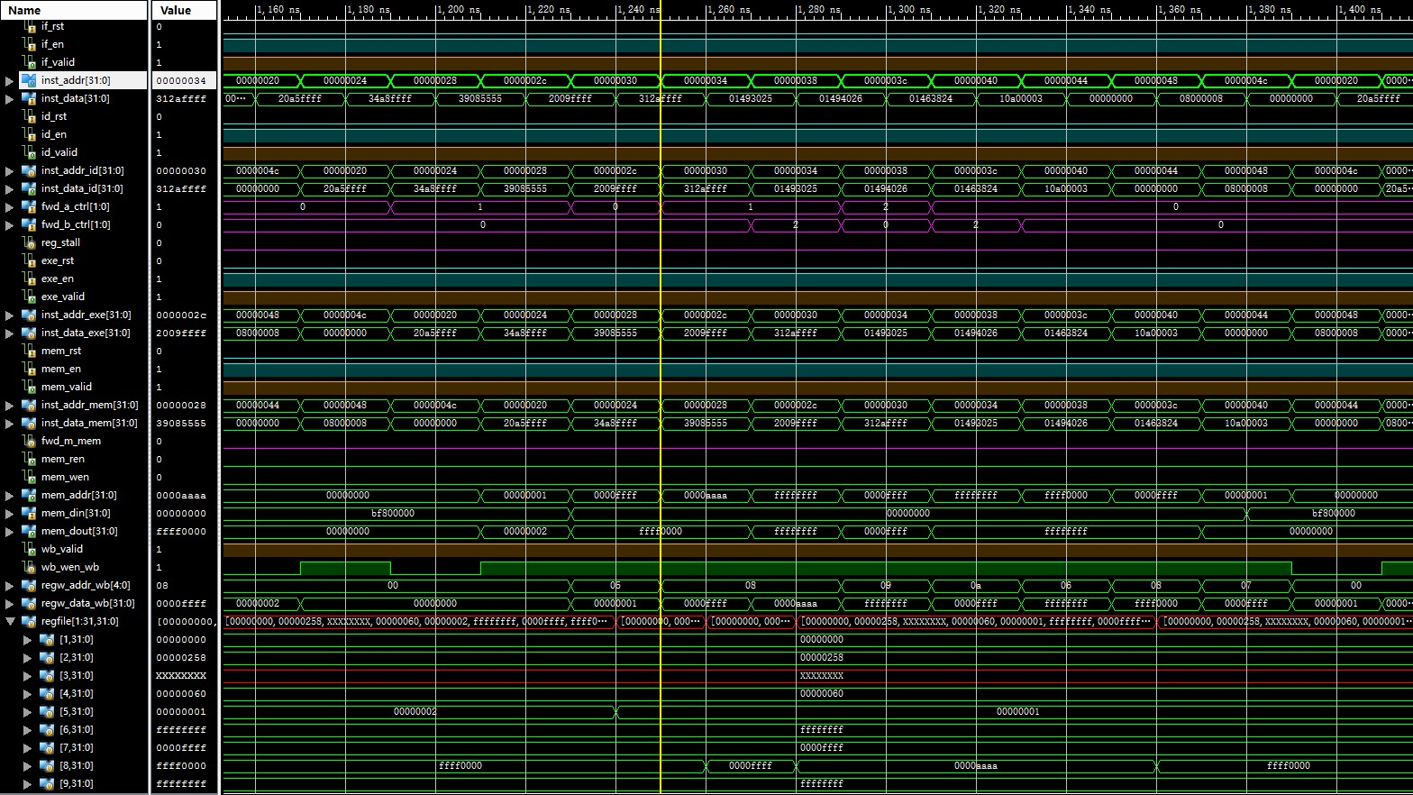
Simulation (5)

Slide 19

Simulation (6)

Slide 20
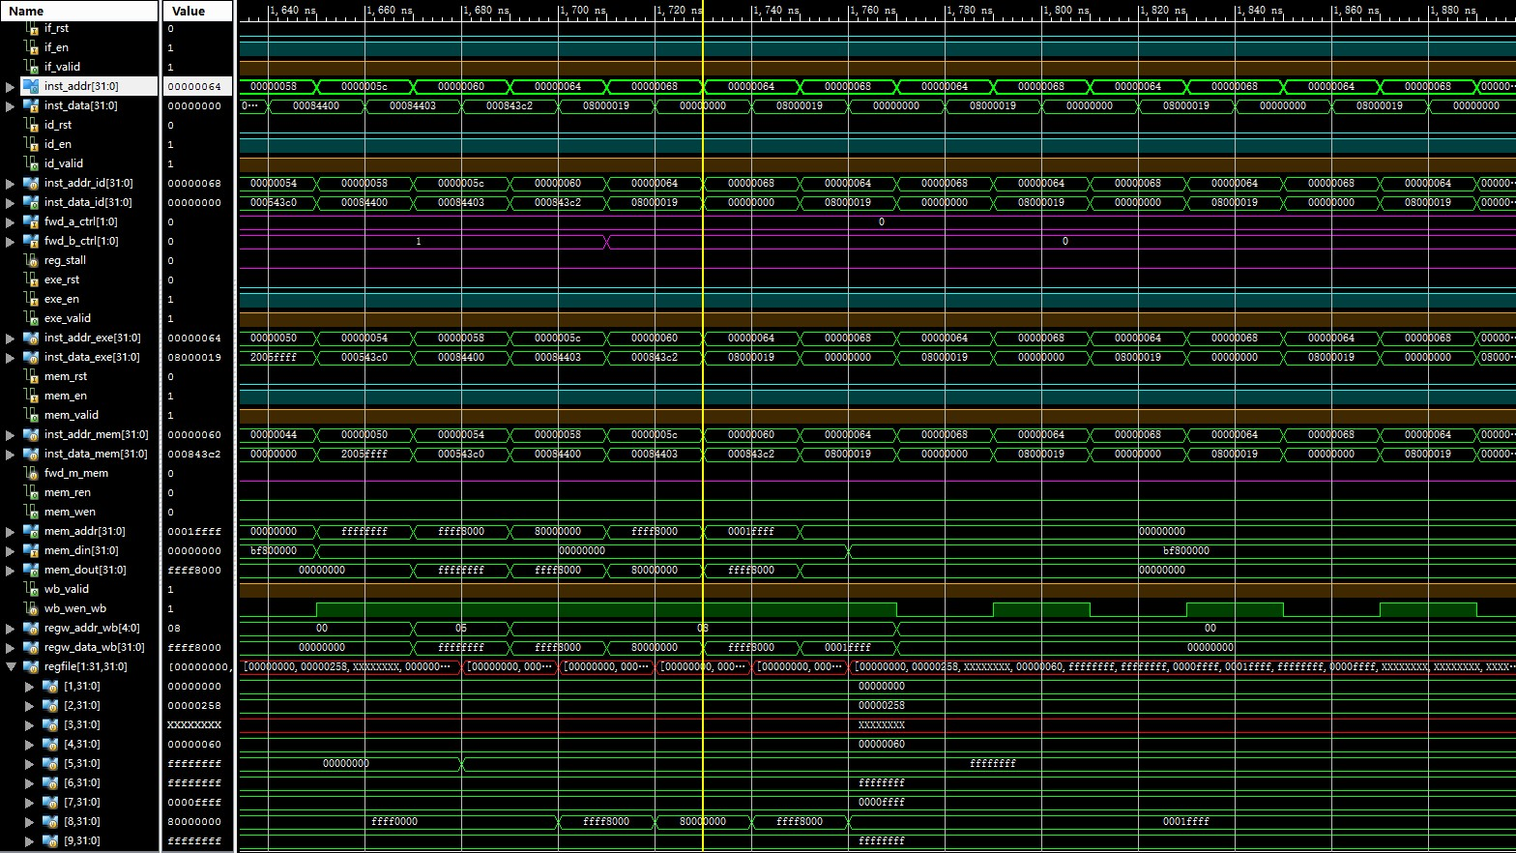
Simulation (7)

Slide 21
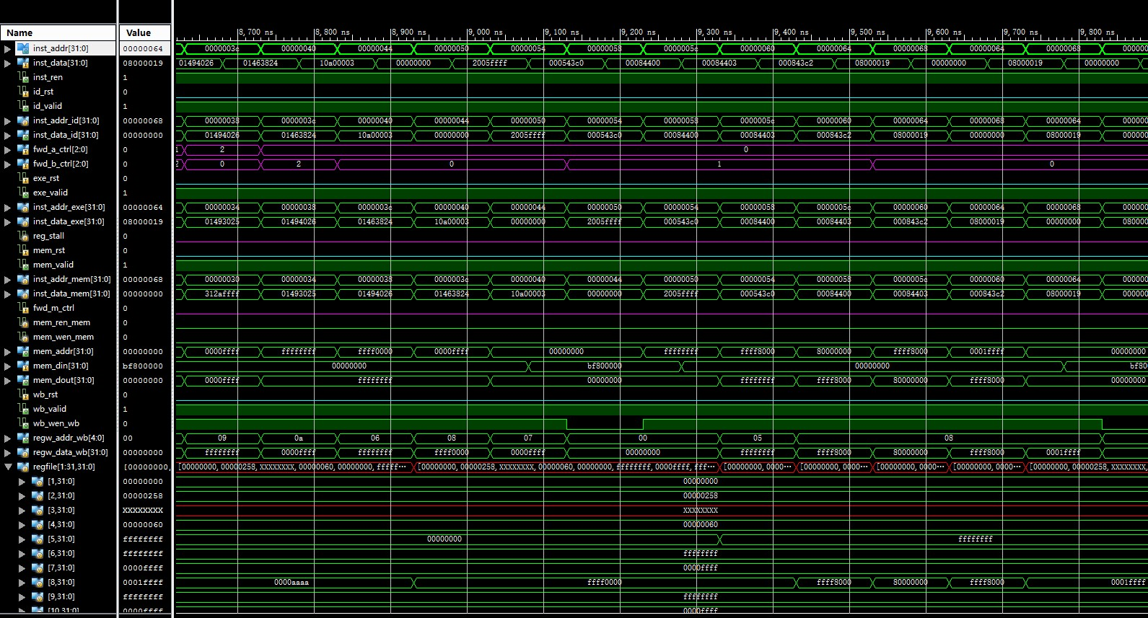
Simulation (8)

Slide 22
Checkpoints
CP 1:
Waveform Simulation of the Pipelined CPU with the verification program
CP 2:
FPGA Implementation of the Pipelined CPU with the verification program

Slide 23
Thanks!

