Slide 1

Prospective Patient Cancellations
A Preliminary Statistical Investigation
Initial Findings
Pathways for Machine Learning

Slide 2
0. Survey of the Data
The dataset under consideration was extracted from CompassionNet and represents prospective patients with Appointments Kept and Not Kept, respectively. This is a binary outcome.
11,034 prospective patients queried
10 Months of Oct, 2017 to Jul, 2018
All 5 Hospitals
Of the patients queried,
8,926 (80.9%) were scheduled once and either kept or did not keep their appointment
1,891 (17.1%) were scheduled more than once and either kept or did not keep their appt
147 (1.3%) were questionable records and were therefore omitted from this study
72 (0.7%) had inaccurate schedule dates and were omitted from certain analyses
11,034 (100.0%)
Variables of interest in this dataset include: Hospital, “Scheduled On” date, “Appt” date, Days Between Appt and Appt Scheduled, Cancellation Reason Code, Reason for Cancel, and various Opportunity fields like Cancer Type, Insurance Type, and Lead Score.

Slide 3
I. Patients Scheduled Once
Preliminary investigation began with patients who were Scheduled Once and then either Kept or did Not Keep their appointment.
8,996 patients were queried. One patient was associated with Facility ID ‘ILPI001’ and was therefore ignored for this analysis leaving 8,995. Sample sizes by Hospital are sufficient⁽¹⁾ to calculate overall proportions (π̂) and 95% Confidence Intervals (CI’s)⁽²⁾ for those proportions of patients who Kept Appointments over the 10 months surveyed. Further stratification of these patients will investigate whether any significant statistical associations are present which could explain or clarify the proportions of patients keeping and not keeping their appointments.
Take Away: Over the 10 months surveyed, ~73.5% of patients kept their appointments with CTCA Philly having the lowest rate at 66.4% and CTCA Tulsa having the highest at 80.5%. Interestingly, Chicago, Atlanta, and Phx tended to have similar outcomes.
Chicago and Atlanta accounted for the largest number of appointment conversions.
⁽¹⁾ Assuming we want to detect a ±10% difference of 50% in proportions (with α = .05), our sample size is n = (z ² _{α/2} π(1- π))/E ² = 97 minimum
⁽²⁾ The standard Wald procedure is used.

Slide 4
I. Patients Scheduled Once
A χ² test of independence was used to detect whether the observed differences in the proportions of patients keeping their appointments by facility was statistically significant⁽¹⁾. This test delivered a Pearson χ² p-value = 0.000 and a Likelihood Ratio statistic (G²) = 0.000, both indicating that there are significant differences in proportions of patients by hospital⁽²⁾ keeping their appointments.
Take Away: differences in the proportions of appts kept by facility are statistically significant, i.e., they do not appear to be merely random. → Further investigation will seek to discover whether our dataset provides any information on why this might the case.
This test does not at present indicate what is causing those differences, only that we can safely reject the notion that those differences are merely random in nature.
Standardized χ² residuals for Philly and Tulsa confirm that these two hospitals exhibit the largest differences in appointments kept compared to the other three hospitals.

Slide 5
I. Patients Scheduled Once
Our first attempt at stratifying the data so as to aid in Knowledge Discovery, is to consider the element of time. If the data exhibits non-stationarity, i.e., shows a trend up or down, then why? On the other hand, if the data is stationary, then other factors consistent through time must be sought after.
Take Away: our dataset shows that the trend of Appointments Kept is non-stationary over the 10 months surveyed. One of the most drastic changes was seen from June to July of this year. Further analysis by Hospital and/or other variables through time is warranted.

Slide 6
I. Patients Scheduled Once
Atlanta has tended to out-pace the other hospitals in Appointments Kept while Philly has lagged behind the others, trending downward most noticeably over the past 10 months.
Three of the hospitals, Chicago, Atlanta, and Phx, tended to have similar outcomes in Appointments Kept and exhibit a similar trend through time.

Slide 7
I. Patients Scheduled Once
Comparing Atlanta’s and Philly’s trend to the weighted average trend of Chicago, Tulsa, and Phx, we can see the striking contrast in Appointments Kept over time.
The downward swing in Appointments Kept from June to July is most apparent at Atlanta.

Slide 8
I. Patients Scheduled Once
Govt conversions tended to be somewhat less than Commercial In-Network and Out-of-Network/Other insurance types.

Slide 9
I. Patients Scheduled Once
The ln transformation should prove sufficient for normalizing the Days Between counts:

Slide 10
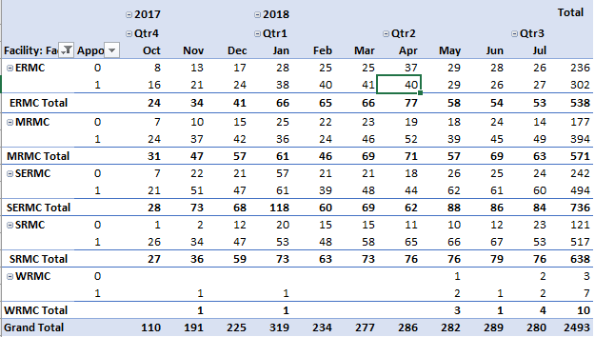
I. Patients Scheduled Once
Govt patients have in some cases more variability and higher median days between for the 0 Appt Kept than for the 1 Appt Kept binary:

Slide 11
I. Patients Scheduled Once (Philly)
Days between the Appointment Scheduled-on date and the Appointment date exhibit consistent differences in the median number of days between appointment for Appointments Kept vs. Not Kept.

Slide 12
I. Patients Scheduled Once (Philly)
Further investigation shows Govt patients with consistently higher days between scheduled and appointment.
(These data points include both ‘0’ and ‘1’ Appointments Kept)

Slide 13
I. Patients Scheduled Once (Philly)
Further investigation shows Govt patients with consistently higher days between scheduled and appointment, whether ‘1’ kept or ‘0’ not kept.

Slide 14
I. Patients Scheduled Once (Chicago)
tbd
A natural log transformation adjusts for skewing and extreme outliers. “Normalized” Days Between Scheduled and Appt Dates were somewhat, though not always, different between 0 and 1 appointments kept:

Slide 15
I. Patients Scheduled Once (Tulsa)
tbd

Slide 16
I. Patients Scheduled Once (Atlanta)
tbd

Slide 17
I. Patients Scheduled Once (Phx)
tbd

Slide 18
I. Patients Scheduled Once (Philly, Chicago, Atlanta, Tulsa)
Stratifying by Insurance Types Commercial INN, Commercial OON/Other, and Govt, we see that the top 3 reasons for Cancellations accounts about half of all cancellations. Moreover, reasons given have shifted in usage over time. The use of “Other? Miscellaneous” is now being used 24% of the time and may prove unhelpful in assessing patient objections to treatment.

Slide 19
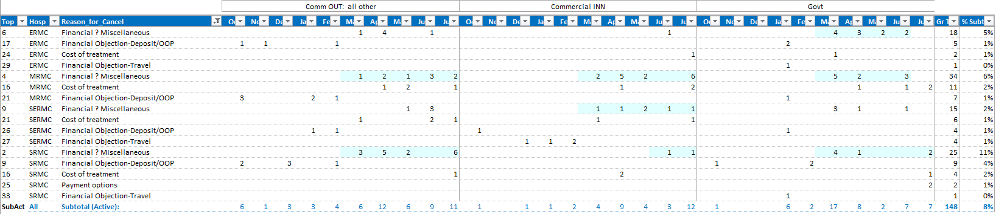
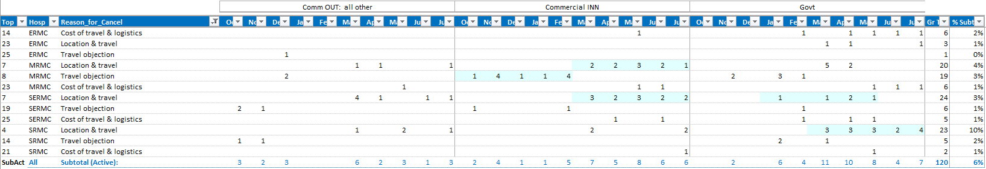
I. Patients Scheduled Once (Philly, Chicago, Atlanta, Tulsa)
Stratifying by Commercial INN, Commercial OON/Other, and Govt, we can also see that “Financial” reasons accounted for only about 8% of reasons for cancellation and did not rank particularly high for these 4 hospitals. Travel-related reasons for cancellation accounted for an additional 6%.

Slide 20
I. Patients Scheduled Once (Philly, Chicago, Atlanta, Tulsa)
Stratifying by Cancer Type for Appointment Kept, 0,1, we see that the Top Five Cancer types are the same, regardless of whether they kept their appointment not. We may infer that cancer type is prevalent for the entire patient population. There are, however, what may be non-random differences in the number of patients who keep their appointments or not, depending on their cancer type. Most appointments Not Kept for these top 5 reasons included “Other? Miscellaneous” (27.5%) and “Staying with Current Medical Team” (11.2%) and “Patient not clinically appropriate for treatment” (10.3%).

