Slide 1
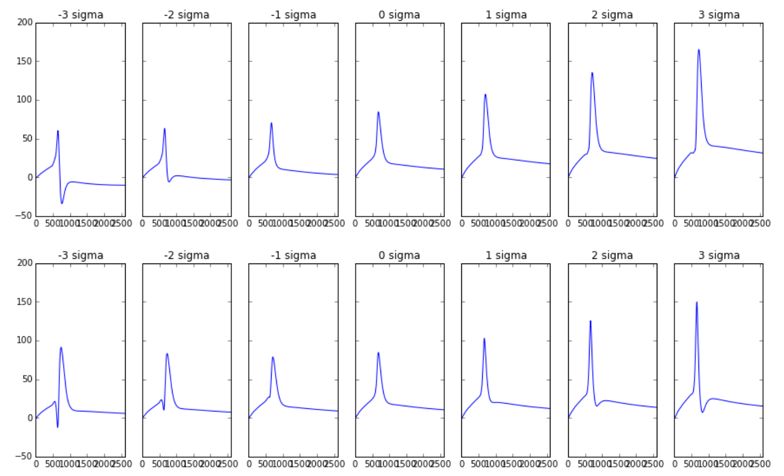
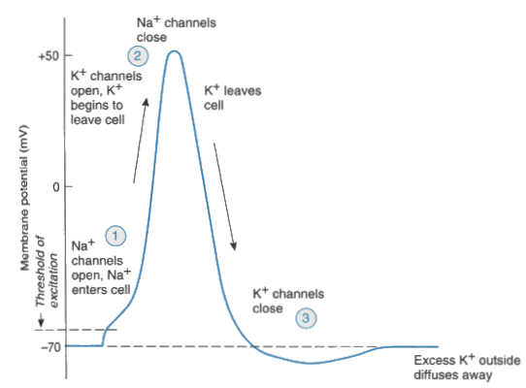
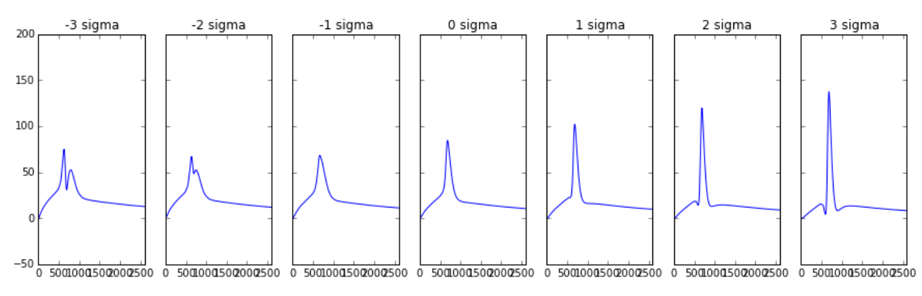
Inhibitory
Excitatory
ephys_ss_00
ephys_ss_01
ephys_ss_02

Slide 2
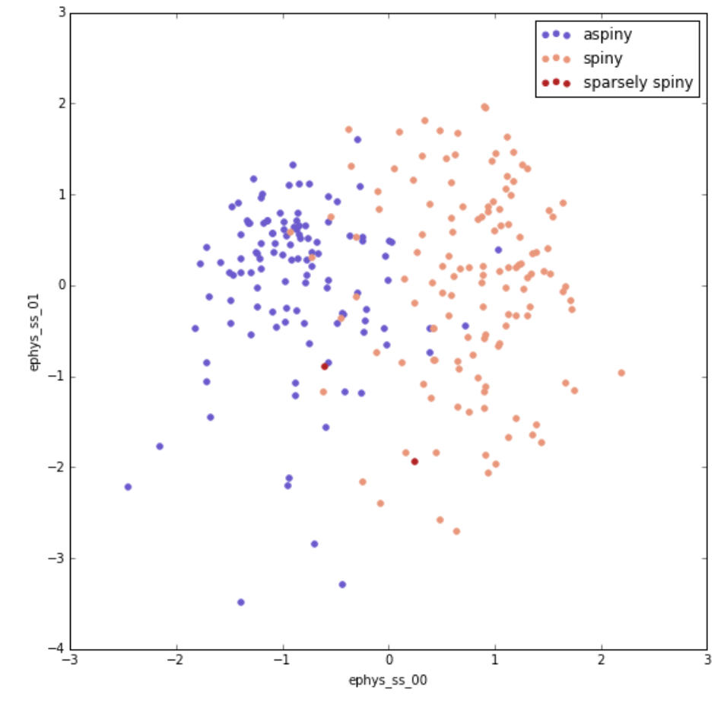
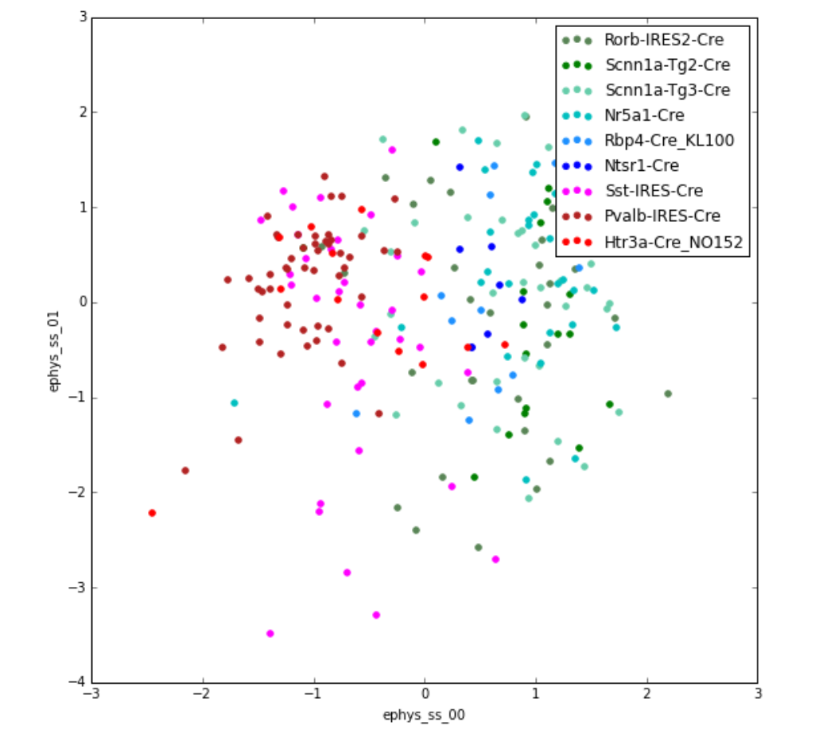
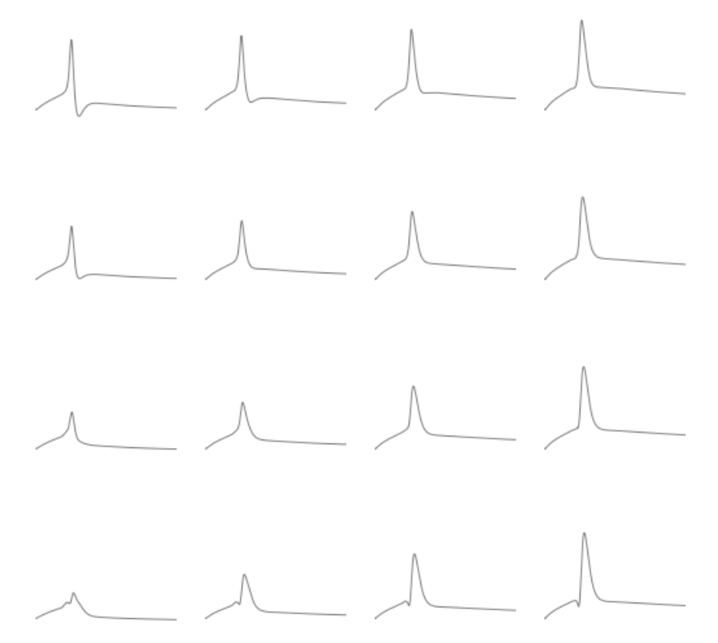
Ephys_ss_01 “spreads out” excitatory cells

Slide 3
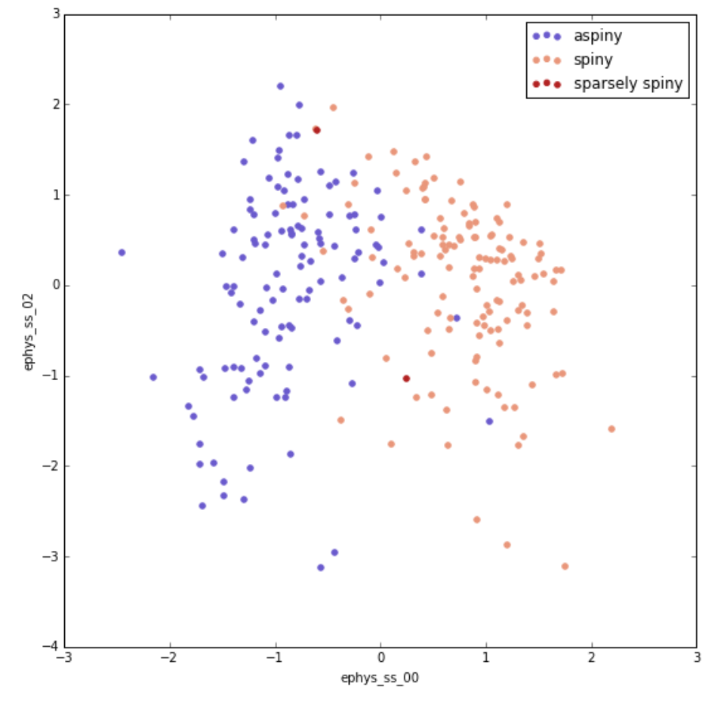
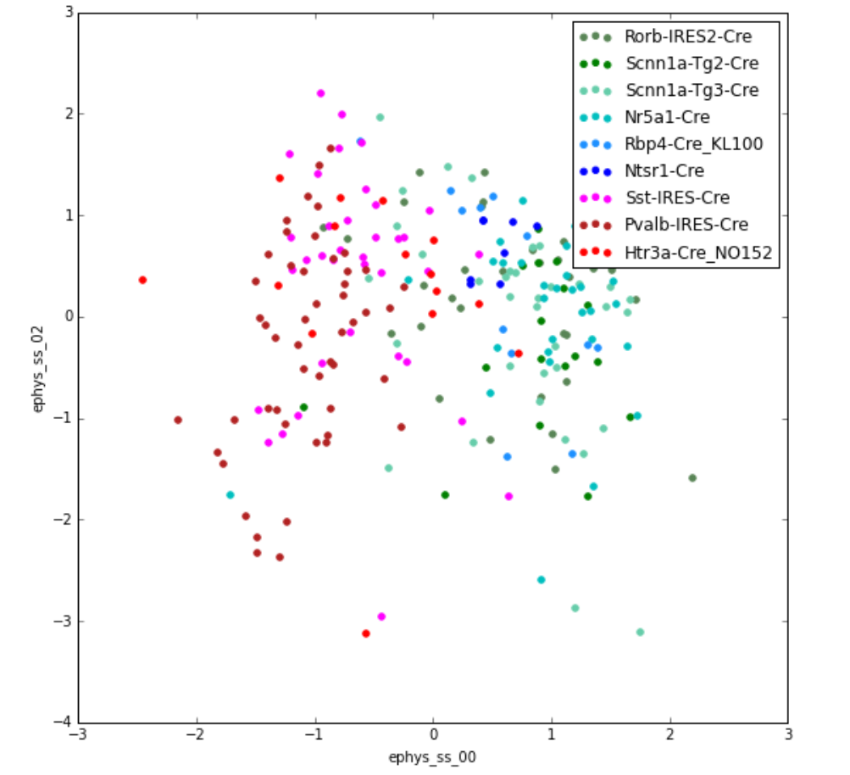
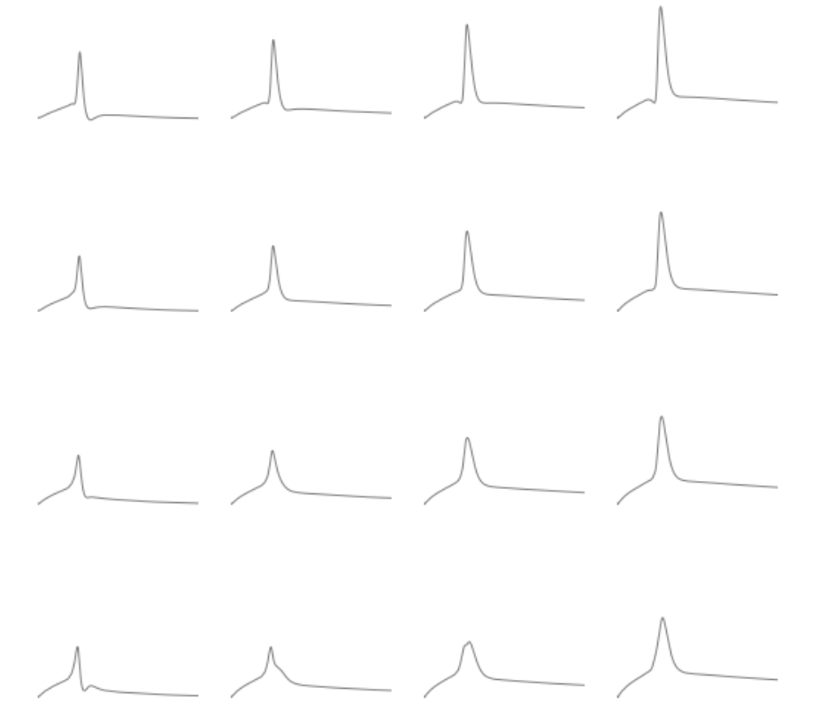
Ephys_ss_02 “spreads out” inhibitory cells

Slide 4
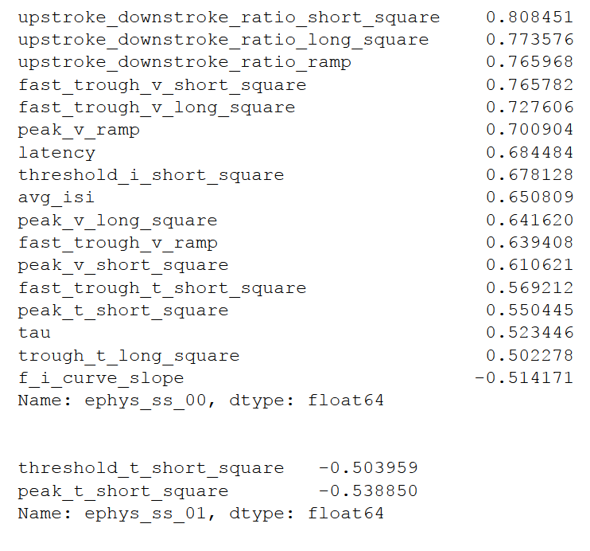
-1.5
-0.5
0.5
1.5
ephys_ss_01
ephys_ss_00

Slide 5
-1.5
-0.5
0.5
1.5
ephys_ss_02
ephys_ss_00

