Slide 1
Spike extraction and stimulus decoding in the primary visual cortex
Anatoly Buchin and Reza Eghbali

Slide 2
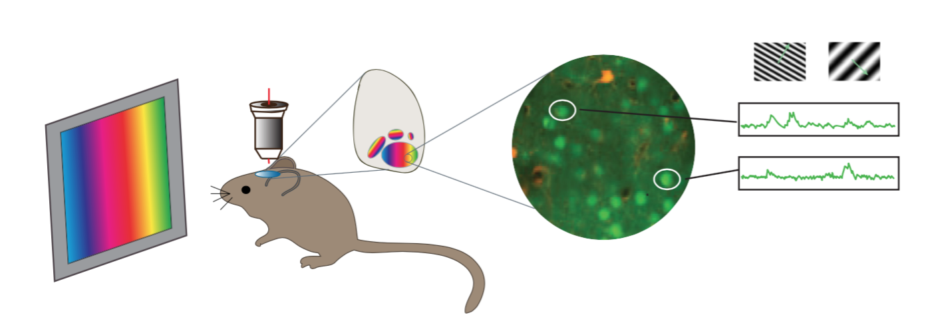
Introduction
The Brain is noisy, so are the measurements
What is the noise? What is the signal?
[Neil et al. 2011]

Slide 3
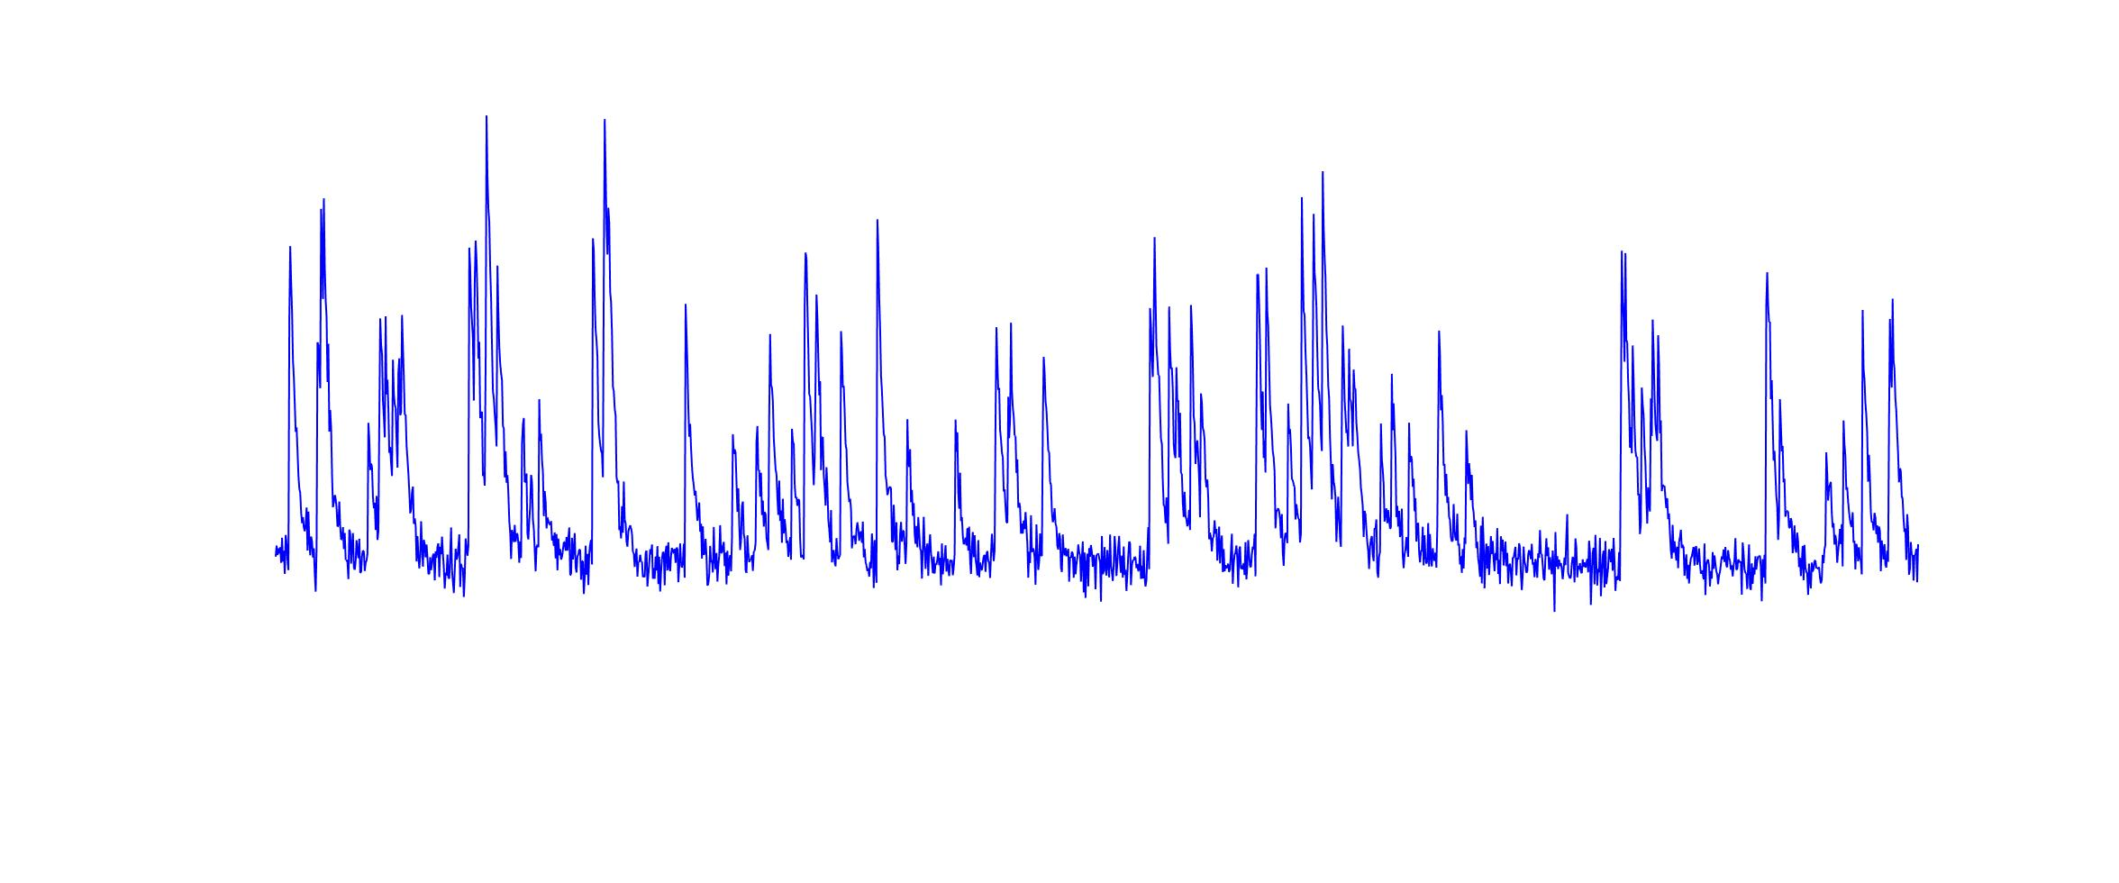

Outline
Spike extraction from the Ca signal in mice V1
Decoding of drifting grating orientation
001001011101101001010
001001011101101001010

Slide 4
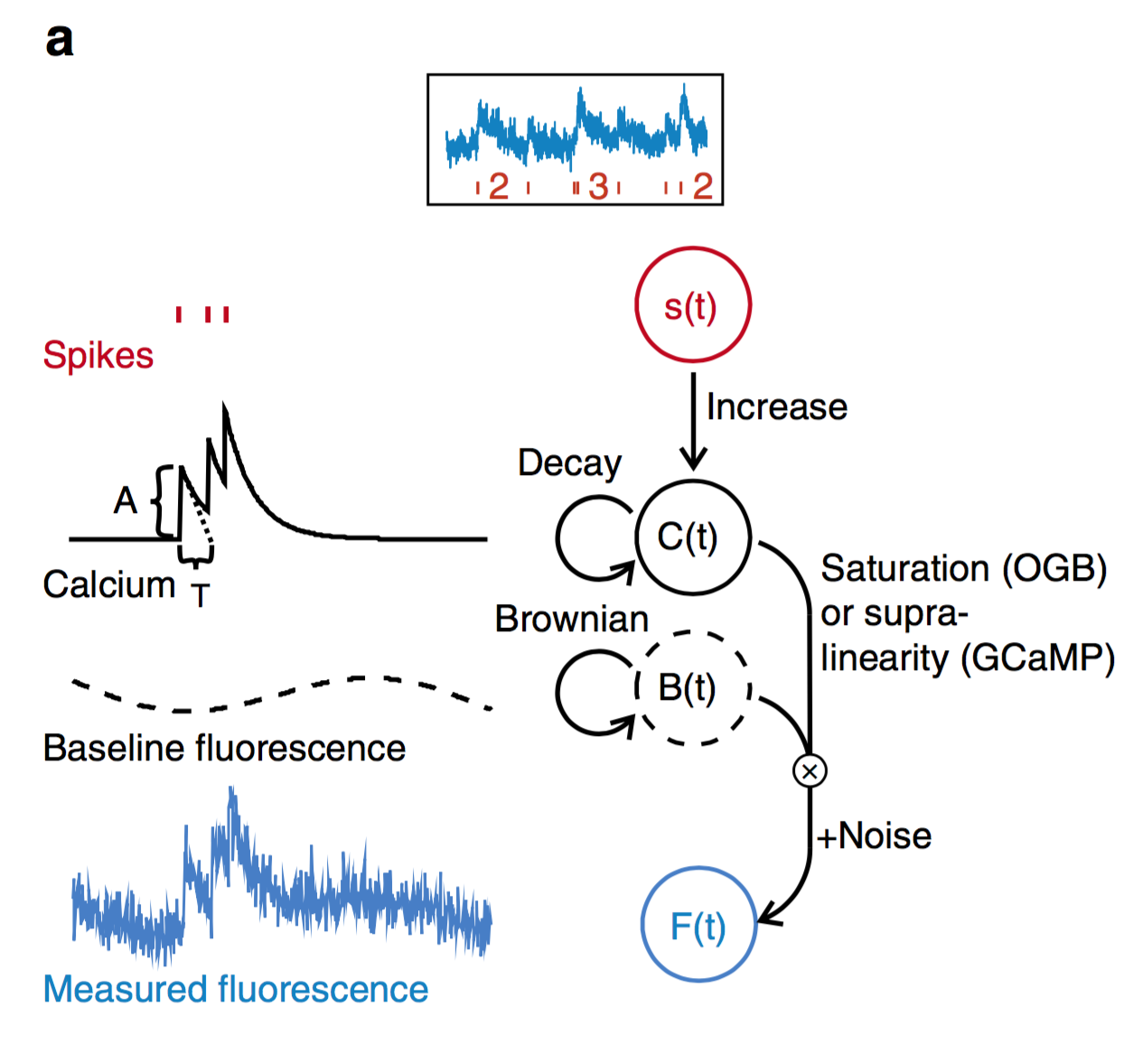
Spike inference algorithm: ML spike
Deneux et al. 2016

Slide 5
Spike inference results

Slide 6
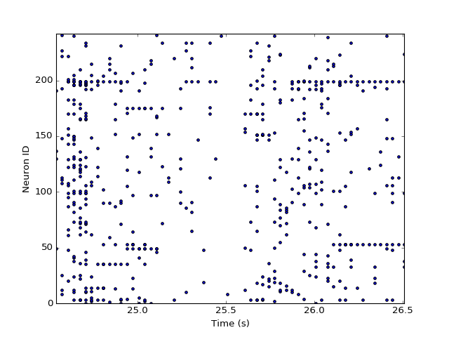
Spike inference results
stimulus

Slide 7
Conclusions
Spike trains could be efficiently inferred from noisy Ca-imaging
Rate-based decoding is ~10% more accurate than Ca-based
Trial-shuffling does not significantly change the decoder performance

