Slide 1
Learning Propositional Functions
D. Ellis Hershkowitz under Stefanie Tellex

Slide 2
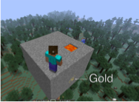
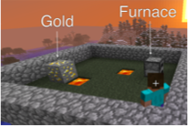
Tabular Representations
Tabular Representation 1
Tabular Representation 2
Stone block 1 at (0, 0, 0)
Stone block 2 at (0, 1, 0)
Gold block 1 at (3, 1, 2)
Agent at (0,0,3)
…
Stone block 1 at (1, 2, 2)
Gold block 1 at (3, 1, 2)
Furnace at (2,3,4)
Agent at (0,0,0)
…
Problems:
Not readily interpretable
A lot of data

Slide 3
Propositional Functions
Given a problem, a propositional function returns a truth value.
agentInLava
->false
agentFacingGold
->true
agentCanWalk
->true

Slide 4
Abstracted Representations with PFs
Block in agent’s way = false
Agent facing gold = true
Agent in lava = false
Furnace on map = false
Block in agent’s way = false
Agent facing gold = true
Agent in lava = false
Furnace on map = true
Problems:
Doesn’t obviously inform behavior
A lot of data
Problems solved:
Behavior well informed by right PFs
Superfluous information gone

Slide 5
Space of Propositional Functions
Less Useful PFs
Useful PFs
Exists an agent
Exactly 6 gold blocks
…
Block in agents way
Agent can jump
Agent in lava
…

Slide 6
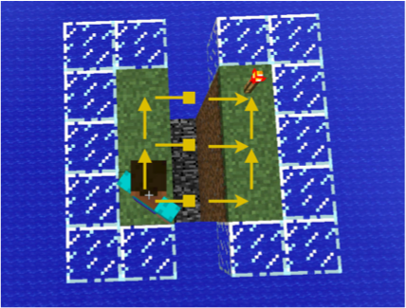
Transition Dynamics
How an agent’s actions change the world are termed the transition dynamics

Slide 7
Learning Propositional Functions with Transition Dynamics
Pick (machine learn) propositional functions which predict transition dynamics.
Useful PFs
Block in agent’s way
Agent can jump
Agent in lava
…

Slide 8
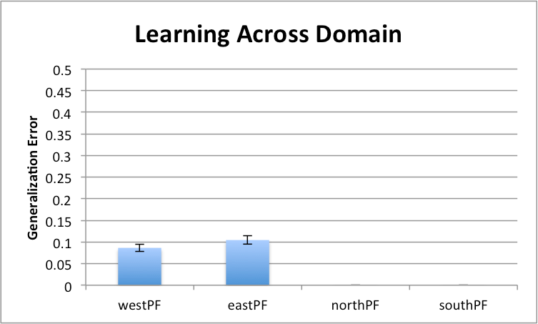
Experimental Results(1/2)

Slide 9
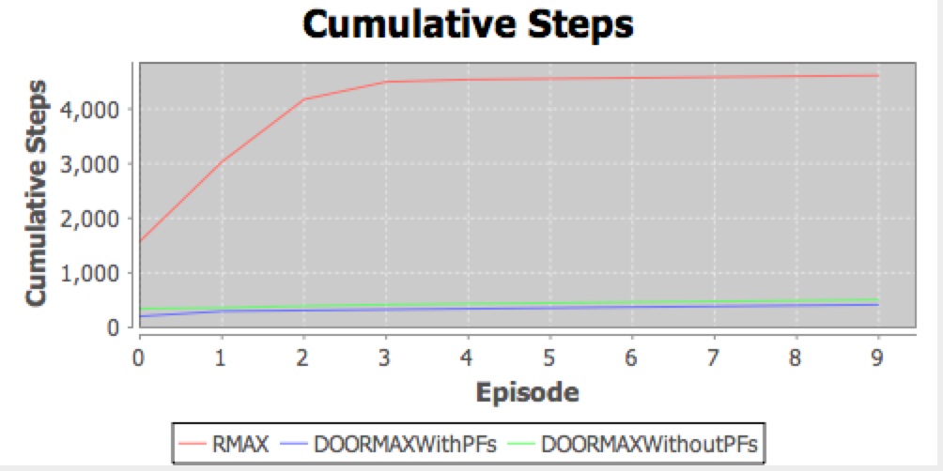
Experimental Results(2/2)

