Slide 1

Phase II Study Design
By: Jacob Rukavina, Xuanlin Liu, Qi Li, Kin Cheung Choy, Wedd Jammal

Slide 2
What should be measured:
Plasma concentration
Thrombosis events & bleeding
Deaths
Potential covariates (weight, age, sex, CrCL)
Population variability of PK parameters in patients
APTT

Slide 3
The patient population
Thrombosis diagnosis
Males and Females
No known severe renal impairments
18 <

Slide 4
Study Arms
Arm 1 - IV 200 mg/day follow by 100 mg/day IM for 6 days
01
Arm 2 – IV 400 mg/day follow by 300 mg/day IM for 6 days
02
Arm 3 – IV 600 mg/day follow by 500 mg/day IM for 6 days
03
Arm 4 – First-line treatment
04

Slide 5
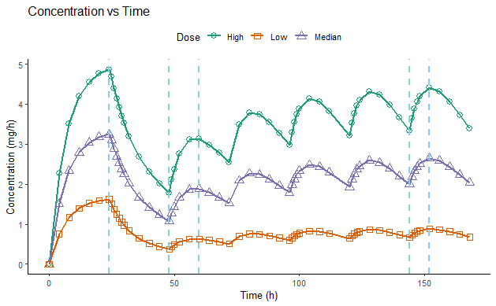
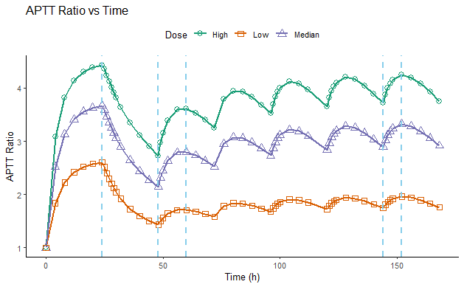

Determining the doses
(worst-case scenario)
Equations
$$R_{0}=Dose/24,C_{ss}=R_{0}/CL$$
During infusion:
$$C=C_{ss}×(1−e^{−k_{e}t})$$
After infusion:
$$C=C_{ss}×e^{−k_{e}t}$$
i.m. injection:
$$C=\frac{F×Dose×k_{a}}{V×(k_{a}−k_{e})}×(e^{−k_{e}t}−e^{−k_{a}t})$$
PK/PD parameters | Value
CL (L/h) | 5
V (L) | 33
F | 0.99
k_{e} (1/h) | 0.15
k_{a} (1/h) | 0.028
E₀ | 1
E_{max} | 7.96
EC₅₀ | 6.43
Dose groups
Low: 200 mg 24h i.v. infusion + 100 mg daily i.m. injection → 2 times APTT
Median: 400 mg 24h i.v. infusion + 300 mg daily i.m. injection → 3 times APTT
High: 600 mg 24h i.v. infusion + 500 mg daily i.m. injection → 4 times APTT
Sampling times
In hours: 24, 48, 60, 144, 152

Slide 6
Analysis method
Estimate PK parameters using Solver
Calculate PD parameters by fitting E_{max} model
Probability of side effects: Logistic regression

Slide 7

THANK YOU FOR LISTENING!

