Slide 1
ECE411 Final Project Efficient Pipelined RISC-V Processor
ZJU-UIUC Institute
Ziyuan Chen
Zhirong Chen
Hao Ren

Slide 2
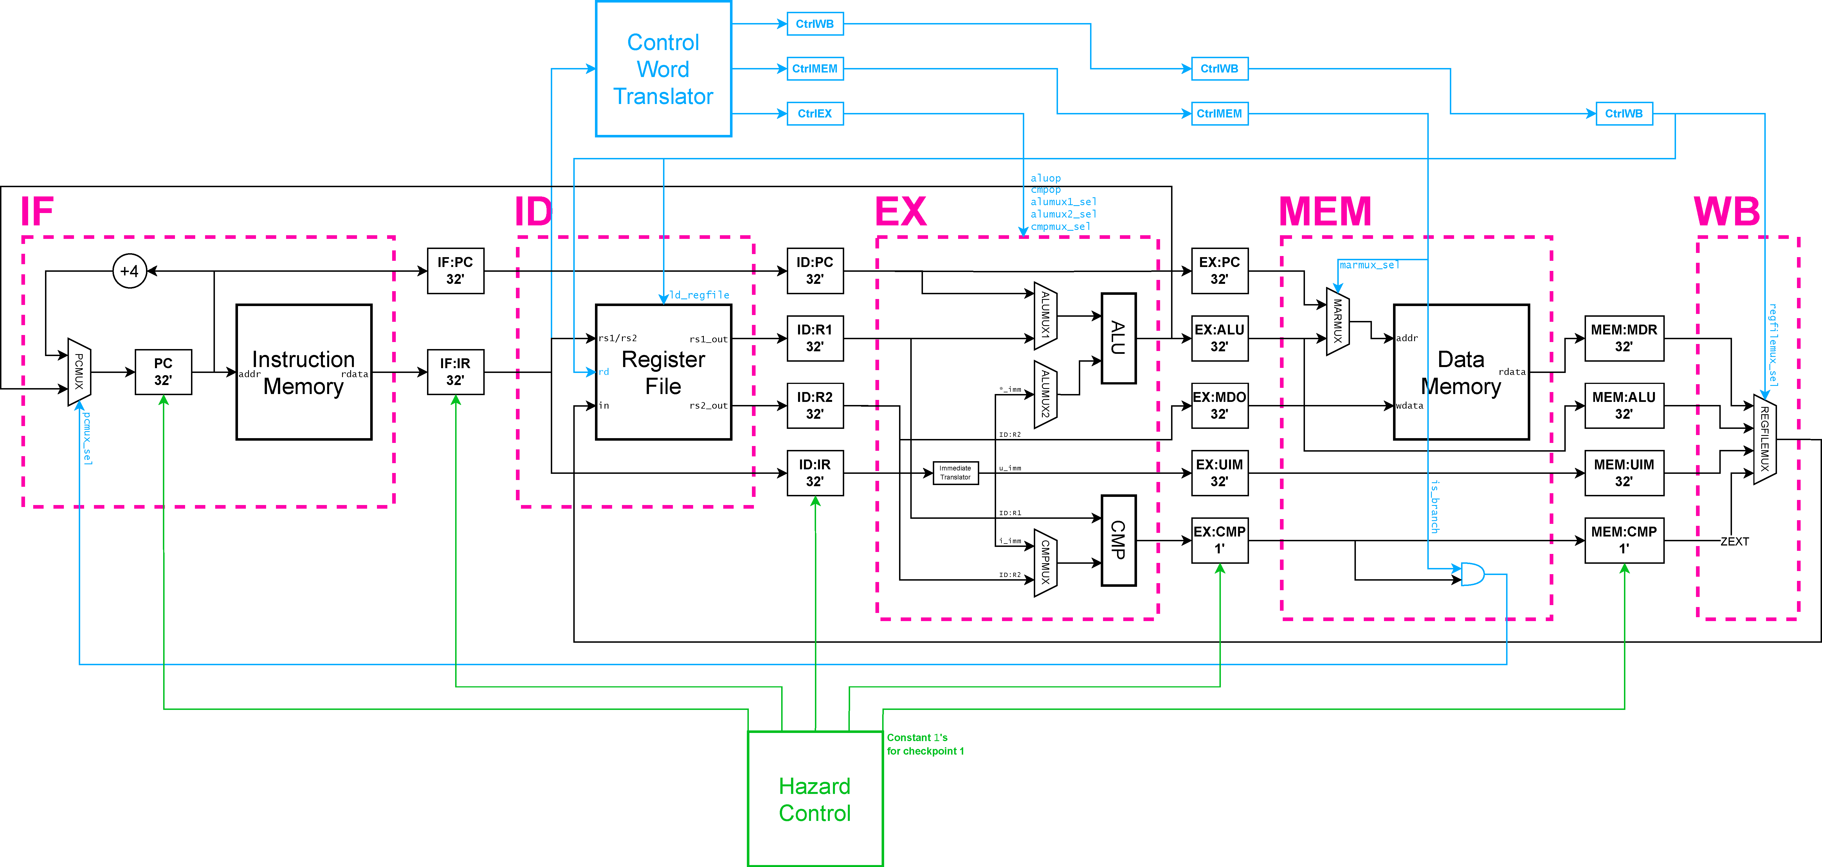
CP1

Slide 3
CP2

Slide 4
Advanced Feature Design

Slide 5
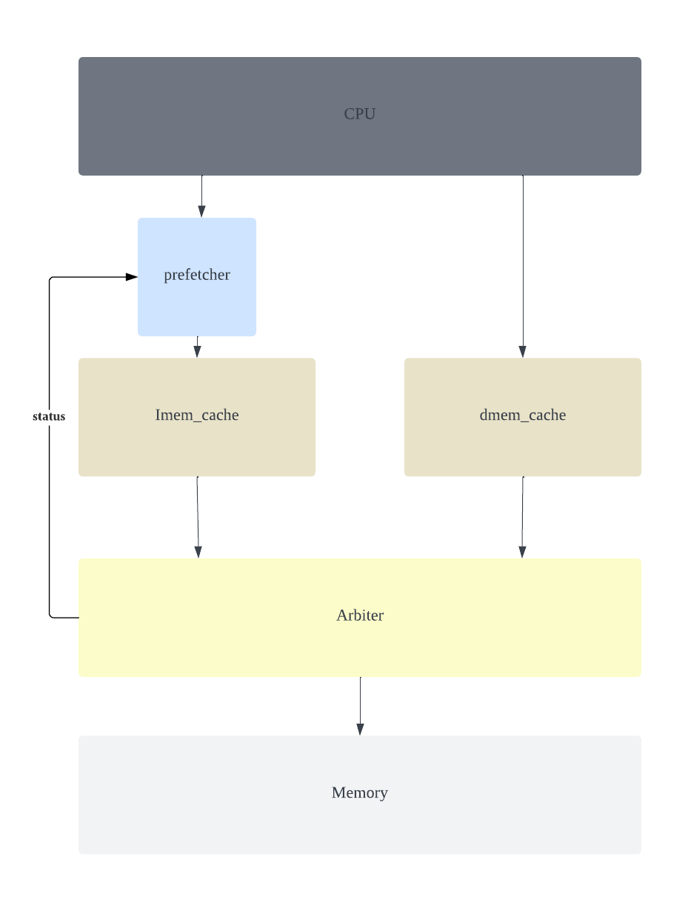
CP3

Slide 6
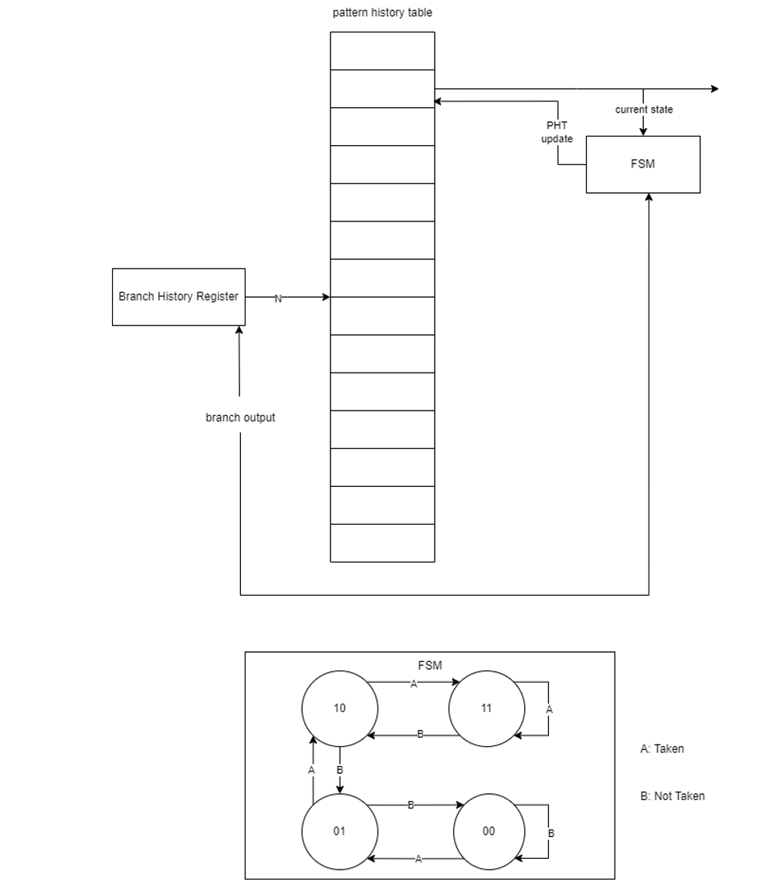
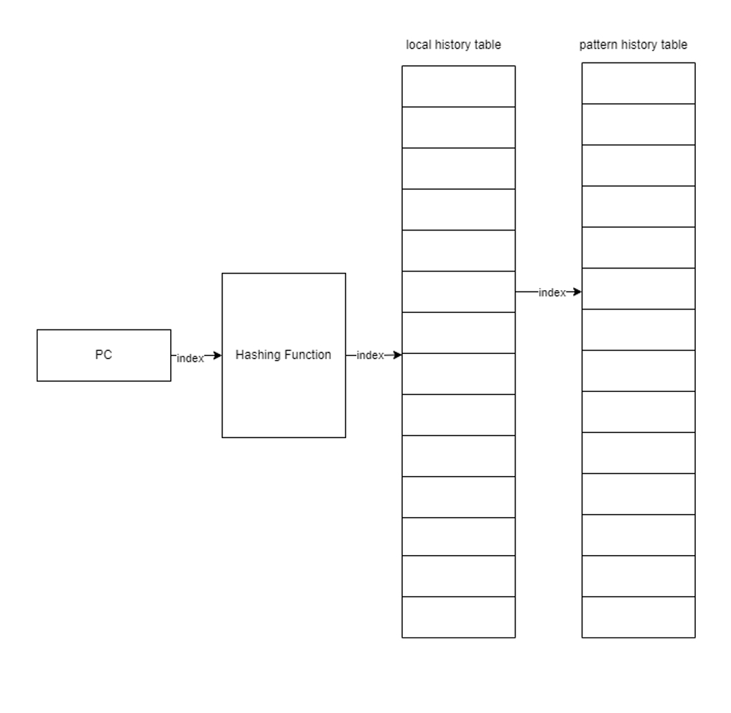
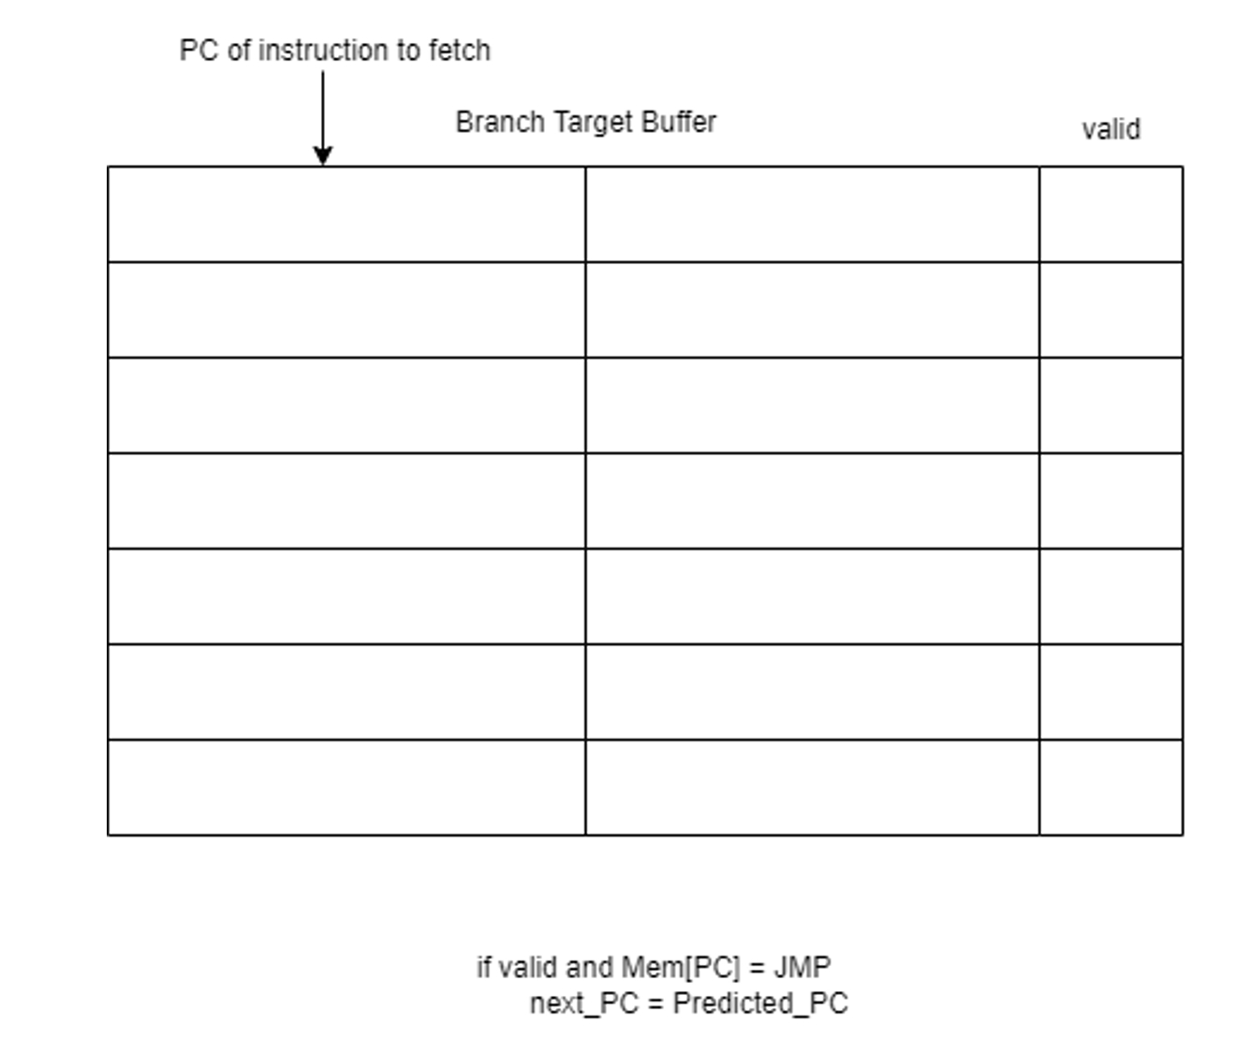
Branch Predictor & Branch Target Buffer
Global Branch Predictor
Local Branch Predictor
Branch Target Buffer

Slide 7
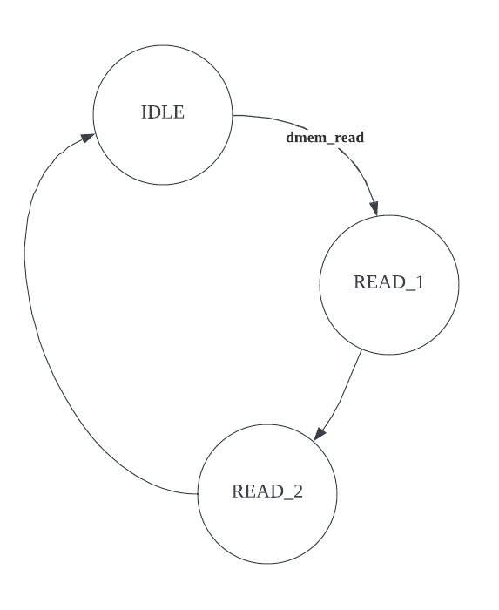
Cacheline Prefetcher
Performance is poor because……
there are too many cache hits, and
blocking cache & 1 sets of memory ports

Slide 8
Parameterizable Cache
Did we miss some edge cases?
Generalized PLRU (custom #sets, #ways)
Update at way #3: XX1XX10
PLRU[s][3'b101] <= 1'b1;
PLRU[s][3'b010] <= 1'b1;
PLRU[s][3'b001] <= 1'b0;
Update at way #6: 0XXX1X1
PLRU[s][3'b111] <= 1'b0;
PLRU[s][3'b011] <= 1'b1;
PLRU[s][3'b001] <= 1'b1;
Way #3 is LRU: ??0??01
if (PLRU[addr_index][3'b101] == 1'b0 &
PLRU[addr_index][3'b010] == 1'b0 &
PLRU[addr_index][3'b001] == 1'b1 )
Way #6 is LRU: 1???0?0
if (PLRU[addr_index][3'b111] == 1'b1 &
PLRU[addr_index][3'b011] == 1'b0 &
PLRU[addr_index][3'b001] == 1'b0 )
PLRU[s][{2'b01, WAYHIT} >> (i+1)]
<= WAYHIT[i];
PLRU_signals[m] &=
(PLRU[addr_index][{2'b01, w} >> (i+1)]
!= w[i]);

Slide 9
Parameterizable Cache
Don't forget the bmem burst size!
But this comes with side effects.
Customizable Word Size
In bus adaptor
assign mem_wdata_l = {(s_word/32){mem_wdata}};
assign mem_rdata = mem_rdata_l[(32*address[s_offset-1:2]) +: 32];
assign mem_mask_l = {{(s_mask-4){1'b0}}, mem_mask} << (address[s_offset-1:2]*4);
In cacheline adaptor
READ:
if (counter == n_burst - 1)
next_state = DONE;
WRITE:
burst_o = line_i[counter*64 +: 64];
if (counter == n_burst - 1)
next_state = DONE;
if (state == DONE)​
counter <= 0;​
else if (resp_i)​
buffer <= {burst_i, buffer[s_word-1:64]};​
counter <= counter + 1;

Slide 10
Unique Challenges We Have Faced
Coremark is weaker than autograder tests
There are no LUI instructions
And it has bugs!
Most advanced design drags performance down
E.g., is the prefetcher working?
Area was once huge
Registered cache didn't turn out well
Configuring the param'able cache
Recompiling SRAM (.db)
PLRU fails when #ways = 1 (?!)

Slide 11
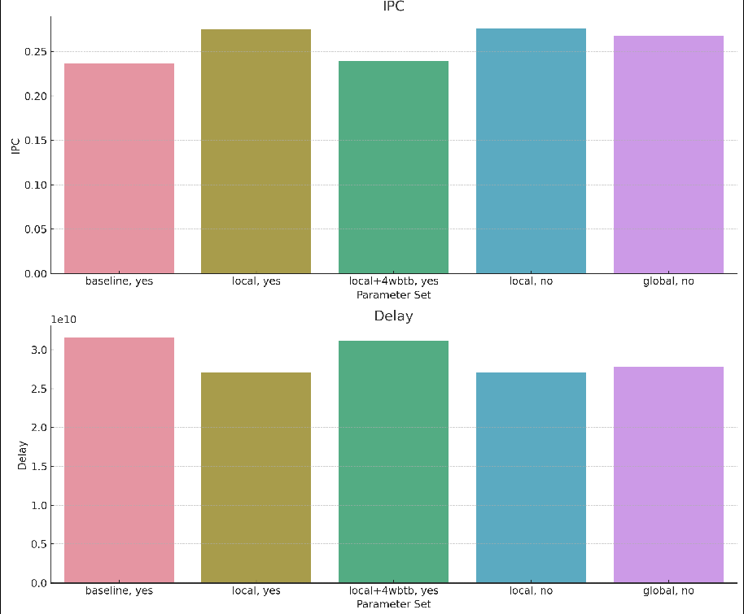
Statistics

Slide 12
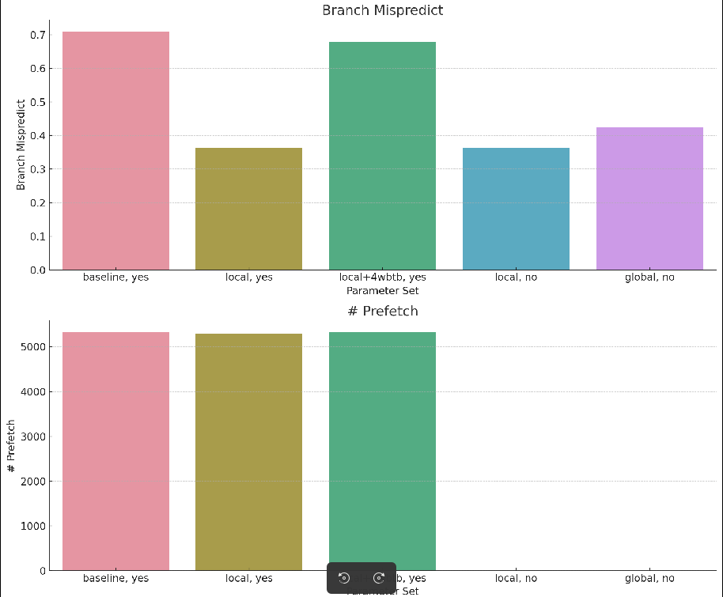
Statistics

Slide 13
Statistics
Optimizing Cache
Sadly, we were forced to go with
s_word = 128, #sets = 16, #ways = 1
to meet the 75000 area constraint
Constraints (Experiments use a less optimized commit)
L1 cache: fixed at 16 sets, 4 ways (MP3, MP4CP2)
L2 cache: 128KB budget
Tradeoffs
Smaller word size, lower miss penalty
Larger word size, lower miss rate only for instruction cache (why?)
s_word | #sets | #ways | Exec time | IPC | L1 Instr Cache |  | L1 Data Cache |  | L2 Instr Cache |  | L2 Data Cache
 |  |  |  |  | Hit/Miss | Penalty | Hit/Miss | Penalty | Hit/Miss | Penalty | Hit/Miss | Penalty
256 | 0 | 0 | 32524050000 | 0.229373 | 1173571/1280 | 11.059 | 73801/135 | 14.667
128 | 64 | 16 | 32776490000 | 0.227675 | 1173862/8476 | 5.610 | 7740/736 | 9.029 | 73361/575 | 8.647 | 784/171 | 9.819
256 | 128 | 4 | 32477390000 | 0.229732 | 1173378/1280 | 7.684 | 900/380 | 11.045 | 73801/135 | 12.289 | 106/87 | 11.977
512 | 16 32 | 16 8 | 33299490000 | 0.223949 | 1259468/505 | 10.194 | 305/200 | 15.120 | 73890/46 | 18.717 | 2/45 | 15.978
1024 | 16 32 | 8 4 | 33378390000 | 0.223395 | 1269162/139 | 20.568 | 36/103 | 23.019 | 73912/24 | 27.375 | 0/24 | 24.375

Slide 14
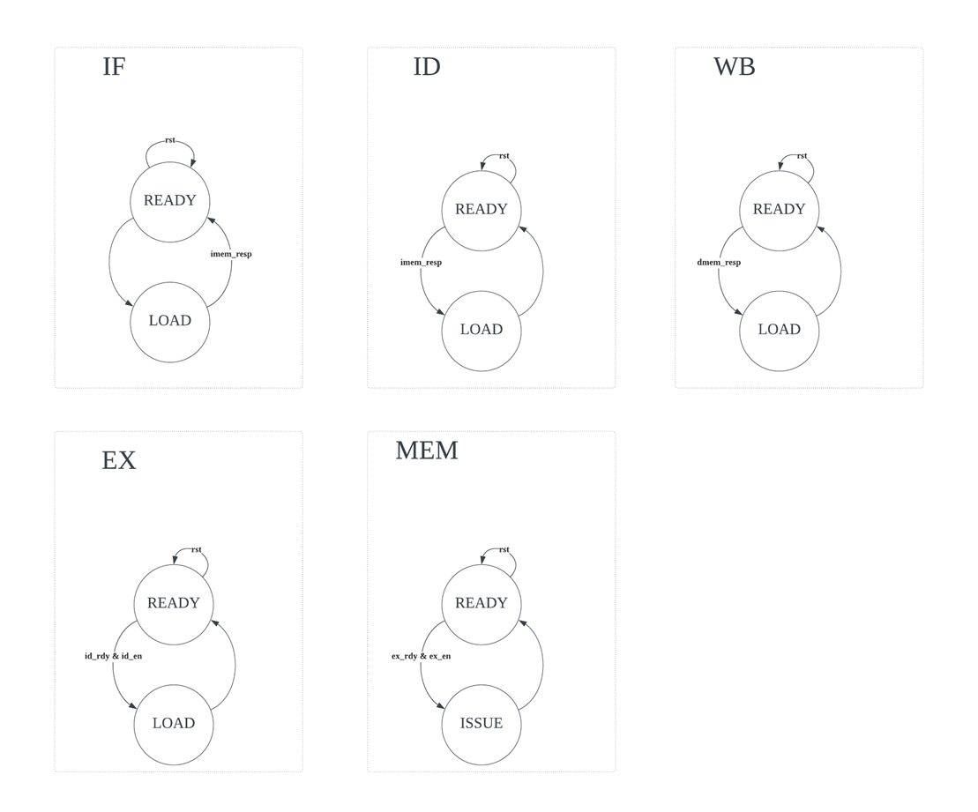
Looking Back, We Would Rather……
Start earlier
We basically missed all deadlines
It accumulates!
Design the pipeline differently
Moving from the FSM approach
It involves way too many dependencies

