Slide 1
Progress Report

Slide 2
Functionalities - Person
Ctrl Word : zhi rong
Verification : Hao
Data Path : zi yuan
Verification : zhirong
Hazard Control : hao
Verification : ziyuan

Slide 3
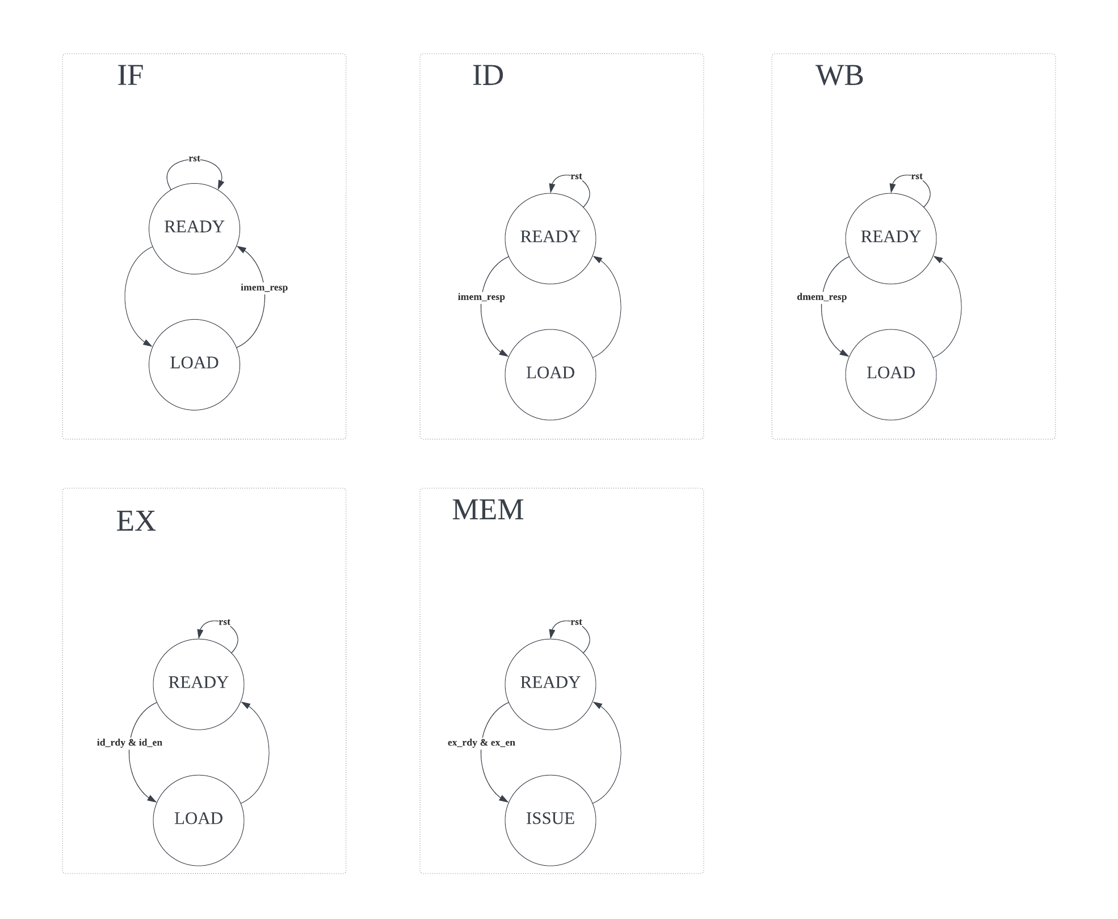
Hazard Control
Functionality : Maintain each stage as 2 cycle to accommodate I mem and D mem.
Testing
Integrated Testing for CPU
Check IF w/ branch instruction.
Check if each stage takes 2 cycles.
Check if stall can work appropriately

Slide 4
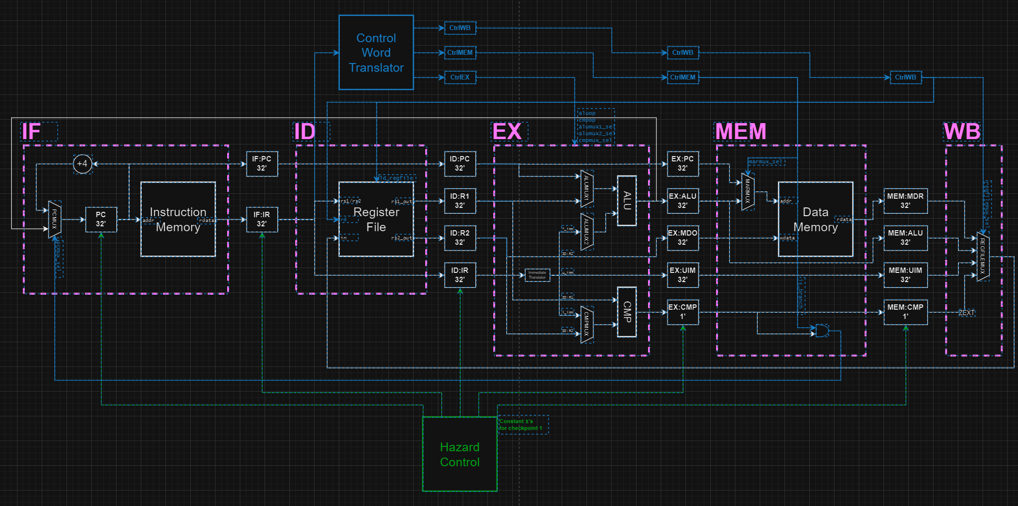
Data Path w/o/ control word
Functionality : Data path containing pipeline registers and other hardware logics controlled by hazard control.
Testing
Cross-verification of comb logic
Run integrated test as a processor

Slide 5
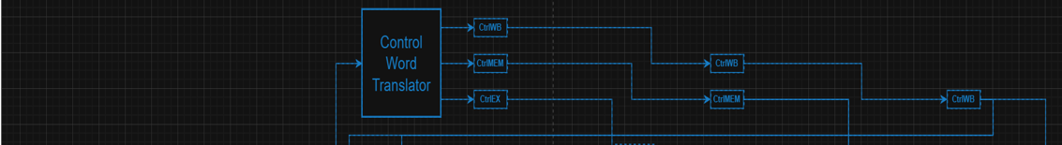
Control Word
Functionality, propagate control words translated from instruction so that each stage as well as monitor have complete info
Testing
Cross-verification of comb logic
Run control word & datapath as DUT to verify if control words can propagate appropriately
Run integrated test

