Slide 1
Progress Report

Slide 2
Progress Report
Functionality – Person
Hazard Control – Hao
Verification – Zhirong
Forwarding – Ziyuan
Verification – Zhirong
Arbiter – Ziyuan
Verification- Zhirong

Slide 3
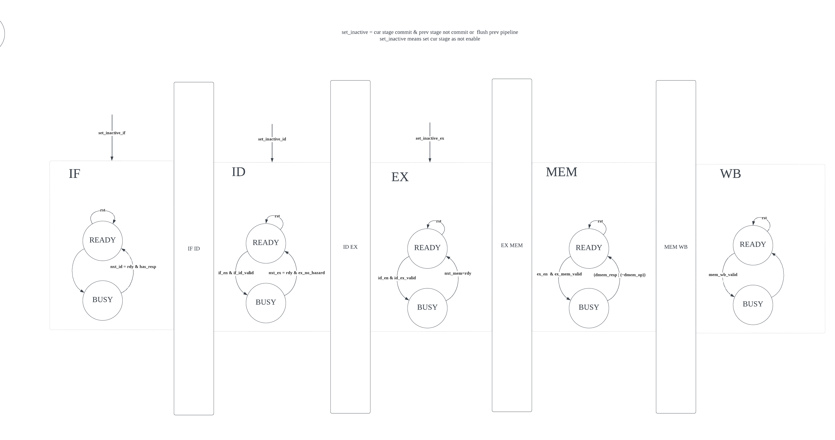
Hazard Control

Slide 4
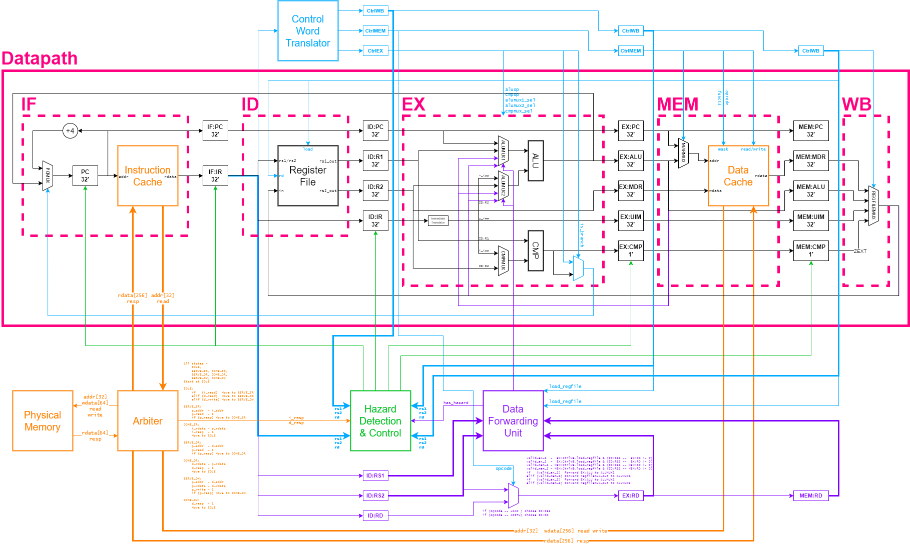
Forwarding

Slide 5
Testing Strategy
Arithmetic.s
Load_Store.s
Branch.s
Arbiter_tb.sv

