Slide 1
Road Map Report

Slide 2
Advanced Design Divide & Conquer
Next Line prefetcher
Ziyuan
Write back buffer w/ write merging & Multi-level Cache
Hao
Branch Prediction [Local branch history table, Global 2-level branch history table, 4-way set associative or higher BTB, Return address stack]
Zhirong

Slide 3
Advanced Design Divide & Conquer
Details introduced in later slides

Slide 4
Advanced Feature Design

Slide 5
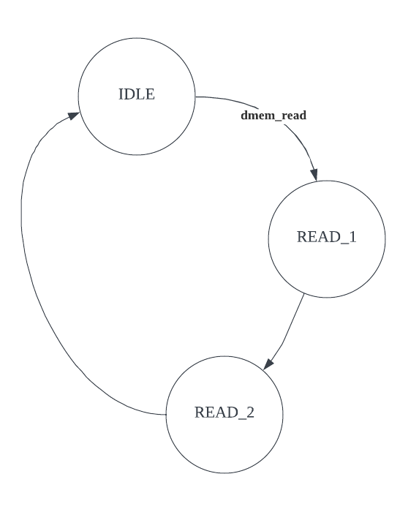
Next Line Prefetcher
Works well for sequential/streaming access pattern

Slide 6
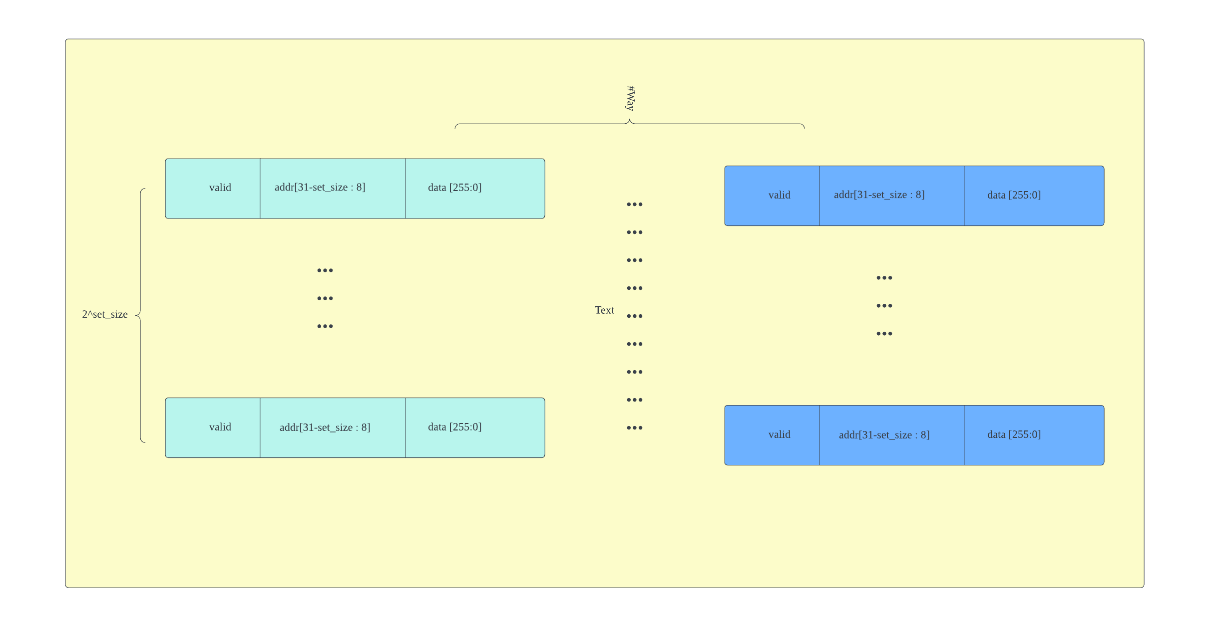
Writeback Buffer w/ Write Merging

Slide 7
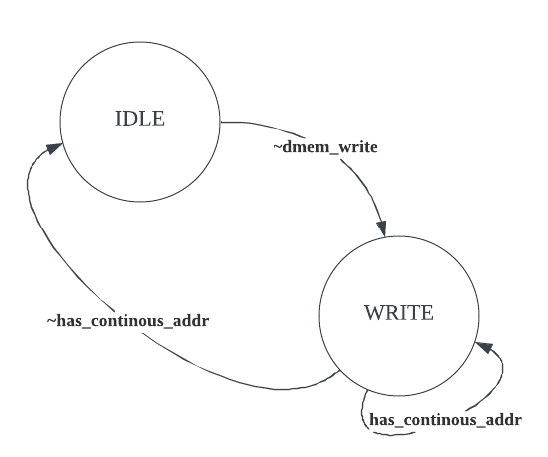
Writeback Buffer w/ Write Merging

Slide 8
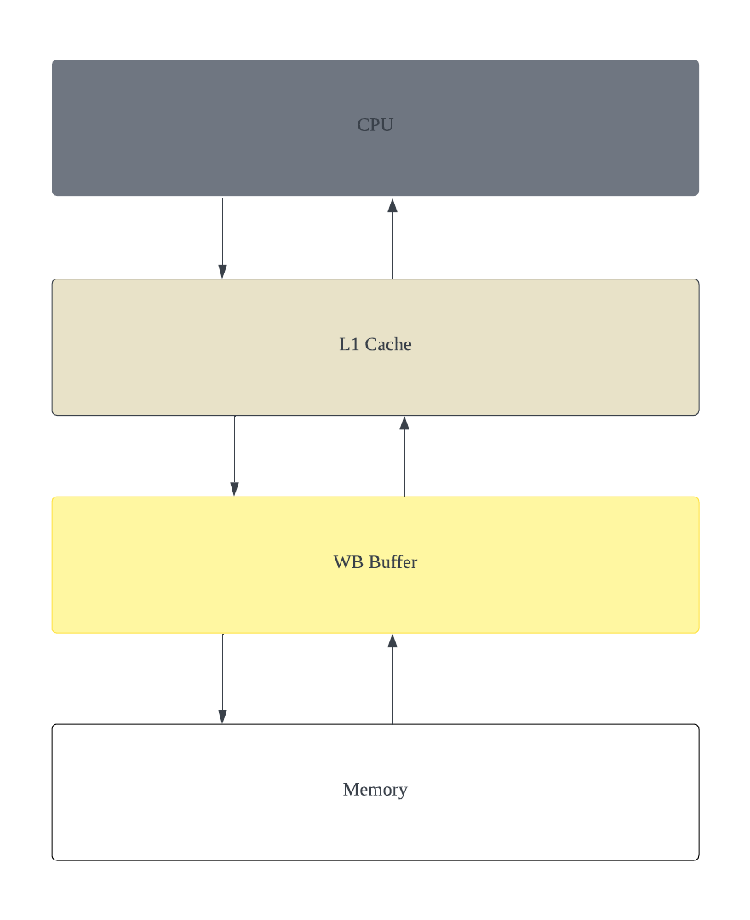
Writeback Buffer w/ Write Merging
WB Buffer
Read Hit : return
Read Miss : Read from Memory
Write Hit : modify
Write Miss : add / write through

Slide 9
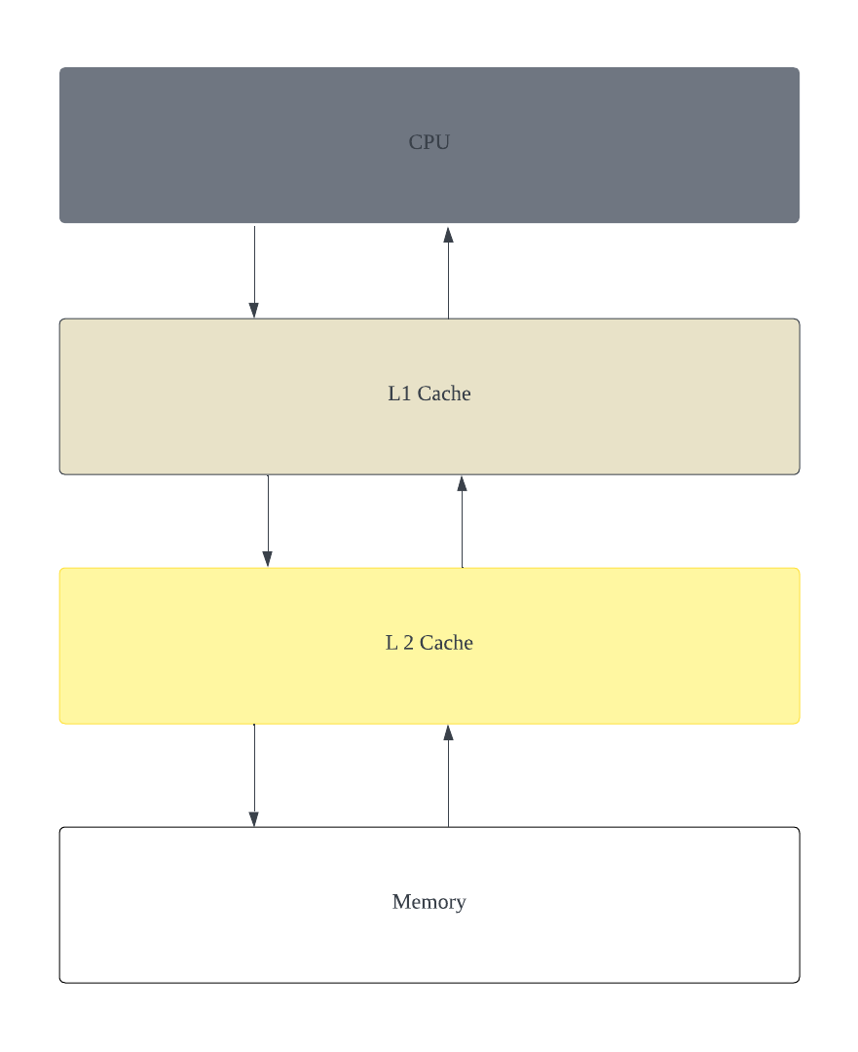
Multi-level Cache
L2 Cache + Memory
From L1’s perspective = Memory
L1 Cache
From L2’s perspective = CPU

Slide 10
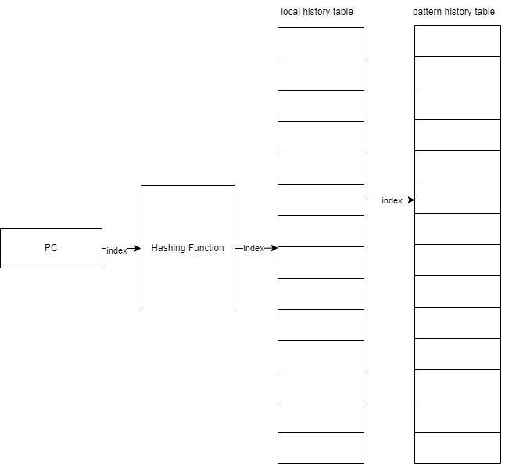
Local Branch Predictor

Slide 11
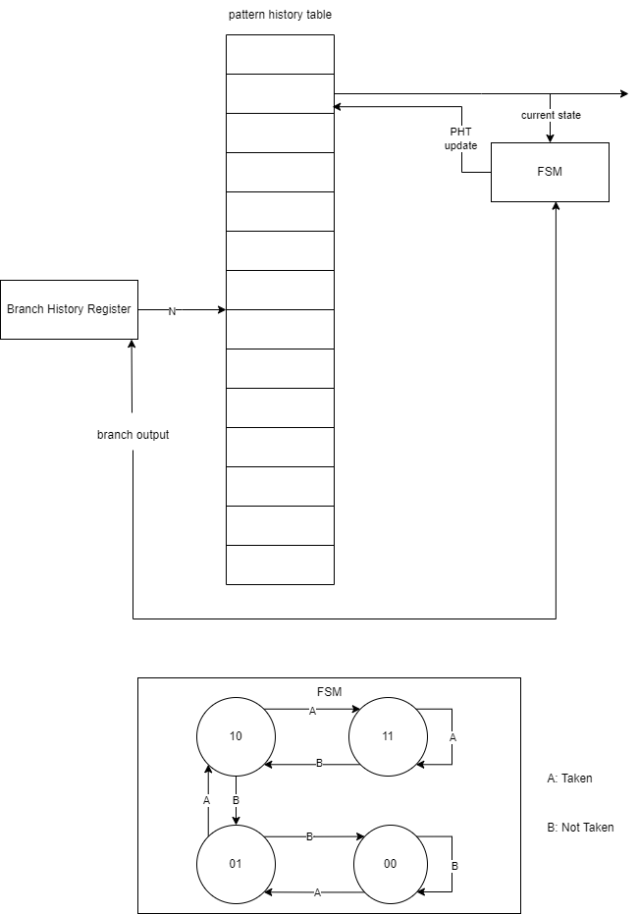
Global Branch Predictor

Slide 12
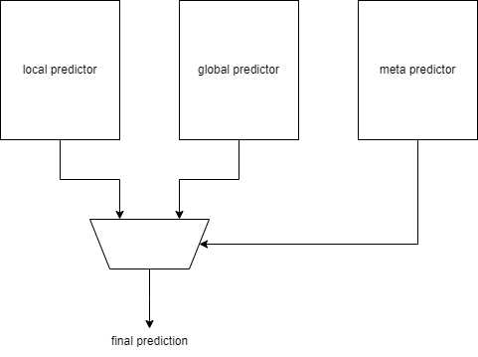
Tournament Predictor

Slide 13
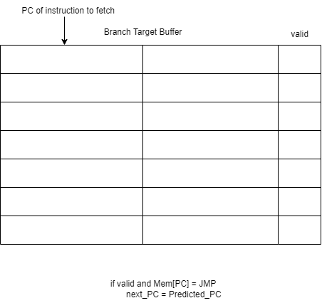
Branch Target Buffer

