Slide 1

CHAPTER 2
ARRAYS AND STRUCTURES
§1 The Array as an Abstract Data Type
For example,
to create a 3 by 4 matrix we shall call
Create (2, (3, 4))
Review in C:
Array and Pointer
Structure and Union
structure Array is
objects: A set of pairs <index, value> where for each value of index there is a value from the set item. Index is a finite ordered set of one or more dimensions, for example, {0, ⋅⋅⋅, n−1} for 1-D, {(0,0), (0,1), (0,2), (1,0), (1,1), (1,2), (2,0), (2,1), (2,2)} for 2-D, etc.
functions: for all A ∈ Array, i ∈ index, x ∈ item, and j, size ∈integer
Array Create(j, list) ::= return an array of j dimensions where list is a j-tuple whose i th element is the size of the i th dimension. Items are undefined.
Item Retrieve(A, i) ::= if (i ∈ index) return the item associated with index value i in array A
else return error
Array Store(A, i, x) ::= if (i ∈ index) return an array that is identical to array A except the new pair <i, x> has been inserted
else return error
end Array

Slide 2
§3 The Polynomial Abstract Data Type
1. The Ordered (or Linear) List
❖ ADT:
Objects: ( item₀, item₁, ⋅⋅⋅ , item_{n−1} )
Operations:
☞ Finding the length, n, of a list.
☞ Reading the items in a list from left to right (or right to left).
☞ Retrieving the i th item from a list, 0 ≤ i < n.
☞ Replacing the item in the i th position of a list, 0 ≤ i < n.
☞ Inserting a new item in the i th position of a list, 0 ≤ i < n. The items previously numbered i, i+1, ⋅⋅⋅ , n−1 are then numbered i+1, i+2, ⋅⋅⋅ , n.
☞ Deleting an item from the i th position of a list, 0 ≤ i < n. The items numbered i+1, ⋅⋅⋅ , n−1 are then numbered i, i+1, ⋅⋅⋅ , n−2.

Slide 3
§3 The Polynomial ADT
❖ Implementation:
(1) Array : array[ i ] = item_{i}
Address
Content
……
……
Sequential mapping
array+i
item_{i}
array+i+1
item_{i+1}
……
……
Without moving the items, we can do:
♦ Finding length ♦ Reading list
♦ Retrieving item ♦ Replacing item
Trouble-makers:
♦ Insertion ♦ Deletion
(2) Non-sequential mappings : will be discussed in Ch. 4

Slide 4
§3 The Polynomial ADT
2. Symbolic Manipulation of Polynomials
【Definition】A polynomial is a sum of terms in the form a⋅x ^{e}.
An example to show
why arrays are
not so adequate.
p ( x ) = a₁ x ^{e1} + ⋅⋅⋅ + a_{n} x ^{en}
where a_{i} is the coefficient, e_{i} ∈ Z⁺∪ { 0 } is the exponent, and max { e_{i} } is the degree of p ( x ).
Other Rules:
✵ If a_{i} = 0 then a_{i} x ^{ei} is not displayed
✵ If e_{i} = 0 then display a_{i} only (without x)
Given polynomials A ( x ) = ∑ a_{i} x ^{i} and B ( x ) = ∑ b_{i} x ^{i}:
✵ A ( x ) ± B ( x ) = ∑ ( a_{i} ± b_{i} ) x ^{i}
✵ A ( x ) ∗ B ( x ) = ∑ [ a_{i} x ^{i} ∗ ( ∑ b_{j} x ^{j} ) ]

Slide 5
§3 The Polynomial ADT
structure Polynomial is
objects: p ( x ) = a₁ x ^{e1} + ⋅⋅⋅ + a_{n} x ^{en} ; a set of ordered pairs of < e_{i} , a_{i} > where a_{i} in Coefficients and e_{i} in Exponents, e_{i} are nonnegative integers.
functions:
for all poly, poly1, poly2 ∈ Polynomial, coef ∈ Coefficients, expon ∈ Exponents
Polynomial Zero( ) ::= return the polynomial p ( x ) = 0
Boolean IsZero(poly) ::= if (poly) return FALSE
else return TRUE
Coefficient Coef(poly, expon)
::= if (expon ∈ poly) return its coefficient
else return zero
Exponent Lead_Exp(poly) ::= return the largest exponent in poly
Polynomial Attach(poly, coef, expon)
::= if (expon ∈ poly) return error
else return the polynomial poly with
the term < coef , expon > inserted

Slide 6

§3 The Polynomial ADT
structure Polynomial is (continued)
Polynomial Remove (poly, expon)
::= if (expon ∈ poly) return the polynomial poly
with the term whose exponent expon is
deleted
else return error
Polynomial SingleMult (poly, coef, expon)
::= return the polynomial poly ⋅ coef ⋅ x ^{expon}
Polynomial Add (poly1, poly2)
::= return the polynomial poly1 + poly2
Polynomial Mult (poly1, poly2)
::= return the polynomial poly1 ⋅ poly2
end Polynomial
It’s always easy for you to say.
Now how are you gonna
implement, for example,
the Add function?

Slide 7
§3 The Polynomial ADT
Algorithm for d = Add(a, b) where a, b, and d are polynomials:
d = Zero ( );
while ( ! IsZero(a) && ! IsZero(b) ) do {
switch COMPARE ( Lead_Exp(a), Lead_Exp(b) ) {
case -1: /* if the degree of b is higher */
d = Attach (d, Coef(b, Lead_Exp(b)), Lead_Exp(b)) ;
/* then attach the 1st term of b to d */
b = Remove(b, Lead_Exp(b)) ; /* remove this term from b */
break ;
case 0 : /* if a and b are of the same degree */
sum = Coef(a, Lead_Exp(a)) + Coef(b, Lead_Exp(b)) ;
/* then add the leading coefficients */
if (sum) Attach(d, sum, Lead_Exp(a)) ;
/* if the coefficient is non-zero, then attach the term to d */
a = Remove(a, Lead_Exp(a)) ;
b = Remove(b, Lead_Exp(b)) ; /* remove the terms from a & b */
break;
case 1 : /* if the degree of a is higher, then similar to case -1 */
d = Attach (d, Coef(a, Lead_Exp(a)), Lead_Exp(a)) ;
a = Remove(a, Lead_Exp(a)) ;
} /* end of switch */ } /* end of while */
insert any remaining terms of a or b into d
Note: The algorithm
given by Program 2.4 on p. 62
is not correct here.
What will happen if we follow
the procedures given
by the book?

Slide 8
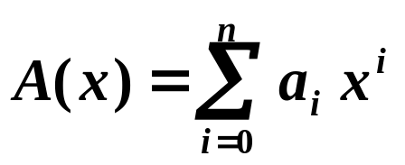
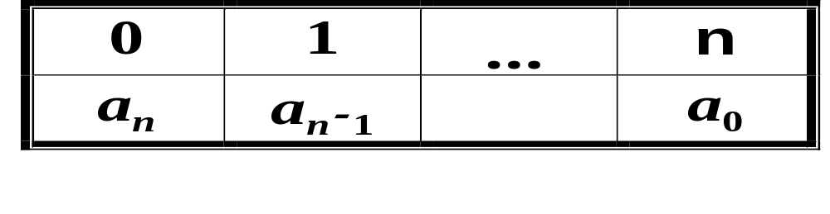


§3 The Polynomial ADT
【Representation 1】
typedef struct {
int degree ;
float coef [ MAX_DEGREE ] ;
} polynomial ;
Now if a is of type polynomial and n < MAX_DEGREE, the polynomial would be represented as:
a.degree = n ; a.coef [ i ] = a_{n−i}; 0 ≤ i ≤ n
a.coef
I don’t. Try to add
3 x¹⁰⁰⁰+x²+4 and 2 x
—— now you see my point?
I like it!
It’s easy to implement
most of the operations,
such as Add.

Slide 9
§3 The Polynomial ADT
【Representation 2】
typedef struct {
int expon ;
float coef ;
} polynomial ;
polynomial terms [ MAX_TERMS ] ;
〖Example〗 A(x) = 3 x¹⁰⁰⁰+x²+4 and B(x) = 2 x are represented as :
polynomial a[3], b[1] ;
a[0].expon = 1000; a[1].expon = 2; a[2].expon = 0;
a[0].coef = 3; a[1].coef = 1; a[2].coef = 4;
b[0].expon = 1; b[0].coef = 2;

Slide 10
§3 The Polynomial ADT
〖Example〗 To add A(x) = 5 x⁴ + 2 x² − 4 x + 1 and
B(x) = 6 x³ + 3 x² + 4 x, we first store both of them into terms[ ]:
startb
=finishb
starta
starta
starta
finisha
starta
=finisha
startb
startb
finishb
finisha
starta
finishb
index
0
1
2
3
4
5
6
terms
coef
5
2
− 4
1
6
3
4
expon
4
2
1
0
3
2
1
index
7
8
9
10
11
12
13
terms
coef
5
6
5
1
expon
4
3
2
0
COMPARE
COMPARE
COMPARE
COMPARE
startb
avail=7
avail=8
avail=9
avail=10
avail=11
startd
=avail
finishd
=avail−1
The resulting polynomial D(x) = A(x) + B(x) is stored in terms[startd] to terms[finishd]. The program Padd can be found on p.64.

Slide 11
§3 The Polynomial ADT
Analysis of Padd: Let m and n be the number of nonzero terms in A(x) and B(x), respectively, then the time complexity of Padd is:
T_{padd}(m, n) = O(m + n)
Well ... What if
the polynomial is NOT sparse?
Then this representation takes
about twice as much space
as the first one!
Isn’t that beautiful?
It’s a lot more efficient
than the first one!
Oh in that case ...
Nobody’s perfect...
A worst case could be:
A(x) = x^{2m} + ⋅⋅⋅ + x⁴ + x² + 1 and
B(x) = x^{2n+1} + ⋅⋅⋅ + x³ + x

Slide 12

§3 The Polynomial ADT
Note:We can store many polynomials in terms [ ], as long as the total number of nonzero terms is not greater than MAX_TERMS.
HW: p.66 #2, 3
If avail ≥ MAX_TERMS, then we can either quit, or remove some unnecessary polynomials and create a large, continuous available space at one end of the array.
That could mean a lot of data movements which takes time. In addition, we also must change the start and end indices for each polynomial moved.

Slide 13
§4 The Sparse Matrix Abstract Data Type
What is a SPARSE matrix?
What’s wrong with my
simple representation
A[MAX_ROWS][MAX_COLS]?
Wow! I see how much space
I could have wasted.
But, but do people really deal with
such kind of matrices?
Well, unlike other
math concepts, there is no
definite line drawn here.
To give you some idea, think of
a 1000 by 1000 matrix with
3000 nonzero entries.
Unfortunately we do.
It’s quite common to see
sparse matrices in
numerical analysis.
So I’d better figure out
another way to represent it.
Hmm.....
A matrix is SPARSE if
it contains many
zero entries.
Many?
How many is “many”?

Slide 14
§4 The Sparse Matrix ADT
1. ADT Definition
structure Sparse_Matrix is
objects: A set of triples, <row, column, value>, where row and column are integers and form a unique combination, and value comes from the set item.
functions:
for all a, b ∈ Sparse_Matrix, x ∈ item, i, j, max_col, max_row ∈ index
Sparse_Matrix Create(max_row, max_col)
::= return a Sparse_Matrix that can hold up to max_items = max_row × max_col and whose maximum row size is max_row and whose maximum column size is max_col.
Sparse_Matrix Transpose(a)
::= return the matrix produced by interchanging the row and column value of every triple.
Sparse_Matrix Add(a, b)
::= if the dimensions of a and b are the same
return the matrix produced by adding corresponding items, namely those with identical row and column values.
else return error
<row, column, value>
can uniquely determine
an element within a matrix.

Slide 15
§4 The Sparse Matrix ADT
structure Sparse_Matrix is (continued)
Sparse_Matrix Multiply(a, b)
::= if number of columns in a equals number of rows in b
return the matrix d produced by multiplying a by b according to the formula: d[i][j] = Σ (a[i][k] ⋅ b[k][j]) where d(i, j) is the (i, j)th element.
else return error
end Sparse_Matrix
Sparse_Matrix Create(max_row, max_col) ::=
#define MAX_TERMS 101
/* maximum number of terms + 1 */
typedef struct {
int col ;
int row ;
int value ;
} term ;
term a [ MAX_TERMS ] ;

Slide 16
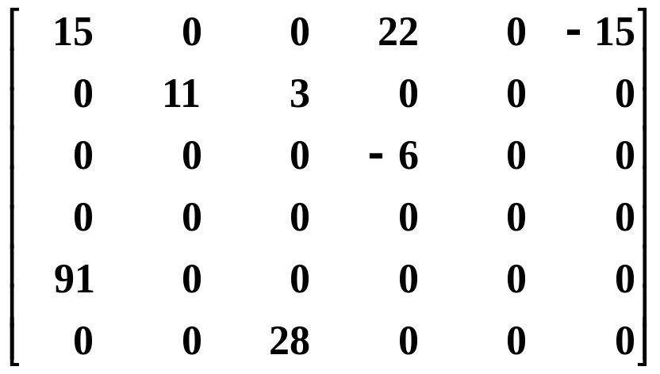
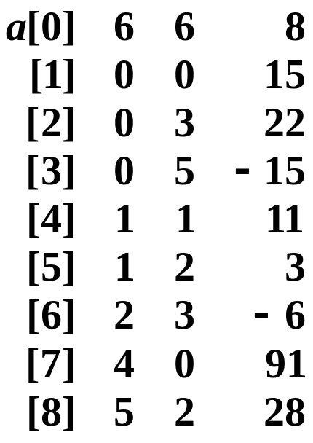
§4 The Sparse Matrix ADT
a[0].row = total number of rows of the matrix;
a[0].col = total number of columns of the matrix;
a[0].value = total number of nonzero entries in the matrix;
a[1] ~ a[MAX_TERMS] store the nonzero elements.
〖Examples〗 p.67 Figure 2.3 and p.69 Figure 2.4
col 0
col 1
col 2
col 3
col 4
col 5
row
col
value
row 0
row 1
row 2
row 3
row 4
row 5
Note: The indices of rows and columns are in ascending order.

Slide 17
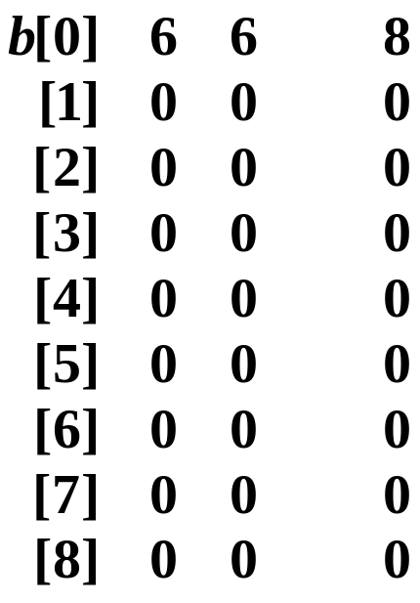
§4 The Sparse Matrix ADT
2. Transposing a Matrix
B = A^{T} ⇔ b [ j ] [ i ] = a [ i ] [ j ]
【Algorithm 1】
for each row i
take element <i, j, value> and store it
as element <j, i, value> of the transpose ;
row
col
value
row
col
value
0 0 15
3 0 22
☹
5 0 −15
1 1 11

Slide 18
§4 The Sparse Matrix ADT
【Algorithm 2】
for all elements in column j
place element <i, j, value> in element <j, i, value> ;
void transpose ( term a[ ], term b[ ] ) /* b = a^{T} */
{ int n, i, j, currentb ;
n = a[0].value ; /* total number of elements */
b[0].row = a[0].col ; /* rows in b = columns in a */
b[0].col = a[0].row ; /* columns in b = rows in a */
b[0].value = n ;
if ( n > 0 ) { /* if it is a nonzero matrix */
currentb = 1 ; /* the current available position in b */
for ( i = 0; i < a[0].col; i++ ) /* transpose by the columns in a */
for (j = 1; j <= n; j++ ) /* from all the elements */
if ( a[j].col == i ) { /* if the element is in the column i */
b[currentb].row = a[j].col ; /* then add it to b */
b[currentb].col = a[j].row ;
b[currentb].value = a[j].value ;
currentb ++ ;
} /* end if */
} /* end if (n>0) */
}

Slide 19
§4 The Sparse Matrix ADT
Analysis of transpose: The time complexity of transpose is
O ( columns ⋅ elements )
Note: The simple algorithm
for ( j = 0; j < columns; j++ )
for ( i = 0; i < rows; i++ )
b [ j ] [ i ] = a [ i ] [ j ] ;
requires O (columns ⋅ rows ). If the matrix is not so sparse, that is, if elements = O (columns ⋅ rows ), then our transpose function takes O (columns² ⋅ rows ).
Oops!
Perhaps I have traded away
too much time for space ...

Slide 20
§4 The Sparse Matrix ADT
【Algorithm 3】 Fast-Transpose
sp
=1
sp
=3
sp
=4
sp
=6
sp
=8
sp
=8
=2
=4
=5
=7
=9
col 0
col 1
col 2
col 3
col 4
col 5
row 0
row 1
row 2
row 3
row 4
row 5
row
col
value
rt
=2
rt
=1
rt
=2
rt
=2
rt
=0
rt
=1
row
col
value
⇒ b [ sp[0] ] ; sp[0]++ ;
0 0 15
⇒ b [ sp[3] ] ; sp[3]++ ;
0 4 91
⇒ b [ sp[5] ] ; sp[5]++ ;
1 1 11
⇒ b [ sp[1] ] ; sp[1]++ ;
2 1 3
⇒ b [ sp[2] ] ; sp[2]++ ;
2 5 28
⇒ b [ sp[3] ] ; sp[3]++ ;
3 0 22
⇒ b [ sp[0] ] ; sp[0]++ ;
3 2 −6
⇒ b [ sp[2] ] ; sp[2]++ ;
5 0 −15

Slide 21
§4 The Sparse Matrix ADT
#define MAX_COL 50 /* maximum number of columns + 1 */
void fast_transpose ( term a[ ], term b[ ] ) /* b = a^{T} */
{ int row_terms[MAX_COL], starting_pos[MAX_COL] ;
int i, j, num_cols = a[0].col, num_terms = a[0].value ;
b[0].row = num_cols ; b[0].col = a[0].row ;
b[0].value = num_terms ;
if ( num_terms > 0 ) { /* if it is a nonzero matrix */
for ( i = 0; i < num_cols; i++ )
row_terms[i] = 0 ; /* initialize rt */
for ( i = 1; i < num_terms; i++ )
row_terms[ a[i].col ] ++ ; /* count # of terms in each column */
starting_pos[0] = 1; /* position of the 1st term of col 0 in b */
for ( i = 1; i < num_cols; i++ )
starting_pos[i] = starting_pos[i−1] + row_terms[i−1] ;
/* position of the 1st term of col i in b */
for ( i = 1; i < num_terms; i++ ) {
j = starting_pos[ a[i].col ] ++ ; /* j is the index of a[i] in b */
/* and sp++ now points to the next term in this column */
b[j].row = a[i].col ; b[j].col = a[i].row ; b[j].value = a[i].value ;
} /* end for-loop */
} /* end if */
}
Time complexity = O( ? )
columns + elements

Slide 22
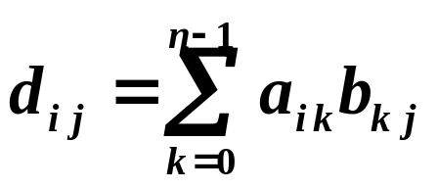
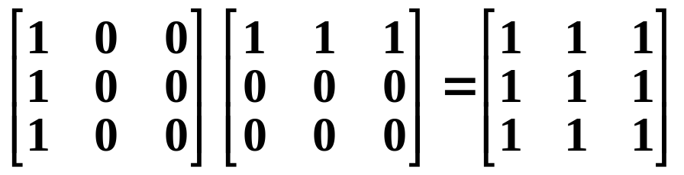
§4 The Sparse Matrix ADT
3. Matrix Multiplication
【Definition】Given A and B where A is m × n and B is n × p, the product matrix D has dimension m × p. Its <i, j> element is:
for 0 ≤ i < m and 0 ≤ j < p.
Note: The product of two sparse matrices may no longer be sparse. For example:

Slide 23
§4 The Sparse Matrix ADT
Sketch of the idea: D = A × B
➢ Compute D by rows so that we can store them in their proper order without moving elements.
➢ Fix any 0 ≤ row of A ≤ rows_a, find all elements in column of B = 0, 1, ⋅⋅⋅, cols_b − 1.
➢ To avoid scanning all elements of B to arrange a column, we compute B^{T} first and store it into new_b.
➢ Multiply row of A with column of B, using an algorithm similar to the symbolic polynomial addition.

Slide 24
§4 The Sparse Matrix ADT
Program:
void mmult ( term a[ ], term b[ ], term d[ ] )
{ /* d = a × b */
int i, j, column, row = a[1].row, row_begin = 1, sum = 0;
int rows_a = a[0].row, cols_a = a[0].col, totala = a[0].value;
int cols_b = b[0].col, totalb = b[0].value, totald = 0;
term new_b[MAX_TERMS];
if ( cols_a != b[0].row ) {
fprintf( stderr, “Incompatible matrices\n” );
exit( 1 ); /* if it’s an illegal call, then you’ll be kicked out */
} /* end if */
fast_transpose( b, new_b ); /* new_b = b^{T} */
a[ totala + 1 ].row = rows_a ; /* set the boundary */
new_b[ totalb + 1 ].row = cols_b; /* conditions for the */
new_b[ totalb + 1 ].col = 0; /* following loops */
There’s a
misprint on p.74

Slide 25
§4 The Sparse Matrix ADT
for ( i = 1; i <= totala; ) {
column = new_b[1].row ; /* start from the 1st column of b */
for ( j = 1; j <= totalb + 1; ) {
/* begin multiplying row of a by column of b */
if ( a[i].row != row ) {
/* if the i-th row of a has no more nonzero terms */
storesum( d, &totald, row, column, &sum );
/* then store the result in d */
i = row_begin;
/* set i back to the beginning of this row */
for ( ; new_b[j].row == column; j++ )
;
/* if there are more terms left in the column of b */
/* then they must be multiplied to zeros in a */
/* so we may simple ignore them */
column = new_b[j].row;
/* column now points to the next column in b */
} /* end if TRUE */
storesum
can be found on p.76

Slide 26
§4 The Sparse Matrix ADT
else if ( new_b[j].row != column ) {
/* if this column of b has no more nonzero terms */
storesum(d, &totald, row, column, &sum);
i = row_begin;
column = new_b[j].row; } /* end else if TRUE */
else switch (COMPARE( a[i].col, new_b[j].col )) {
/* if in the middle of multiplication */
case -1: i++; break; /* goto next term in a */
case 0: sum += (a[i++].value * new_b[j++].value);
break; /*add terms, goto next term in a & b */
case 1: j++; /* advance to next term in b */
} /* end switch */
} /* end for -loop of j <= totalb + 1 */
for ( ; a[i].row == row; i++ ) /* if b has no more nonzero */
; /* columns, yet a has some left in this row, ignore them */
row_begin = i; row = a[i].row; /* next row */
} /* end for-loop of i <= totala */
d[0].row = rows_a; d[0].col = cols_b; d[0].value = totald;
}

Slide 27
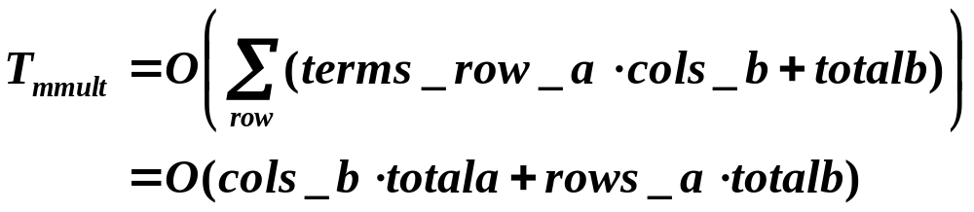
§4 The Sparse Matrix ADT
Analysis of mmult
Space = simple variables + a + b + d + new_b (including additional space required by fast_transpose)
Time :
• For fast_transpose —— O( cols_b + totalb )
 For each single d_{ij} in the ith row —— O( terms_row_a )
 For the ith row of d
—— O( terms_row_a ⋅ cols_b + cols_b + totalb )
Reset i
j-loop
Total time complexity

Slide 28
§4 The Sparse Matrix ADT
Compare to the simple algorithm:
for ( i = 0; i < rows_a; i++ )
for ( j = 0; j < cols_b; j++ )
{ sum = 0;
for ( k = 0; k < cols_a; k++ )
sum += a[i][k] * b[k][j] ;
d[i][j] = sum ;
}
T_{p} = O( rows_a ∗ cols_b ∗ cols_a )
Similar to the short-coming
of the presentation of polynomials:
since the matrices are of different sizes,
I would like to put them all
in one array. Then ...
Yeah I know I know,
then allocating space from
the array will be difficult.
But there’s little I can do
with Array ...
HW:
p.77 ~ 78 #1, 6
Now,
are you satisfied?
What do you mean
by “almost”?!
The worst case of mmult :
totala ≈ cols_a ∗ rows_a or totalb ≈ cols_b ∗ rows_b
Then T_{mmult} ≈ T_{p} .
Almost ...

Slide 29
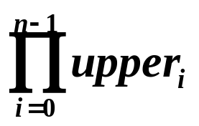
§5 Multidimensional Array
—— computing the address
If an array is declared
a[upper₀][upper₁] ⋅⋅⋅ [upper_{n−1}],
then the total number of elements in the array is
One way to represent multidimensional arrays is row major order.
〖Example〗 2-D array: a[upper₀][upper₁]
Note: sizeof( element )
is omitted here.
row 0
row 1
row upper₀−1
a
⋅⋅⋅⋅⋅⋅
⋅⋅⋅⋅⋅⋅
⋅⋅⋅ ⋅⋅⋅ ⋅⋅⋅
⋅⋅⋅⋅⋅⋅
upper₁
upper₁
upper₁
Content: a[0][0] a[0][1] ⋅⋅⋅ a[i][0] ⋅⋅⋅ ⋅⋅⋅ a[i][j]
Address: α α+1 ⋅⋅⋅ α+i⋅upper₁ ⋅⋅⋅ α+i⋅upper₁+j

Slide 30
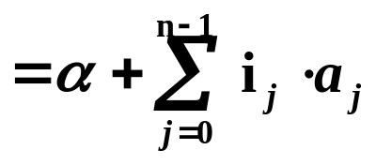
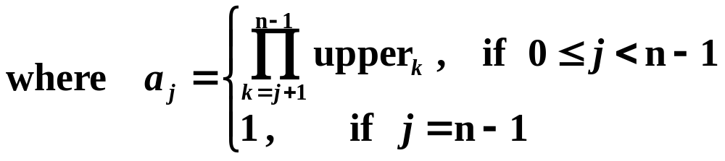
§5 Multidimensional Array
〖Example〗 3-D array: a[upper₀][upper₁][upper₂]
How many multiplications
must the compiler do to compute
the address using this formula?
row 0
row upper₀−1
a
⋅⋅⋅⋅⋅⋅
⋅⋅⋅ ⋅⋅⋅ ⋅⋅⋅
⋅⋅⋅⋅⋅⋅
upper₁×upper₂
upper₁×upper₂
Content: a[0][0][0] ⋅⋅⋅ a[i][0][0] ⋅⋅⋅ ⋅⋅⋅ a[i][j][k]
Address: α ⋅⋅⋅ α+i⋅upper₁⋅upper₂ ⋅⋅⋅ α+ i⋅upper₁⋅upper₂ +j⋅upper₂+k
In general, for any given n-D array a[upper₀][upper₁] ⋅⋅⋅ [upper_{n−1}], if the address of a[0]⋅⋅⋅[0] is α, then the address of a[i₀][i₁] ⋅⋅⋅ [i_{n−1}] must be
α + i₀⋅upper₁⋅upper₂⋅⋅⋅upper_{n−1}
+i₁⋅upper₂⋅⋅⋅upper_{n−1}
+ ⋅⋅⋅ ⋅⋅⋅
+i_{n−2}⋅upper_{n−1}
+i_{n−1}

Slide 31
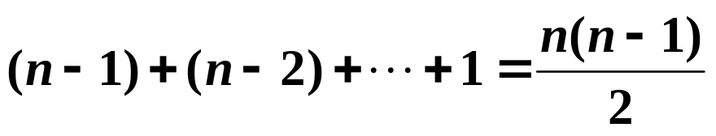
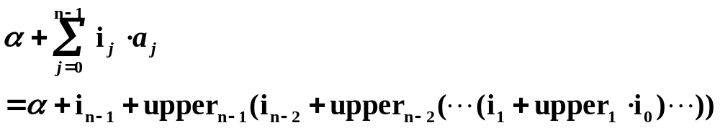
§5 Multidimensional Array
According to the formula, the number of multiplications is
Addition and subtraction
are much faster than
multiplication and division.
That’s why we only care about
# of multiplications here.
Other options:
❖ Notice that a_{j} = upper_{j+1} ⋅ a_{j+1}, therefore we can compute a_{j} using (n −2) multiplications. With (n −1) additional multiplications in the formula, we can get the address using (2n −3) multiplications.
❖ Using the law of association, we can reduce the amount of computations even further:
There are (n −1) multiplications only.

Slide 32
§6 The String Abstract Data Type
1. Introduction
structure String is
objects: A finite set of zero or more characters.
functions: for all s, t ∈ String, i, j, m ∈ non-negative integers
String Null(m) ::= return a string whose maximum length is m characters, but is initially set to NULL. We write NULL as “”.
Integer Compare(s, t) ::= if (s equals t) return 0
else if (s precedes t) return −1
else return +1
Boolean IsNull(s) ::= if (Compare(s, NULL)) return FALSE
else return TRUE
Integer Length(s) ::= if (Compare(s, NULL)) return the number of characters in s
else return 0

Slide 33
§6 The String ADT
structure String is (continued)
String Concat(s, t) ::= if (Compare(t, NULL)) return a string whose elements are those of s followed by those of t. It is called concatenation.
else return s
String Substr(s, i, j) ::= if ( (j > 0) && (i+j−1) < Length(s) )
return the string containing the characters of s at positions i, i+1, ⋅⋅⋅, i+j−1
else return NULL
end String
HW:
Review the representation of strings in C,
and the functions provided by < string.h >
(shown on p.82).

Slide 34
§6 The String ADT
2. Other Operations
➢ String Insert ( s, t, i )
::= if (length(s) == 0) return Concat ( s, t )
else (insert t into s at position i) return s
➢ int Find_Pattern ( s, p )
::= if (p is found in s) return (the start position of p in s)
else return −1
➢ String Remove ( s, t )
::= if ( Find_Pattern ( s, t ) == −1 ) return s
else ( remove t from s ) return s
HW: p.92 #6
On page 85, Program 2.11 inserts
one string into another. However, it is so
wasteful in its use of time and space that
it should never be used in practice.
Can you give a better one?

Slide 35
§6 The String ADT
3. Pattern Matching : Given string and pat. Check if pat is in string.
【Method 1】Use the built-in function strstr.
char *strstr (char *s, char *pat)
return pointer to start of pat in s
Yes. It takes a computing time
of O(mn) if the lengths of
pat and string are
n and m, respectively.
char pat [ MAX_SIZE ], string [ MAX_SIZE ], *t ;
if ( t = strstr (string, pat) )
printf ( “The string from strstr is: %s\n”, t ) ;
else
printf ( “The pattern was not found with strstr\n” ) ;
So the worst case could happen,
for example, when
string = “aaaaaaaaaa”
and pat = “aaab”
What do you think
of this function,
my picky friend?
It checks string sequentially.
Oh come on!
You can do better
than this.
I knew you’d say that.
Depends on
the way it works.

Slide 36
§6 The String ADT
【Method 2】Check the last character of pat first. If it is matched, then compare from the beginning of pat.
void nfind ( char *string, char *pat )
{ int i, j, start = 0 ;
int lasts = strlen ( string ) − 1 ;
int lastp = strlen ( pat ) − 1 ;
int endmatch = lastp ;
for ( i = 0; endmatch <= lasts; endmatch++, start++ ) {
if ( string[endmatch] == pat[lastp] ) /* if the last one is ok */
for ( j = 0, i = start; j < lastp && string[i] == pat[j]; i++, j++ )
;
/* then compare from the beginning of pat and string[start] */
if ( j == lastp ) /* if the whole pat is matched */
return start ;
} /* end i-loop */
return −1 ;
}

Slide 37
§6 The String ADT
〖Example〗 Given string = ababbaabaa and pat = aab
start
start
start
endmatch
start
endmatch
endmatch
start
start
endmatch
endmatch
endmatch
lasts
string
a
b
a
b
b
a
a
b
a
a
\0
Now if this program is
applied to your string = “aaaaaaaaaa”
and pat = “aaab”,
T_{p} = O(m) where m is
the length of string.
lastp
i
i
i
i
i
i
pat
a
a
b
\0
j
j
j
j
j
j
What if
pat =“aaba”?
Calm down my friend.
You can do better.

Slide 38
§6 The String ADT
【Method 3】The optimal time complexity
T_{p} = O( strlen(string) + strlen(pat) )
was obtained by Knuth, Morris, and Pratt.
Sketch of the idea:
string
⋅⋅⋅⋅⋅⋅
a
b
c
d
a
b
?
?
⋅⋅⋅⋅⋅⋅
\0
pat
a
b
c
d
a
b
a
b
c
d
\0
pat
a
b
c
d
a
b
⋅⋅⋅⋅⋅⋅
【Definition】If p = p₀p₁ ⋅⋅⋅⋅⋅⋅ p_{n−1} is a pattern, then its failure function, f, is defined as:
pat
a
b
c
a
b
c
a
c
a
b
\0
j
0
1
2
3
4
5
6
7
8
9
10
f
−1
−1
−1
0
1
2
3
−1
0
1
\

Slide 39
§6 The String ADT
int pmatch ( char *string, char *pat )
{ /* Knuth, Morris, Pratt string matching algorithm */
int i = 0, j = 0 ;
int lens = strlen ( string );
int lenp = strlen ( pat );
while ( i < lens && j < lenp ) {
if ( string[i] == pat[j] ) {
i++; j++; }
else if ( j == 0 ) i++;
else j = failure[j−1] + 1;
} /* end while-loop */
return ( (j == lenp) ? (i − lenp) : −1 );
}
i
j
failure[j−1]
i
return
Time complexity = O ( ? )
strlen ( string )
provided that failure [ j ] is ready.

Slide 40

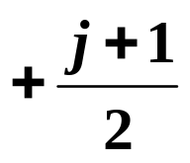
§6 The String ADT
How to compute failure [ j ] ?
【Method 1】Based on the definition:
To compute each f ( j ) we need to do ? comparisons.
O ( j ² )
⋅⋅⋅ ⋅⋅⋅ ⋅⋅⋅
⋅⋅⋅ ⋅⋅⋅ ⋅⋅⋅
1
+ 2
+ ⋅⋅⋅
+ ⋅⋅⋅ + j

Therefore the total time complexity will be O ( n³ ).

Slide 41


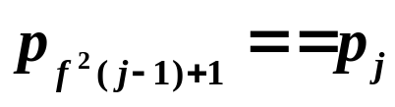

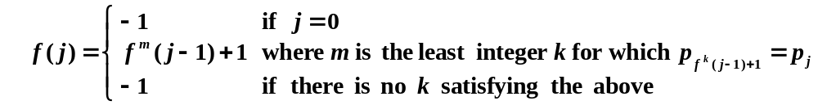
§6 The String ADT
【Method 2】
f ( j−1)+1
j−1
j
?
?
f ( j − 1)
yes
no
i = f ( j − 1)
j
?
×
?
f ( i ) =
f ² ( j − 1)
yes
no
…

Slide 42
§6 The String ADT
void fail ( char *pat )
{ /* compute the pattern’s failure function */
int n = strlen ( pat );
failure [ 0 ] = −1;
for ( j = 1; j < n; j++ ) {
i = failure [ j − 1 ];
while ( ( pat [ j ] != pat [ i + 1 ] ) && ( i >= 0 ) )
i = failure [ i ]; /* i = f ^{k}( j − 1) */
if ( pat [ j ] == pat [ i + 1 ] )
failure [ j ] = i + 1;
else failure [ j ] = −1;
} /* end j-loop */
}
O( n )
Total number of
decrements is O( n )
HW:
p. 91 #4
p. 92 #9
Total number of
increments is O( n )
Time complexity = O ( ? )
strlen ( pat )
T_{fail + pmatch} = O ( strlen ( string ) + strlen ( pat ) )

