Slide 1



CHAPTER 3
STACKS AND QUEUES
6
5
§1 The Stack Abstract Data Type
6
A stack is a Last-In-First-Out (LIFO) list, that is, an ordered list in which insertions and deletions are made at the top only.
5
4
3
〖Example〗 System Stack
5
2
f p
6
1
Old Frame Pointer
s p
Return Address
s p
Local Variables
s p
f p
f p
Stack Frame
s p
s p
Return Address

Slide 2
§1 The Stack ADT
structure Stack is
objects: A finite ordered list with zero or more elements.
functions:
for all stack ∈ Stack, item ∈ element, max_stack_size ∈ positive integer
Stack CreateS (max_stack_size)
::= create an empty stack whose maximum size is max_stack_size
Boolean IsFull (stack, max_stack_size)
::= if ( number of elements in stack = = max_stack_size ) return TRUE
else return FALSE
Stack Push (stack, item)
::= if ( IsFull ( stack ) ) stack_full
else insert item into top of stack and return
Boolean IsEmpty (stack)
::= if (stack = = CreateS(max_stack_size) ) return TRUE
else return FALSE
Element Pop (stack)
::= if ( IsEmpty ( stack ) ) return
else remove and return the item on the top of stack
It is named “Add”
in the text book.
It is named “Delete”
in the text book.
end Stack

Slide 3

§1 The Stack ADT
Implementations:
Stack CreateS ( max_stack_size ) ::=
#define MAX_STACK_SIZE 100 /* maximum stack size */
typedef struct {
int key ;
/* other fields */
} element ;
element stack [ MAX_STACK_SIZE ] ;
int top = −1 ;
Boolean IsEmpty ( stack ) ::=
top < 0 ;
Boolean IsFull ( stack ) ::=
top >= MAX_STACK_SIZE − 1 ;

Slide 4
§1 The Stack ADT
Stack Push ( stack, item ) ::=
void push ( int *top, element item )
{ /* add an item to the global stack */
if ( *top >= MAX_STACK_SIZE − 1 ) {
stack_full ( ) ; /* print an error message and more ... */
return ;
} /* end if */
stack [ ++*top ] = item ;
}
Element Pop ( stack ) ::=
element pop ( int *top )
{ /* return the top element from the stack */
if ( *top == −1 )
return stack_empty ( ) ; /* return an error key */
return stack [ ( *top ) − − ] ;
}

Slide 5
§2 The Queue Abstract Data Type
A queue is a First-In-First-Out (FIFO) list, that is, an ordered list in which insertions take place at one end and deletions take place at the opposite end.
4
3
2
structure Queue is
1
objects: A finite ordered list with zero or more elements.
2
functions:
for all queue ∈ Queue, item ∈ element, max_queue_size ∈ positive integer
Queue CreateQ (max_queue_size)
::= create an empty queue whose
maximum size is max_queue_size
1
2
1

Slide 6
§2 The Queue ADT
structure Queue is ( continued )
functions:
Boolean IsFullQ (queue, max_queue_size)
::= if ( number of elements in queue = = max_queue_size ) return TRUE
else return FALSE
Queue PushQ (queue, item)
::= if ( IsFullQ ( queue ) ) queue_full
else insert item at rear of queue and return queue
Boolean IsEmptyQ (queue)
::= if (queue = = CreateQ(max_queue_size) ) return TRUE
else return FALSE
Element PopQ (queue)
::= if ( IsEmptyQ ( queue ) ) return
else remove and return the item at front of queue
end Queue

Slide 7
§2 The Queue ADT
Implementations:
Queue CreateQ ( max_queue_size ) ::=
#define MAX_QUEUE_SIZE 100 /* maximum queue size */
typedef struct {
int key ;
/* other fields */
} element ;
element queue [ MAX_STACK_SIZE ] ;
int rear = −1, front = −1 ;
Boolean IsEmptyQ ( queue ) ::=
front = = rear ;
Boolean IsFullQ ( queue ) ::=
rear = = MAX_QUEUE_SIZE − 1 ;

Slide 8
§2 The Queue ADT
Queue PushQ ( queue, item ) ::=
void pushq ( int *rear, element item )
{ /* add an item to the global queue */
if ( *rear = = MAX_QUEUE_SIZE − 1 ) {
queue_full ( ) ; /* ? */
return ;
} /* end if */
queue [ ++*rear ] = item ;
}
Element PopQ ( queue ) ::=
element popq ( int *front, int rear )
{ /* return the element at the front of the queue */
if ( *front == rear )
return queue_empty ( ) ; /* return an error key */
return queue [ ++ *front ] ;
}

Slide 9
§2 The Queue ADT
〖Example〗 Job Scheduling in an Operating System
−1
0
1
2
3
4
5
6
Job 1
Job 2
Job 3
Job 4
Job 5
Job 6
Job 7
front
rear
rear
rear
rear
rear
front
rear
rear
front
rear
front
 Push Job 1
 Push Job 2
 Push Job 3
 Pop Job 1
 Push Job 4
 Push Job 5
 Push Job 6
 Pop Job 2
 Push Job 7
 Push Job 8
queue_full ( ) ::= move the entire queue to the left, so that the first element is again at queue [ 0 ], front is at −1, and rear is also correctly positioned.
The worst case T_{queue_full} = O( MAX_QUEUE_SIZE )

Slide 10

§2 The Queue ADT
Circular Representation:
rear
[ 5 ]
[ 0 ]
rear
Question:
Why is the queue
announced full
while there is
still a free
space left?
front
rear
 Push Job 1
rear
Job
5
Job
6
front
 Push Job 2
rear
Do you have
a better idea?
front
Are you kidding?
Of course I do!
rear
 Push Job 3
Job
4
Job
1
[ 4 ]
[ 1 ]
 Pop Job 1
 Push Job 4
Job
3
Job
2
 Push Job 5
rear
rear
The queue
is full
 Push Job 6
The queue
is full
[ 3 ]
[ 2 ]
 Push Job 7
Note: We should rotate rear and front before we push or pop any item.

Slide 11
§2 The Queue ADT
Queue CreateQ ( max_queue_size ) ::=
#define MAX_QUEUE_SIZE 100 /* maximum queue size */
typedef struct {
int key ;
/* other fields */
} element ;
element queue [ MAX_STACK_SIZE ] ;
int rear = 0, front = 0 ;
Boolean IsEmptyQ ( queue ) ::=
front = = rear ;
Notice that if we insert an item at queue[rear] while rear = = front, then we will not be able to distinguish between the cases of full and empty.

Slide 12
§2 The Queue ADT
Queue PushQ ( queue, item ) ::=
void pushq ( int front, int *rear, element item )
{ /* add an item to the circular queue */
*rear = ( *rear + 1 ) % MAX_QUEUE_SIZE ;
if ( front = = *rear ) {
queue_full ( rear ) ; /* print error and reset rear */
return ;
} /* end if */
queue [ *rear ] = item ;
}
Think:
Do we have to waste one empty space
to distinguish “full” from “empty”?
Do you have any better ideas?
HW:
p. 111 #1, 2
Element PopQ ( queue ) ::=
element popq ( int *front, int rear )
{ /* return the element at the front of the queue */
if ( *front == rear )
return queue_empty ( ) ; /* return an error key */
*front = ( *front + 1 ) % MAX_QUEUE_SIZE ;
return queue [ *front ] ;
}

Slide 13
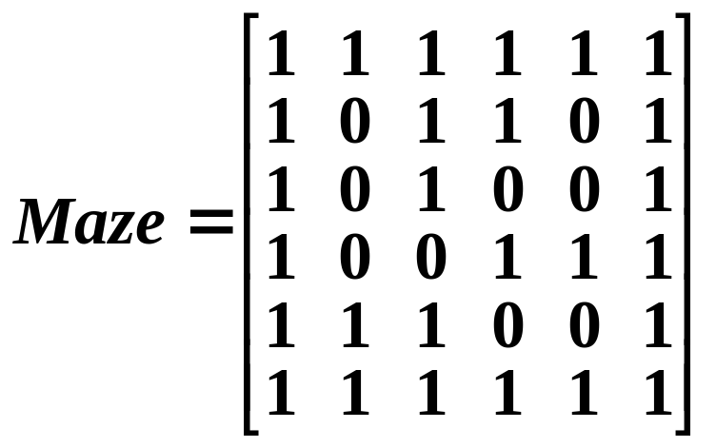
§3 A Mazing Problem —— an application of stacks
A Maze
1. Representing the Maze
entrance
➢ position = < row, col >
➢ maze = maze [ row ] [ col ]
= 1 if blocked
0 if open
exit
➢ maze border = 1
➢ entrance = < 1, 1 >,
exit = < m, p >
maze [ m+2 ] [ p+2 ]

Slide 14
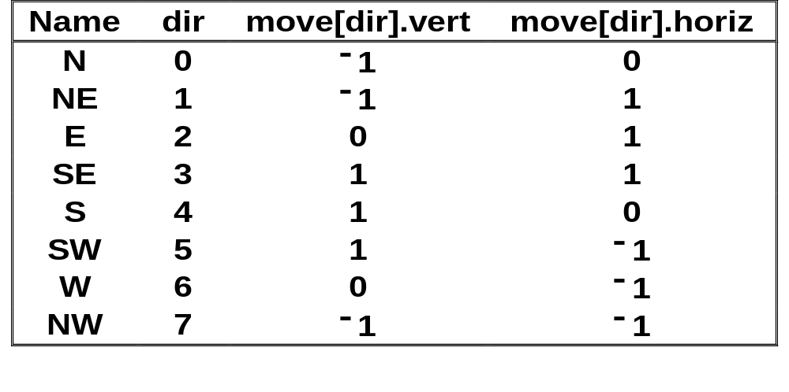
§3 A Mazing Problem
2. Representing the Move
NW
[row−1][col−1]
N
[row−1][col]
NE
[row−1][col+1]
typedef struct {
short int vert ;
short int horiz ;
} offsets ;
offsets move [ 8 ] ;
W
[row][col −1]
[row][col]
E
[row][col+1]
SW
[row+1][col −1]
S
[row+1][col]
SE
[row+1][col+1]
next_row =
row + move[dir].vert;
next_col =
col + move[dir].horiz;

Slide 15
§3 A Mazing Problem
3. Sketch of the Idea
0 1 2 3 4 5
Read Programs 3.7 and 3.8
on p. 115 ~ 117.
Then try to do ... ...
< 1, 4, S >
top
top
< 2, 3, NE >
< 4, 3, E >
top
top
top
0 1 2 3 4 5
top
5 4 3 2 1 0
< 3, 2, NE >
< 3, 2, SE >
top
top
top
top
< 2, 1, SE >
top
top
< 1, 1, N >
< 1, 1, S >
top
0 1 2 3 4 5
top
top
Note:
❖ Since each position is visited at most once, we need another 2-D array mark [ ][ ] for the record.
mark [row][col] = 1 checked
0 not checked
❖ MAX_STACK_SIZE ≤ m ⋅ p

Slide 16


§3 A Mazing Problem
Laboratory Project 2
( p. 116 #5 Due: 11-08, Friday)
Project Report #2
1. Problem Description (3 pts.)
2. Algorithm Specification (8 pts.)
3. Program (25 pts.)
4. Test Records (6 pts.)
5. Analysis and Comments (4 pts.)
Don’t forget to sign
you group ID, names
and duties at the end of
your report.
Note:
➢ The program must be sufficiently commented.
➢ Analysis and comments include time complexity analysis and possible improvement of the program.
➢ 4 points for the overall style of documentation.

Slide 17
§4 Evaluation of Expressions
—— another application of stacks
〖Example〗An infix expression: a + b ∗ c − d / e
A prefix expression: − + a ∗ b c / d e
A postfix expression: a b c ∗ + d e / −
operand
operator
with the highest precedence
operator
1. Evaluating Postfix Expressions
〖Example〗 6 2 / 3 − 4 2 ∗ + = ?
8
Get token: 6 ( operand )
Get token: 2 ( operand )
Get token: / ( operator )
Get token: 3 ( operand )
2
top
Get token: − ( operator )
Get token: 4 ( operand )
top
top
top
2
top
3
4
8
top
6
/
2
= 3
top
Get token: 2 ( operand )
Get token: ∗ ( operator )
top
top
top
top
top
6
top
3
0
8
top
3
−
3
= 0
top
top
top
Get token: + ( operator )
Pop: 8
top
+
= 8
top
4
∗
2
= 8
0
8

Slide 18
§4 Evaluation of Expressions
Implementation
#define MAX_STACK_SIZE 100 /* maximum stack size */
#define MAX_EXPR_SIZE 100 /* max size of expression*/
typedef enum { lparen, rparen, plus, minus, times, divide,
mod, eos, operand } precedence;
int stack [ MAX_STACK_SIZE ]; /* global stack */
char expr [ MAX_EXPR_SIZE ]; /* input string */
int eval ( void )
{ /* evaluate a postfix expression*/
precedence token;
char symbol; /* original character of token */
int op1, op2; /* operands */
int n = 0; /* counter for the expression string */
int top = −1;
token = get_token( &symbol, &n );
/* get one symbol and token type from expr [ n ] */

Slide 19
§4 Evaluation of Expressions
while ( token != eos ) { /* while it’s not the end of expr */
if ( token == operand )
push (&top, symbol − ’0’); /* push the number into stack */
else {
op2 = pop ( &top ); /* pop two operands */
op1 = pop ( &top );
switch ( token ) { /* perform operation and push result */
case plus: push ( &top, op1 + op2 ); break;
case minus: push ( &top, op1 − op2 ); break;
case times: push ( &top, op1 ∗ op2 ); break;
case divide: push ( &top, op1 / op2); break;
case mod: push ( &top, op1 % op2 );
} /* end switch */
} /* end else */
token = get_token (&symbol, &n); /* get the next token */
} /* end while-loop */
return pop ( &top ); /* return result */
}

Slide 20
§4 Evaluation of Expressions
precedence get_token ( char *symbol, int *n )
{ /* symbol is the character representation, which is returned,
and token is represented by its enumerated value, which is
returned in the function name */
*symbol = expr[(*n)++]; /* get one symbol from expr */
switch ( *symbol ) {
case '( ' : return lparen;
case ' )' : return rparen;
case '+' : return plus;
case '−' : return minus;
case '/ ' : return divide;
case '∗' : return times;
case '%': return mod;
case ' ' : return eos;
default : return operand;
/* no error checking, default is operand */
} /* end switch */
}

Slide 21


§4 Evaluation of Expressions
2. Infix to Postfix
〖Example〗 a + b ∗ c − d = ?
a b c ∗ + d −
Note:
➢ The order of operands is the same in infix and postfix.
➢ Operators with higher precedence appear before those with lower precedence.
Output:
a
b
c
∗
+
d
−
Wait till
you see
the next
example...
Get token: a (operand)
Isn’t that
simple?
Get token: + (plus)
Get token: b (operand)
Get token: ∗ (times)
Get token: c (operand)
Get token: − (minus)
+ ≥ ∗ ?
∗
top
Get token: d (operand)
∗ ≥ − ?
+ ≥ − ?
top
top
+
top
−
top
top
top

Slide 22
§4 Evaluation of Expressions
〖Example〗 a ∗ ( b + c ) / d = ?
a b c + ∗ d /
Output:
a
b
c
+
∗
d
/
Get token: a (operand)
Get token: ∗ (times)
Get token: ( (lparen)
Get token: b (operand)
+
top
Get token: + (plus)
Get token: c (operand)
top
∗ ≥ ( ?
(
top
Get token: ) (rparen)
Get token: / (divide)
( ≥ + ?
∗
top
/
top
top
Get token: d (operand)
∗ ≥ / ?
top
top
top
NO?!
Note: When ( is not in the stack, its precedence is the highest; but when it is in the stack, its precedence is the lowest.

Slide 23
§4 Evaluation of Expressions
Implementation
precedence stack [ MAX_STACK_SIZE ] ;
static int isp [ ] = { 0, 19, 12, 12, 13, 13, 13, 0 } ;
/* in-stack precedence for lparen, rparen, plus, minus, times,
divide, mod, eos */
static int icp [ ] = { 20, 19, 12, 12, 13, 13, 13, 0 } ;
/* incoming precedence for lparen, rparen, plus, minus, times,
divide, mod, eos */
void postfix ( void )
{ /* output the postfix of the expression. The expression string,
the stack, and top are global */
char symbol;
precedence token;
int n = 0;
int top = 0; /* place eos on stack to signal the end of */
stack[0] = eos; /* expression*/

Slide 24
§4 Evaluation of Expressions
for ( token = get_token(&symbol, &n); token != eos;
token =get_token(&symbol,&n) ) {
if ( token == operand )
printf ( "%c", symbol ) ;
else if ( token == rparen ) {
while ( stack[top] != lparen )
/* pop tokens until left parenthesis */
print_token ( pop ( &top ) ) ;
pop ( &top ); /* discard the left parenthesis */
} /* end else if */
else {
while ( isp[stack[top]] >= icp[token] )
print_token ( pop ( &top ) ) ;
/* remove and print symbols whose isp is greater than or
equal to the current token's icp */
push ( &top, token ) ; } /* end else-if-else */
} /* end for-loop */

Slide 25
§4 Evaluation of Expressions
while ( ( token = pop ( &top ) ) != eos )
print_token ( token ) ; /* print the rest of operators in stack */
printf ( "\n” ) ;
}
Time complexity T_{postfix} = O ( n ) where n is the number of tokens in the expression.
HW:
p.125 #1,
p.127 #2.

Slide 26
§5 Multiple Stacks and Queues
Use memory [ MEMORY_SIZE ] to store n stacks
without wasting any free space.
#define MEMORY_SIZE 100 /* size of memory */
#define MAX_STACKS 10 /* max number of stacks + 1 */
/* global memory declaration */
element memory [ MEMORY_SIZE ];
int top [ MAX_STACKS ];
int boundary [ MAX_STACKS ];
int n ; /* number of stacks entered by the user */
If there are 2 stacks only, the solution will be simple.
I can use memory[0] for the bottom element of one stack,
and memory[MEMORY_SIZE−1] for that of the other.
But putting in more stacks is gonna be a headache.
To divide the array into roughly equal segments we use the following code:
top [ 0] = boundary [ 0] = −1 ;
for ( i = 1; i < n; i ++ )
top [ i ] = boundary [ i ] = ( MEMORY_SIZE / n ) ∗ i ; boundary [n ] = MEMORY_SIZE − 1;

Slide 27
§5 Multiple Stacks & Queues
0
1
M−1
……
……
……
……
top[0]
= boundary[0]
= −1
top[1]
= boundary[1]
= M / n
top[2]
= boundary[2]
= M / n ∗ 2
boundary[n]
= M − 1
void push ( int i, element item )
{ /* push an item to the ith stack */
if ( top[i] == boundary[i+1] )
stack_full ( i ) ; /* simply kick me out? */
memory[ ++top[i] ] = item ;
}
element pop ( int i )
{ /* pop the top element from the ith stack */
if ( top[i] == boundary[i] )
return stack_empty ( i ) ; /* return an error key */
return memory[ top[i]−− ] ;
}

Slide 28
§5 Multiple Stacks & Queues
stack_full ( i ) must guarantee that the element is pushed in as long as there is a free space in memory [ ].
Case 1:
……
……
……
……
……
……
push( i, item )
The first stack that
has free space.
Case 2:
……
……
……
……
……
……
The first stack that
has free space.
push( i, item )
Case 3: memory [ ] is really full. Then stack_full ( i ) terminates with an error message.
HW: p. 131 #1

