Slide 1

§8 Selection Trees
A sequence of keys in non-decreasing (or non-increasing) order is called a run. Given k runs, we are supposed to merge them into a single run (there are n keys in total).
This structure may be compared
to the playing of a tournament
in which the winner is the record
with the smaller key.
The leaf nodes are the players and
the root node is the final winner.
Method 1:
while (there are keys left) {
make k−1 comparisons of the leading keys to find the
minimum key ;
output the minimum key ;
}
T_{p} = O( nk )
Method 2:
Selection Tree ::= a binary tree where each node represents the smaller of its two children. Thus the root node represents the smallest node in the tree.
6
9
6
Possible improvement:
The number of comparisons can be reduced.
10
9
20
6

Slide 2
§8 Selection Trees
6
output
〖Example〗
8
① store the leading records in the leaf nodes
6
9
8
9
6
15
8
17
② play the tournament and save the winners in parents
10
9
20
6
15
8
9
90
17
10
9
20
6
8
9
90
17
③ enter the next record
15
20
20
15
15
11
100
18
height = ⎡ log₂ k ⎤ + 1
16
38
30
25
50
16
110
20
T_{p} = O( n log₂ k )
run1
run2
run3
run4
run5
run6
run7
run8
Representation of selection tree
Array is used since it is easy to compute the addresses of siblings and parents. Each node contains a pointer to the record, not the record itself.

Slide 3
§8 Selection Trees
A faster algorithm:
9
9
output
output
6
output
9
8
9
6
9
9
15
8
15
17
9
15
10
6
20
15
8
15
9
17
90
10
9
20
6
15
8
15
9
90
17
10
9
20
6
8
9
90
17
15
20
20
15
15
11
100
18
16
38
30
25
50
16
110
20
run1
run2
run3
run4
run5
run6
run7
run8
① find the first winner
② construct a tree of losers
③ enter the next record
④ compare with parents only, and move winners up

Slide 4
§9 Forests
【Definition】A forest is a set of n ≥ 0 disjoint trees.
A
〖Example〗 A forest with three trees
A
E
G
B
E
B
C
D
F
H
I
C
F
G
D
H
This is actually
the left child-right sibling
representation of a tree
1. Transforming a Forest into a Binary Tree
I
【Definition】If T₁, ⋅⋅⋅, T_{n} is a forest of trees, then the binary tree corresponding to this forest, denoted by B(T₁, ⋅⋅⋅, T_{n})
(1) is empty, if n = 0
(2) has root equal to root(T₁); has left subtree equal to B(T₁₁, ⋅⋅⋅, T _{1m}), where T₁₁, ⋅⋅⋅, T _{1m} are the subtrees of root (T₁); and has right subtree B(T₂, ⋅⋅⋅, T_{n}).

Slide 5
§9 Forests
2. Forest Traversals
Preorder Traversal: VLR
(1) If F is empty, then return.
(2) Visit the root of the first tree of F.
(3) Traverse the subtrees of the first tree in tree preorder.
(4) Traverse the remaining trees of F in tree preorder.
Inorder Traversal: LVR
(1) If F is empty, then return.
(2) Traverse the subtrees of the first tree in tree inorder.
(3) Visit the root of the first tree of F.
(4) Traverse the remaining trees of F in tree inorder.
Postorder Traversal: LRV
(1) If F is empty, then return.
(2) Traverse the subtrees of the first tree in tree postorder.
(3) Traverse the remaining trees of F in tree postorder.
(4) Visit the root of the first tree of F.
HW:
p.238 #1

Slide 6
§10 Set Representation
1. Introduction
 Elements of the sets: 0, 1, 2, 3, ..., n − 1
 Sets : S₁, S₂, ... ... and S_{i} ∩ S_{j} = φ ( if i ≠ j ) —— disjoint
〖Example〗 S₁ = { 0, 6, 7, 8 }, S₂ = { 1, 4, 9 }, S₃ = { 2, 3, 5 }
Note:
Pointers are
from children
to parents
0
4
2
6
7
8
1
9
3
5
A possible forest representation of these sets
 Operations :
(1) Union( i, j ) ::= Replace S_{i} and S_{j} by S = S_{i} ∪ S_{j}
(2) Find( i ) ::= Find the set S_{k} which contains the element i.

Slide 7
§10 Set Representation
2. Union and Find Operations
❖ Union ( i, j )
Idea: Make S_{i} a subtree of S_{j} , or vice versa. That is, we can set the parent pointer of one of the roots to the other root.
0
4
6
8
4
0
1
9
7
S₂ ∪ S₁
1
9
6
7
8
S₁ ∪ S₂
Implementation 1:
0
S1
•
6
7
8
S₁ ∪ S₂
name[ ]
S2
•
4
⇒ S₂
S3
•
1
9
2
3
5

Slide 8
§10 Set Representation
Implementation 2: parent [ element ] = the element’s parent.
Note: parent [ root ] = −1 and set name = root index.
〖Example〗The array representation of the three sets is
Here we use the fact that
the elements are numbered from 0 to n − 1.
Hence they can be used as
indices of an array.
0
4
2
[0]
[1]
[2]
[3]
[4]
[5]
[6]
[7]
[8]
[9]
parent
−1
6
8
1
9
3
5
4
4
−1
2
−1
2
0
0
0
4
7
void union1 ( int i, int j )
{
parent [ i ] = j ;
}
( S₁ ∪ S₂ ⇒ S₂ ) ⇔ parent [ 0 ] = 4
❖ Find ( i )
Implementation 1:
Implementation 2:
j
int find1 ( int i )
{ for ( ; parent[i] >= 0; i = parent[i] )
;
return i ;
}
name[k]
S
•
i
...
find ( i ) =
‘S’

Slide 9

§10 Set Representation
❖ Analysis
Practically speaking, union and find are always paired. Thus we consider the performance of a sequence of union-find operations.
n−1
Sure. Try this one:
union(0, 1), find(0);
union(1, 2), find(0);
..., ... ;
union(n−2, n −1), find(0).
Can you think of
a worst case example?
T_{p} = O( n² ) !
That’s not
good.
n−2
〖Example〗 Given S = { 0, 1, 2, 3, 4, 5, 6, 7, 8, 9, 10, 11 } and 9 relations: 0≡4, 3≡1, 6≡10, 8≡9, 7≡4, 6≡8, 3≡5, 2≡11, 11≡0. We have 3 equivalence classes { 0, 2, 4, 7, 11 }, { 1, 3, 5 }, and { 6, 8, 9, 10 }

0
Algorithm using union-find operations
{ Initialize S_{i} = { i } for i = 0, 1, ..., 11 ;
for ( k = 1; k <= 9; k++ ) { /* for each pair i ≡ j */
if ( find( i ) != find( j ) )
union( find( i ), find( j ) );
}
}

Slide 10
§10 Set Representation
3. Improvement 1
【Definition】Weighting rule for union( i, j )
If the number of nodes in tree i is less than the number in tree j, then make j the parent of i ; otherwise make i the parent of j. In other words, we shall always attach the smaller tree to the larger tree.
Now T_{p} = O( n )
for the worst case example
I gave.
void union2 ( int i, int j )
{ /* union the sets with roots i and j, i != j, using the weighting
rule. parent [ root ] = − count [ root ] */
int temp = parent [ i ] + parent [ j ] ; /* count for the new set */
if ( parent [ i ] > parent [ j ] ) {
parent [ i ] = j ; /* make j the new root */
parent [ j ] = temp ; } /* reset the counter */
else {
parent [ j ] = i ; /* make i the new root */
parent [ i ] = temp ; } /* reset the counter */
}
0
1
☹
n−1

Slide 11

§10 Set Representation
【Lemma】Let T be a tree created by union2 with n nodes, then
Proof: By induction.
Slower for a single find,
but faster for a sequence of
find operations.
Note: The upper bound can be achieved (Example 5.1 on p.244).
Time complexity of n union and m find operations is now O( n + m log₂ n ).
4. Improvement 2
int find2 ( int i )
{ /* find the root of the tree containing i. Use the collapsing rule */
int root, trail, lead ;
for ( root = i; parent [ root ] >= 0; root = parent [ root ] )
; /* find the root */
for ( trail = i; trail != root; trail = lead ) {
lead = parent [ trail ] ; parent [ trail ] = root ; } /* collapsing */
return root ;
}

Slide 12
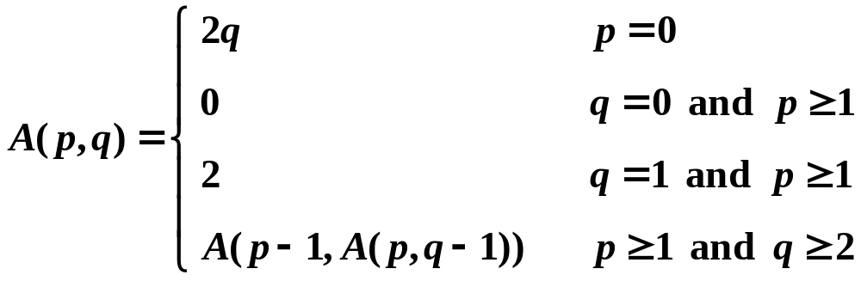
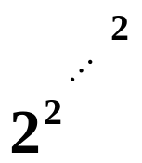
§10 Set Representation
5. Analysis
【Lemma (Tarjan)】Let T( m, n ) be the maximum time required to process an intermixed sequence of m ≥ n finds and n − 1 unions. Then:
k₁m α ( m, n ) ≤ T( m, n ) ≤ k₂m α ( m, n )
for some positive constants k₁ and k₂ .
?
?
In the equivalence classes example, we
need to perform 2 finds and at most 1 union
to process each pair. Hence T_{p} = O(m α ( 2m, n )),
and S = O( n ) only.
 Ackermann’s Function and α ( m, n )
Misprints on
p.245
HW:
p.247 #1
≤ 3 for m ≠ 0
and log₂ n < A(3, 4) = ?
65,536 twos

Slide 13
§11 Counting Binary Trees
1. Distinct Binary Trees: How many distinct binary trees are there with n nodes?
n = 0 ⇒ ( ); n = 1 ⇒ ( ); n = 2 ⇒ ( ); n = 3 ⇒ ( ); ⋅⋅⋅
1
1
2
5
2. Stack Permutations
Given a preorder sequence, e.g., ABCDEFGHI, the corresponding binary trees are not unique.
If the corresponding inorder sequence is given as well, e.g., BCAEDGHFI, then can we uniquely define a binary tree?
Yes.
Fix a preorder sequence
1, 2, 3, ..., n
The number of distinct
binary trees is
the number of distinct
inorder permutations.
A
Misprint on
p.250
BC
B
EDGHFI
D
C
E
F
GHFI
GH
I
G
H

Slide 14

§11 Counting Binary Trees
Inorder permutation is also equivalent to passing the numbers 1 to n through a stack and deleting in all possible ways.
〖Example〗 Given the preorder sequence 1, 2, 3.
1
1
2
1
1
2
3
2
3
1
3
2
2
1
2
3
1
2
3
3
3
4
1
1
2
2
1
3
2
2
3
1
3
2
1
3
2
3
1
3
5
1
Note: It is impossible to obtain 3, 1, 2
3
2
3
2
1
2
1
1
3
3
2

Slide 15

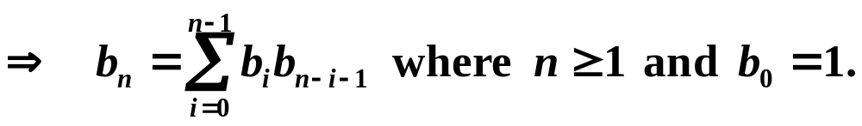

§11 Counting Binary Trees
3. Matrix Multiplication: M₁⋅ M₂⋅ ⋅ ⋅ ⋅ M_{n}
Let b_{n} = number of different ways to compute M₁⋅ M₂⋅ ⋅ ⋅ ⋅ M_{n}. Then we have b₂ = 1, b₃ = 2, b₄ = 5, ⋅ ⋅ ⋅
Let M_{ij} = M_{i}⋅ ⋅ ⋅ ⋅ M_{j} . Then M_{1n} = M₁⋅ ⋅ ⋅ ⋅ M_{n} = M_{1i} ⋅ M_{i+1 n}
b_{n}
b_{i}
b_{n−i}
Note: If we let b_{n} = number of distinct binary trees with n nodes, then similarly we have
BT = root + subtree with i nodes + subtree with n−i −1 nodes
b_{n}
b_{i}
b_{n−i−1}
The above 3 problems are equivalent

Slide 16
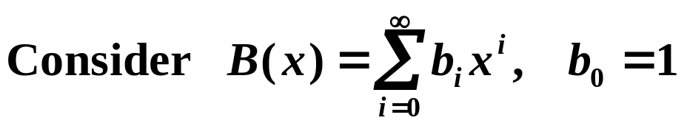
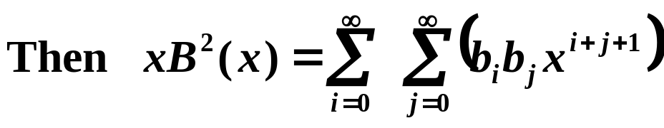
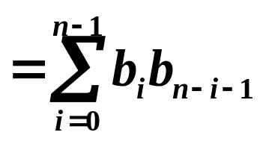
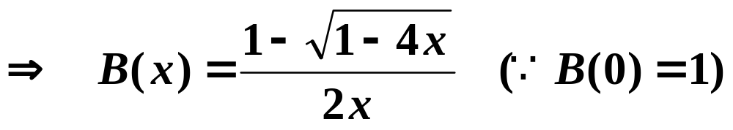
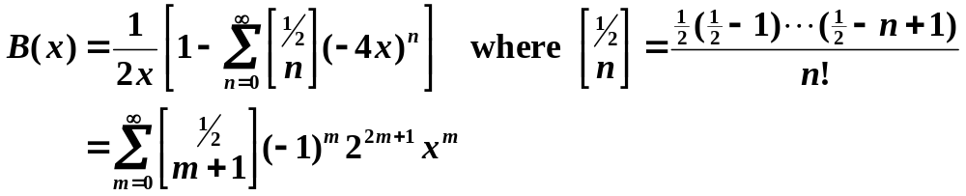
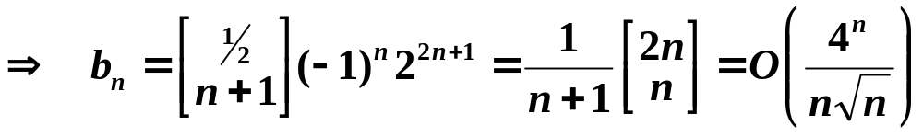
§11 Counting Binary Trees
4. Number of Distinct Binary Trees: b_{n} = ?
HW:
p.254 #5,
5.13 #1
The coefficient of x^{n} in xB²( x )
The coefficient of x^{n} in B( x ) = b_{n}
∴ xB²( x ) = B( x ) − 1

