Slide 1
§2 Elementary graph Operations
3. Connected Components
(1) Is the graph connected?
➢ Call dfs(0) or bfs(0) —— O( e )
➢ Check if there is any vertices missing —— O( n )
T_{p} = O( n + e )
(2) List the connected components of G
void connected ( void )
{ /* determine the connected components of a graph */
int i ;
for ( i = 0; i < n; i++ )
if ( !visited[ i ] ) {
dfs ( i ) ; /* bfs can be used with no change in T_{p} */
printf ( “\n” );
} /* end if */
}
O( n )
O( e_{i1} + e_{i2} + ... ) = O( e )
T_{p} = O( n + e )

Slide 2
§2 Elementary graph Operations
4. Spanning Tree —— a tree which consists of V( G ) and a subset of E( G )
〖Example〗 A complete graph and three of its spanning trees
【Remarks】
① E( G ) = T + N where T is for tree edges and N for non-tree edges.
② T consists of the edges traversed by the search program. We can add a piece of code to collect these edges into a linked list T.

Slide 3
§2 Elementary graph Operations
【Remarks】
0
1
0
1
③ dfs and bfs give different spanning trees.
④ Adding an edge in N to a spanning tree, we obtain a cycle.
2
3
2
3
⑤ If we introduce the edges in N into the spanning tree one at a time, then we obtain a cycle basis —— that is, all the cycles are independent, and all other cycles in G can be constructed as a linear combination of the cycles in the basis.
⑥ A spanning tree is a minimal subgraph. That is, G’ ⊂ G such that V( G’ ) = V( G ), G’ is connected, and E( G’ ) is minimal.
 G is connected ⇒ e ≥ n − 1,
and G is connected and e = n − 1 ⇒ G is a tree.
∴ e = n − 1 for a spanning tree.

Slide 4
§2 Elementary graph Operations
5. Biconnected Components and Articulation Points
 v is an articulation point if G’ = DeleteVertex( G, v ) has at least 2 connected components.


 G is a biconnected graph if G is connected and has no articulation points.
Biconnected
graph
Articulation
point

 A biconnected component is a maximal biconnected subgraph.


〖Example〗
0
8
9
0
8
9
1
7
7
1
7
1
7
Note: No edges can be shared by two or more biconnected components. Hence E(G) is partitioned by the biconnected components of G.
2
3
5
2
3
3
5
5
4
6
4
6
Connected graph
Biconnected components

Slide 5
§2 Elementary graph Operations
Finding the biconnected components of a connected undirected G
➢ Use depth first search to obtain a spanning tree of G
dfs ( 3 )
Depth first spanning tree
0
0
4
9
8
9
8
Back edges
::= (u, v) in N
and u (or v) is
an ancestor of
v (or u).
3
3
Depth first
number (dfn)
1
7
4
1
5
5
Note: If u is an ancestor of v, then dfn( u ) < dfn( v ).
7
2
0
5
2
3
5
2
2
6
6
4
6
1
3
7
7
1
6
0
4
8
9
8
9
➢ Find the articulation points in G
 The root is an articulation point iff it has at least 2 children
 Any other vertex u is an articulation point iff u has at least 1 child, and it is impossible to move down at least 1 step and then jump up to u’s ancestor.

Slide 6
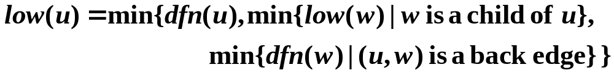
§2 Elementary graph Operations
0
3
4
1
5
5
vertex
0
1
2
3
4
5
6
7
8
9
2
2
6
6
dfn
4
3
2
0
1
5
6
7
9
8
low
4
0
0
0
0
5
5
5
9
8
1
3
7
7
Therefore, u is an articulation point iff
(1) u is the root and has at least 2 children; or
(2) u is not the root, and has at least 1 child such that low( child ) ≥ dfn( u ).
Misprint on
p.281
Misprint on
p.281
0
4
8
9
8
9
void init ( void )
{ int i ;
for ( i = 0; i < n; i++ )
dfn[ i ] = low[ i ] = −1 ;
num = 0 ;
}
#define MIN2 ( x, y ) ( (x) < (y) ? (x) : (y) )
short int dfn [ MAX_VERTICES ] ;
short int low [ MAX_VERTICES ] ;
int num ;

Slide 7
§2 Elementary graph Operations
void dfnlow ( int u, int v )
{ /* compute dfn and low while performing a dfs search
beginning at vertex u, v is the parent of u (if u is the root,
then v = −1) */
node_ptr ptr ;
int w ;
dfn[ u ] = low[ u ] = num++ ;
for ( ptr = graph[ u ]; ptr; ptr = ptr->next ) {
w = ptr->vertex ;
if ( dfn[ w ] < 0 ) { /* if w has not been visited */
dfnlow( w, u ) ; /* continue dfs */
low[ u ] = MIN2( low[ u ], low[ w ] ); /* min{dfn(u), low(child)} */
} /* end if */
else if ( w != v ) /* else if w is not u’s parent */
low[ u ] = MIN2( low[ u ], dfn[ w ] ); /* (u, w) is a back edge */
} /* end for-loop */
}

Slide 8
§2 Elementary graph Operations
➢ Find the biconnected components of G
If low[ w ] ≥ dfn[ u ], then u is an articulation point, and u must be the last vertex of a biconnected component.
void bicon ( int u, int v )
{ /* compute dfn and low, and output the edges of G by their
biconnected components, v is the parent (if any) of the u
(if any) in the resulting spanning tree. It is assumed that all
entries of dfn[ ] have been initialized to −1, num has been
initialized to 0, and the stack has been set to empty */
node_ptr ptr ;
int w, x, y ;
dfn[ u ] = low[ u ] = num++;
for ( ptr = graph[ u ]; ptr; ptr = ptr->next ) {
w = ptr->vertex ;
if ( v != w && dfn[ w ] < dfn[ u ] ) /* w is u’s ancestor or −1 */
push( &top, u, w ); /* push edge to stack */
if ( dfn[ w ] < 0 ) { /* w has not been visited */
bicon ( w, u ) ; /* continue bfs */

Slide 9
§2 Elementary graph Operations
low[ u ] = MIN2( low[ u ], low[ w ] ) ;
if ( low[ w ] >= dfn[ u ] ) {
/* u is the last vertex of a biconnected component */
printf( “New biconnected component: “ ) ;
do { /* pop edge from stack */
pop( &top, &x, &y ) ;
printf( “ <%d, %d>”, x, y ) ;
} while ( !( (x == u) && (y == w) ) ) ;
printf( “\n” ) ;
} /* end if */
} /* end if ( dfn[w] < 0 ) */
else if ( w != v ) low[ u ] = MIN2( low[ u ], dfn[ w ] );
} /* end for-loop */
}
T_{p} = O( n + e )
Note: bicon does not consider the case where G has only one vertex and no edge.

Slide 10
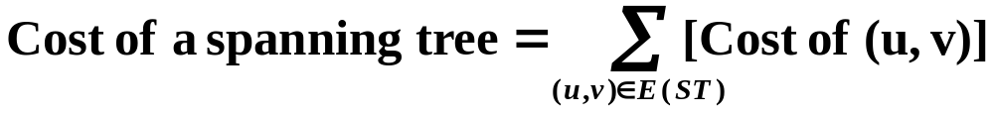

§3 Minimum Cost Spanning Trees
HW:
Self-study
Prim’s algorithm
& Sollin’s algorithm
Greedy Method
Make the best decision for each stage, under the following constrains :
(1) we must use only edges within the graph
(2) we must use exactly n−1 edges
(3) we may not use edges that would produce a cycle.
Kruskal’s Algorithm
T = { } ;
while (T contains less than n−1 edges && E is not empty) {
choose a least cost edge (v, w) from E ;
delete (v, w) from E ;
if ((v, w) does not create a cycle in T) add (v, w) to T ;
else discard (v, w) ;
}
if (T contains fewer than n−1 edges)
printf ( “No spanning tree\n” ) ;

Slide 11


Laboratory Project 4
( p. 292 #6 Due:12-13, Friday)
Project Report #4
1. Problem Description (3 pts.)
2. Algorithm Specification (9 pts.)
3. Program (25 pts.)
4. Test Records (7 pts.)
5. Analysis and Comments (3 pts.)
How to debug C code --
If it doesn't work, re-write it in assembler.
This won't fix the bug, but it will
make sure no one else finds it
and makes you look bad.
Don’t forget to sign
you group ID, names
and duties at the end of
your report.
Note:
➢ The program must be sufficiently commented.
➢ Please hand in your *.exe file.
➢ 3 points for the overall style of documentation.

Slide 12
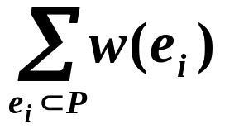

§4 Shortest Paths and Transitive Closure
Given a digraph G = ( V, E ), and a weighting function w( e ) > 0 for e ∈ E( G ). The length of a path P from source to destination is
1. Single Source All Destinations
Given a source v₀. Determine a shortest path to each v ∈V(G) \ { v₀ }.
45
Path
Length
non-decreasing
50
10
v₀
v₁
v₄
1) v0 v2
10
2) v0 v2 v3
25
20
10
15
35
3) v0 v2 v3 v1
45
20
30
4) v0 v4
45
v₂
15
v₃
3
v₅
Note: A path with minimal number of vertices is NOT necessarily the shortest.

Slide 13


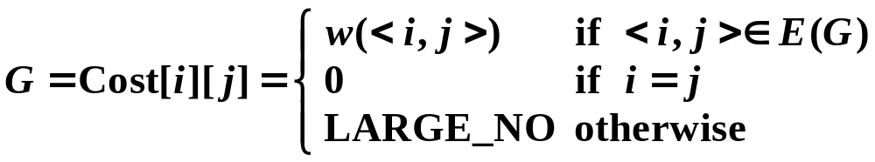
§4 Shortest Paths & Transitive Closure
Let S = { v₀ and v_{i}’s whose shortest paths have been found }
For any u ∉ S, define distance [ u ] = minimal length of path { v₀ → ( v_{i} ∈ S ) → u }. If the paths are generated in non-decreasing order, then
① the shortest path must go through ONLY v_{i} ∈ S ;
② u is chosen so that distance[ u ] = min{ w∉S | distance[ w ] } (If u is not unique, then we may select any of them) ;
Why? If it is not true, then
there must be a vertex w on this path
that is not in S. Then ...
③ if distance [ u₁ ] < distance [ u₂ ] and we add u₁ into S, then distance [ u₂ ] may change. If so, a shorter path from v₀ to u₂ must go through u₁ and distance’ [ u₂ ] = distance [ u₁ ] + length(< u₁, u₂>).
Implementation
Note:
LARGE_NO must be greater than max{w(e_{i})}, and max{distance[i]} +
LARGE_NO won’t overflow.
{ v_{i} } = { 0, 1, ..., n−1 }

Slide 14
§4 Shortest Paths & Transitive Closure
void shortestpath ( int v, int cost [ ] [ MAX_VERTICES ],
int distance [ ], int n, short int found [ ] )
{ int i, u, w ;
for ( i = 0; i < n; i++ ) { /* initialization */
found [ i ] = FALSE ;
distance [ i ] = cost [ v ] [ i ] ;
} /* end for-loop */
found [ v ] = TRUE ;
distance [ v ] = 0 ;
for ( i = 0; i < n−2; i++ ) {
u = choose ( distance, n, found ) ; /* O( n ) */
/* find the min distance not yet checked. Program 6.11 on p.296 */
found [ u ] = TRUE ;
for ( w = 0; w < n; w++ )
if ( !found [ w ] )
if ( distance [ u ] + cost [ u ] [ w ] < distance [ w ] )
/* if adding u into S makes distance[w] shorter */
distance [ w ] = distance [ u ] + cost [ u ] [ w ] ;
} /* end for-loop */
}
HW:
p.302 #4
T_{p} = O( n² )

