Slide 1

§4 Shortest Paths & Transitive Closure
2. All Pairs Shortest Paths
For all pairs of v_{i} and v_{j} ( i ≠ j ), find the shortest path between.
Method 1 Use shortestpath for all v ∈ V( G ). T_{p} = O( n³ ).
Method 2 Define
A^{k}[ i ] [ j ] = min{ length of path i → { l ≤ k } → j }
and A⁻¹[ i ] [ j ] = Cost [ i ] [ j ]. Then the length of the shortest path from i to j is
A^{n−1}[ i ] [ j ].
Algorithm
Start from A⁻¹ and successively generate A⁰, A¹, ..., A^{n−1}. If A^{k−1} is done, then either
① k ∉ the shortest path i → { l ≤ k } → j ⇒ A^{k} = A^{k−1} ; or
② k ∈ the shortest path i → { l ≤ k } → j
= { the S.P. from i to k } ∪ {the S.P. from k to j }
⇒ A^{k} [ i ] [ j ] = A^{k−1}[ i ] [ k ] + A^{k−1}[ k ] [ j ]

Slide 2
§4 Shortest Paths & Transitive Closure
void allcosts ( int cost [ ] [ MAX_VERTICES ],
int distance [ ] [ MAX_VERTICES ], int n )
{ /* determine the distances from each vertex to every other
vertex, cost is the adjacency matrix, distance is the matrix
A^k and A^k will over-write A^(k−1) */
int i, j, k ;
for ( i = 0; i < n; i++ )
for ( j = 0; j < n; j++ )
distance [ i ] [ j ] = cost [ i ] [ j ] ; /* initialize A^(−1) */
for ( k = 0; k < n; k++ )
for ( i = 0; i < n; i++ )
for ( j = 0; j < n; j++ )
if ( distance [ i ] [ k ] + distance [ k ] [ j ] < distance [ i ] [ j ] )
distance [ i ] [ j ] = distance [ i ] [ k ] + distance [ k ] [ j ];
}
HW:
p.303 #8
T_{p} = O( n³ ) but with a smaller constant factor.

Slide 3
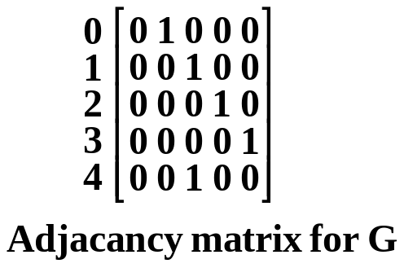
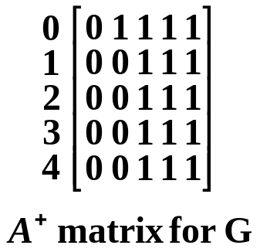
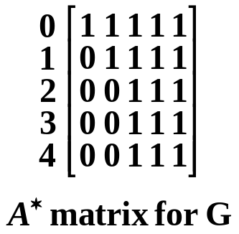

§4 Shortest Paths & Transitive Closure
3. Transitive Closure
Given a directed graph G with unweighted edges. We want to determine if there is a path from i to j for all values of i and j.
【Definition】The transitive closure matrix, denoted A⁺, of a directed graph, G, is a matrix such that A⁺[ i ] [ j ] = 1 if there is a path of length > 0 from i to j ; otherwise A⁺[ i ] [ j ] = 0.
Misprint on
p.301
【Definition】The reflexive transitive closure matrix, denoted A∗, of a directed graph, G, is a matrix such that A∗[ i ] [ j ] = 1 if there is a path of length ≥ 0 from i to j ; otherwise A∗[ i ] [ j ] = 0.
0
1
2
3
4
Note: A⁺ and A∗ may be different only when i = j .
A slight modification of allcosts can give A⁺ and A∗ (p.301).

Slide 4


§5 Activity Networks
1. Activity On Vertex ( AOV ) Networks
〖Example〗 Courses needed for a computer science degree at a hypothetical university
How shall we convert this list
into a graph?

Slide 5
§5 Activity Networks
 AOV Network ::= digraph G in which V( G ) represents activities ( e.g. the courses ) and E( G ) represents precedence relations ( e.g. means that C1 is a prerequisite course of C3 ).
C1
C3
 i is a predecessor of j ::= there is a path from i to j
i is an immediate predecessor of j ::= < i, j > ∈ E( G )
Then j is called a successor ( immediate successor ) of i
 Partial order ::= a precedence relation which is both transitive ( i → k, k → j ⇒ i → j ) and irreflexive ( i → i is impossible ).
Note: If the precedence relation is reflexive, then there must be an i such that i is a predecessor of i. That is, i must be done before i is started. Therefore if a project is feasible, it must be irreflexive.
Feasible AOV network must be a dag (directed acyclic graph).

Slide 6
§5 Activity Networks
【Definition】A topological order is a linear ordering of the vertices of a graph such that, for any two vertices, i, j, if i is a predecessor of j in the network then i precedes j in the linear ordering.
Note: The topological orders may not be unique for a network. For example, there are several ways (topological orders) to meet the degree requirements in computer science.
Goal
Test an AOV for feasibility, and generate a topological order if possible.
Algorithm
for ( i = 0; i < n; i++ ) {
if every vertex has a predecessor {
fprintf(stderr, “Network has a cycle.\n” );
exit( 1 ) ; }
pick a vertex v that has no predecessors ;
output v ;
delete v and all edges leading out of v from the network ;
}

Slide 7
§5 Activity Networks
Implementation
Declarations
typedef struct node *node_ptr ;
typedef struct node {
int vertex ;
node_ptr next ;
} ;
typedef struct {
int count ; /* number of immediate predecessors */
/* when v is deleted, count− − for all nodes on v’s list */
node_ptr next ; /* points to the first node on adjacency list */
} hdnodes ;
hdnodes graph [ MAX_VERTICES ] ;
Program for topological sort, topsort,
can be found on p.308
HW:
p.315 #1

Slide 8
§5 Activity Networks
2. AOE ( Activity On Edge ) Networks
—— scheduling a project
a_{i} ::= activity
Signals the completion of a_{i}
v_{j}
 early( i ) \ late( i ) ::= the earliest \ latest start time for the activity a_{i}
 earliest[ j ] \ latest[ j ] ::= the earliest \ latest time the event v_{j} can occur
Techniques
A CPM notation:
 PERT ( Performance Evaluation & Review Technique )
Index of vertex
Earliest
Start Time
 CPM ( Critical Path Method )
Lasting Time
 RAMPS ( Resource Allocation & Multiproject Scheduling )
Slack Time
Latest
Start Time

Slide 9
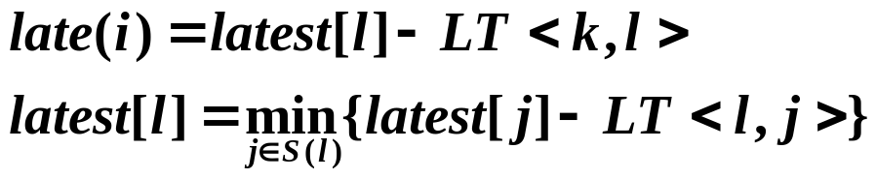
§5 Activity Networks
〖Example〗 AOE network of a hypothetical project
6
16
a0=6
1
a3=1
6
0
6
a6=9
16
a9=2
start
0
7
0
4
a1=4
7
8
18
2
a7=7
a10=4
finish
4
a4=1
14
18
2
7
HW:
p.315 #2
6
2
a2=5
14
a11=0
a8=4
5
7
3
3
a5=2
5
5
7
Dummy activity
➢ Calculation of EST: Start from v0, for any a_{i} = <k, l>, we have
➢ Calculation of LST: Start from the last vertex v8, for any a_{i} = <k, l>, we have
Immediate predecessors of k
➢ Slack Time of <i, j> =
➢ Critical Path ::= { v_{i} | earliest [ i ] = latest [ i ] }
Critical Activity ::= {a_{i} | early ( i ) = late ( i ) }
Implementation:
Modify topsort

