Slide 1

The point of this section
is to show you
how important sorting is.
CHAPTER 7
SORTING
§1 Searching and List Verification
❖ Sequential Search
#define MAX_SIZE 1000 /* maximum size of list + 1 */
typedef struct {
int key ;
/* other field */
} element ;
element list [ MAX_SIZE ] ;
int seqsearch ( int list [ ], int searchnum, int n )
{ int i ;
list [ n ] = searchnum;
for ( i = 0; list [ i ] != searchnum; i++ ) ;
return ( ( i < n ) ? i : −1);
}
T_{p} = O( n )

Slide 2
§1 Searching & List Verification
❖ Binary Search
int binsearch ( element list [ ], int searchnum, int n )
{ /* search list [ 0 ] ≤ list [ 1 ] ≤ ⋅⋅⋅ ≤ list [ n − 1 ] */
int left = 0, right = n − 1, middle ;
while ( left <= right ) {
middle = ( left + right ) / 2 ;
switch ( COMPARE( list [ middle ].key, searchnum ) ) {
case −1: left = middle + 1 ;
break ;
case 0: return middle ;
case 1: right = middle − 1 ;
} /* end switch */
} /* end while-loop */
return −1 ;
}
T_{p} = O( log n ) provided that the list is sorted.

Slide 3
§1 Searching & List Verification
❖ Decision Tree for Binary Search
〖Example〗
[0]
[1]
[2]
[3]
[4]
[5]
[6]
[7]
[8]
[9]
[10]
[11]
4
15
17
26
30
46
48
56
58
82
90
95
middle = 5
[5]
46
≤
≥
[2]
[8]
17
58
[0]
[3]
[6]
[10]
4
26
48
90
[1]
[4]
[7]
[9]
[11]
15
30
56
82
95
From the depth of the tree, we can easily see that binsearch makes no more than O( log n ) comparisons.
HW:
p.324 #3

Slide 4
§1 Searching & List Verification
❖ List Verification —— Are the two given lists identical?
void verify1 ( element list1[ ], element list2[ ], int n, int m )
{ /* compare two unordered lists list1 and list2 */
int i, j ;
int marked [ MAX_SIZE ] ;
/* mark index of the element in list2 that is also in list1 */
for ( i = 0; i < m; i++ )
marked [ i ] = FALSE; /* initialization */
for ( i = 0; i < n; i++ )
if ( ( j = seqsearch ( list2, m, list1[ i ].key ) ) < 0 )
printf("%d is not in list2 \n", list1[ i ].key);
else /* if list1[ i ].key is found in list2 */
/* then check each of the other fields from list1[ i ] and
list2[ j ], and print out any discrepancies */
marked[ j ] = TRUE; /* successfully matched */
for ( i = 0; i < m; i++ )
if ( !marked[ i ] )
printf("%d is not in list1\n", list2[ i ].key);
}
O( m )
T_{p} = O( mn )

Slide 5
§1 Searching & List Verification
void verify2( element list1[ ], element list2[ ], int n, int m)
{ /* same task as verify1, but list1 and list2 are sorted first */
int i, j ;
sort(list1, n); sort(list2, m);
i = j = 0;
while ( i < n && j < m )
if ( list1[ i ].key < list2[ j ].key ) {
printf("%d is not in list2\n", list1[ i ].key);
i++; } /* end if */
else if ( list1[ i ].key == list2[ j ].key ) {
/* compare list1[ i ] and list2[ j ] on each of the other
fields and report any discrepancies */
i++; j++; } /* end else-if */
else {
printf("%d is not in list1\n",list2[ j ].key);
j++; } /* end else-else */
for ( ; i < n; i++ )
printf("&d is not in list2\n", list1[ i ].key );
for ( ; j < m; j++ )
printf("&d is not in list1\n", list2[ j ].key );
}
T_{p} = O( max( m log m, n log n )
Can be done in
O( n log n ) time.

Slide 6
§2 Definitions
 Problem Description:
Given a list of records ( R₀, R₁, ⋅⋅⋅, R_{n−1} ) where each R_{i} has a key value K_{i}. There is a transitive ordering relation “<” on the keys such that for any two key values K_{i} and K_{j}, either K_{i} = K_{j} or K_{i} < K_{j} or K_{j} < K_{i}. Sorting is to find a permutation σ such that K_{σ(i−1)} ≤ K_{σ(i)} for all 0 < i ≤ n−1. The desired ordering is then
( R_{σ(0)}, R_{σ(1)}, ⋅⋅⋅, R_{σ(n−1)} ) .
 Remarks:
① No single sorting technique is the best in all cases.
② If there are identical key values, then σ is not unique.
③ If σ_{s} is a permutation which is not only sorted, but also stable — that is, if K_{i} = K_{j} for i < j, then R_{i} precedes R_{j} in the sorted list — then such a σ_{s} is unique.
④ A sorting method is stable if it generates σ_{s} .
⑤ An internal sort is to sort the list entirely in main memory.
⑥ An external sort is to sort the file piece by piece in main memory.

Slide 7
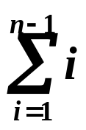
§3 Insertion Sort
void insertion_sort ( element list[ ], int n )
{ /* perform an insertion sort on the list */
int i, j ;
element next ;
for ( i = 1; i < n; i++ ) {
next = list[ i ] ; /* the next coming card */
for ( j = i − 1; j >= 0 && next.key < list[ j ].key ; j − − )
list [ j + 1] = list [ j ] ;
/* shift sorted cards to provide a position
for the new coming card */
list [ j +1] = next ;
/* place the new card at the proper position */
} /* end for-i-loop */
}
The pivot key is placed
at the right position with respect to
the sorted sub-list.
Worst case T_{p} = O( ? )
= O( n² )

Slide 8
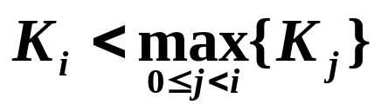
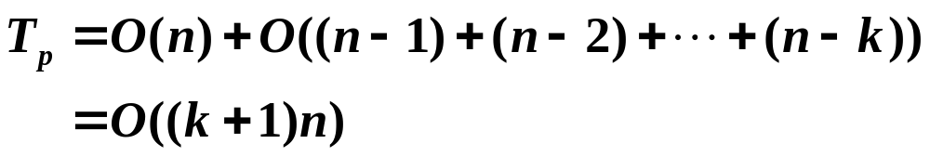
§3 Insertion Sort
❖ A record R_{i} is LOO ( Left Out of Order ) ⇔
❖ If there are k records that are LOO, then the worst case
Good for k << n
and n is not too large.
If k = n, T_{p} = O( n² ).
Average T_{p} = O( n² ).
❖ Variations:
☞ Replace the sequential search by the binary search.
Now insertion becomes simple,
but we have to use
the sequential search.
Search faster but still
have to move the records.
☞ Use linked list for representation.
HW: p.329 #1
(Use a pointer to a function as
a parameter in a function)

Slide 9
Sartaj K. Sahni
Data Structures, Algorithms and Applications in C++
sahni@cise.ufl.edu

