Slide 1


§11 External Sorting
1. Introduction
Problem: The file to be sorted is too LARGE to be contained in the internal memory.
Solution: Perform merge sort on external storage devices (e.g. a disk or a tape).
Step 1: Sort the segments of the input file by an internal sort method.
Step 2: Merge sort these sorted segments which have been written onto external storage in Step 1.

Slide 2
§11 External Sorting
Terminology
☞ Seek time ::= time taken to position the read/write head to the correct track of the disk.
☞ Latency time ::= time until the right sector of the track is under the read/write head.
Depend on the # of tracks
which the head has to move across
☞ Transmission time ::= time to transmit the data to/from the disk.
☞ Block ::= unit of data that is read from or written to the disk at one time.
☞ Run ::= Sorted segment of the input file.

Slide 3
§11 External Sorting
〖Example〗 Sort a file containing 4500 records, using a computer with an internal memory capable of sorting at most 750 records.
The input file is maintained on a disk which is not to be written on, and has a block length of 250 records. Another disk is available as a scratch pad.
Input Disk
Step 1: Internally sort 3 blocks at a time (by heap sort or quick sort).
Scratch Disk
Run 1
Run 2
Run 3
Run 4
Run 5
Run 6
Step 2: Merge
Internal Memory
input buffers
output buffer
Scratch Disk
1 - 1500
1500 - 3000
3000 - 4500

Slide 4
§11 External Sorting
Analysis
• t_{s} ::= maximum seek time
 t_{l} ::= maximum latency time
 t_{rw} ::= time to read or write one block of 250 records
 t_{IO} ::= t_{s} + t_{l} + t_{rw}
 n t_{m} ::= time to merge n records from input buffers to the output buffer
 t_{IS} ::= time to internally sort 750 records
operation
time
Read 18 blocks of input
18 t_{IO}
Internal sort
6 t_{IS}
Write 18 blocks
18 t_{IO}
Merge runs 1 - 6 in pairs
36 t_{IO} + 4500 t_{m}
Merge two runs of 1500 records each
24 t_{IO} + 3000 t_{m}
Merge one run of 3000 records with one run of 1500 records
36 t_{IO} + 4500 t_{m}
Total time
132 t_{IO} + 12000 t_{m} + 6 t_{IS}

Slide 5
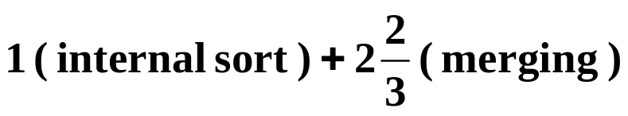
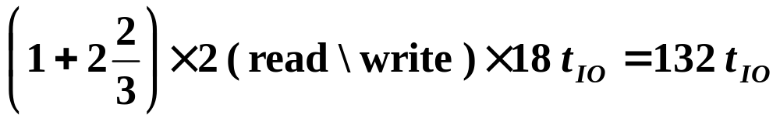
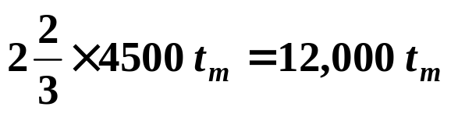


Total time:
132 t_{IO} + 12000 t_{m} + 6 t_{IS}
§11 External Sorting
Note:
1. Seek time can be reduced by writing consecutive blocks on the same track or on adjacent tracks —— it depends mainly on the number of passes.
Number of passes in Example =
Future analysis
will be concerned mainly with
counting the number of
passes
I\O time =
Merge time =
2. Computer can carry out I\O and CPU processing in parallel
Total time ≈ 132 t_{IO} ≈ 12,000 t_{m} + 6 t_{IS}
Given 2 disks, we can do reading, writing, and merging all at the same time. Therefore Total time ≈ 66 t_{IO}.
(1) reduction of the number of passes
(2) efficient utilization of program buffers so that I\O and
CPU processing is overlapped as much as possible
(3) run generation
(4) run merging
Targets

Slide 6


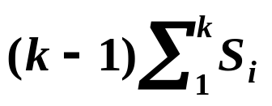



§11 External Sorting
2. k - way Merging
If we start with m runs, then the total number of passes in a 2-way merge will be ?
For a k-way merge, the number will be ?
Aha! So we can reduce
the number of passes
by using a high order merge.
Oh that is easy!
Oh yeah?
What is the point of
reducing the
number of passes?
All right, you win again.
I have to think it over ...
I\O is faster all right.
But will it really help merging?
Say, how can you determine
the next record to be output?
To merge k runs of size S₁, ......, S_{k}, we will have to make
O( ? ) Comparisons.
Uhhh... By making
k − 1 comparisons?
To speed up I\O and CPU
time needed for merging.
Right.
And how will it cost you?
The total number of comparisons is O( ? )
Therefore, as k increases, the reduction in I\O time will be offset by the increase of a factor ( k − 1) / log₂ k in CPU time needed to perform the k-way merge.
Shall we abandon this idea?
Wait a minute! How about the loser tree that we have learnt in Chapter 5?

Slide 7

§11 External Sorting
For large k ( ≥ 6 ), a k-way merge can be performed using a loser tree introduced in §5.8 with T_{p} = O( n log₂ k ). Therefore the internal processing time becomes O( n log₂ m ), which is independent of k.
k
# of input buffers
buffer size
Okay, then why don’t you
simply perform
an m-way merge?
Hey! So I WAS right!
seek & latency time
block size on disk
Beyond a certain k value, the I\O time would actually
increase despite the decrease in the number of passes being
made. The optimal value for k clearly depends on disk
parameters and the amount of internal memory available
for buffers.
Why not?
Q: How many I\O buffers are needed to perform parallel operations?

Slide 8

§11 External Sorting
3. Buffer Handling For Parallel Operation
2-way merge:
input buffers
output buffer
In general, for a k-way merge we need 2k input buffers and 2 output buffers for parallel operations.
〖Example〗 Use 2-way merge in the following situation:
Run 1
01 03
05 07
08 09
10 12
……
The output problem can be solved.
But for the inputs, can we simply
assign 2 buffers to each run?
Run 2
02 04
06 15
20 25
30 32
……
in[1]
in[3]
out[1]
Internal Memory
For Run 1
01 03
08 09
05 07
01 02
05 06
09
02 04
20 25
06 15
03 04
For Run 2
07 08
in[2]
in[4]
out[2]
All records from Run 1
get exhausted before
out[1] gets full.
Scratch Disk
01 02
03 04
05 06
07 ...
Q: If we cannot assign 2 buffers per run, then what can we do with 2k input buffers?

Slide 9
§11 External Sorting
Assumptions on parallel processing capabilities:
(1) We have 2 disk drives and it is possible to simultaneously read
from one disk and write onto the other.
(2) While data transmission is taking place between an input/
output device and a block of memory, the CPU cannot make
references to that same block of memory.
(3) To simplify the discussion, we assume that input and output
buffers are to be the same size.
Assumptions on implementation:
(1) Input buffers are queued in k queues, one queue for each run.
(2) Each I\O buffer can hold one block of records.
(3) Empty buffers are placed on a linked stack.
(4) The end of each run has a sentinel record with a key = +∞.

Slide 10
§11 External Sorting
Algorithm
Step 1: initialize k linked queues by the first block of each of the k runs;
keep the rest of k input buffers into a linked stack;
set ou = 0.
Step 2: lastkey[i] ::= the last key input from run i.
nextrun ::= the run for which lastkey is minimum.
if ( lastkey[ nextrun ] != +∞ )
initiate reading the next block from run nextrun.
Step 3: kwaymerge ::= a function that merges records from the k queues into out[ou].
do { kwaymerge ;
} while !((out[ou] is full) || (+∞ is merged into out[ou]))

Slide 11
§11 External Sorting
Step 3 (continued):
In kwaymerge:
if ( one in buffer is empty )
if !((out[ou] is full) || (+∞ is merged into out[ou]))
link that in buffer to the stack and advance
to the next buffer on the same queue;
else
break;
?
Step 4: wait for any ongoing disk I\O to complete.
Step 5: if ( an in buffer has been read )
push it to the queue for the appropriate run;
determine nextrun;
Step 6: if ( lastkey[nextrun] != +∞ )
initiate reading the next block from run nextrun into
a free in buffer on stack;
?

Slide 12
§11 External Sorting
Step 7: initiate writing out [ ou ]; set ou = 1 − ou;
Step 8: if ( +∞ has not been merged into out[ ] )
goto Step 3;
else
{ wait for the ongoing write to complete;
stop. }
HW:
Read Example 7.13
on p.383-384
【Theorem】The following is true for the above algorithm:
(1) In step 6, there is always a buffer available in which to begin reading the next block; and
(2) during the k-way merge of step 3, the next block in the queue has been read in by the time it is needed.
Over the entire sorting of a file, the only time that is
not overlapped with the internal merging time is the time
for the first k blocks of input and that for the last block of
output.

Slide 13


§11 External Sorting
4. Run Generation
Tool: Loser Tree —— assume that there is enough space in internal memory to construct a loser tree for k records, where k is the number of nodes in the tree.
To generate a run,
we simply sort one segment of file
at a time in the internal memory.
So what’s the point of
further discussion?
As large as the internal memory
can hold at one time.
What ...
Can you get a larger one?!
Not me.
Walters, Painter, and Zalk did it
—— not only to generate longer runs,
but also to allow parallel processing.
Idea: ① Find the winner in the first k records.
How large will
a run be?
② Adjust the tree into a loser tree.
③ Write out the winner and read in another record.
④ If the key of the new record is less than the key of the output record, then assign this new record to the next run; repeat step 2.
〖Example〗 k = 3
5
4
3
2
1
0
3
4
5
0
1
2
5
4
1
2
3
0
1
2
3
4
5
0
1
0
3
2
5
4
0
1
2
3
4
5
Program 7.21 is given on p.387-388. The average size of a run
generated is almost 2k, and Tp = O( n log k ).

Slide 14
§11 External Sorting
5. Optimal Merging of Runs
〖Example〗 Suppose we have 4 runs of length 2, 4, 5, and 15, respectively. How can we arrange the merging to obtain minimum merge times?
Total merge time = O ( the weighted external path length )
26
26
11
15
6
20
6
5
2
4
5
15
2
4
The cost of a 2-way merge of n runs of length q_{i} ( 1≤ i ≤ n ) is minimized by using a binary merge tree which has minimum weighted external path length. The idea can be easily generalized to the case k > 2.

Slide 15
§11 External Sorting
D. Huffman Algorithm:
void huffman ( tree_pointer heap[ ], int n )
{ consider the n external nodes as n single node binary trees,
and initialize them into a min heap;
for ( i = 1; i < n; i++ )
{ create a new node;
delete root from min heap and attach it to left_child of node;
delete root from min heap and attach it to right_child of node;
weight of node = sum of weights of its children;
insert node into min heap;
}
}
The Huffman function is given by
Program 7.23 on p.391.

Slide 16
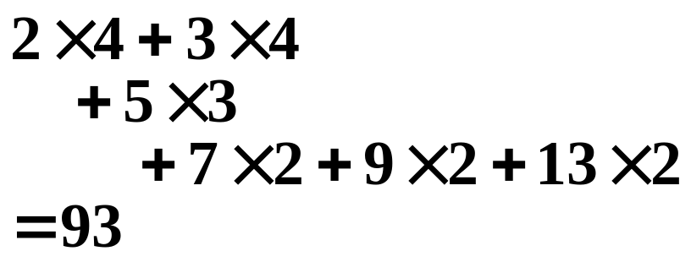
§11 External Sorting
〖Example〗 Suppose we have 6 runs of length 2, 3, 5, 7, 9 and 13. Construct the huffman tree.
2
5
3
5
7
5
9
7
10
39
9
13
16
The weighted external path length is
23
2
3
5
5
7
9
10
13
16
23
2
3
5
5
7
9
10
13
2
3
5
5
T_{p} = O( ? )
n log n
2
3

Slide 17
§11 External Sorting
An Application of Huffman Algorithm
—— Text Compression
What if the frequencies
of the four symbols are
( 996, 1, 2, 1 ) ?
〖Example〗 Suppose our text is a string of length 1000 that comprises the characters a, u, x, and z. Then it will take ? bits to store the string as 1000 one-byte characters.
8000
We may encode the symbols as a = 00, u = 10, x = 01, z = 11. For example, aaaxuaxz is encoded as 0000000110000111. Then the space taken by the string with length 1000 will be 2000 bits + space for code table.
Notice that we have only
4 distinct characters in that string.
Hence we need only
2 bits to identify them.
➢ frequency ::= number of occurrences of a symbol.
In string aaaxuaxz , f(a) = 4, f(u) = 1, f(x) = 2, f(z) = 1.
The size of the coded string can be reduced using variable-length codes, for example, a = 0, u = 110, x = 10, z = 111.
00010110010111

Slide 18
§11 External Sorting
Huffman codes ::= a class of variable-length codes that satisfy the prefix property.
The root to external node paths in an extended binary tree may be coded using 0 to represent a move to a left subtree, and 1 to represent a move to a right subtree.
Now, with
a = 0, u = 110, x = 10, z = 111
and the string 00010110010111,
can you decode it?
The answer is aaaxuaxz (with
a = 0, u = 110, x = 10, z = 111).
What makes this decoding method
work?
A = 000
B = 001
C = 01
D = 1
0
1
The trick is:
No code is a prefix of another.
D
0
1
C
0
1
A
B
weight = frequency or probability
Q: Given the frequencies of symbols, how can we obtain the optimal Huffman codes?
A: By constructing a Huffman tree.

