Slide 1
CHAPTER 9
HEAP STRUCTURES
§1 Min-Max Heaps
【Definition】A double-ended priority queue is a data structure that supports the following operations:
(1) Insert an element with arbitrary key.
(2) Delete an element with the largest key.
(3) Delete an element with the smallest key.
Max heap
Min heap
【Definition】A min-max heap is a complete binary tree such that if it is not empty, each element has a field called key. Alternating levels of this tree are min levels and max levels, respectively. The root is on a min level. Let x be any node in a min-max heap. If x is on a min level then the element in x has the minimum key from among all elements in the subtree with root x. We call this node a min node. Similarly, if x is on a max level then the element in x has the maximum key from among all elements in the subtree with root x. We call this node a max node.

Slide 2
§1 Min-Max Heaps
grandparent
〖Example〗
heap[0] = 5
grandparent
7
5
7
min
Find the
minimum
parent
70
40
80?
parent
80
max
30
9
10
parent
7
10
5?
40?
15
min
10
40
5?
45
50
30
20
12
40
80?
max
1. Insertion
〖Example〗 Insert the element with key 5
〖Example〗 Insert the element with key 80
The program min_max_insert is given by Program 9.1 on p.434.
T_{p} = O( height ) = O( ln n )
2. Deletion of Min Element ( the root )
The program delete_min is given by Program 9.3 on p.438.
T_{p} = O( height ) = O( ln n )

Slide 3
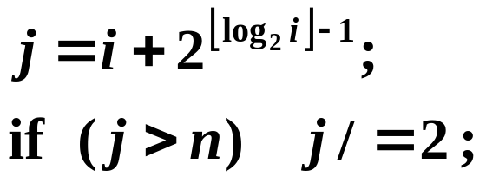
§2 Deaps
【Definition】A deap is a complete binary tree that is either empty or satisfies the following properties:
(1) The root contains no element.
(2) The left subtree is a min-heap.
(3) The right subtree is a max-heap.
(4) If the right subtree is not empty, then let i be any node in the left subtree. Let j be the corresponding node in the right subtree. If such a j does not exist, then let j be the node in the right subtree that corresponds to the parent of i. The key in node i is less than or equal to the key in j.
Faster than
min-max heap’s algorithms
by a constant factor and
its algorithms are simpler.
〖Example〗
5
45
10
8
25
40
15
19
9
30
20

Slide 4
§2 Deaps
deap[0]=4
5
4
5
45
4
5
40
10
40
42
10
8
25
40
4
10
40
19
19
40
15
19
9
30
20
25
42
40
max heap
min heap
max heap
min partner
1. Insertion
min partner
max partner
〖Example〗 Insert the element with key 4
< 19
〖Example〗 Insert the element with key 42
> 9
The program deap_insert is given by Program 9.4 on p.443.
T_{p} = O( height ) = O( ln n )
2. Deletion of Min Element ( the root of the min-heap )
The program deap_delete_min is given by Program 9.5 on p.444.
T_{p} = O( height ) = O( ln n )

