Slide 1


CHAPTER 10
SEARCH STRUCTURES
§1 Optimal Binary Search Trees
—— The best for static searching (without insertion and deletion)
An external (or failure) node
while
An internal node
if
do
if
do
while
if
It depends on how often we need
to search each of the identifiers.
do
Which one is
the best?
while
while
do
Extended
Binary
Trees
do
while
if
if

Slide 2
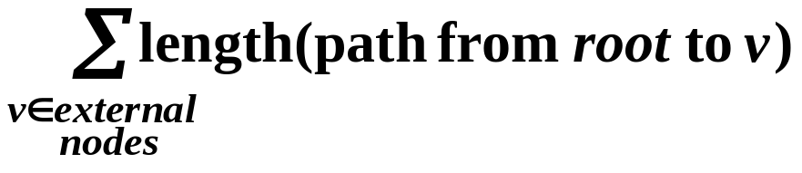
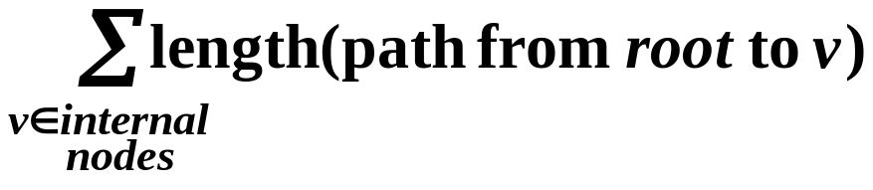
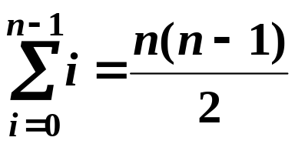
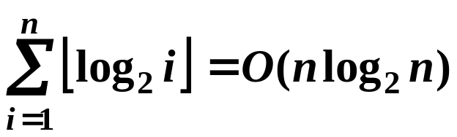
§1 Optimal Binary Search Trees
 External path length ::=
for
E = 2 + 2 + 2 + 3 + 4 + 4 = 17
do
while
I = 0 + 1 + 1 + 2 + 3 = 7
HW:
p.480 #1
void
if
E = I + 2n
 Internal path length ::=
That means that
when I gets larger,
E gets larger as well.
➢ Worst case ( ? ) I = ?
skewed
➢ Best case ( ? ) I = ?
complete

Slide 3
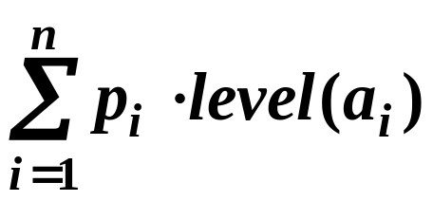
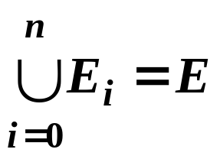
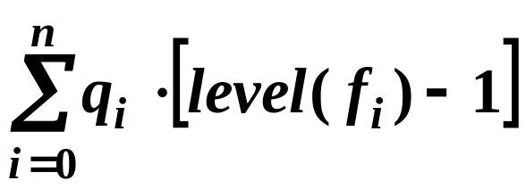
§1 Optimal Binary Search Trees
Given n identifiers a₁ < a₂ < …… < a_{n}, and the probability of searching for each a_{i} is p_{i} , then for the successful searches,
the cost of any binary search tree is
Notice that unsuccessful searches terminate at failure nodes.
E₀ < a₁ < E₁ < a₂ < …… < E_{n−1} < a_{n} < E_{n} where
and for all identifiers in some E_{i}, the search terminates at the same failure node f_{i} .
If q_{i} is the probability that the identifier we are searching for is in E_{i} , then the cost for the unsuccessful searches is

Slide 4
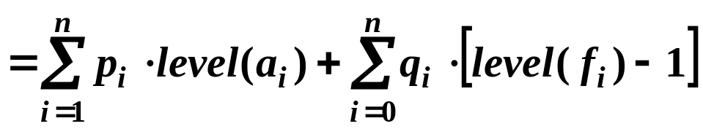
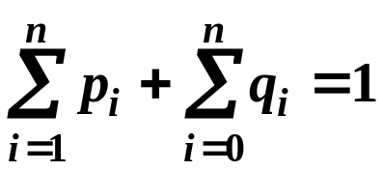


§1 Optimal Binary Search Trees
The total cost of a binary search tree
where
An optimal binary search tree for a set of identifiers is one that minimizes the cost over all possible binary search trees for this identifier set.
Please read Example 10.1 on p.474
Note: T_{p} for computing the cost of a binary
search tree is O( n ). But there are
O( 4^{n} / n^{3/2} ) distinct binary search trees
with n identifiers!

Slide 5
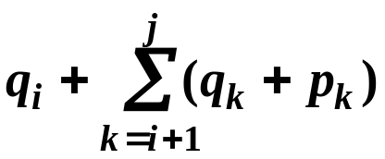

§1 Optimal Binary Search Trees
An algorithm with T_{p} = O( n² )
—— Can you believe it?
T_{i j} ::= OBST for a_{i+1} , ……, a_{j} ( i < j )
T_{0n} with root r_{0n},
weight w_{0n}, and
cost c_{0n} .
c_{i j} ::= cost of T_{i j} ( c_{i i} = 0 )
r_{i j} ::= root of T_{i j} ( r_{i i} = 0 )
T_{i i} ::= empty tree;
T_{i j} is NOT defined for i > j.
w_{i j} ::= weight of T_{i j} = ( w_{i i} = q_{i} )
E_{i} < a_{i+1} < …… < E_{j−1} < a_{j} < E_{j}
q_{i} p_{i+1} …… q_{j−1} p_{j} q_{j}
w_{i j}

Slide 6
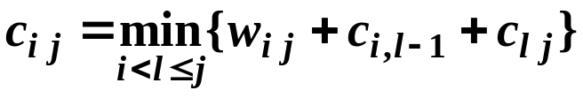

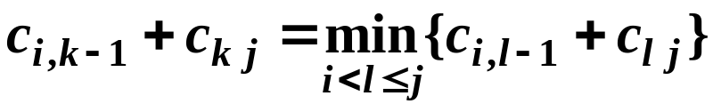
§1 Optimal Binary Search Trees
T_{i j}
a_{k}
L
a_{i+1}…a_{k−1}
R
a_{k+1}…a_{j}
The total cost of a binary search tree
c_{i j} = ?
p_{k} + cost( L ) + cost( R )
+ weight( L ) + weight( R )
= p_{k} + c_{i, k−1} + c_{k j} + w_{i, k−1} + w_{k j} = w_{i j} + c_{i, k−1} + c_{k j}
T_{i j} is optimal ⇒ r_{i j} = k is such that
Starting from T_{i i} = φ and c_{i i} = 0, we can obtain T_{on} and c_{0n} .

Slide 7

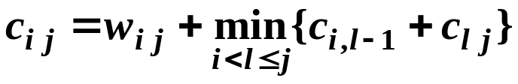
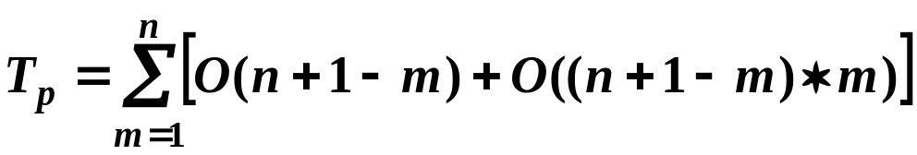


§1 Optimal Binary Search Trees
〖Example〗Let (a₁, a₂, a₃, a₄) = ( do, for, void, while ).
Let ( p₁, p₂, p₃, p₄) = (3, 3, 1, 1) /16
and ( q₀, q₁, q₂, q₃, q₄) = (2, 3, 1, 1, 1) /16
HW:
Read Program10.1
on p.479, and do
p.480 #2
w₀₀ = 2
c₀₀ = 0
r₀₀ = 0
w₁₁ = 3
c₁₁ = 0
r₁₁ = 0
w₂₂ = 1
c₂₂ = 0
r₂₂ = 0
w₃₃ = 1
c₃₃ = 0
r₃₃ = 0
w₄₄= 1
c₄₄ = 0
r₄₄ = 0
for
w₀₁ = 8
c₀₁ = 8
r₀₁ = 1
w₁₂ = 7
c₁₂ = 7
r₁₂ = 2
w₂₃ = 3
c₂₃ = 3
r₂₃ = 3
w₃₄ = 3
c₃₄ = 3
r₃₄ = 4
j − i =1
do
void
w₀₂ = 12
c₀₂ = 19
r₀₂ = 1
w₁₃ = 9
c₁₃ = 12
r₁₃ = 2
w₂₄ = 5
c₂₄ = 8
r₂₄ = 3
j − i =2
Let j − i = m , m = 1, ..., n
while
T _{Wij} = O( n + 1 − j + i )
w₀₃ = 14
c₀₃ = 25
r₀₃ = 2
w₁₄ = 11
c₁₄ = 19
r₁₄ = 2
j − i =3
T_{rij} = O( j − i )
w₀₄ = 16
c₀₄ = 32
r₀₄ = 2
D. E. Knuth: Find the optimal l in r_{i, j−1}≤ l ≤ r_{i+1, j} .
Then T_{p} = O( n² ).
j − i =4

