Slide 1

ALGORITHM-DESIGN METHODS
The Greedy Method
❖ Optimization Problems:
Given a set of constrains and an optimization function. Solutions that satisfy the constrains are called feasible solutions. A feasible solution for which the optimization function has the best possible value is called an optimal solution.
❖ The Greedy Method:
Make the best decision at each stage, under some greedy criterion. A decision made in one stage is not changed in a later stage, so each decision should assure feasibility.

Slide 2
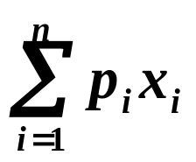
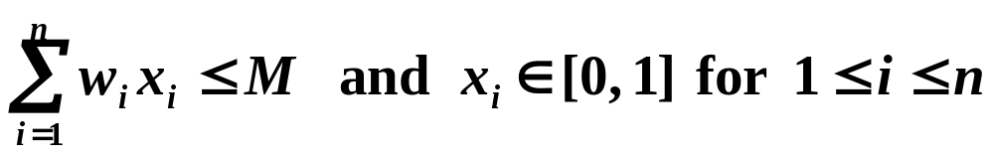

The Greedy Method
〖Example 1〗 Knapsack Problem
A knapsack with a capacity M is to be packed. Given n items. Each item i has a weight w_{i} and a profit p_{i} . If x_{i} is the percentage of the item i being packed, then the packed profit will be p_{i} x_{i} .
An optimal packing is a feasible one with maximum profit. That is, we are supposed to find the values of x_{i} such that
obtains its maximum under the constrains
n = 3, M = 20,
(p₁, p₂, p₃)
= (25, 24, 15)
(w₁, w₂, w₃)
= (18, 15, 10)
Q: What must we do in each stage?
A: Pack one item into the knapsack.
Q: On which criterion shall we be greedy?
① maximum profit
② minimum weight
③ maximum profit density p_{i} / w_{i}
( 0, 1, 1/2 )
P = 31.5

Slide 3

The Greedy Method
Note: The greedy algorithm does not guarantee optimal solutions. However, it generally produces solutions that are very close in value to the optimal, and hence is intuitively appealing when finding the optimal solution takes too much time.
〖Example 2〗 Chinese Mailman (Traveling Salesperson )
Given a map of the streets (a complete directed graph with weighted edges). We are supposed to find a tour — a cycle which consists of all the nodes — with minimal cost.
Result obtained by the greedy method:
1
10
1
2
① -> ② -> ③ -> ④ -> ① Cost = 28
20
1
2
Optimal result:
2
2
3
4
① -> ③ -> ④ -> ② -> ① Cost = 13
3
8
5
5
When the weights of edges don’t differ too much
from each other, the greedy method works pretty
well with time complexity of O( n² ) only.
4

Slide 4
The Greedy Method
Algorithms that do not guarantee optimal solutions but generally produce solutions that are close to optimal are called heuristics.
❖ Possible greedy heuristics for Chinese mailman problem:
➢ Choose different starting points
➢ Choose edges with minimal and second minimal weights alternately
➢ Choose an edge from a node randomly
➢ Find k solutions using a combination of the above heuristics. Then select the best tour from these k solutions. The total time complexity will be O( k n² )

Slide 5
Dynamic Programming
In the greedy method we make irrevocable decisions one at a time using a greedy criterion. If the optimal decision sequence cannot be determined by local information, then the greedy method may not be the proper tool.
Dynamic programming cannot be applied
when this principle does not hold.
In dynamic programming, we examine the decision sequence to see whether an optimal decision sequence contains optimal decision subsequences. If it does, then we can establish recurrence equations that enable us to solve the problem in an effective way.
Recurrence is set up according to the principle of optimality, which states that no matter what the first decision, the remaining decisions must be optimal with respect to the state that results from this first decision.

Slide 6
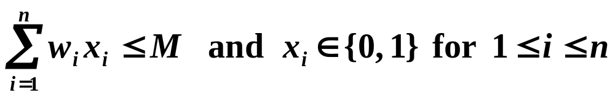
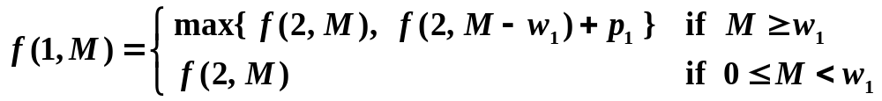
Dynamic Programming
〖Example 1〗 0/1 Knapsack Problem
A knapsack with a capacity M is to be packed. Given n items. Each item i has a weight w_{i} and a profit p_{i} .
An optimal packing is a feasible one with maximum profit. That is, we are supposed to find the values of x_{i} such that
obtains its maximum under the constrains
Optimal subsequences
Let f ( i, y ) denote the value of an optimal solution to the knapsack instance with remaining capacity y and remaining items i, i+1, ... , n. We need to find f ( 1, M ).
x₁ = 0 ⇒ f ( 2, M )
x₁ = 1 ⇒ f ( 2, M − w₁ )

Slide 7
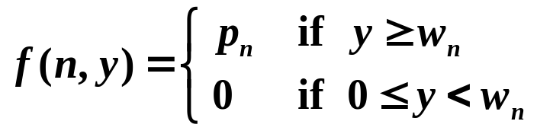
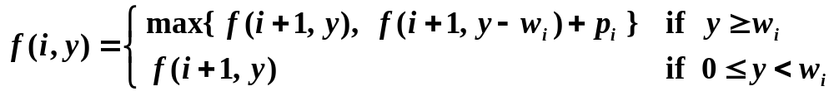

Dynamic Programming
Recurrence equations:
Note: It is very tempting to write a simple recursive
program to solve the dynamic-programming recurrence.
However, unless care is taken to avoid re-computing
previously computed values, the recursive program will
have prohibitive complexity.
There is a way to
run it in O( nM ).
Can you do it?
T_{recursive} = O( 2^{n} )

Slide 8

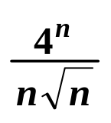
Dynamic Programming
〖Example 2〗 Matrix Multiplication Chains
Suppose we are to multiply 4 matrices
M_{1 [ 10×20 ]} ∗ M_{2 [ 20×50 ]} ∗ M_{3 [ 50×1 ]} ∗ M_{4 [ 1×100 ]} .
If we multiply in the order
M_{1 [ 10×20 ]} ∗ ( M_{2 [ 20×50 ]} ∗ ( M_{3 [ 50×1 ]} ∗ M_{4 [ 1×100 ]} ) )
Then the computing time is
50 × 1 × 100 + 20 × 50 × 100 + 10 × 20 × 100 = 125,000
If we multiply in the order
( M_{1 [ 10×20 ]} ∗ ( M_{2 [ 20×50 ]} ∗ M_{3 [ 50×1 ]} ) ) ∗ M_{4 [ 1×100 ]}
Then the computing time is
20 × 50 × 1 + 10 × 20 × 1 + 10 × 1 × 100 = 2,200
Problem: In which order can we compute the product of n matrices with minimal computing time?
Note: A complete search will take O( ) time.

Slide 9
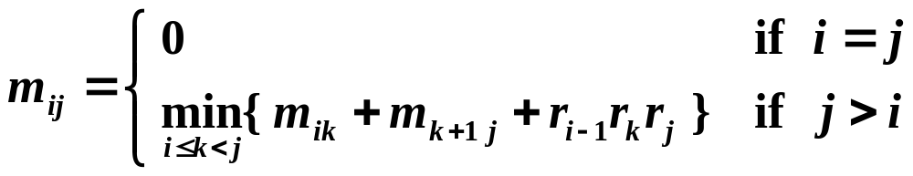
Dynamic Programming
Suppose we are to multiply n matrices M₁ ∗ ⋅⋅⋅ ⋅⋅⋅ ∗ M_{n} where M_{i} is an r_{i−1}× r_{i} matrix. Let m_{ij} be the cost of the optimal way to compute M_{i} ∗ ⋅⋅⋅ ⋅⋅⋅ ∗ M_{j} . Then we have the recurrence equations:
Algorithm
for ( i = 1; i <= n; i++ ) m_{ii} = 0;
for ( l = 1; l < n; l++ ) {
for ( i = 1; i < n; i++ ) {
j = i + l ;
if ( j <= n )
m_{ij} = min( m_{ik} + m_{k+1 j} + r_{i−1}∗ r_{k} ∗ r_{j} ) over i ≤ k < j
}
}
T_{p} = O( n³ )

Slide 10
Dynamic Programming
〖Example 3〗 Flow Shop Scheduling
Consider a machine shop that has m identical processors P_{i} , 1 ≤ i ≤ m . We have n jobs T₁, ... , T_{n} that need to be processed. Each job T_{i} can be broken into m tasks T_{ij} , where 1 ≤ j ≤ m .
A schedule is an assignment of jobs to time intervals on machines such that
➢ T_{ij} must be processed by P_{j} and the processing time is t_{ij} .
➢ No machine processes more than one job at any time.
➢ T_{ij} may not be started before T_{i j−1} is finished.
Our task is to construct a minimum-finish-time m machine schedule for a given set of n jobs.

Slide 11
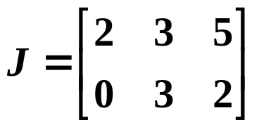
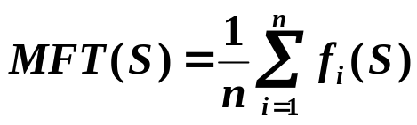

Dynamic Programming
For example, given m = 3 machines and n = 2 jobs.
The processing time matrix for the tasks is
Method 1: Priority Scheduling
—— processing of a task can be interrupted.
0
2
5
6
10
12
A feasible schedule with f₁( S ) = 10 and f₂( S ) = 12.
P₁
T₁₁
P₂
T₂₂
T₁₂
T₂₂
P₃
T₁₃
T₂₃
interrupt
Method 2: Non-priority Scheduling
—— processing of a task must not be interrupted.
0
2
3
5
6
11
A feasible schedule with f₁( S ) = 11 and f₂( S ) = 5.
P₁
T₁₁
P₂
T₂₂
T₁₂
P₃
T₂₃
T₁₃
Total finish time . Mean finish time
Optimal finish time

Slide 12

Dynamic Programming
Let’s consider the case where m = 2 :
Let a_{i} = t_{i1} ≠ 0, and b_{i} = t_{i2} . The scheduling problem satisfies the principle of optimality. That is, after the first job is finished, the remaining job schedule must still be an optimal schedule with respect to the jobs left.
If there is an a_{i} = 0, then we can
schedule all the jobs with a_{j} ≠ 0 first.
Then we insert the jobs with a_{i} = 0
to the front of the schedule list
in arbitrary order.
Let g( s, t ) = { The optimal finish time of a subset s of the jobs. Here P₂ may not start processing before time t. }
0
P₁
T_{i 1}
P₂
T_{i 2}
a_{i}
b_{i}

Slide 13


Dynamic Programming
In general, for any s and t, we have
where g( φ, t ) = max { t, 0 }, a_{i} ≠ 0, 1 ≤ i ≤ n .
P₁
T_{i 1}
P₂
T_{i 2}
a_{i}
t
b_{i}
P₁
T_{i 1}
P₂
a_{i}
T_{i 2}
t
b_{i}
Note: A direct implementation of the above recurrence
equation will take O( n ! ) time.

Slide 14
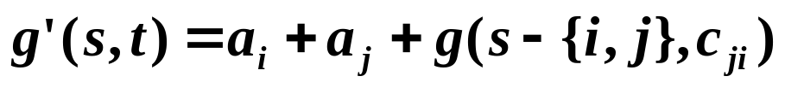
Dynamic Programming
Let T_{i} and T_{j} be the first two jobs processed. Then
c_{ij}
After simplification we have
Switch T_{i} and T_{j} , then
where
g( s, t ) is the OFT ⇒ g( s, t ) ≤ g’( s, t ) ⇒ c_{ij} ≤ c_{ji}
⇒ min { b_{i} , a_{j} } ≥ min { b_{j} , a_{i} }
【Proposition】If min { b_{i} , a_{j} } ≥ min { b_{j} , a_{i} } for any pair of adjacent jobs T_{i} and T_{j} , then there exists an optimal schedule, and all the schedules with this property have the same FT.

Slide 15
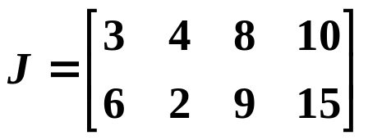
Dynamic Programming
Algorithm
Sort { a₁ , ... , a_{n} , b₁ , ... , b_{n} } into non-decreasing sequence ;
m = minimum element ;
do {
if ( ( m == a_{i} ) && ( T_{i} is not in the schedule ) )
Place T_{i} at the left-most empty position ;
else if ( ( m == b_{j} ) && ( T_{j} is not in the schedule ) )
Place T_{j} at the right-most empty position ;
m = next minimum element ;
} while ( m )
T_{p} = O( n log n )
〖Example〗 Given n = 4,
Sorting ⇒ { b₂ a₁ a₂ b₁ a₃ b₃ a₄ b₄ }
T₁
T₃
T₄
T₂
The scheduling problem with m > 2 is an NP-hard problem.

Slide 16

Dynamic Programming
Bonus Problem ( 2 points)
Crashing Balloon

