Slide 1


Backtracking
A sure-fire way to find the answer to a problem is to make a list of all candidate answers, examine each, and following the examination of all or some of the candidates, declare the identified answer.
Backtracking enables us to eliminate the explicit examination of a large subset of the candidates while still guaranteeing that the answer will be found if the algorithm is run to termination.
Suuuure — if the list is finite and it is
possible to identify the answer following
the examinations. AND, if there are
not too many candidates.
The basic idea is that suppose we have a partial solution ( x₁, ... , x_{i} ) where each x_{k} ∈ S_{k} for 1 ≤ k ≤ i < n. First we add x_{i+1} ∈ S_{i+1} and check if ( x₁, ... , x_{i}, x_{i+1} ) satisfies the constrains. If the answer is “yes” we continue to add the next x, else we delete x_{i} and backtrack to the previous partial solution ( x₁, ... , x_{i−1} ).

Slide 2

Backtracking
〖Example〗 Eight Queens
Find a placement of 8 queens on an 8 × 8 chessboard such that no two queens attack.
Two queens are said to attack iff they are in the same row, column, diagonal, or antidiagonal of the chessboard.
1
2
3
4
5
6
7
8
Q_{i} ::= queen in the i-th row
1
Q
x_{i} ::= the column index in which Q_{i} is
2
Q
This implies
that the solution must
be a permutation of 1, 2, ... , 8.
Thus the number of candidates
in the solution space
is reduced to 8!.
3
Q
Solution = ( x₁, x₂, ... , x₈ )
4
Q
5
Q
= ( 4, 6, 8, 2, 7, 1, 3, 5 )
This implies 8⁸ candidates
in the solution space.
6
Q
For the problem with n queens,
there are n! candidates
in the solution space.
7
Q
8
Q
Constrains:
① S_{i} = { 1,2,3,4,5,6,7,8 } for 1 ≤ i ≤ 8
② x_{i} ≠ x_{j} if i ≠ j
③ ( x_{i}− x_{j} ) / (i − j ) ≠ ± 1

Slide 3
Backtracking
Method: Take the problem of 4 queens as an example
Step 1: Construct a solution space tree
1
x1 = 1
2
3
4
2
18
34
50
x2 = 2
3
4
1
3
4
1
2
4
1
2
3
3
8
13
19
24
29
35
40
45
51
56
61
x3 = 3
4
2
4
2
3
3
4
1
4
1
3
2
4
1
4
1
2
2
3
1
3
1
2
4
6
9
11
14
16
20
22
25
27
30
32
36
38
41
43
46
48
52
54
57
59
62
64
x4 = 4
3
4
2
3
2
4
3
4
1
3
1
4
2
4
1
2
1
3
2
3
1
2
1
5
7
10
12
15
17
21
23
26
28
31
33
37
39
42
44
47
49
53
55
58
60
63
65
4 ! leaves
Each path from the root to a leaf defines an element of the solution space.

Slide 4
Live node
Expansion node
Backtracking
1
E
x1 = 1
L
2
3
4
L
E
2
E
18
34
50
E
L
L
E
E
E
L
E
E
E
x2 = 2
3
4
L
1
3
4
1
2
4
1
2
3
L
3
8
13
19
24
29
35
40
45
51
56
61
L
E
E
E
L
L
L
x3 = 3
4
2
4
2
3
3
4
1
4
1
3
2
4
1
4
1
2
2
3
1
3
1
2
4
6
9
11
14
16
20
22
25
27
30
32
36
38
41
43
46
48
52
54
57
59
62
64
x4 = 4
3
4
2
3
L
E
2
4
3
4
1
3
1
4
2
4
1
2
1
3
2
3
1
2
1
L
E
5
7
10
12
15
17
21
23
26
28
31
33
37
39
42
44
47
49
53
55
58
60
63
65
L
E
L
E
Step 2: Perform a depth-first search ( post-order traversal ) to examine the paths
Q
Q
Q
Q
Q
Q
Q
( 2, 4, 1, 3 )
Q
Q
Q
Q
Q
Q
Q
Q

Slide 5

Backtracking
Bonus Problem ( 2 points to your final grade )
Review of Programming Contest Rules

Slide 6
Branch and Bound
Like backtracking, branch and bound searches a solution space that is often organized as a tree. However, unlike backtracking which searches these tree organizations in a depth-first manner, branch and bound usually searches these trees in either a breadth-first or least-cost manner.
Since the space requirements of branch-and-bound algorithms are often considerably more than those of their backtracking counterparts, backtracking is often more successful at finding the answer in memory-limited situations.
Branch and bound differs from backtracking primarily in the way an E-node is expanded. Its applications usually involve finding an optimal solution with least cost or maximum profit.

Slide 7
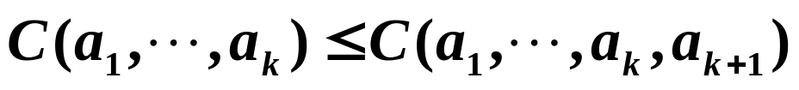
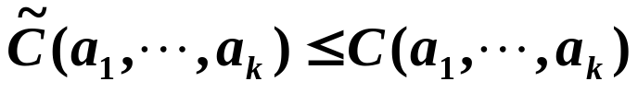

Branch and Bound
Sketch of idea:
Each node v in a solution space tree corresponds to a local solution ( a₁, ... , a_{k} ). On the other hand, a local solution ( a₁, ... , a_{k}, a_{k+1} ) expanded from v corresponds to a child of v.
Define a cost function for each local solution, satisfying
If C ( a₁, ... , a_{k} ) is larger than some upper bound U (usually U is defined as the cost of some feasible solution), then the node v and its subtrees will be cut off.
If C ( a₁, ... , a_{k} ) is hard to get, we can define another function which is easy to obtain to replace the C function. must satisfy , and it is called the lower bound function.

Slide 8
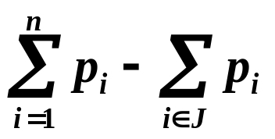
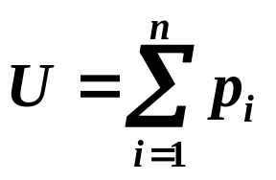

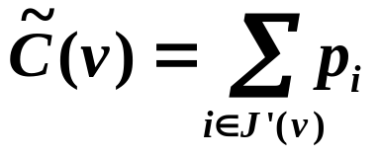
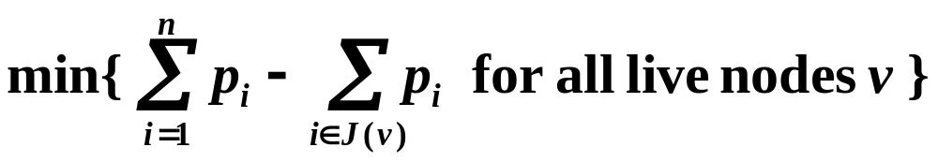
Branch and Bound
〖Example〗 Job Scheduling with Deadline
Given n jobs J₁ ... J_{n} and one processor. J_{i} requires time t_{i} ≥ 1 to finish, and has a deadline d_{i} ≥ t_{i} . The profit p_{i} ≥ 0 for doing the job J_{i} can be obtained only if the job is finished before its deadline.
Our task is to find a subset J of the jobs such that the maximum profit is gained.
Profit that will for sure
be lost at v
Note: The problem is equivalent to that of minimizing
It’s the lower bound of
the maximum lost of profit
for current feasible solution.
Hence if > U, then
v and its subtrees must be
cut off.
Step 1: Initialize the upper bound U ——
Step 2: Define the lower bound function
where J’(v) = { set of J_{i} that is impossible to get from the root to v }.
Step 3: Refine U to be

Slide 9



Branch and Bound
n = 4
U=24
=0
i
1
2
3
4
1
p
5
10
6
3
x1 = 1
2
3
4
d
1
3
2
1
19
2
14
3
18
4
21
5
U=14
t
1
2
1
1
0
5
15
21
x2 = 2
3
4
3
4
4
J = { 2, 3 }
Profit = 16
U=9
9
6
13
7
8
8
11
U=8
9
10
11
0
10
5
11
x3 = 3
4
4
4
12
13
14
15
x4 = 4
Remarks:
(1) The efficiency of the algorithm depends on our choice of
the upper and lower functions.
(2) The problem can also be solved by least-cost search,
in which the E-node is the node with minimum .
16

Slide 10




Branch and Bound
Efficiency Analysis:
Q: Is it true that with better (i.e. smaller) initial value of U we can always reduce the number of nodes generated?
A: Yes, it is true for branch-and-bound with FIFO, LIFO, and LC methods.
Q: Is it true that deleting v when will not increase the number of nodes generated?
The red numbers are
the real costs C
A: Yes, it is true for branch-and-bound with FIFO, LIFO, and LC methods.
Q: Is it true that with better (i.e. larger) lower bound function we can always reduce the number of nodes generated?
1
3
A: Yes for FIFO and LIFO. No for LC.
4
2
3
3
Define
4
5
6
7
8
9
Define
6
6
4
4
4
3

Slide 11
Branch and Bound
Bonus Problem ( 2 points to your final grade )
Good-Bye Party

Slide 12
Local Search Algorithms
Algorithm:
① Randomly select a solution
② Improve the current solution by some transformation, then replace the current solution.
③ Repeat ② until there is no possible improvement
The key is how to select the proper transformation. Suppose n is the size of the inputs. Usually people choose transformation of O( n² ) or O( n³ ) such that the new solution after transformation is closely related to the current solution —— hence it is called a local transformation.
The local search algorithms do not guarantee an optimal solution.

Slide 13

Local Search Algorithms
〖Example 1〗 Minimal Cost Tour of an undirected graph
Transformation ::= remove 2 edges and re-connect the vertices to obtain a new tour.
3
3
a
b
7
4
4
3
3
e
8
c
a
b
a
b
7
4
2
4
6
5
e
c
d
c
d
6
5
6
8
2
6
d
e
The total number of possible transformations at each stage is
4
n ( n − 3 ) / 2.
a
c
In general, if we define a transformation to be removing k edges at a stage, then there will be O( n^{k} ) possible ways. The number of stages required to find an optimal solution cannot be determined.
2
4
Do you think it fast?
We don’t know how many
stages we are gonna have!
d
b
6
3
e

Slide 14
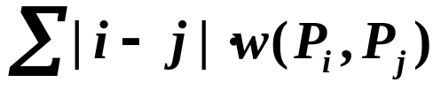
Local Search Algorithms
〖Example 2〗 Unit Arrangement
Given n unit parts P₁ ... P_{n} which are represented as nodes in a graph. The weight of the edge ( P_{i} , P_{j} ) is defined to be the number of wires connecting the two parts.
Our task is to arrange the parts so that the total length of the wires is minimized.
Heuristic local transformations:
① Randomly choose a pair of parts P_{i} and P_{j} and swap them.
T_{p} = O( C_{n}² ) = O( n² )
How can we
know that?
② For any pair of i and j, insert P_{i} between P_{j} and P_{j+1}.
T_{p} = O( C_{n}² ) = O( n² )
③ Swap P_{i} and P_{i+1} only when it can improve the situation.

Slide 15
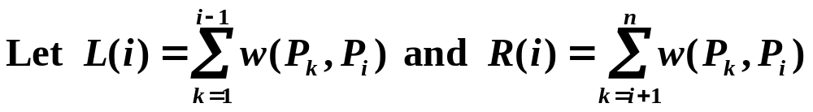

Local Search Algorithms
Then the extra length after swaping P_{i} and P_{i+1} is
We will switch P_{i} and P_{i+1} only if this quantity is less than 0.
3
Cost = 1 + 2 + 3 × 2 = 9
1
2
L(a)=0, R(a)=4, L(b)=1, R(b)=2
a
b
c
L(a) − R(a) − L(b) + R(b) + 2 × 1 = −1
2
L(a)=1, R(a)=3, L(c)=5, R(c)=0
1
3
b
a
c
L(a) − R(a) − L(c) + R(c) + 2 × 3 = −1
T_{p} cannot
be properly
estimated
1
2
3
Cost = 2 + 3 + 1 × 2 = 7
b
c
a

