Slide 1
80X86汇编语言与C语言-1
数据传送指令
地址计算指令
64位模式

Slide 2
汇编程序员眼中的处理器系统结构
CPU
内存空间
Registers
地址
P
C
Object Code
Program Data
OS Data
数据
Condition
Codes
指令
栈
（Stack）
  指令寄存器 （PC Program Counter）
    下一条指令的地址
    EIP (x86-32) 或 RIP (x86-64)
  寄存器堆
  条件码
    用于存储最近执行指令的结果状态信息
    用于条件跳转指令的判断
  内存空间
    以字节编码的连续存储空间
    存放程序代码、数据、运行栈以及操作系统数据
Notes:
系统结构分层的概念。从其定义引入这一张ppt的主要含义。

Slide 3
如何从C代码生成汇编代码
C 代码
对应的X86-32 汇编（AT&T汇编格式）
int sum(int x, int y)
{
int t = x+y;
return t;
}
sum:
pushl %ebp
movl %esp, %ebp
movl 12(%ebp), %eax
movl 8(%ebp), %edx
addl %edx, %eax
leave
ret
  命令行：gcc –O2 -S code.c
  生成汇编文件code.s
leave指令等价于：
movl %ebp,%esp
popl %ebp
Notes:
看一下cygwin的环境。简单演示
所有的指令后缀都是“l”，解释一下。

Slide 4
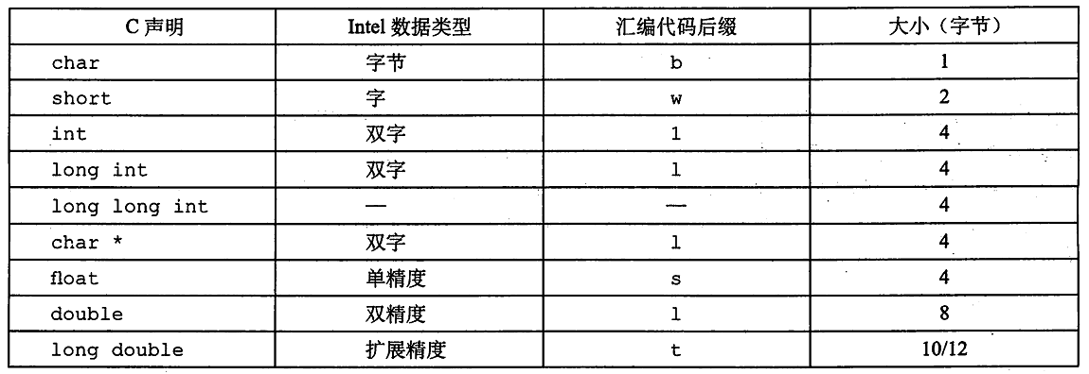
汇编语言数据格式
在X86-32中，使用“字（word）”来表示16位整数类型，“双字”表示32位。
汇编语言中没有数据类型，一般采用汇编指令的后缀来进行区分。

Slide 5
第一条汇编指令实例
C代码
  两个整数（32位）相加
汇编代码
  两个32位整数相加
    “l” 后缀表示是双字运算
    无符号/带符号整数加法运算的指令是一样的
  操作数:
    x: Register eax
    y: Register edx
    t: Register eax
      结果存于 eax
机器码
  2-字节指令
int t = x+y;
addl %edx, %eax
类似于表达式:
x += y
或者
int eax;
int edx
eax += edx
a: 01 d0 add %edx,%eax

Slide 6
数据传送指令（mov）
数据传送 (AT&T 语法)
movl Source, Dest:
  将一个“双字”从Source移到Dest
  常见指令
允许的操作数类型
  立即数: 常整数
    如：$0x400, $-533
    可以被1,2或4个字节来表示
  寄存器: 8个通用寄存器之一
  存储器: 四个连续字节
    支持多种访存寻址模式
%eax
%edx
%ecx
%ebx
%esi
%edi
%esp
%ebp
Notes:
第一类汇编指令。。。

Slide 7
数据传送指令支持的不同操作数类型组合
源操作数
目的操作数
类似的C语言表示
Reg
movl $0x7,%eax
temp = 0x7;
Imm
Mem
movl $189,(%eax)
*p = 189;
Reg
movl %eax,%edx
temp2 = temp1;
movl
Reg
Mem
movl %eax,(%edx)
*p = temp;
Mem
Reg
movl (%eax),%edx
temp = *p;
但是不能两个操作数都为内存地址！
Notes:
补充 movl 0x4, %eax

Slide 8
简单的寻址模式
间接寻址 (R) Mem[Reg[R]]
  寄存器R指定内存地址
  movl (%ecx),%eax
基址+偏移量 寻址 D(R) Mem[Reg[R]+D]
  寄存器R指定内存起始地址
  常数D给出偏移量
  movl 8(%ebp),%edx

Slide 9
寻址模式使用实例
swap:
pushl %ebp
movl %esp,%ebp
pushl %ebx
movl 12(%ebp),%ecx
movl 8(%ebp),%edx
movl (%ecx),%eax
movl (%edx),%ebx
movl %eax,(%edx)
movl %ebx,(%ecx)
movl -4(%ebp),%ebx
movl %ebp,%esp
popl %ebp
ret
Set
Up
void swap(int *xp, int *yp)
{
int t0 = *xp;
int t1 = *yp;
*xp = t1;
*yp = t0;
}
Body
Finish

Slide 10
swap:
pushl %ebp
movl %esp,%ebp
pushl %ebx
movl 12(%ebp),%ecx
movl 8(%ebp),%edx
movl (%ecx),%eax
movl (%edx),%ebx
movl %eax,(%edx)
movl %ebx,(%ecx)
movl -4(%ebp),%ebx
movl %ebp,%esp
popl %ebp
ret
Set
Up
void swap(int *xp, int *yp)
{
int t0 = *xp;
int t1 = *yp;
*xp = t1;
*yp = t0;
}
Body
Finish

Slide 11
实例分析
•
•
•
void swap(int *xp, int *yp)
{
int t0 = *xp;
int t1 = *yp;
*xp = t1;
*yp = t0;
}
栈（Stack）
偏移量
12
yp
8
xp
4
Rtn adr
0
Old %ebp
%ebp
-4
Old %ebx
Register Variable
%ecx yp
%edx xp
%eax t1
%ebx t0
movl 12(%ebp),%ecx # ecx = yp
movl 8(%ebp),%edx # edx = xp
movl (%ecx),%eax # eax = *yp (t1)
movl (%edx),%ebx # ebx = *xp (t0)
movl %eax,(%edx) # *xp = eax
movl %ebx,(%ecx) # *yp = ebx

Slide 12
地址
123
0x124
456
0x120
0x11c
%eax
0x118
%edx
偏移量
0x114
%ecx
yp
12
0x120
0x110
xp
8
0x124
0x10c
%ebx
4
Rtn adr
0x108
%esi
%ebp
0
0x104
%edi
-4
0x100
%esp
movl 12(%ebp),%ecx # ecx = yp
movl 8(%ebp),%edx # edx = xp
movl (%ecx),%eax # eax = *yp (t1)
movl (%edx),%ebx # ebx = *xp (t0)
movl %eax,(%edx) # *xp = eax
movl %ebx,(%ecx) # *yp = ebx
%ebp
0x104

Slide 13
地址
123
0x124
456
0x120
0x11c
%eax
0x118
%edx
偏移量
0x114
yp
12
0x120
%ecx
0x120
0x120
0x110
xp
8
0x124
0x10c
%ebx
4
Rtn adr
0x108
%esi
%ebp
0
0x104
%edi
-4
0x100
%esp
movl 12(%ebp),%ecx # ecx = yp
movl 8(%ebp),%edx # edx = xp
movl (%ecx),%eax # eax = *yp (t1)
movl (%edx),%ebx # ebx = *xp (t0)
movl %eax,(%edx) # *xp = eax
movl %ebx,(%ecx) # *yp = ebx
%ebp
0x104

Slide 14
地址
123
0x124
456
0x120
0x11c
%eax
0x118
%edx
0x124
偏移量
0x114
%ecx
0x120
yp
12
0x120
0x110
xp
8
0x124
0x124
0x10c
%ebx
4
Rtn adr
0x108
%esi
%ebp
0
0x104
%edi
-4
0x100
%esp
movl 12(%ebp),%ecx # ecx = yp
movl 8(%ebp),%edx # edx = xp
movl (%ecx),%eax # eax = *yp (t1)
movl (%edx),%ebx # ebx = *xp (t0)
movl %eax,(%edx) # *xp = eax
movl %ebx,(%ecx) # *yp = ebx
%ebp
0x104

Slide 15
地址
123
0x124
456
456
0x120
0x11c
%eax
456
0x118
%edx
0x124
偏移量
0x114
%ecx
0x120
yp
12
0x120
0x110
xp
8
0x124
0x10c
%ebx
4
Rtn adr
0x108
%esi
%ebp
0
0x104
%edi
-4
0x100
%esp
movl 12(%ebp),%ecx # ecx = yp
movl 8(%ebp),%edx # edx = xp
movl (%ecx),%eax # eax = *yp (t1)
movl (%edx),%ebx # ebx = *xp (t0)
movl %eax,(%edx) # *xp = eax
movl %ebx,(%ecx) # *yp = ebx
%ebp
0x104

Slide 16
地址
123
123
0x124
456
0x120
0x11c
%eax
456
0x118
%edx
0x124
偏移量
0x114
%ecx
0x120
yp
12
0x120
0x110
xp
8
0x124
0x10c
%ebx
123
4
Rtn adr
0x108
%esi
%ebp
0
0x104
%edi
-4
0x100
%esp
movl 12(%ebp),%ecx # ecx = yp
movl 8(%ebp),%edx # edx = xp
movl (%ecx),%eax # eax = *yp (t1)
movl (%edx),%ebx # ebx = *xp (t0)
movl %eax,(%edx) # *xp = eax
movl %ebx,(%ecx) # *yp = ebx
%ebp
0x104

Slide 17
地址
456
0x124
456
0x120
0x11c
%eax
456
456
0x118
%edx
0x124
偏移量
0x114
%ecx
0x120
yp
12
0x120
0x110
xp
8
0x124
0x10c
%ebx
123
123
4
Rtn adr
0x108
%esi
%ebp
0
0x104
%edi
-4
0x100
%esp
movl 12(%ebp),%ecx # ecx = yp
movl 8(%ebp),%edx # edx = xp
movl (%ecx),%eax # eax = *yp (t1)
movl (%edx),%ebx # ebx = *xp (t0)
movl %eax,(%edx) # *xp = eax
movl %ebx,(%ecx) # *yp = ebx
%ebp
0x104

Slide 18
地址
456
0x124
123
0x120
0x11c
%eax
456
0x118
%edx
0x124
偏移量
0x114
%ecx
0x120
yp
12
0x120
0x110
xp
8
0x124
0x10c
%ebx
123
123
4
Rtn adr
0x108
%esi
%ebp
0
0x104
%edi
-4
0x100
%esp
movl 12(%ebp),%ecx # ecx = yp
movl 8(%ebp),%edx # edx = xp
movl (%ecx),%eax # eax = *yp (t1)
movl (%edx),%ebx # ebx = *xp (t0)
movl %eax,(%edx) # *xp = eax
movl %ebx,(%ecx) # *yp = ebx
%ebp
0x104

Slide 19
寻址模式
通用形式
D(Rb,Ri,S) Mem[Reg[Rb]+S*Reg[Ri]+ D]
  D: 常量（地址偏移量）
  Rb: 基址寄存器: 8个通用寄存器之一
  Ri: 索引寄存器: %esp不作为索引寄存器
      一般 %ebp也不用做这个用途
  S: 比例因子 1, 2, 4, or 8
变形
(Rb,Ri) Mem[Reg[Rb]+Reg[Ri]]
D(Rb,Ri) Mem[Reg[Rb]+Reg[Ri]+D]
(Rb,Ri,S) Mem[Reg[Rb]+S*Reg[Ri]]

Slide 20
寻址模式实例
注意：如果是$0x8,则表示立即数；否则就是内存地址
%edx
0xf200
%ecx
0x100
地址表达式 | 地址计算 | 访存地址
0x8 | 0x8 | 0x8
0x8(%edx) | 0xf200 + 0x8 | 0xf208
(%edx,%ecx) | 0xf200 + 0x100 | 0xf300
(%edx,%ecx,4) | 0xf200 + 4*0x100 | 0xf600
0x80(,%edx,2) | 2*0xf200 + 0x80 | 0x1e480

Slide 21
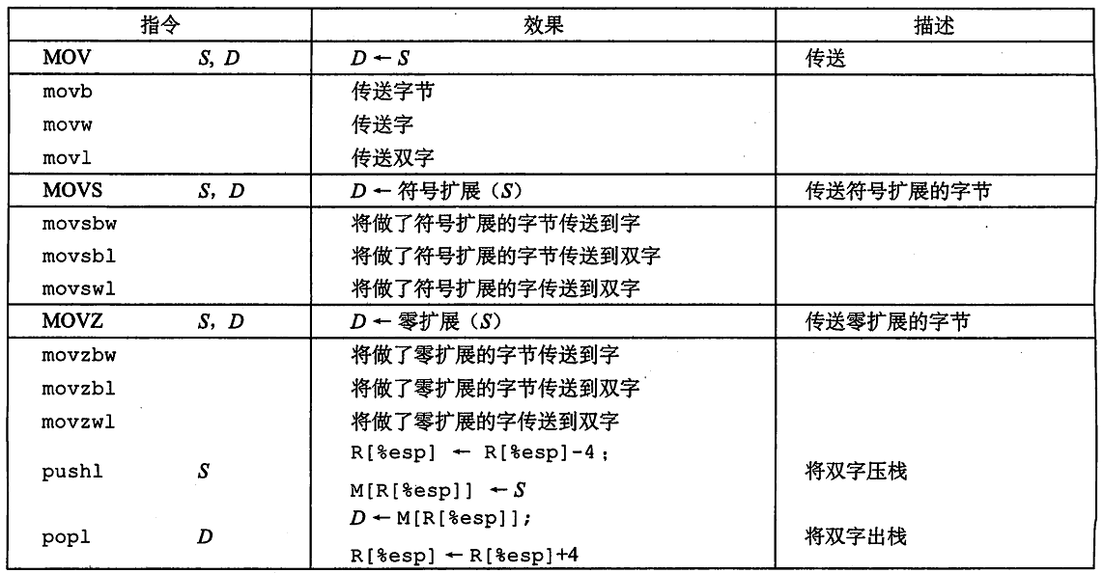

Slide 22
地址计算指令
leal Src,Dest
  Src 是地址计算表达式
  计算出来的地址赋给 Dest
使用实例
  地址计算（无需访存）
    比如计算元素的地址（p = &x[i];)
  进行x + k*y这一类型的整数计算
    k = 1, 2, 4, or 8.

Slide 23
整数计算指令
  指令格式 计算
双操作数指令
  addl Src,Dest Dest = Dest + Src
  subl Src,Dest Dest = Dest - Src
  imull Src,Dest Dest = Dest * Src
  sall Src,Dest Dest = Dest << Src 与shll等价
  sarl Src,Dest Dest = Dest >> Src 算术右移
  shrl Src,Dest Dest = Dest >> Src 逻辑右移
  xorl Src,Dest Dest = Dest ^ Src
  andl Src,Dest Dest = Dest & Src
  orl Src,Dest Dest = Dest | Src
Notes:
The IA32 supports signed and unsigned 32x32 multiply yeilding a 64-bit result.
imull S R[%edx]:R[%eax] ← S * R[%eax] signed
mull S R[%edx]:R[%eax] ← S * R[%eax] unsigned

Slide 24
  指令格式 计算
单操作数指令
  incl Dest Dest = Dest + 1
  decl Dest Dest = Dest - 1
  negl Dest Dest = - Dest
  notl Dest Dest = ~ Dest

Slide 25
将leal指令用于计算（实例1）
arith:
pushl %ebp
movl %esp,%ebp
movl 8(%ebp),%eax
movl 12(%ebp),%edx
leal (%edx,%eax),%ecx
leal (%edx,%edx,2),%edx
sall $4,%edx
addl 16(%ebp),%ecx
leal 4(%edx,%eax),%eax
imull %ecx,%eax
movl %ebp,%esp
popl %ebp
ret
Set
Up
int arith
(int x, int y, int z)
{
int t1 = x+y;
int t2 = z+t1;
int t3 = x+4;
int t4 = y * 48;
int t5 = t3 + t4;
int rval = t2 * t5;
return rval;
}
Body
Finish

Slide 26
int arith
(int x, int y, int z)
{
int t1 = x+y;
int t2 = z+t1;
int t3 = x+4;
int t4 = y * 48;
int t5 = t3 + t4;
int rval = t2 * t5;
return rval;
}
•
•
•
Stack
Offset
16
z
12
y
8
x
4
Rtn adr
0
Old %ebp
%ebp
movl 8(%ebp),%eax # eax = x
movl 12(%ebp),%edx # edx = y
leal (%edx,%eax),%ecx # ecx = x+y (t1)
leal (%edx,%edx,2),%edx # edx = 3*y
sall $4,%edx # edx = 48*y (t4)
addl 16(%ebp),%ecx # ecx = z+t1 (t2)
leal 4(%edx,%eax),%eax # eax = 4+t4+x (t5)
imull %ecx,%eax # eax = t5*t2 (rval)

Slide 27
int arith
(int x, int y, int z)
{
int t1 = x+y;
int t2 = z+t1;
int t3 = x+4;
int t4 = y * 48;
int t5 = t3 + t4;
int rval = t2 * t5;
return rval;
}
•
•
•
Stack
Offset
16
z
12
y
8
x
4
Rtn adr
0
Old %ebp
%ebp
movl 8(%ebp),%eax # eax = x
movl 12(%ebp),%edx # edx = y
leal (%edx,%eax),%ecx # ecx = x+y (t1)
leal (%edx,%edx,2),%edx # edx = 3*y
sall $4,%edx # edx = 48*y (t4)
addl 16(%ebp),%ecx # ecx = z+t1 (t2)
leal 4(%edx,%eax),%eax # eax = 4+t4+x (t5) imull %ecx,%eax # eax = t5*t2 (rval)

Slide 28
int arith
(int x, int y, int z)
{
int t1 = x+y;
int t2 = z+t1;
int t3 = x+4;
int t4 = y * 48;
int t5 = t3 + t4;
int rval = t2 * t5;
return rval;
}
•
•
•
Stack
Offset
16
z
12
y
8
x
4
Rtn adr
0
Old %ebp
%ebp
movl 8(%ebp),%eax # eax = x
movl 12(%ebp),%edx # edx = y
leal (%edx,%eax),%ecx # ecx = x+y (t1)
leal (%edx,%edx,2),%edx # edx = 3*y
sall $4,%edx # edx = 48*y (t4)
addl 16(%ebp),%ecx # ecx = z+t1 (t2)
leal 4(%edx,%eax),%eax # eax = 4+t4+x (t5) imull %ecx,%eax # eax = t5*t2 (rval)

Slide 29
int arith
(int x, int y, int z)
{
int t1 = x+y;
int t2 = z+t1;
int t3 = x+4;
int t4 = y * 48;
int t5 = t3 + t4;
int rval = t2 * t5;
return rval;
}
•
•
•
Stack
Offset
16
z
12
y
8
x
4
Rtn adr
0
Old %ebp
%ebp
movl 8(%ebp),%eax # eax = x
movl 12(%ebp),%edx # edx = y
leal (%edx,%eax),%ecx # ecx = x+y (t1)
leal (%edx,%edx,2),%edx # edx = 3*y
sall $4,%edx # edx = 48*y (t4)
addl 16(%ebp),%ecx # ecx = z+t1 (t2)
leal 4(%edx,%eax),%eax # eax = 4+t4+x (t5) imull %ecx,%eax # eax = t5*t2 (rval)

Slide 30
int arith
(int x, int y, int z)
{
int t1 = x+y;
int t2 = z+t1;
int t3 = x+4;
int t4 = y * 48;
int t5 = t3 + t4;
int rval = t2 * t5;
return rval;
}
•
•
•
Stack
Offset
16
z
12
y
8
x
4
Rtn adr
0
Old %ebp
%ebp
movl 8(%ebp),%eax # eax = x
movl 12(%ebp),%edx # edx = y
leal (%edx,%eax),%ecx # ecx = x+y (t1)
leal (%edx,%edx,2),%edx # edx = 3*y
sall $4,%edx # edx = 48*y (t4)
addl 16(%ebp),%ecx # ecx = z+t1 (t2)
leal 4(%edx,%eax),%eax # eax = 4+t4+x (t5) imull %ecx,%eax # eax = t5*t2 (rval)

Slide 31
int arith
(int x, int y, int z)
{
int t1 = x+y;
int t2 = z+t1;
int t3 = x+4;
int t4 = y * 48;
int t5 = t3 + t4;
int rval = t2 * t5;
return rval;
}
•
•
•
Stack
Offset
16
z
12
y
8
x
4
Rtn adr
0
Old %ebp
%ebp
movl 8(%ebp),%eax # eax = x
movl 12(%ebp),%edx # edx = y
leal (%edx,%eax),%ecx # ecx = x+y (t1)
leal (%edx,%edx,2),%edx # edx = 3*y
sall $4,%edx # edx = 48*y (t4)
addl 16(%ebp),%ecx # ecx = z+t1 (t2)
leal 4(%edx,%eax),%eax # eax = 4+t4+x (t5) imull %ecx,%eax # eax = t5*t2 (rval)

Slide 32
实例2
logical:
pushl %ebp
movl %esp,%ebp
movl 8(%ebp),%eax
xorl 12(%ebp),%eax
sarl $17,%eax
andl $8185,%eax
movl %ebp,%esp
popl %ebp
ret
int logical(int x, int y)
{
int t1 = x^y;
int t2 = t1 >> 17;
int mask = (1<<13) - 7;
int rval = t2 & mask;
return rval;
}
Set
Up
Body
Finish
movl 8(%ebp),%eax eax = x
xorl 12(%ebp),%eax eax = x^y
sarl $17,%eax eax = t1>>17
andl $8185,%eax eax = t2 & 8185

Slide 33
logical:
pushl %ebp
movl %esp,%ebp
movl 8(%ebp),%eax
xorl 12(%ebp),%eax
sarl $17,%eax
andl $8185,%eax
movl %ebp,%esp
popl %ebp
ret
int logical(int x, int y)
{
int t1 = x^y;
int t2 = t1 >> 17;
int mask = (1<<13) - 7;
int rval = t2 & mask;
return rval;
}
Set
Up
Body
Finish
movl 8(%ebp),%eax eax = x
xorl 12(%ebp),%eax eax = x^y (t1)
sarl $17,%eax eax = t1>>17 (t2)
andl $8185,%eax eax = t2 & 8185

Slide 34
logical:
pushl %ebp
movl %esp,%ebp
movl 8(%ebp),%eax
xorl 12(%ebp),%eax
sarl $17,%eax
andl $8185,%eax
movl %ebp,%esp
popl %ebp
ret
int logical(int x, int y)
{
int t1 = x^y;
int t2 = t1 >> 17;
int mask = (1<<13) - 7;
int rval = t2 & mask;
return rval;
}
Set
Up
Body
Finish
movl 8(%ebp),%eax eax = x
xorl 12(%ebp),%eax eax = x^y (t1)
sarl $17,%eax eax = t1>>17 (t2)
andl $8185,%eax eax = t2 & 8185

Slide 35
logical:
pushl %ebp
movl %esp,%ebp
movl 8(%ebp),%eax
xorl 12(%ebp),%eax
sarl $17,%eax
andl $8185,%eax
movl %ebp,%esp
popl %ebp
ret
int logical(int x, int y)
{
int t1 = x^y;
int t2 = t1 >> 17;
int mask = (1<<13) - 7;
int rval = t2 & mask;
return rval;
}
Set
Up
Body
Finish
2¹³ = 8192, 2¹³ – 7 = 8185
movl 8(%ebp),%eax eax = x
xorl 12(%ebp),%eax eax = x^y (t1)
sarl $17,%eax eax = t1>>17 (t2)
andl $8185,%eax eax = t2 & 8185 (rval)

Slide 36
x86-32 与 x86-64的数据类型宽度
Sizes of C Objects (in Bytes)
  C Data Type Typical 32-bit Intel IA32 x86-64
    unsigned 4 4 4
    int 4 4 4
    long int 4 4 8
    char 1 1 1
    short 2 2 2
    float 4 4 4
    double 8 8 8
    long double 8 10/12 16
    char * 4 4 8
      Or any other pointer

Slide 37
x86-64的通用寄存器
%rax
%r8
%eax
%r8d
%rdx
%r9
%edx
%r9d
%rcx
%r10
%ecx
%r10d
%rbx
%r11
%ebx
%r11d
%rsi
%r12
%esi
%r12d
%rdi
%r13
%edi
%r13d
%rsp
%r14
%esp
%r14d
%rbp
%r15
%ebp
%r15d
  扩展现有的，并增加了8个新的
  %ebp/%rbp 不再是专用寄存器

Slide 38
X86-32下的swap
swap:
pushl %ebp
movl %esp,%ebp
pushl %ebx
movl 12(%ebp),%ecx
movl 8(%ebp),%edx
movl (%ecx),%eax
movl (%edx),%ebx
movl %eax,(%edx)
movl %ebx,(%ecx)
movl -4(%ebp),%ebx
movl %ebp,%esp
popl %ebp
ret
Set
Up
void swap(int *xp, int *yp)
{
int t0 = *xp;
int t1 = *yp;
*xp = t1;
*yp = t0;
}
Body
Finish

Slide 39
X86-64下的…
void swap(int *xp, int *yp)
{
int t0 = *xp;
int t1 = *yp;
*xp = t1;
*yp = t0;
}
swap:
movl (%rdi), %edx
movl (%rsi), %eax
movl %eax, (%rdi)
movl %edx, (%rsi)
retq
  不同点
    参数通过寄存器来传递
      第一个参数(xp) 由%rdi传递, 第二个(yp) 位于 %rsi内
      64位指针
    无栈操作
  被操作的数据仍是32位
    所以使用寄存器 %eax 、%edx
    以及movl 指令
当参数少于7个时， 参数从左到右放入寄存器: rdi, rsi, rdx, rcx, r8, r9。当参数为 7 个以上时， 前 6 个传送方式不变， 但后面的依次从 "右向左" 放入栈中。

Slide 40
X86-64下long int类型的swap过程
void swap_l
(long int *xp, long int *yp)
{
long int t0 = *xp;
long int t1 = *yp;
*xp = t1;
*yp = t0;
}
swap_l:
movq (%rdi), %rdx
movq (%rsi), %rax
movq %rax, (%rdi)
movq %rdx, (%rsi)
retq
  被操作的数据是64位
    所以使用寄存器%rax 、%rdx
    以及movq 指令
      “q” 表示“4字”

Slide 41
小结
X86指令的特点
支持多种类型的指令操作数
  立即数, 寄存器, 内存数据
算逻指令可以以内存数据为操作数
支持多种内存地址计算模式
  Rb + S*Ri + D
  也可用于整数计算(如leal指令)
变长指令
  from 1 to 15 bytes

Slide 42
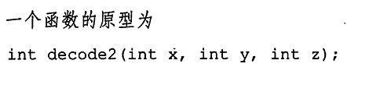
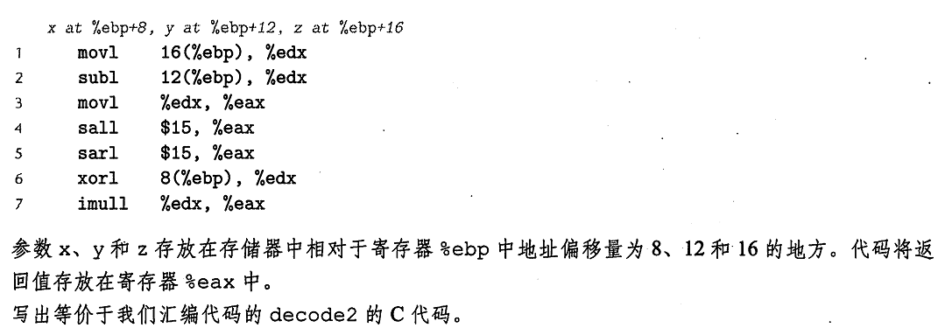
练习题

Slide 43
int decode2(int x, int y, int z)
{
  int t1 = z - y;
  int t2 = (t1 << 15) >> 15;
  int t3 = x ^ t1;
  int t4 = t2 * t1;
  return t4;
}

