Slide 1

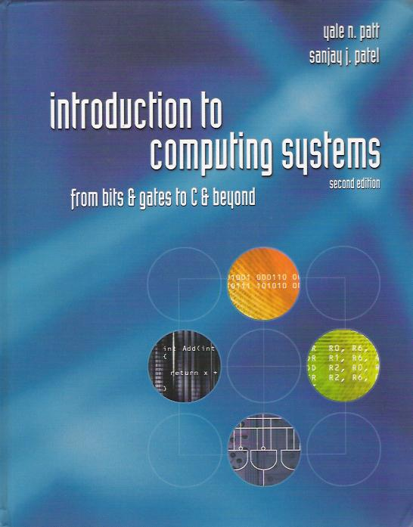

Slide 2
Chapter 1
Welcome Aboard!

Slide 3
This course is about:
What computers consist of
How computers work
How they are organized internally
What are the design tradeoffs
How design affects programming and applications
How to fix computers
How to build myself one real cheap
Which one to buy
Knowing all about the Pentium IV or PowerPC

Slide 4
Computing Machines
Ubiquitous ( = everywhere)
  General purpose: servers, desktops, laptops, PDAs, etc.
  Special purpose: cash registers, ATMs, games, telephone switches, etc.
  Embedded: cars, hotel doors, printers, VCRs, industrial machinery, medical equipment, etc.
Distinguishing Characteristics
  Speed
  Cost
  Ease of use, software support & interface
  Scalability

Slide 5
Two recurring themes
Abstraction
  The notion that we can concentrate on one “level” of the big picture at a time, with confidence that we can then connect effectively with the levels above and below.
  Framing the levels of abstraction appropriately is one of the most important skills in any undertaking.
Hardware vs. Software
  On the other hand, abstraction does not mean being clueless about the neighboring levels.
  In particular, hardware and software are inseparably connected, especially at the level we will be studying.

Slide 6
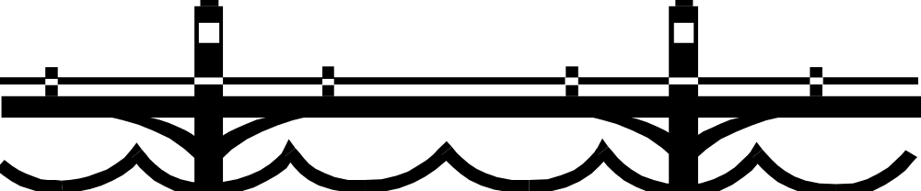
What is Computer Organization?
Electronic
Devices
Desired
Behavior
… a very wide semantic gap between the intended behavior and the workings of the underlying electronic devices that will actually do all the work.
The forerunners to modern computers attempted to assemble the raw devices (mechanical, electrical, or electronic) into a separate purpose-built machine for each desired behavior.

Slide 7
Role of General Purpose Computers
computer
organization
software
Electronic
Devices
General
Purpose
Computer
Desired
Behavior
  A general purpose computer is like an island that helps span the gap between the desired behavior (application) and the basic building blocks (electronic devices).

Slide 8
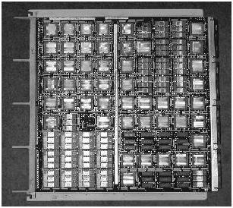
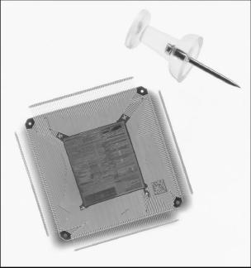
CPUs: the heart of computing systems
ca 2000
You can see why they called this CPU a microprocessor!
ca 1980
It took 10 of these boards to make a Central Processing Unit

Slide 9
Two pillars of Computing
Universal Computational Devices
  Given enough time and memory, all computers are capable of computing exactly the same things (irrespective of speed, size or cost).
    Turing’s Thesis: every computation can be performed by some “Turing Machine” - a theoretical universal computational device
Problem Transformation
  The ultimate objective is to transform a problem expressed in natural language into electrons running around a circuit!
    That’s what Computer Science and Computer Engineering are all about: a continuum that embraces software & hardware.

Slide 10
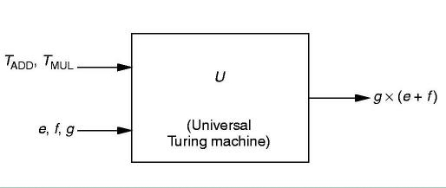
A Turing Machine
  Also known as a Universal Computational Device: a theoretical device that accepts both input data and instructions as to how to operate on the data

Slide 11
Problem Transformation
- levels of abstraction
The desired behavior:
the application
Natural Language
Algorithm
Program
Machine Architecture
Micro-architecture
Logic Circuits
The building blocks:
electronic devices
Devices

Slide 12
Levels of Abstraction
  These levels do not necessarily correspond to discrete components, but to well defined standard interfaces.
  Standard interfaces provide
    portability
    third party software/hardware
    wider usage
  These levels are to some extent arbitrary - there are other ways to draw the lines.
Natural Language
Algorithm
Program
Machine Architecture
Micro-architecture
Logic Circuits
Devices

Slide 13
The Program Level
  Most computers run a management program called the operating system (OS).
  Application programs interface to the machine architecture via the OS.
  An example:
Application Program
Operating System
Program (Software)
This lecture
Data
PowerPoint
Application Program
Windows XP
Operating System

Slide 14
The Machine Level - 1
Machine Architecture
  This is the formal specification of all the functions a particular machine can carry out, known as the Instruction Set Architecture (ISA).
Microarchitecture
  The implementation of the ISA in a specific CPU - i.e. the way in which the specifications of the ISA are actually carried out.

Slide 15
The Machine Level - 2
Logic Circuits
  Each functional component of the microarchitecture is built up of circuits that make “decisions” based on simple rules
Devices
  Finally, each logic circuit is actually built of electronic devices such as CMOS or NMOS or GaAs (etc.) transistors.

Slide 16
Course Outline - What is Next?
How to represent information
The building blocks of computers: logic gates
The basic algorithm: the von Neumann model
An example: the LC-3 structure and language
Programming the machine: assembly language
A higher-level language: C

