Slide 1
4 Tile example and more
Purpose:
Understand EM_aligner, MATLAB code base for assembling and solving EM-connectomics fine alignment problems.
Understand the linear algebra going into these solutions.
Develop plan for scaling the solver for large chunks of mm² sections.

Slide 2
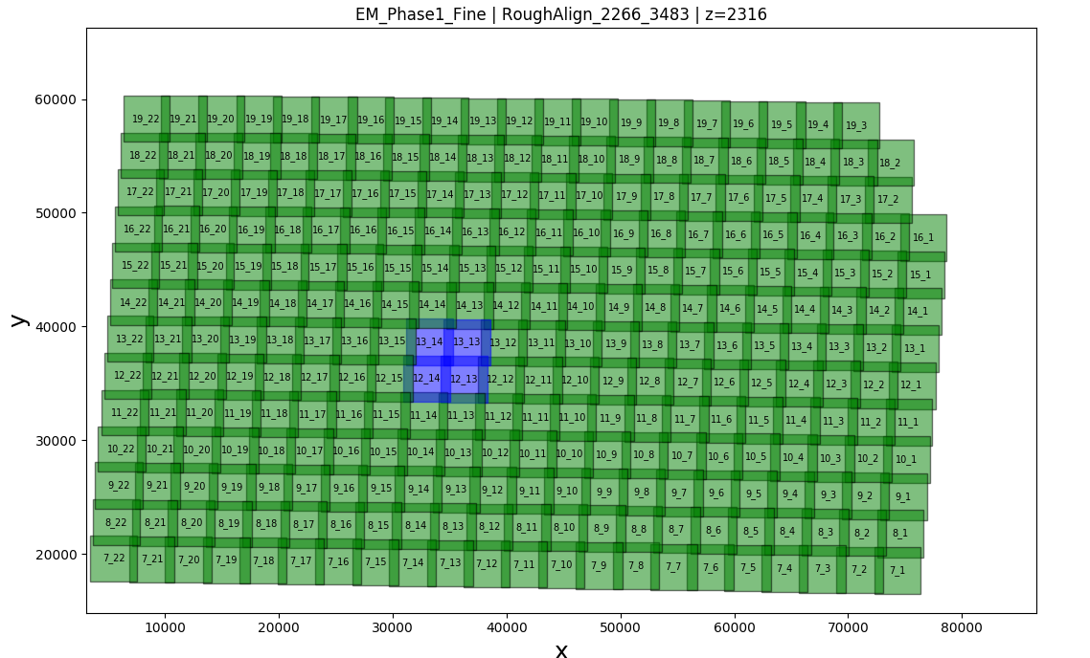
Source of Data

Slide 3
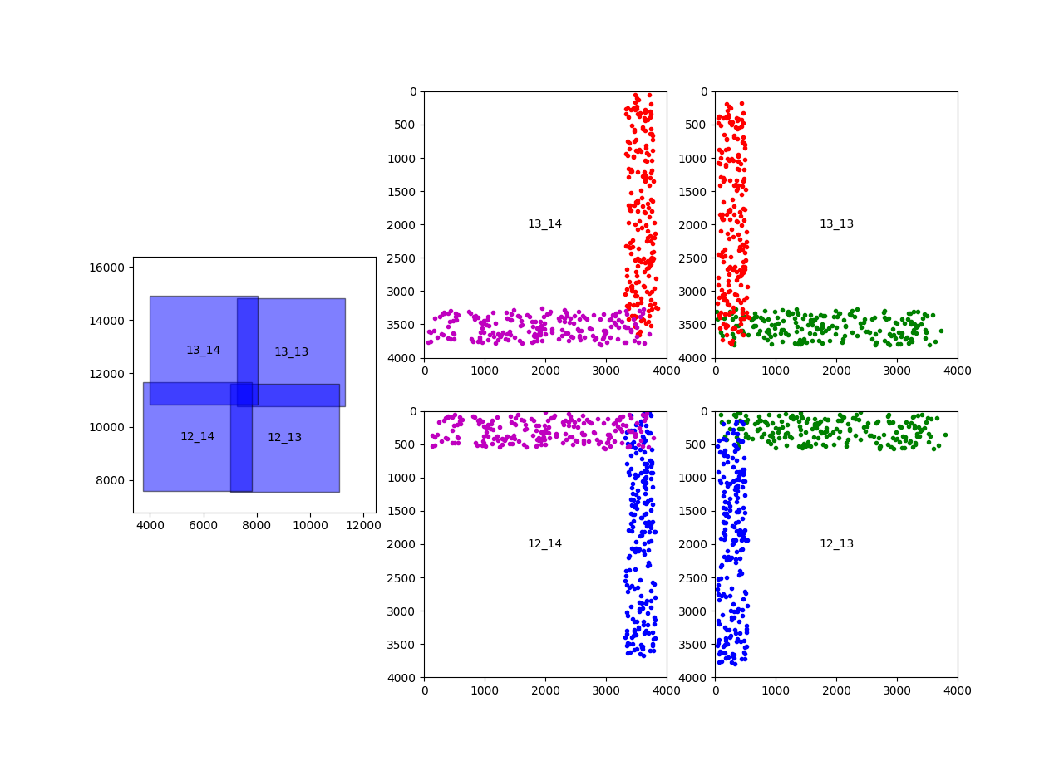
4 Tiles and Point Matches

Slide 4
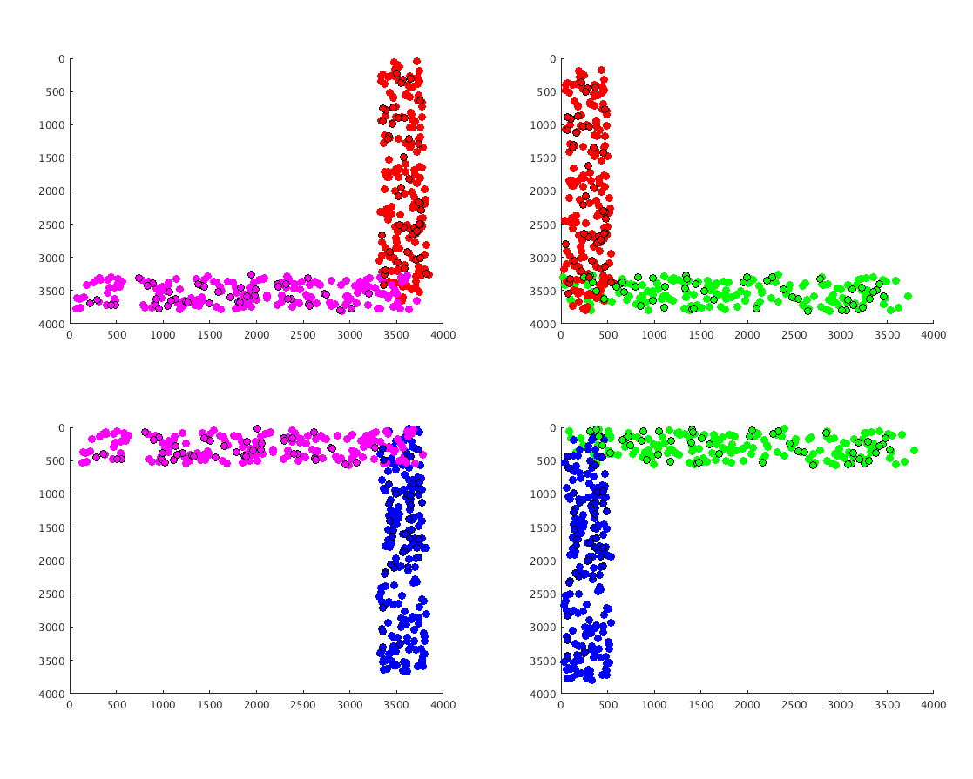
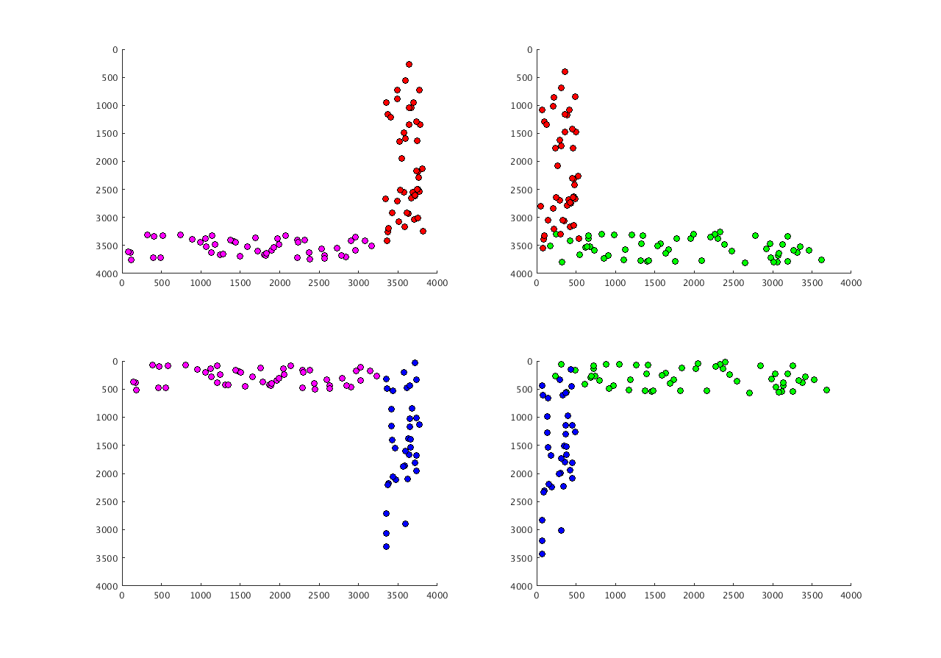
Filtering
EM_aligner includes filtering to limit the number of included point matches.
In this example, the filtering reduced the # from 200 points per tile pair to ~50.

Slide 5
Naming
^{1,2}P:
^{1,2}Q:
¹x₁,¹y₁
²x₁,²y₁
¹x₂,¹y₂
²x₂,²y₂
...
...
Tile 1
Tile 2
^{2,4}P:
²x₁,²y₁
²x₂,²y₂
²x₂,²y₂
^{4,3}P
...
^{2,4}Q:
^{4,3}Q
⁴x₁,⁴y₁
⁴x₂,⁴y₂
Tile 3
Tile 4
...
^{4,3}P
^{4,3}Q

Slide 6
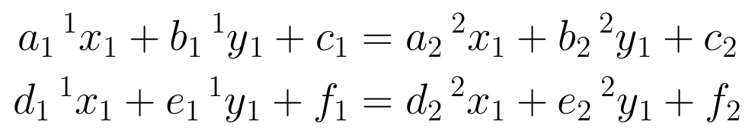
Affine Transformation
The point match coordinates in each tile will be transformed according to an affine transformation:
The goal of alignment between two tiles is to meet the criteria:
Explicitly:
¹u₁ = a₁¹x₁ + b₁¹y₁ + c₁
¹v₁ = d₁¹x₁ + e₁¹y₁ + f₁
¹u₁ = ²u₁
¹v₁ = ²v₁
¹u₂ = ²u₂
¹v₂ = ²v₂
...

Slide 7
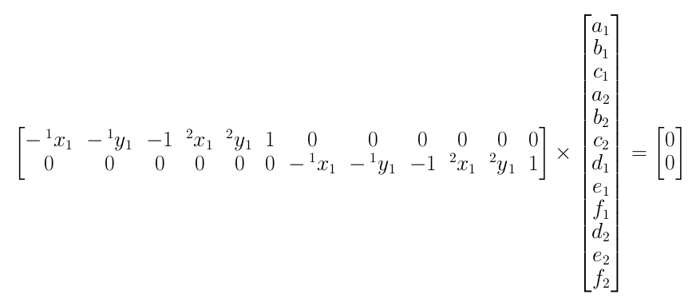
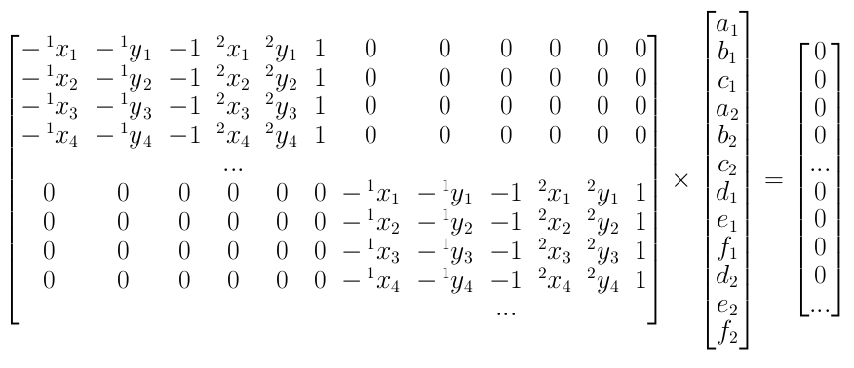
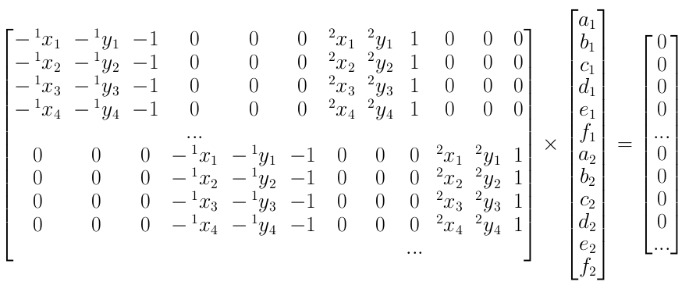
Matrix Assembly
which is the same as:
And for multiple pairs of points:
Reorder to keep all tile 1 coordinates in a column block

Slide 8
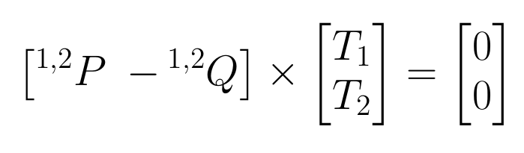
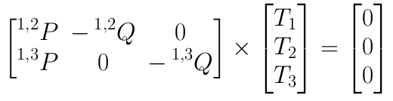
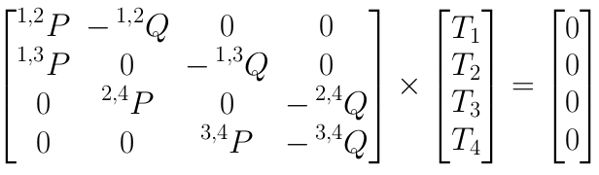
Matrix Assembly
Block-wise shorthand:
2 tiles:
3 tiles:
4 tiles:

Slide 9
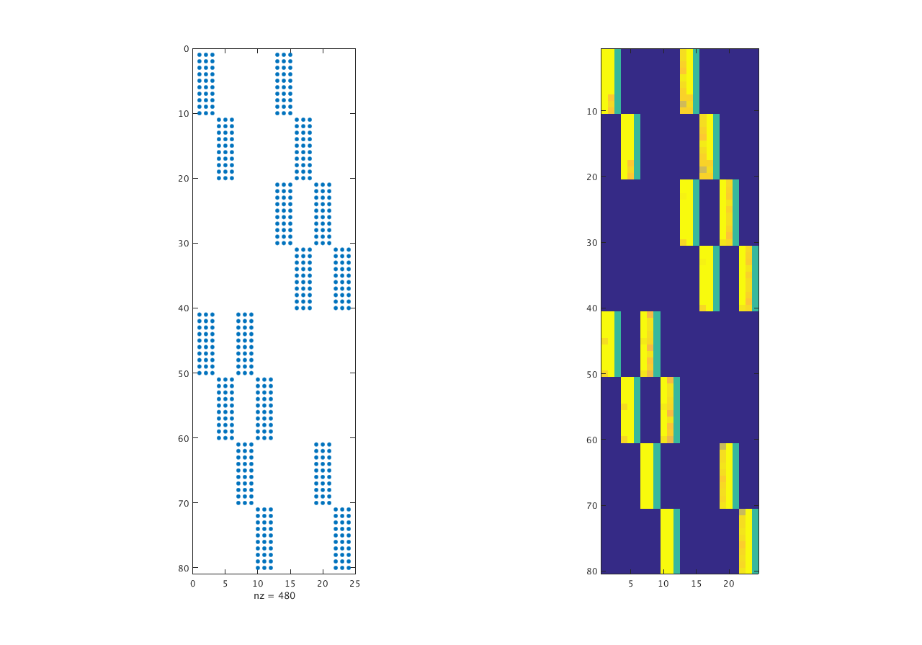
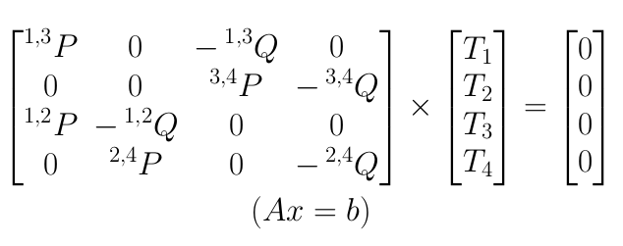
Matrix Assembly (from data)
Force filtering to limit to 10 point matches per tile, for easy visualization:
Non-zero structure
value-colored
^{1,3}P
^{1,3}Q
The ordering is a little different than the example, but, it’s just block-wise row permutations:
^{3,4}P
^{3,4}Q
^{1,2}P
^{1,2}Q
^{2,4}P
^{2,4}Q
We know these values. They are the coordinates of the point matches.
We want to know these transform values, and apply them to the image data.

Slide 10
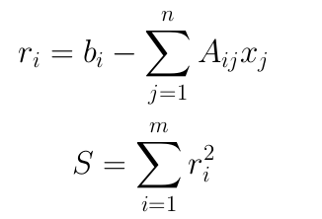
Least Squares
For this simple problem, there are:
80 equations (4 tile matches x 10 points x 2 DOF)
24 unknowns (4 tiles x (2 affine +1 translation) x 2 DOF)
The system is overdetermined.
Use linear least-squares to determine the best possible set of transformations.
Per row (i) residual:
We want norm² to be as small as possible:

Slide 11
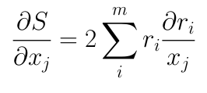
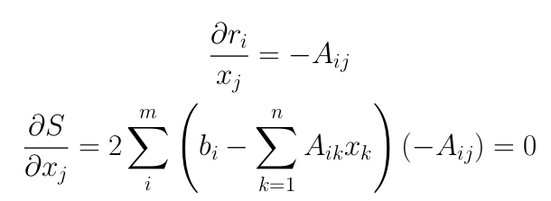
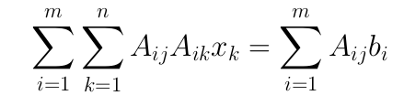

Least Squares
Per row (i) residual:
Find the minimum by seeking where the gradient relative to the parameters =0
We want norm² to be as small as possible:
gradient
gradient, expanded
rearranged
Matrix notation
This product is a square matrix (24x24, in our example).
Now there are 24 equations and 24 unknowns.

Slide 12



Weighting and Regularization
Our new matrix equation:
We can weight each row of A differently
Example: within-section point matches should be weighted more than cross-section point matches
We can regularize
Derivation to-be-added, but, it’s much like on the last page, with an additional term in S that increases S if the solution strays far from a first guess/approximation fo x
Renaming things:

Slide 13
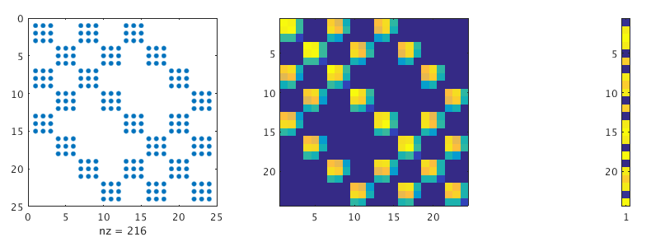
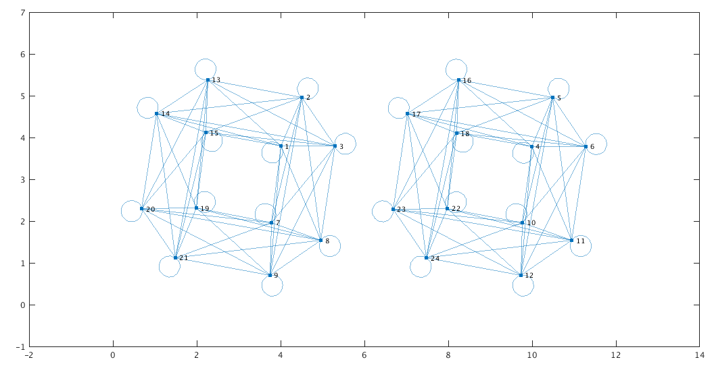
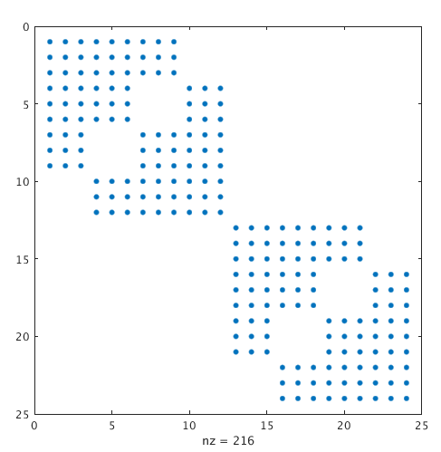
Properties of K and L_{m}
L_{m} has non-zero values
K is symmetric
K is symmetric
The graph of K shows two separate sub-matrices.
Which we can see easily from re-ordering rows and columns:
This type of structure will be important for partitioning large matrices for distributed solving.
I know about 2 partitioning packages for this:
Scotch: used by the Pastix solver. (Also, PT-Scotch for parallel partitioning.)
METIS. Also, (ParMetis)

Slide 14
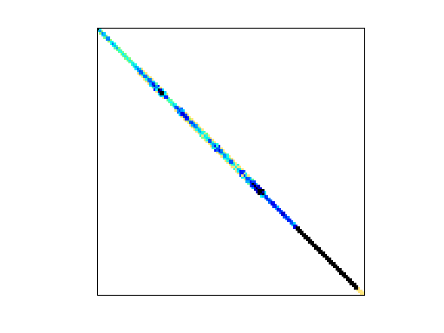
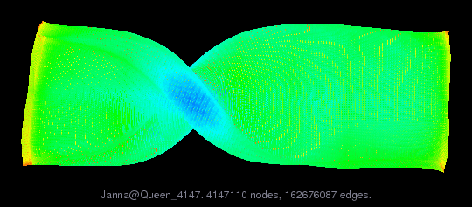
Size estimate for 1mm³
Estimate for K
  Ntiles = 2.5e8 = (1e4 tiles/section)x(2.5e4 sections)
  K m x n = 1.5e9 x 1.5e9 (6DOF per tile)
  Guess that each tile has point matches to 10 other tiles.
  nnz = 5e10 (each row has 3*(10+1) nz entries)
Similar (?), smaller matrix: Janna/Queen_4147 (SuiteSparse...):
  m x n = 4.1e6 x 4.1e6
  nnz = 3.2e8

Slide 15
First pastix with Janna/Queen_4147
root@15884987838d:/app/pastix_5.2.3/src/example/bin# ./simple -MM /app/matrices/Queen_4147.mtx
MPI_Init_thread level = MPI_THREAD_MULTIPLE
driver: MatrixMarket file: /app/matrices/Queen_4147.mtx
open RHS file : /app/matrices/Queen_4147.mtx.rhs
cannot load /app/matrices/Queen_4147.mtx.rhs
Setting right-hand-side member such as X[i] = i
Check : Numbering OK
Check : Sort CSC OK
Check : Duplicates OK
+--------------------------------------------------------------------+
+ PaStiX : Parallel Sparse matriX package +
+--------------------------------------------------------------------+
Matrix size 4147110 x 4147110
Number of nonzeros in A 166823197
+--------------------------------------------------------------------+
+ Options +
+--------------------------------------------------------------------+
Version :
SMP_SOPALIN : Defined
VERSION MPI : Defined
PASTIX_DYNSCHED : Not defined
STATS_SOPALIN : Not defined
NAPA_SOPALIN : Defined
TEST_IRECV : Not defined
TEST_ISEND : Defined
TAG : Exact Thread
FORCE_CONSO : Not defined
RECV_FANIN_OR_BLOCK : Not defined
OUT_OF_CORE : Not defined
DISTRIBUTED : Defined
METIS : Not defined
WITH_SCOTCH : Defined
INTEGER TYPE : int
PASTIX_FLOAT TYPE : double
+--------------------------------------------------------------------+
Time to compute ordering 46.2 s
Time to analyze 5.09 s
Number of nonzeros in factorized matrix -2147483648
Fill-in -12.8728
Number of operations (LLt) 2.69604e+14
Prediction Time to factorize (AMD 6180 MKL) 3.61e+04 s
--- Sopalin : Threads are binded ---
First, try simple.c (single-threaded...)
1.7e8 nnz before factorization
-2.1e9 nnz after factorization
(note minus sign, I thought I compiled with 64-bit integers, but, now I need to go check)
At start of factorization, RAM usage went up to 115GB. (from ~5GB)
10 hours predicted time to factorize...
This is a terrible example for single-thread, but, good for parallel

Slide 16
Janna/Queen_4147 multi-processor
root@15884987838d:/app/pastix_5.2.3/src/example/bin# ./simple -t 12 -MM /app/matrices/Queen_4147.mtx
MPI_Init_thread level = MPI_THREAD_MULTIPLE
driver: MatrixMarket file: /app/matrices/Queen_4147.mtx
open RHS file : /app/matrices/Queen_4147.mtx.rhs
cannot load /app/matrices/Queen_4147.mtx.rhs
Setting right-hand-side member such as X[i] = i
Check : Numbering OK
Check : Sort CSC OK
Check : Duplicates OK
+--------------------------------------------------------------------+
+ PaStiX : Parallel Sparse matriX package +
+--------------------------------------------------------------------+
Matrix size 4147110 x 4147110
Number of nonzeros in A 166823197
+--------------------------------------------------------------------+
+ Options +
+--------------------------------------------------------------------+
Version :
SMP_SOPALIN : Defined
VERSION MPI : Defined
PASTIX_DYNSCHED : Not defined
STATS_SOPALIN : Not defined
NAPA_SOPALIN : Defined
TEST_IRECV : Not defined
TEST_ISEND : Defined
TAG : Exact Thread
FORCE_CONSO : Not defined
RECV_FANIN_OR_BLOCK : Not defined
OUT_OF_CORE : Not defined
DISTRIBUTED : Defined
METIS : Not defined
WITH_SCOTCH : Defined
INTEGER TYPE : int
PASTIX_FLOAT TYPE : double
+--------------------------------------------------------------------+
Time to compute ordering 46.1 s
Time to analyze 5.19 s
Number of nonzeros in factorized matrix -2147483648
Fill-in -12.8728
Number of operations (LLt) 2.69604e+14
Prediction Time to factorize (AMD 6180 MKL) 3.19e+03 s
--- Sopalin : Threads are binded ---
- iteration 1 :
total iteration time 7.57 s
error 2.4232e-13
Static pivoting 149446
Inertia (NB: with pivoting) 4147110
Time to factorize 1.32e+04 s
FLOPS during factorization 19.045 GFLOPS
Time to solve 7.3 s
Refinement 1 iterations, norm=2.42e-13
Time for refinement 7.83 s
Precision : ||ax -b||/||b|| = 2.3221479458594105064e-13
Running on em-131db
12 cores
250GB RAM (used 115GB)
3.7 hours
Using simple.c example from pastix. No fancy options.

Slide 17
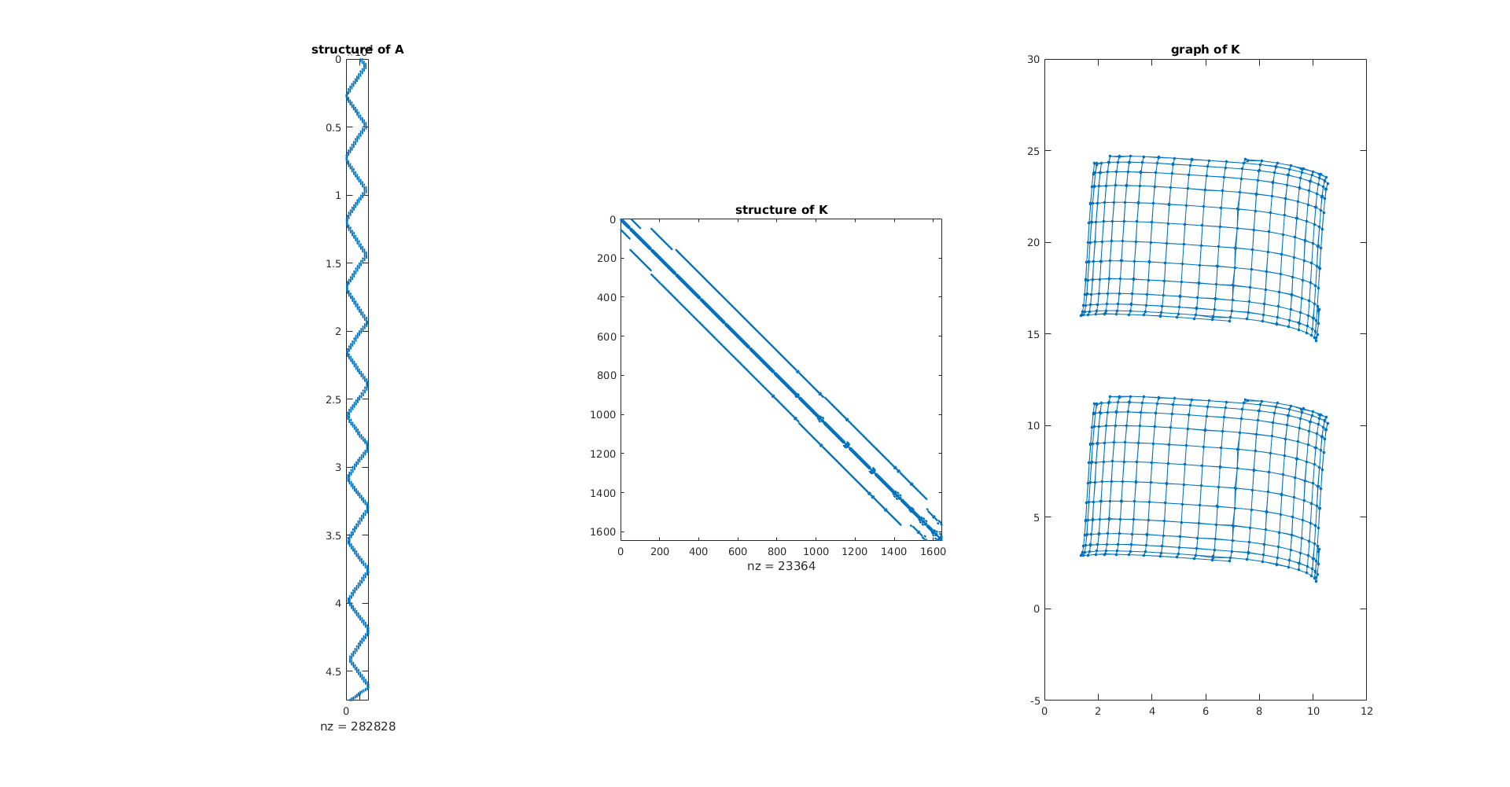
A and K from a whole section (282 tiles)

Slide 18
EM_aligner
system_solve_affine_with_constraint
get_section_ids
load_all_transformations
system_solve_helper_load_point_matches
load_montage_pm
load_cross_section_pm
filter_pm_local
filter_pm_consistency
split_PM_XXX.mat
gen_A_b_row_range
Construct K and Lm
solve_AxB
solve_pastix
system_solve_helper_ingest_into_renderer_database
Inspect diagnostics

Slide 19
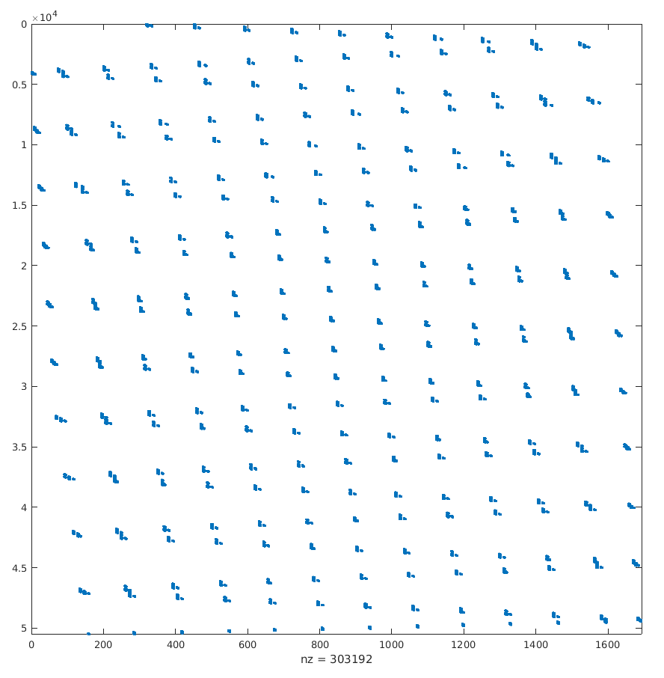
Do these plots make sense?
Change aspect
A size: 50532x1692
1692 = 282tiles x 6DOF/tile
50532 = average of ~190 point matches per overlap

