Slide 1
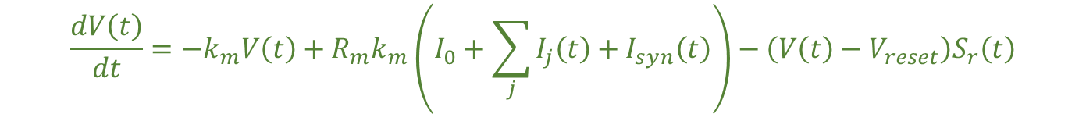




$$\frac{dI_{j}}{dt}=−k_{j}I_{j}\left(t\right)+\left(a_{j}+r_{j}I_{j}\left(t\right)\right)S_{r}(t)$$
W_{lat}
$$S_{r}\left(t\right)=\frac{S\left(t\right)}{τ}$$
k_{j}
I_{j}(t)
a_{j},r_{j}
V_{reset}
$$S\left(t\right)=\frac{1}{1+e^{−(V\left(t\right)−V_{th})/σ_V}}$$
$$I_{syn}\left(t\right)=W_{in}S_{pre}\left(t\right)+W_{lat}S(t)$$
W_{in}
I_{syn}(t)
R_{m},k_{m}
V(t)
V_{th}
S(t)
k_{m}
$$\frac{dV\left(t\right)}{dt}=−k_{m}V\left(t\right)+R_{m}k_{m}\left(I_{0}+\sum_{j}{I_{j}\left(t\right)}+I_{syn}\left(t\right)\right)−\left(V\left(t\right)−V_{reset}\right)S_{r}\left(t\right)$$

Slide 2
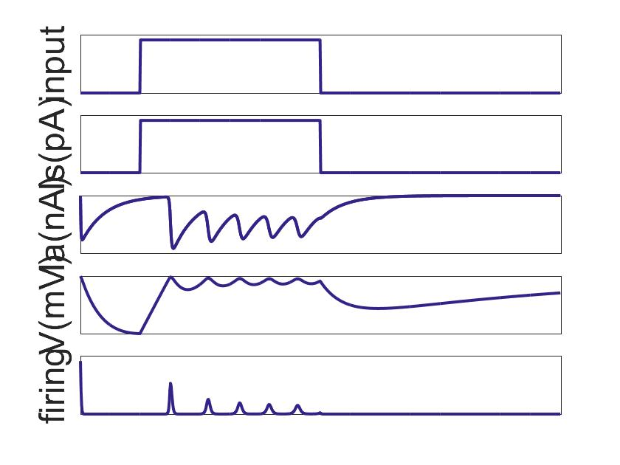
recurrent connection
current
decay
I_{j}(t)
after-spike current
voltage reset
I_{syn}(t)
synaptic current
V(t)
voltage
S(t)
firing rate
input
output
current integration
membrane decay

Slide 3
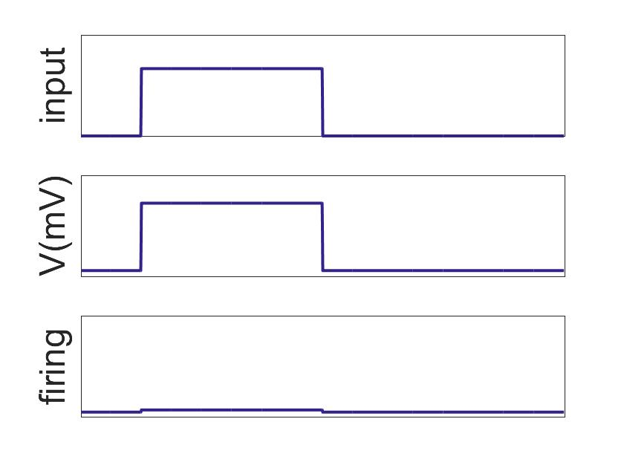
recurrent connection
r(t)
hidden state
S(t)
output
input
nonlinearity
output

