Slide 1
Poster Outline

Slide 2
Background
As we continue to build and combine larger reference datasets, it becomes increasingly important to optimize accuracy of mapping algorithms
https://www.biorxiv.org/content/10.1101/2021.08.04.453579v1.full
The challenge with creating large reference datasets is usability:
SIDE ISSUE: (I don’t think is necessarily addressed, as our mapping algorithms aren’t quick)
Need an easy, effective method of integrating ones own data with the reference dataset.
Using this machine learning approach, we would be able to outline easy-to-follow guidelines for individual labs interested in mapping onto our reference atlases.
https://www.ncbi.nlm.nih.gov/pmc/articles/PMC7289686/

Slide 3
“Coordinated large-scale efforts, exemplified by the Human Cell Atlas (HCA)¹², aim to establish comprehensive and well-annotated reference datasets comprising millions of cells that capture the broad spectrum of cell states. Building these reference atlases requires integrating multiple datasets that may have been collected under different technical and biological conditions. Hence, reference construction requires application of one of many recently developed single-cell integration algorithms”
Kang et al 2021
https://doi.org/10.1038/s41467-021-25957-x

Slide 4
Allen Institute Aging Brain Mouse Dataset Construction
We are challenged to integrate and map cells to create a comprehensive reference dataset while minimizing batch effects.
ADD: Number of cells that will be in aging dataset
Important to have accurate computational and statistical methods to integrate the single cell data.
This thorough comparison of mapping algorithms was run on 622,350 cells, which is a subset of cells from Allen Institute forebrain dataset
SS: 143625 cells; 28746 genes (full: 143625 cells)
V3: 270545 cells; 31053 genes (full: 1126392 cells)
V2: 208180 cells ; 31053 genes (full: 2422766 cells)

Slide 5
“Data cards” and “model cards” section
Explain differences between the 3 mapping algorithms
Visual representation of cluster, subclass, neighborhood, class distributions
Similar to Rohan’s data cards

Slide 6
Results

Slide 7
Which mapping algorithm is most accurate when using default parameters?

Slide 8
Flat
HKNN
Seurat
v3
Test error
Test error
Test error
# of marker genes
# of marker genes
# of marker genes
v2
Test error
Test error
Test error
# of marker genes
# of marker genes
# of marker genes
SS
Test error
Test error
Test error
# of marker genes
# of marker genes
# of marker genes

Slide 9
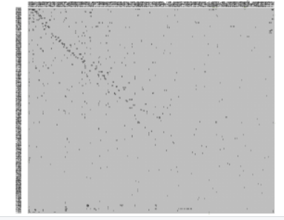
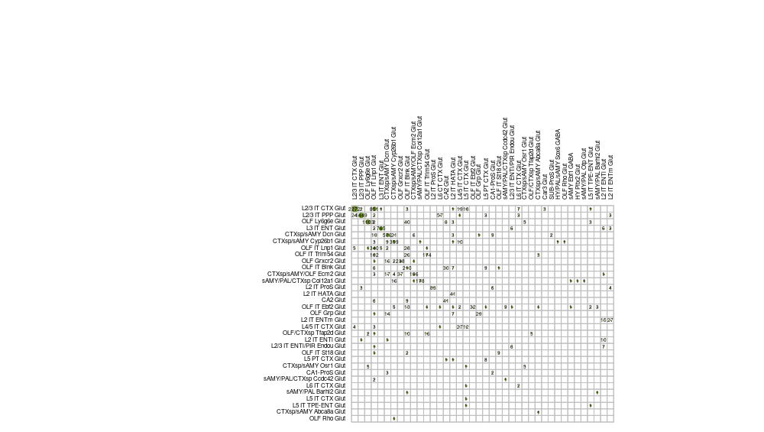
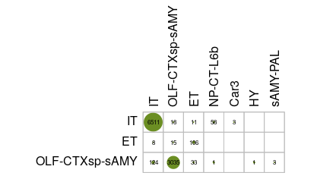
Sample corr plot on a subset of SS data:
Cluster
Subclass
Neighborhood

