Slide 1
SpaceHack_3.0
Dec 11, 2024

Slide 2
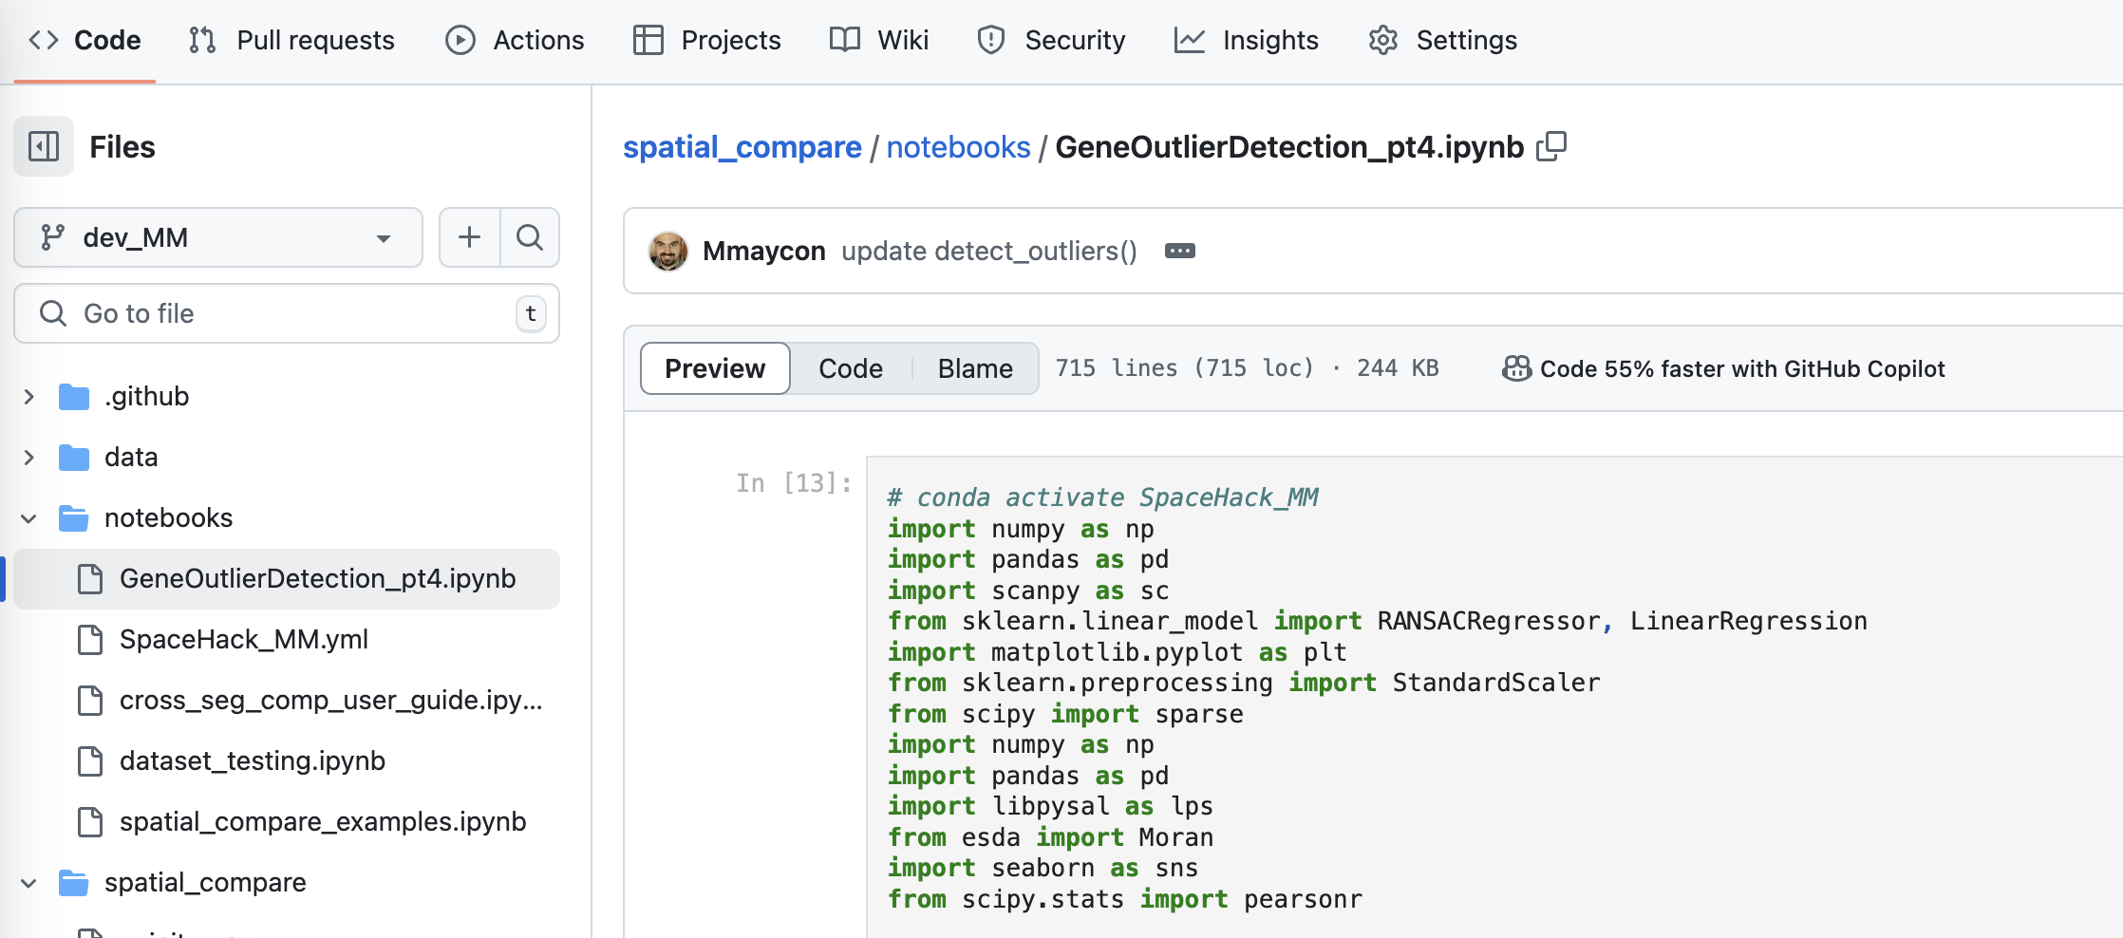
Updates summary - Maycon
https://github.com/Mmaycon/spatial_compare/blob/dev_MM/notebooks/GeneOutlierDetection_pt4.ipynb

Slide 3
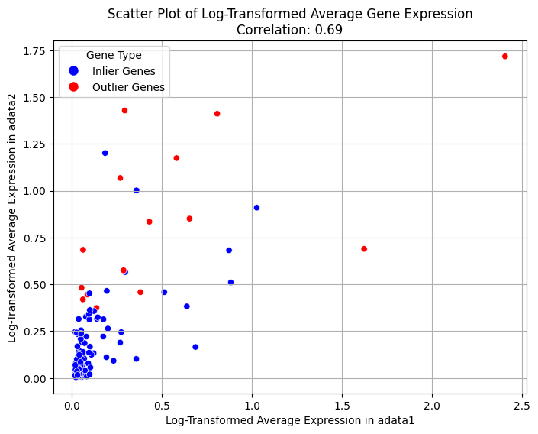
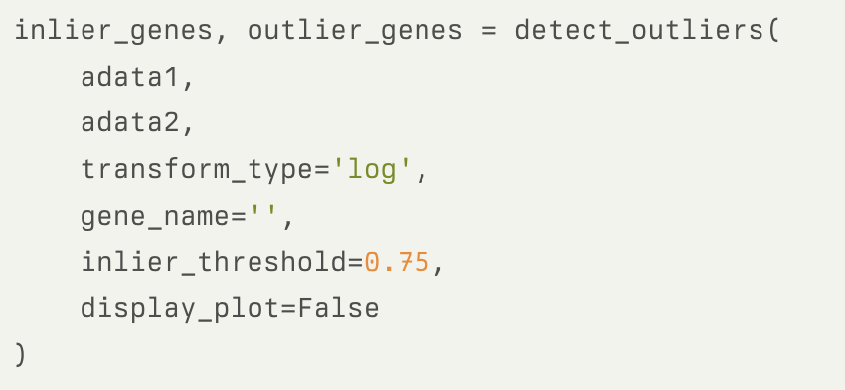
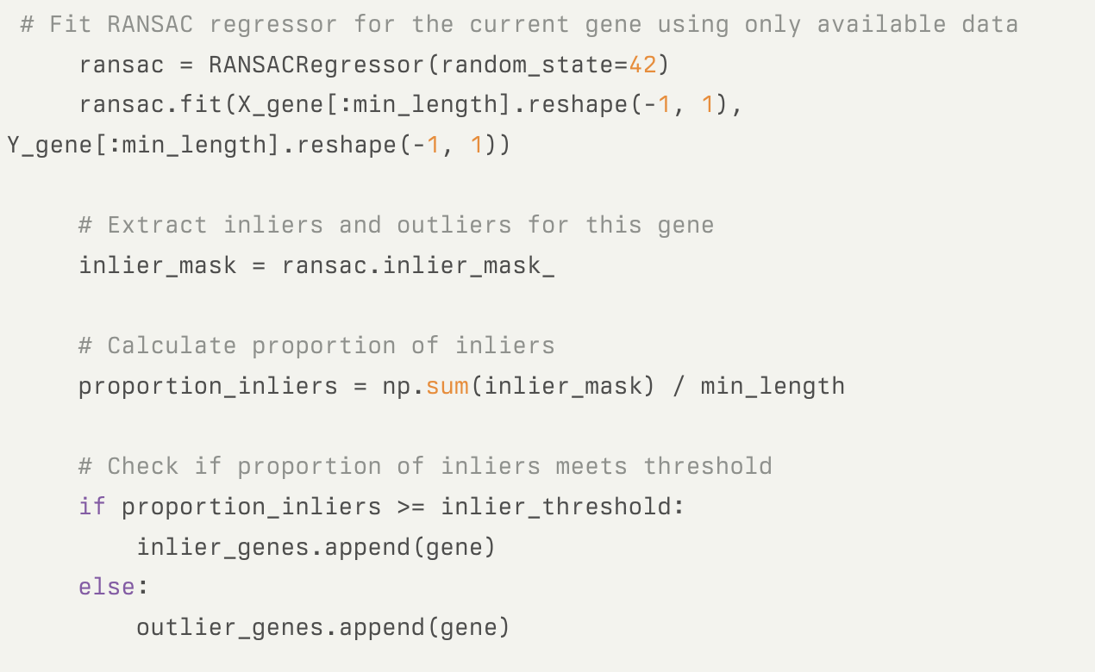
Function to detect outlier genes between platforms, same tissue type
In the detect_outliers()
Inlier_threshold
- it’s a percentage of cells that got a ”Inlier” label
from RANSAC for a given gene
- if it’s 0.75, it means that for that tested gene
75% of the cells got classified as a “inlier” based
on their expression values. So that gene should be
called a inlier gene. Otherwise, it gets called a
outlier gene. - it’s still a manual set up and can impact on the size
of the outlier genes output
*CosMx and Xenium of breast tissue

