Slide 1
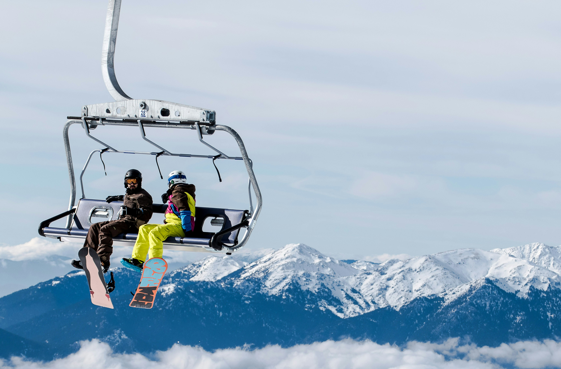
Big Mountain Ticket Price Research

Slide 2
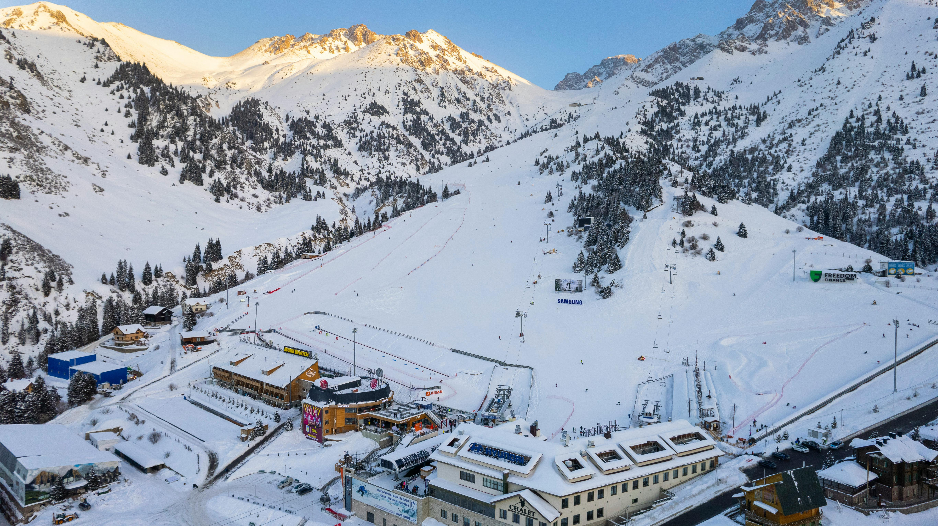
Agenda
Problem Identification
Recommendations & Key Findings
Modeling Approach
Modeling Performance
Key Drivers
Scenario Analysis
Conclusion

Slide 3
Problem Identification
Problem: The current premium pricing strategy at Big Mountain lacks feature-based justification, and there is no clear linkage between resort features and ticket price.
The result is limited support for investment decision-making.
Big Mountain’s current adult weekend ticket price is $81 (above national average and among highest in Montana).
Initial Directive: Increase revenue by 10% by the end of next season via night skiing expansion and marketing of new lift and Hellfire run.

Slide 4
Recommendations & Key Findings
Recommendation #1: Immediate $1 increase to weekend ticket price and close 3-5 of the least used runs. The price increase alone easily accommodates the cost of recently installed chair lift.
Recommendation #2: Add new run to increase vertical drop 150' with additional chair lift. This will warrant an $8.61 bump in price.
It is with the above recommendation that the desired 10% increase in seasonal revenue will be achieved.
Recommendation #2 Stretch: Add 2 acres of snowmaking to new run to achieve extra $1.29 bump in price.

Slide 5
Modeling Approach
Dataset (cleaned): 277 resorts, 25 features
Constraint: No information regarding one-time and seasonal operating costs at Big Mountain
Target variable: Adult weekend ticket price
Note: Adult weekday ticket price was dropped due to original dataset having excessive missing values for this feature.
Models tested:
Baseline (average weekend ticket price across all resorts)
Linear Regression
Random Forest (ultimately selected for best performance)

Slide 6
Modeling Performance Mean Absolute Error (MAE) = average magnitude of errors between predicted (from model) and actual (from dataset) values
Baseline MAE: $19.13 (Would expect random guess of ticket price to be off by $19)
Linear Regression MAE: $10.50
Random Forest MAE: $9.64 (exhibited lower variability versus linear model)
Random forest model was selected as best choice for price prediction.

Slide 7
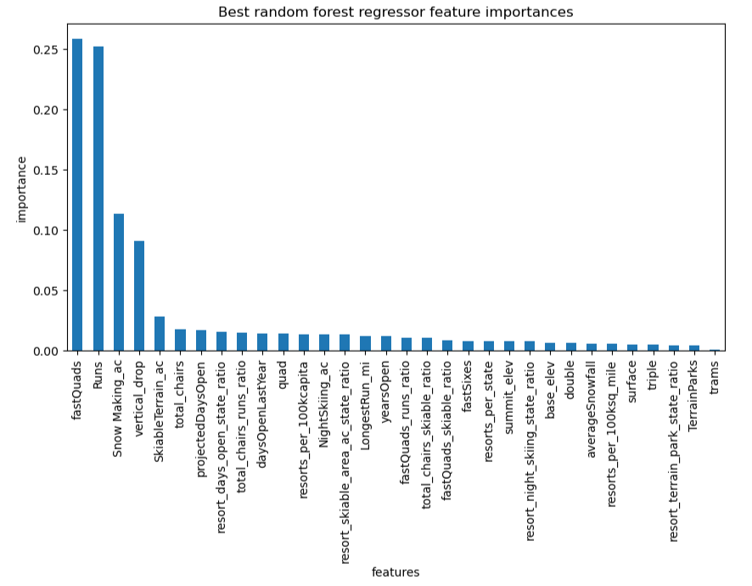
Key Drivers
Key drivers of price from selected model:
Fast quads
Runs
Snow making acreage
Vertical drop
Note: Neither night skiing acreage nor length of Hellfire run were significant to pricing.

Slide 8
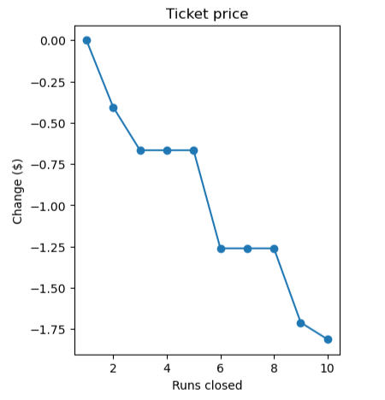
Scenario Analysis
#1 - Closing underutilized runs: Model predicts that the closing of up to 5 runs will result in $0.57 overall drop in ticket price.

Slide 9
Scenario Analysis (continued)
#2 - Increasing vertical drop by 150 feet with additional lift: Model predicts price increase of $8.61 from current.
#3 - Same as previous option but with 2 acres of snow making: Model predicts price increase of $9.90 from current.
#4 - Increasing the Hellfire run by 0.2 miles with 4 acres of snow making: Model predicts no price change from current.
Note: The predicted ticket price from the model was calculated to be $95.87 for current facilities. This suggests Big Mountain is underpricing relative to its features.

Slide 10
Conclusion
Big Mountain has been underpricing tickets relative to the features offered.
Immediate $1 price increase is easily warranted to cover costs of new chair lift.
Closing 3-5 of least-used runs can reduce costs without impacting ticket price.
150-foot vertical drop expansion offers strongest return-on-investment potential.
150-foot vertical drop with 2 acres of snow making is a nice-to-have, but will depend on cost.
Future work: Incorporate Big Mountain’s operational cost data for further refinement of model.

Slide 11
Thank you
Allen Jahnke
316-253-2334
Jahn.al@live.com

