Slide 1
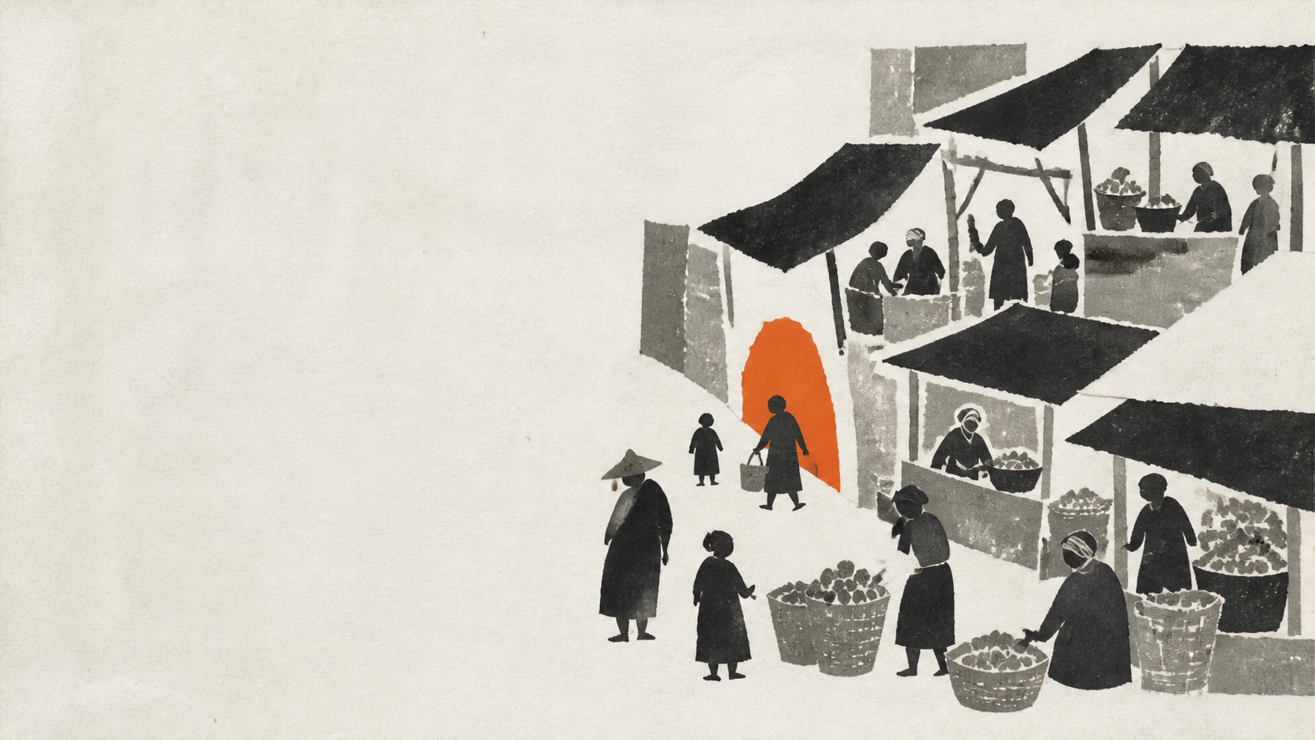
01 / 08
A COMPLEX ZINE-ANCHOR DEMONSTRATION
Memory is
infrastructure
A market is remembered through patterns—not monuments.
THE THRESHOLD AS A LIVING SYSTEM
Notes:
[Sources]
Original illustration generated with OpenAI image generation for this demonstration.
No external factual claims.
[Animation cues — static PPTX fallback]
Reveal s01-scene-a through a left-to-right mask over 0.6 seconds.
Hold the orange aperture as the visual anchor state: compact opening.
[Motion status]
Objects are independently selectable, but this PPTX intentionally contains no claimed native timing tree. Use the cues above or the companion HTML for verified motion.

Slide 2
A PATTERN HAS LAYERS
02 / 08
Four layers make the pattern legible
01
OBJECTS
Stalls, tarps, tools, signs
The visible kit of everyday trade.
02
RITUALS
Opening, exchange, pause
Sequences that make use recognizable.
03
ROUTES
Approach, passage, return
Movement that connects repeated encounters.
04
ACCESS
Affordability, presence, choice
Conditions that keep participation possible.
Notes:
[Sources]
Concept model authored for this demonstration; no external factual claims.
[Animation cues — static PPTX fallback]
Reveal the four row compartments from top to bottom with 0.12-second overlap.
The orange seam advances one row at a time; anchor state: reading seam.
[Motion status]
Objects are independently selectable, but this PPTX intentionally contains no claimed native timing tree. Use the cues above or the companion HTML for verified motion.

Slide 3
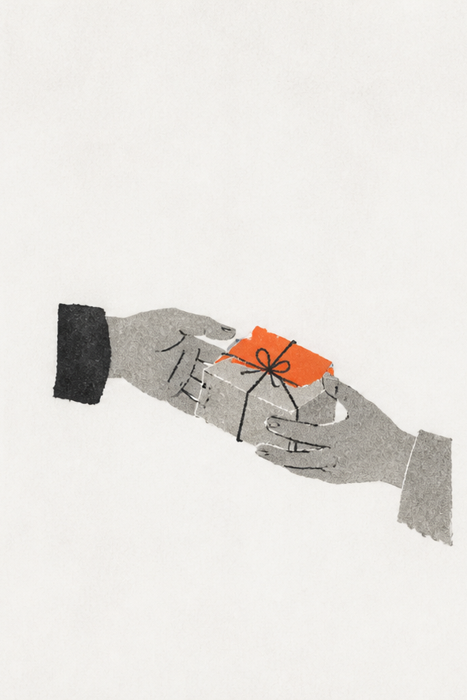
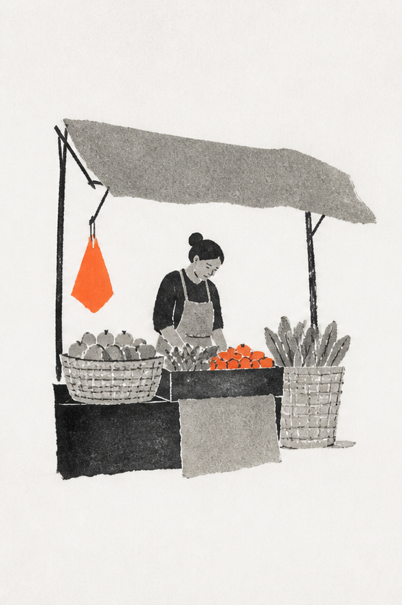
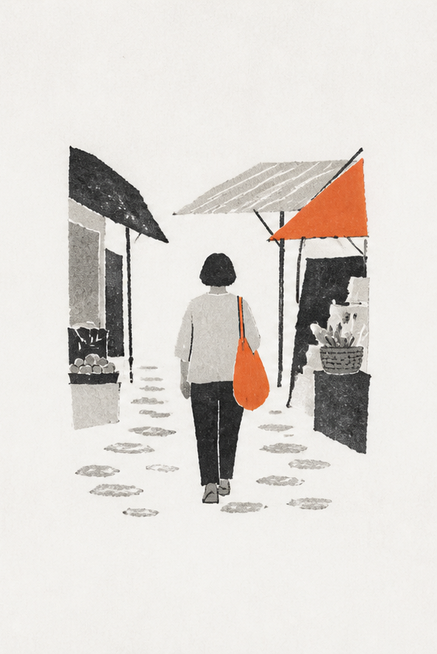
RECOGNITION LIVES IN REPETITION
03 / 08
Three everyday rituals keep recognition alive
01 · STALL
02 · EXCHANGE
03 · PASSAGE
Notes:
[Sources]
Original three-part illustration generated with OpenAI image generation.
Each scene is a separate image object and remains independently selectable.
[Animation cues — static PPTX fallback]
Animate s03-scene-a, then s03-scene-b, then s03-scene-c.
Entrance: rise 18 px and fade; duration 0.52 seconds each; 0.13-second overlap.
Reduced-motion equivalent: show all three in final position.
[Motion status]
Objects are independently selectable, but this PPTX intentionally contains no claimed native timing tree. Use the cues above or the companion HTML for verified motion.

Slide 4
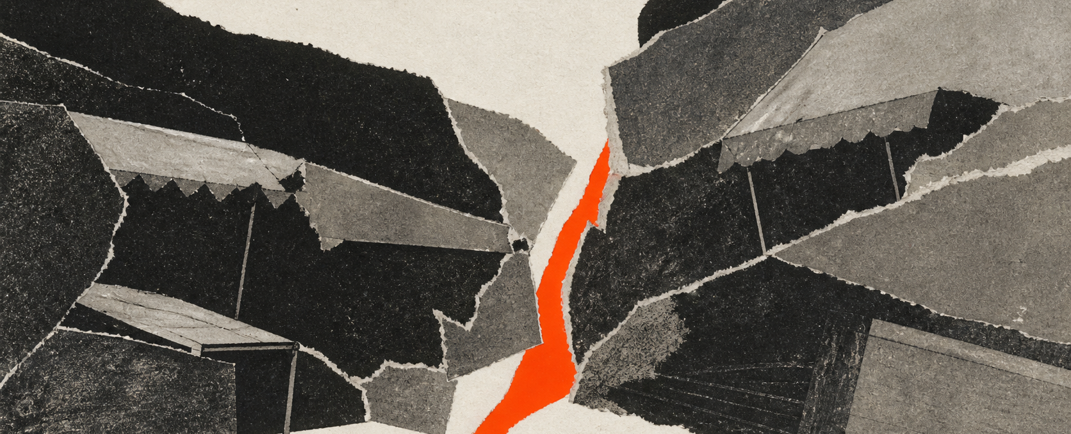
THE TENSION IS SPATIAL
04 / 08
A narrowed route makes every other layer fragile
A path can remain technically open—and still stop carrying the rituals people recognize.
Notes:
[Sources]
Original illustration generated with OpenAI image generation.
No external factual claims.
[Animation cues — static PPTX fallback]
Reveal s04-scene-a with a horizontal clip expanding from the orange seam; 0.7 seconds.
Anchor state: constricted but not closed.
[Motion status]
Objects are independently selectable, but this PPTX intentionally contains no claimed native timing tree. Use the cues above or the companion HTML for verified motion.

Slide 5
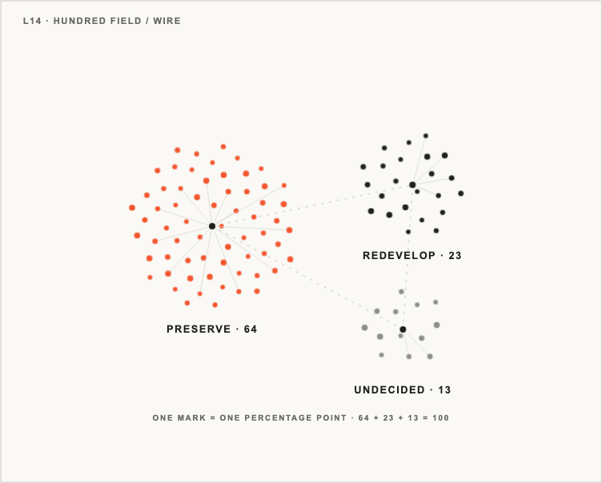
SIMULATED DEMONSTRATION DATA
05 / 08
Preserve the pattern
64 to 23
L14 · HUNDRED FIELD / WIRE
+41
percentage points
One mark equals one percentage point. The orange cluster turns the threshold into evidence.
Illustrative values only: preserve 64%, redevelop 23%, undecided 13%.
Notes:
[Sources]
Simulated demonstration data: preserve 64%, redevelop 23%, undecided 13%; not a real survey.
Chart system: Lieflat Charts L14 Hundred Field, Wire color system. Lieflat Charts was created at Moxt and is distributed by larashero3-dotcom. PolyForm Noncommercial 1.0.0; this is a noncommercial demonstration.
Template audit: L14 selected; F4 Tick Donut rejected because comparison is slower; L5 radial convergence rejected because it adds relationship geometry absent from the data.
[Animation cues — static PPTX fallback]
Reveal marks with the L14 phyllotaxis stagger; preservation cluster first.
Duration about 0.76 seconds; reduced-motion equivalent shows all marks immediately.
Companion HTML includes click-to-replay.
[Motion status]
Objects are independently selectable, but this PPTX intentionally contains no claimed native timing tree. Use the cues above or the companion HTML for verified motion.

Slide 6
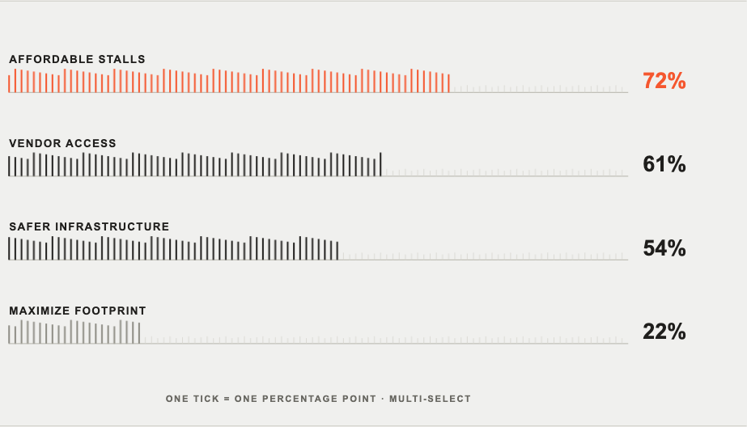
WHAT SHOULD CHANGE PROTECT?
06 / 08
Access priorities outrank maximum footprint
L15 · BALLOT TALLY / WIRE
72
affordable stalls
The strongest request is not stasis. It is continued participation.
Illustrative tally only; values are simulated for this deck.
Notes:
[Sources]
Simulated demonstration values: affordable stalls 72, vendor access 61, safer infrastructure 54, maximize footprint 22; not a real ballot.
Chart system: Lieflat Charts L15 Ballot Tally, Wire color system. Lieflat Charts was created at Moxt and is distributed by larashero3-dotcom. PolyForm Noncommercial 1.0.0; this is a noncommercial demonstration.
Template audit: L15 selected for explicit vote counting; conventional bar chart rejected because tally accumulation is the story.
[Animation cues — static PPTX fallback]
Reveal each ballot row left to right; 0.10-second stagger between rows.
The orange affordable-stalls row resolves last as the persistent visual anchor.
Companion HTML includes click-to-replay and reduced-motion support.
[Motion status]
Objects are independently selectable, but this PPTX intentionally contains no claimed native timing tree. Use the cues above or the companion HTML for verified motion.

Slide 7
A DECISION RULE
07 / 08
Change is viable when it protects rhythm, access,
and adaptation
01 / RHYTHM
03 / ADAPTATION
Protect repetition
Permit visible
change
02 / ACCESS
Keep participation
possible
Retain the cues and sequences through which daily rituals remain recognizable.
Upgrade safety and infrastructure without erasing the pattern that carries memory.
Protect affordable stalls, vendor presence, and routes people can still use.
Notes:
[Sources]
Decision framework authored for this demonstration; no external factual claims.
[Animation cues — static PPTX fallback]
Reveal the three station compartments in sequence: rhythm, access, adaptation.
Draw the orange anchor path only after all body text has settled; keep it below the text reserve.
Reduced-motion equivalent: show the complete rule and path at once.
[Motion status]
Objects are independently selectable, but this PPTX intentionally contains no claimed native timing tree. Use the cues above or the companion HTML for verified motion.

Slide 8
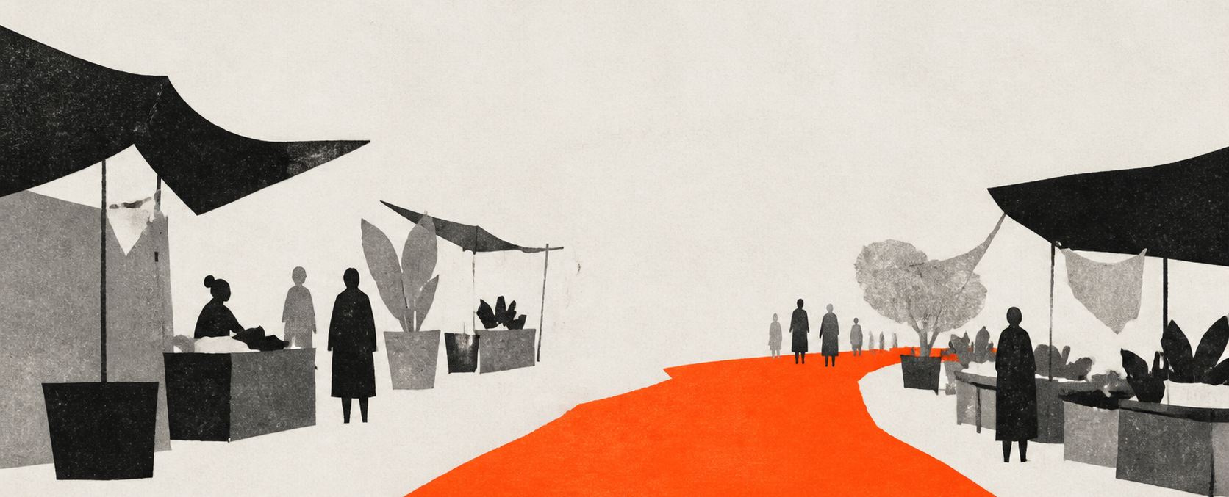
A CLOSING PROPOSITION
08 / 08
Keep the threshold open enough for memory to move
VISUAL SYSTEMS · Zine art direction: Zeejay0. Lieflat Charts: created at Moxt, distributed by larashero3-dotcom; L14 Hundred Field + L15 Ballot Tally, Wire; PolyForm Noncommercial 1.0.0.
PRODUCTION · Original illustrations: OpenAI image generation. PPTX workflow: OpenAI Presentations. Simulated data, not a real survey. No external factual claims.
Notes:
[Sources]
Zine visual direction: Zeejay0.
Lieflat Charts: created at Moxt, distributed by larashero3-dotcom; PolyForm Noncommercial 1.0.0.
OpenAI Presentations and OpenAI image generation used for production.
[Animation cues — static PPTX fallback]
Soft reveal of s08-scene-a over 0.6 seconds.
Anchor state: the orange threshold opens into a stable passage.
[Motion status]
Objects are independently selectable, but this PPTX intentionally contains no claimed native timing tree. Use the cues above or the companion HTML for verified motion.

