Slide 1
Ch. 7: Wireless and Mobile Networks
Background:
# wireless (mobile) phone subscribers now exceeds # wired phone subscribers (5-to-1)!
# wireless Internet-connected devices equals # wireline Internet-connected devices
laptops, Internet-enabled phones promise anytime untethered Internet access
two important (but different) challenges
wireless: communication over wireless link
mobility: handling the mobile user who changes point of attachment to network

Slide 2
Chapter 7 outline
7.1 Introduction
Wireless
7.2 Wireless links, characteristics
CDMA
6.73 IEEE 802.11 wireless LANs (“Wi-Fi”)
67.4 Cellular Internet Access
architecture
standards (e.g., 3G, LTE)
Mobility
7.5 Principles: addressing and routing to mobile users
7.6 Mobile IP
7.7 Handling mobility in cellular networks
7.8 Mobility and higher-layer protocols

Slide 3



















Elements of a wireless network
network
infrastructure

Slide 4



Elements of a wireless network
wireless hosts
laptop, smartphone
run applications
may be stationary (non-mobile) or mobile
wireless does not always mean mobility
network
infrastructure

Slide 5

Elements of a wireless network
base station
typically connected to wired network
relay - responsible for sending packets between wired network and wireless host(s) in its “area”
e.g., cell towers, 802.11 access points
network
infrastructure

Slide 6
Elements of a wireless network
wireless link
typically used to connect mobile(s) to base station
also used as backbone link
multiple access protocol coordinates link access
various data rates, transmission distance
network
infrastructure

Slide 7
Characteristics of selected wireless links
1300
802.11 ac
450
802.11n
54
802.11a,g
802.11a,g point-to-point
5-11
802.11b
4G: LTWE WIMAX
4
3G: UMTS/WCDMA-HSPDA, CDMA2000-1xEVDO
Data rate (Mbps)
1
802.15
.384
2.5G: UMTS/WCDMA, CDMA2000
.056
2G: IS-95, CDMA, GSM
Indoor
10-30m
Outdoor
50-200m
Mid-range
outdoor
200m – 4 Km
Long-range
outdoor
5Km – 20 Km

Slide 8
Elements of a wireless network
infrastructure mode
base station connects mobiles into wired network
handoff: mobile changes base station providing connection into wired network
network
infrastructure

Slide 9
Elements of a wireless network
ad hoc mode
no base stations
nodes can only transmit to other nodes within link coverage
nodes organize themselves into a network: route among themselves

Slide 10
Chapter 7 outline
7.1 Introduction
Wireless
7.2 Wireless links, characteristics
CDMA
7.3 IEEE 802.11 wireless LANs (“Wi-Fi”)
7.4 Cellular Internet Access
architecture
standards (e.g., 3G, LTE)
Mobility
7.5 Principles: addressing and routing to mobile users
7.6 Mobile IP
7.7 Handling mobility in cellular networks
7.8 Mobility and higher-layer protocols

Slide 11
Wireless Link Characteristics (1)
important differences from wired link ….
decreased signal strength: radio signal attenuates as it propagates through matter (path loss)
interference from other sources: standardized wireless network frequencies (e.g., 2.4 GHz) shared by other devices (e.g., phone); devices (motors) interfere as well
multipath propagation: radio signal reflects off objects ground, arriving ad destination at slightly different times
…. make communication across (even a point to point) wireless link much more “difficult”

Slide 12
Wireless Link Characteristics (2)
SNR: signal-to-noise ratio
larger SNR – easier to extract signal from noise (a “good thing”)
SNR versus BER tradeoffs
given physical layer: increase power -> increase SNR->decrease BER
given SNR: choose physical layer that meets BER requirement, giving highest thruput
SNR may change with mobility: dynamically adapt physical layer (modulation technique, rate)
10⁻¹
10⁻²
10⁻³
BER
10⁻⁴
10⁻⁵
10⁻⁶
10⁻⁷
10
20
30
40
SNR(dB)
QAM256 (8 Mbps)
QAM16 (4 Mbps)
BPSK (1 Mbps)

Slide 13

Wireless network characteristics
Multiple wireless senders and receivers create additional problems (beyond multiple access):
A
B
C
C
A’s signal
strength
C’s signal
strength
B
A
Hidden terminal problem
B, A hear each other
B, C hear each other
A, C can not hear each other means A, C unaware of their interference at B
space
Signal attenuation:
B, A hear each other
B, C hear each other
A, C can not hear each other interfering at B

Slide 14
Chapter 7 outline
7.1 Introduction
Wireless
7.2 Wireless links, characteristics
CDMA
7.3 IEEE 802.11 wireless LANs (“Wi-Fi”)
7.4 Cellular Internet Access
architecture
standards (e.g., 3G, LTE)
Mobility
7.5 Principles: addressing and routing to mobile users
7.6 Mobile IP
7.7 Handling mobility in cellular networks
7.8 Mobility and higher-layer protocols

Slide 15
IEEE 802.11 Wireless LAN
802.11b
2.4-5 GHz unlicensed spectrum
up to 11 Mbps
direct sequence spread spectrum (DSSS) in physical layer
all hosts use same chipping code
802.11a
5-6 GHz range
up to 54 Mbps
802.11g
2.4-5 GHz range
up to 54 Mbps
802.11n: multiple antennae
2.4-5 GHz range
up to 600 Mbps
all use CSMA/CA for multiple access
all have base-station and ad-hoc network versions

Slide 16




802.11 LAN architecture
wireless host communicates with base station
base station = access point (AP)
Basic Service Set (BSS) (aka “cell”) in infrastructure mode contains:
wireless hosts
access point (AP): base station
ad hoc mode: hosts only
Internet
hub, switch
or router
BSS 1
BSS 2

Slide 17
802.11: Channels, association
802.11: 2.4GHz-2.485GHz spectrum divided into 11 channels at different frequencies
AP admin chooses frequency for AP
interference possible: channel can be same as that chosen by neighboring AP!
host: must associate with an AP
scans channels, listening for beacon frames containing AP’s name (SSID) and MAC address
selects AP to associate with
may perform authentication [Chapter 8]
will typically run DHCP to get IP address in AP’s subnet

Slide 18
802.11: passive/active scanning
BBS 1
BBS 2
BBS 1
BBS 2
1
AP 2
AP 1
1
1
AP 2
AP 1
2
2
2
3
3
4
H1
H1
passive scanning:
beacon frames sent from APs
association Request frame sent: H1 to selected AP
association Response frame sent from selected AP to H1
active scanning:
Probe Request frame broadcast from H1
Probe Response frames sent from APs
Association Request frame sent: H1 to selected AP
Association Response frame sent from selected AP to H1

Slide 19




IEEE 802.11: multiple access
avoid collisions: 2⁺ nodes transmitting at same time
802.11: CSMA - sense before transmitting
don’t collide with ongoing transmission by other node
802.11: no collision detection!
difficult to receive (sense collisions) when transmitting due to weak received signals (fading)
can’t sense all collisions in any case: hidden terminal, fading
goal: avoid collisions: CSMA/C(ollision)A(voidance)
A
B
C
C
B
A’s signal
strength
C’s signal
strength
A
space

Slide 20
IEEE 802.11 MAC Protocol: CSMA/CA
802.11 sender
1 if sense channel idle for DIFS then
transmit entire frame (no CD)
2 if sense channel busy then
start random backoff time
timer counts down while channel idle
transmit when timer expires
if no ACK, increase random backoff interval, repeat 2
802.11 receiver
- if frame received OK
return ACK after SIFS (ACK needed due to hidden terminal problem)
sender
receiver
DIFS
data
SIFS
ACK

Slide 21
Avoiding collisions (more)
idea: allow sender to “reserve” channel rather than random access of data frames: avoid collisions of long data frames
sender first transmits small request-to-send (RTS) packets to BS using CSMA
RTSs may still collide with each other (but they’re short)
BS broadcasts clear-to-send CTS in response to RTS
CTS heard by all nodes
sender transmits data frame
other stations defer transmissions
avoid data frame collisions completely
using small reservation packets!

Slide 22

Collision Avoidance: RTS-CTS exchange
A
B
AP
RTS(B)
RTS(A)
reservation collision
RTS(A)
CTS(A)
CTS(A)
DATA (A)
defer
time
ACK(A)
ACK(A)

Slide 23
802.11 frame: addressing
2
2
6
6
6
2
6
0 - 2312
4
frame
control
duration
address
1
address
2
address
3
seq
control
address
4
payload
CRC
Address 4: used only in ad hoc mode
Address 1: MAC address
of wireless host or AP
to receive this frame
Address 3: MAC address
of router interface to which AP is attached
Address 2: MAC address
of wireless host or AP
transmitting this frame

Slide 24
802.11 frame: addressing
Internet
H1
R1
router
R1 MAC addr H1 MAC addr
dest. address
source address
802.3 frame
AP MAC addr H1 MAC addr R1 MAC addr
address 1
address 2
address 3
802.11 frame

Slide 25
802.11 frame: more
frame seq #
(for RDT)
duration of reserved
transmission time (RTS/CTS)
2
2
6
6
6
2
6
0 - 2312
4
frame
control
duration
address
1
address
2
address
3
seq
control
address
4
payload
CRC
2
2
4
1
1
1
1
1
1
1
1
Protocol
version
Type
Subtype
To
AP
From
AP
More
frag
Retry
Power
mgt
More
data
WEP
Rsvd
frame type
(RTS, CTS, ACK, data)

Slide 26

802.11: mobility within same subnet
H1 remains in same IP subnet: IP address can remain same
switch: which AP is associated with H1?
self-learning (Ch. 5): switch will see frame from H1 and “remember” which switch port can be used to reach H1
BBS 1
H1
BBS 2

Slide 27
Chapter 7 outline
7.1 Introduction
Wireless
7.2 Wireless links, characteristics
CDMA
7.3 IEEE 802.11 wireless LANs (“Wi-Fi”)
7.4 Cellular Internet access
architecture
standards (e.g., 3G, LTE)
Mobility
7.5 Principles: addressing and routing to mobile users
7.6 Mobile IP
7.7 Handling mobility in cellular networks
7.8 Mobility and higher-layer protocols

Slide 28

Components of cellular network architecture
MSC
connects cells to wired tel. net.
manages call setup (more later!)
handles mobility (more later!)
cell
covers geographical region
base station (BS) analogous to 802.11 AP
mobile users attach to network through BS
air-interface: physical and link layer protocol between mobile and BS
Mobile
Switching
Center
Public telephone
network
Mobile
Switching
Center
wired network

Slide 29
Cellular networks: the first hop
Two techniques for sharing mobile-to-BS radio spectrum
combined FDMA/TDMA: divide spectrum in frequency channels, divide each channel into time slots
CDMA: code division multiple access
time slots
frequency
bands

Slide 30
3G (voice+data) network architecture
MSC
G
Public
telephone
network
radio
network
controller
Gateway
MSC
G
Public
Internet
SGSN
Key insight: new cellular data
network operates in parallel
(except at edge) with existing
cellular voice network
voice network unchanged in core
data network operates in parallel
GGSN
Serving GPRS Support Node (SGSN)
Gateway GPRS Support Node (GGSN)

Slide 31
3G (voice+data) network architecture
MSC
G
Public
telephone
network
radio
network
controller
Gateway
MSC
G
Public
Internet
SGSN
GGSN
radio interface
(WCDMA, HSPA)
radio access network
Universal Terrestrial Radio
Access Network (UTRAN)
core network
General Packet Radio Service
(GPRS) Core Network
public
Internet

Slide 32
3G versus 4G LTE network architecture
MSC
G
Public
telephone
network
3G
radio
network
controller
Gateway
MSC
G
Public
Internet
SGSN
GGSN
4G-LTE
HSS
MME
G
G
Public
Internet
S-GW
P-GW
radio access network
Universal Terrestrial Radio
Access Network (UTRAN)
Evolved Packet Core
(EPC)

Slide 33
4G: differences from 3G
all IP core: IP packets tunneled (through core IP network) from base station to gateway
no separation between voice and data – all traffic carried over IP core to gateway
Mobility
Management
Entity (MME)
Home Subscriber
Server(HSS)
(like HLR+VLR)
Serving
Gateway
(S-GW)
Packet data
network
Gateway
(P-GW)
UE
(user element)
eNodeB
(base station)
HSS
MME
control
G
G
Public
Internet
data
S-GW
P-GW
radio access network
Universal Terrestrial Radio
Access Network (UTRAN)
Evolved Packet Core
(EPC)

Slide 34
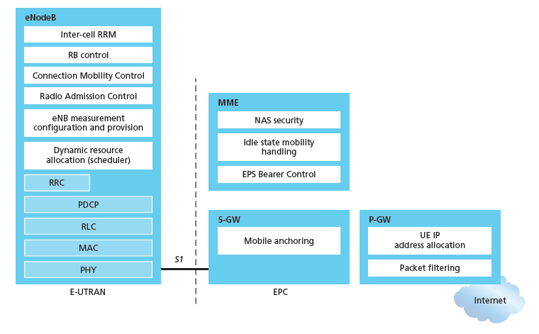
Functional split of major LTE components
handles idle/active UE transitions
pages UE
sets up eNodeB-PGW tunnel (aka bearer)
holds idle UE info
QoS enforcement

Slide 35
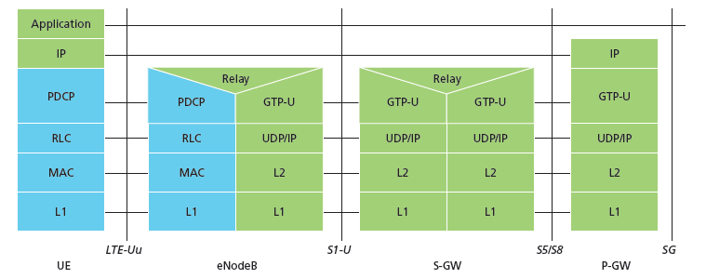
Radio+Tunneling: UE – eNodeB – PGW
IP packet from UE encapsulated in GPRS Tunneling Protocol (GTP) message at ENodeB
GTP message encapsulated in UDP, then encapsulated in IP. large IP packet addressed to SGW
G
G
UE
eNodeB
S-GW
P-GW
tunnel
link-layer radio net

Slide 36
Chapter 7 outline
7.1 Introduction
Wireless
7.2 Wireless links, characteristics
CDMA
7.3 IEEE 802.11 wireless LANs (“Wi-Fi”)
7.4 Cellular Internet Access
architecture
standards (e.g., 3G, LTE)
Mobility
7.5 Principles: addressing and routing to mobile users
7.6 Mobile IP
7.7 Handling mobility in cellular networks
7.8 Mobility and higher-layer protocols

Slide 37
What is mobility?
spectrum of mobility, from the network perspective:
no mobility
high mobility
mobile wireless user,
using same access
point
mobile user, connecting/ disconnecting from network using DHCP.
mobile user, passing through multiple access point while maintaining ongoing connections (like cell phone)

Slide 38



Mobility: vocabulary
home network: permanent “home” of mobile
(e.g., 128.119.40/24)
home agent: entity that will perform mobility functions on behalf of mobile, when mobile is remote
wide area network
permanent address: address in home network, can always be used to reach mobile
e.g., 128.119.40.186

Slide 39
Mobility: more vocabulary
permanent address: remains constant (e.g., 128.119.40.186)
visited network: network in which mobile currently resides (e.g., 79.129.13/24)
care-of-address: address in visited network.
(e.g., 79,129.13.2)
wide area network
foreign agent: entity in visited network that performs mobility functions on behalf of mobile.
correspondent: wants to communicate with mobile

Slide 40

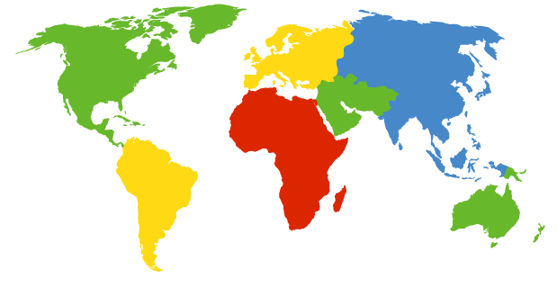

How do you contact a mobile friend:
Consider friend frequently changing addresses, how do you find her?
I wonder where Alice moved to?
search all phone books?
call her parents?
expect her to let you know where he/she is?
Facebook!

Slide 41
Mobility: approaches
let routing handle it: routers advertise permanent address of mobile-nodes-in-residence via usual routing table exchange.
routing tables indicate where each mobile located
no changes to end-systems
let end-systems handle it:
indirect routing: communication from correspondent to mobile goes through home agent, then forwarded to remote
direct routing: correspondent gets foreign address of mobile, sends directly to mobile

Slide 42
Mobility: approaches
let routing handle it: routers advertise permanent address of mobile-nodes-in-residence via usual routing table exchange.
routing tables indicate where each mobile located
no changes to end-systems
let end-systems handle it:
indirect routing: communication from correspondent to mobile goes through home agent, then forwarded to remote
direct routing: correspondent gets foreign address of mobile, sends directly to mobile
not
scalable
to millions of
mobiles

Slide 43
Mobility: registration
visited network
home network
1
2
wide area network
mobile contacts foreign agent on entering visited network
foreign agent contacts home agent home: “this mobile is resident in my network”
end result:
foreign agent knows about mobile
home agent knows location of mobile

Slide 44

Mobility via indirect routing
foreign agent receives packets, forwards to mobile
home agent intercepts packets, forwards to foreign agent
visited
network
home
network
3
wide area network
2
1
correspondent addresses packets using home address of mobile
4
mobile replies directly to correspondent

Slide 45



Indirect Routing: comments
mobile uses two addresses:
permanent address: used by correspondent (hence mobile location is transparent to correspondent)
care-of-address: used by home agent to forward datagrams to mobile
foreign agent functions may be done by mobile itself
triangle routing: correspondent-home-network-mobile
inefficient when
correspondent, mobile
are in same network

Slide 46
Indirect routing: moving between networks
suppose mobile user moves to another network
registers with new foreign agent
new foreign agent registers with home agent
home agent update care-of-address for mobile
packets continue to be forwarded to mobile (but with new care-of-address)
mobility, changing foreign networks transparent: on going connections can be maintained!

Slide 47


Mobility via direct routing
foreign agent receives packets, forwards to mobile
correspondent forwards to foreign agent
visited
network
home
network
3
1
2
4
correspondent requests, receives foreign address of mobile
mobile replies directly to correspondent

Slide 48




Mobility via direct routing: comments
overcome triangle routing problem
non-transparent to correspondent: correspondent must get care-of-address from home agent
what if mobile changes visited network?
3
1
2
4

Slide 49
Chapter 7 outline
7.1 Introduction
Wireless
7.2 Wireless links, characteristics
CDMA
7.3 IEEE 802.11 wireless LANs (“Wi-Fi”)
7.4 Cellular Internet Access
architecture
standards (e.g., 3G, LTE)
Mobility
7.5 Principles: addressing and routing to mobile users
7.6 Mobile IP
7.7 Handling mobility in cellular networks
7.8 Mobility and higher-layer protocols

Slide 50
Mobile IP
RFC 3344
has many features we’ve seen:
home agents, foreign agents, foreign-agent registration, care-of-addresses, encapsulation (packet-within-a-packet)
three components to standard:
indirect routing of datagrams
agent discovery
registration with home agent

Slide 51

Mobile IP: indirect routing
foreign-agent-to-mobile packet
packet sent by home agent to foreign agent: a packet within a packet
dest: 128.119.40.186
dest: 79.129.13.2
dest: 128.119.40.186
Permanent address: 128.119.40.186
Care-of address: 79.129.13.2
dest: 128.119.40.186
packet sent by correspondent

Slide 52
Mobile IP: agent discovery
agent advertisement: foreign/home agents advertise service by broadcasting ICMP messages (typefield = 9)
H,F bits: home and/or foreign agent
R bit: registration required

Slide 53
Mobile IP: registration example
visited network: 79.129.13/24
home agent
HA: 128.119.40.7
foreign agent
COA: 79.129.13.2
mobile agent
MA: 128.119.40.186
ICMP agent adv.
COA: 79.129.13.2
….
registration req.
registration req.
COA: 79.129.13.2
HA: 128.119.40.7
MA: 128.119.40.186
Lifetime: 9999
identification: 714
encapsulation format
….
COA: 79.129.13.2
HA: 128.119.40.7
MA: 128.119.40.186
Lifetime: 9999
identification:714
….
registration reply
HA: 128.119.40.7
MA: 128.119.40.186
Lifetime: 4999
Identification: 714
encapsulation format
….
registration reply
HA: 128.119.40.7
MA: 128.119.40.186
Lifetime: 4999
Identification: 714
….
time

Slide 54
Handling Mobility in LTE
Paging: idle device may move from cell to cell: network does not know where the idle device is resident
paging message from MME broadcast by all eNodeB to locate device
handoff: similar to 3G:
preparation phase
execution phase
completion phase
source
MME
P-GW
target
MME
old
routing
new
routing
old
eNodeB
new
eNodeB

Slide 55
Wireless, mobility: impact on higher layer protocols
logically, impact should be minimal …
best effort service model remains unchanged
TCP and UDP can (and do) run over wireless, mobile
… but performance-wise:
packet loss/delay due to bit-errors (discarded packets, delays for link-layer retransmissions), and handoff
TCP interprets loss as congestion, will decrease congestion window un-necessarily
delay impairments for real-time traffic
limited bandwidth of wireless links

Slide 56
Chapter 7 summary
Wireless
wireless links:
capacity, distance
channel impairments
CDMA
IEEE 802.11 (“Wi-Fi”)
CSMA/CA reflects wireless channel characteristics
cellular access
architecture
standards (e.g., 3G, 4G LTE)
Mobility
principles: addressing, routing to mobile users
home, visited networks
direct, indirect routing
care-of-addresses
case studies
mobile IP
mobility in GSM, LTE
impact on higher-layer protocols

