Slide 1
CS35L Software Construction Laboratory
Nandan Parikh
Week 1 : Lecture 1
SPRING 2019

Slide 2
About this course
Course Syllabus : https://web.cs.ucla.edu/classes/winter19/cs35L/syllabus.html
Why this course?
To get accustomed to the most commonly used software environments and tools to be used in upper division CS classes
Linux, scripting, VMs, version control management, systems programming, low-level construction, parallelism, etc.

Slide 3
Course Logistics
3 credit course
Structure: 9 assignments (Lab + HW), 1 report + Presentation
1 Common Final exam – 3 hour exam
PTEs
SEASnet account mandatory!
Use piazza for questions
Office Hours: TBD

Slide 4
Course Logistics contd…
Grading : 50% HW and 50% Final exam
Lateness penalty: N days late -> 2^{N} % of assignment deducted
All assignments due by 23:55 of the specified date
Instructions for 3760 BH
Do not carry food or liquid inside.
Always logout if you use the computers in lab
My email id : nandanparikh@cs.ucla.edu

Slide 5
About SEAS account and its connection
Create account from https://www.seas.ucla.edu/acctapp/
Connect to lxnsrv server
Install PuTTY SSH client (highly recommended) : Follow instructions on http://www.seasnet.ucla.edu/lnxsrv/
Remember your SEAS username and password! (will mostly be different from your UCLA login and password)
Use host lnxsrv.seas.ucla.edu and port 22 in PuTTY

Slide 6
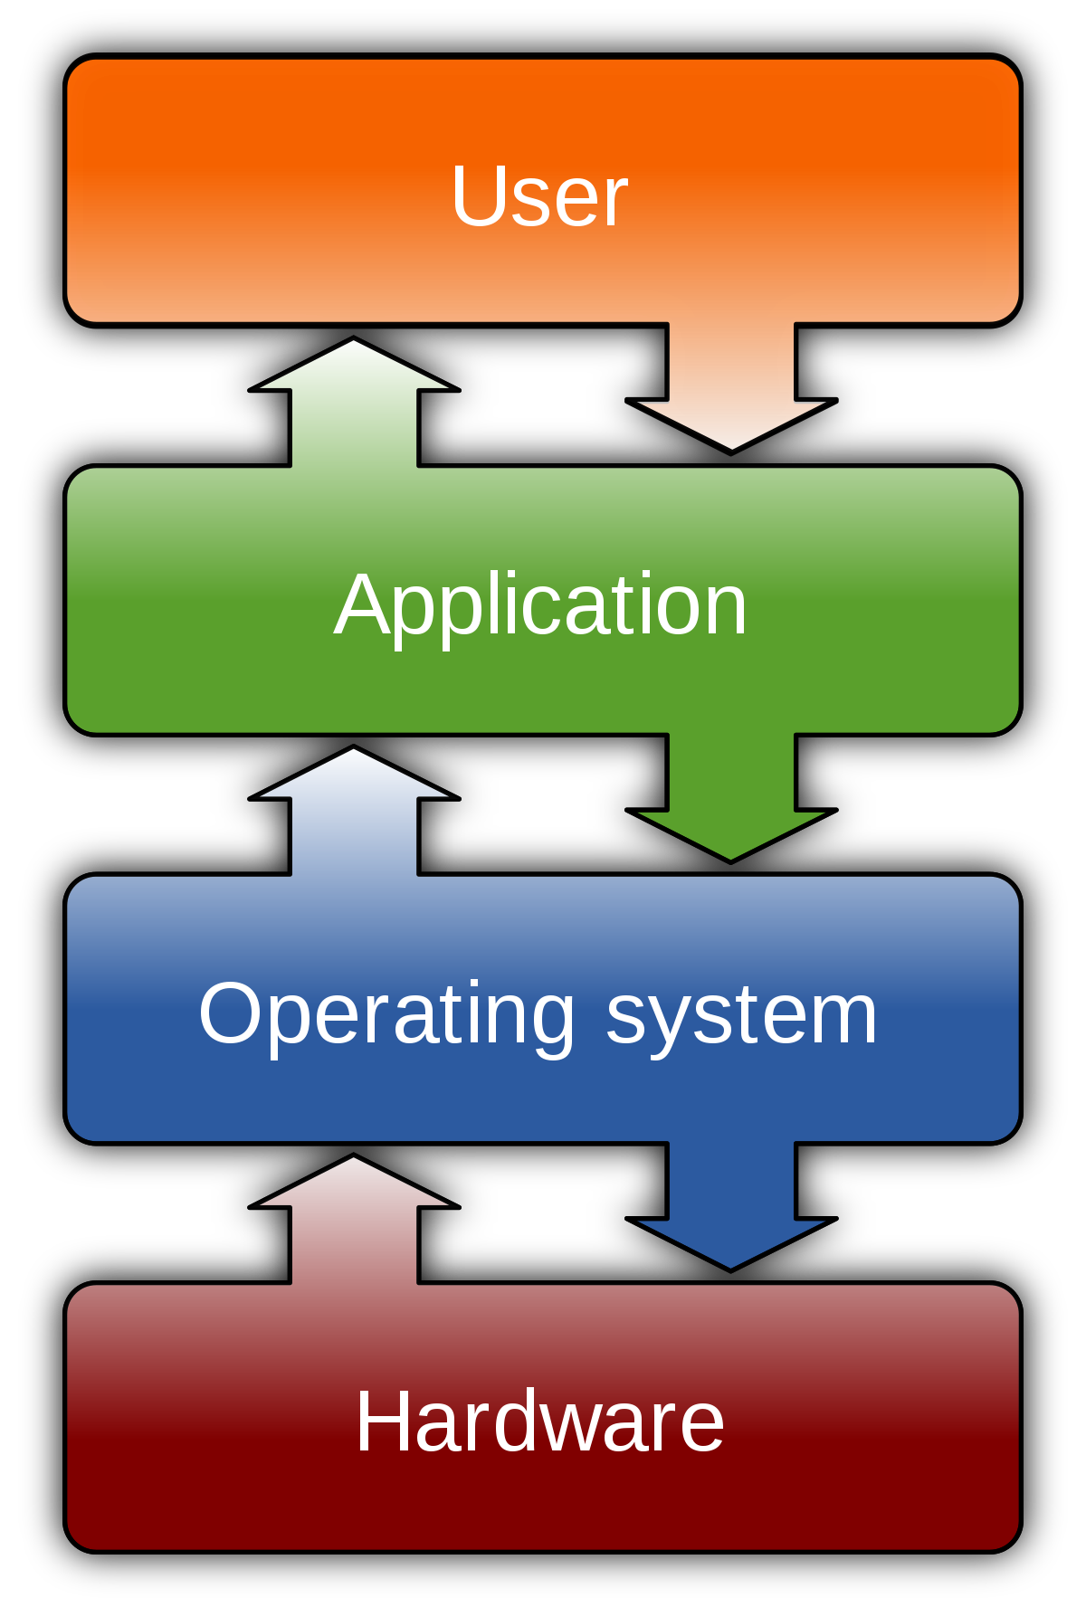
What is an Operating System?
Most important software that runs on a computer
Manages memory, processes, other softwares and hardwares
Makes human to computer communication easy
Computer is useless without an OS!
Brief history of Operating Systems: http://www.informit.com/articles/article.aspx?p=24972
OS Examples : Windows ( Windows 10, 8.. ), MacOS (OS X), UNIX
Source : https://en.wikipedia.org/wiki/Operating_system

Slide 7
Multiuser and Multi-process Operating System
Multi-User OS- Allow many users to access/work on a single system at the same time (as long as they have their own terminal)
Multi-Process OS- Allows many processes, programs and applications to run simultaneously.
Variants :
Single User Single Task
Single User Multi Task
Multi User OS

Slide 8
User Interfaces: CLI v/s GUI
Command Line Interface
Steep learning curve
Pure control (e.g., scripting)
Speed: Only keyboard, faster performance
Consumes less resources
No change; less diverse
Graphical User Interface
Intuitive
Limited Control
Mouse + keyboard; Slower
More resources; e.g. loading icons, fonts, etc.
Frequent changes; More diverse

Slide 9
Debian GNU/Linux
Clone of UNIX
Linux is just a kernel.
What is a kernel?
Core of any OS
Allocates time and memory to programs
Interfaces applications with the physical hardware
Allows communication between different processes: inter-process communication (IPC)
Linux distribution make the Linux kernel a completely usable OS by adding various applications
Linux distribution = GUI + GNU utilities (cp,mv,ls,etc) + installation and management tools + GNU compilers (c/c++) + Editors(vi/emacs) + ….
Shell : Interface between the user and kernel

Slide 10
Basics of Shell
Outermost layer around the kernel; hence called shell !
Can be used as CLI as well as GUI depending upon the task/operation
Examples:
CLI shell in Windows :
Command Prompt
CLI shell in UNIX :
Shell
CLI in Mac :
Terminal
Basic shell commands:
<up arrow>: previous command
<tab>: auto-complete
!!: replace with previous command
![str]: refer to previous command with str

Slide 11
Files and Processes
Everything is either a process or a file
Process: an executing program identified by PID
File: collection of data
A document
Text of program written in high-level language
Executable
Directory
Devices

Slide 12
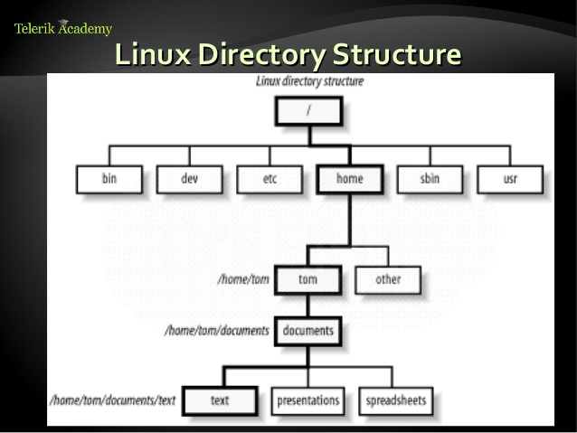
Linux File System Layout
Tree Structure Hierarchy
Only One Root- ‘/’
Directories are also files
E.g. home, tom
Regular files can only be leaves
E.g. text, spreadsheets, etc
Source: https://www.slideshare.net/azilian/4-linux-file-systems-18175783

Slide 13
The Basics: Moving Around
pwd: print working directory
cd: change directory
~ home directory
. current directory
/ root directory, or directory separator
.. parent directory

Slide 14
The Basics: Dealing with Files
mv: move/rename a file
cp: copy a file
rm: remove a file
r: remove directories and their contents recursively
mkdir: make a directory
rmdir: remove an empty directory
ls: list contents of a directory
d: list only directories
a: list all files including hidden ones
l: show long listing including permission info
s: show size of each file, in blocks

Slide 15
The Basics: Changing File Attributes
ln : creates a link
Hard links : Point to physical Data
Additional name for an existing file
ln file1 hlink1
Soft Links/ Symbolic Links (-s): Point to file
ln –s <source file> <my file>
touch: update access & modification time to current time
touch filename
touch -t 201101311759.30 filename
Change filename’s access & modification time to (year 2011 January day 31 time 17:59:30)

Slide 16
The Basics: File Permissions

Slide 17
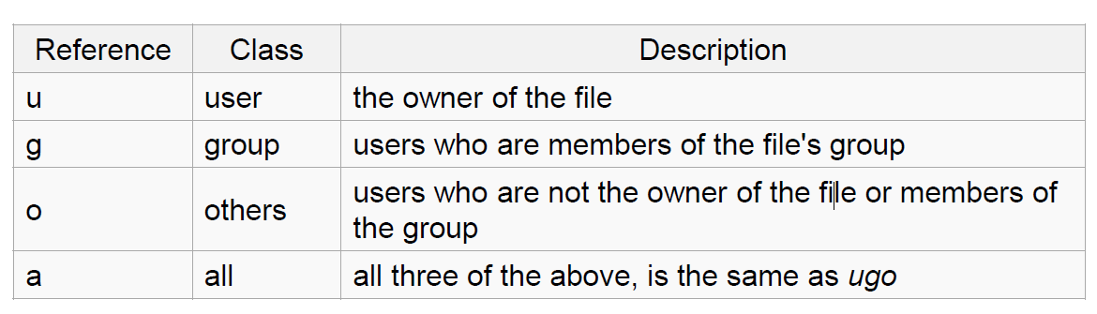
File Permissions
chmod
read (r), write (w), executable (x)
User, group, others

Slide 18
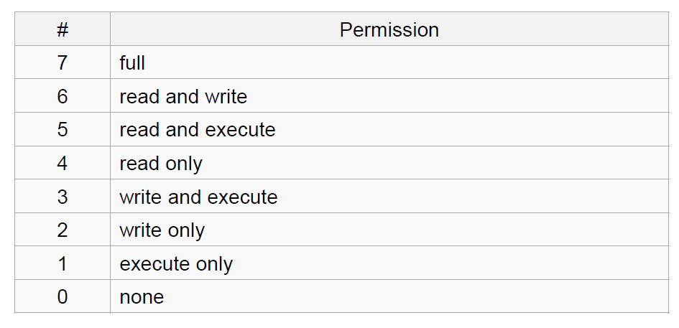
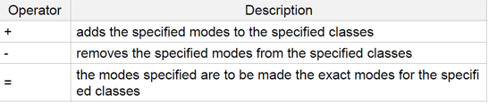
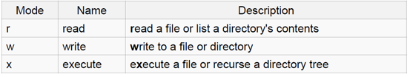
chmod contd…
Numeric
Symbolic

Slide 19
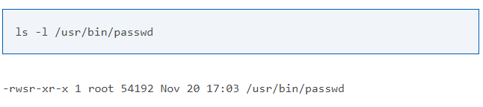
Special permissions
setuid : set user ID on execution
Permits users to run certain programs with escalated privileges
E.g. : chmod u+s file1
When an executable file’s setuid permission is set, users may access the program with a level of access that matches the owner
E.g. passwd command

Slide 20
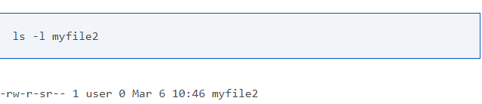
Special permissions contd…
setgid : Grants permission of the group which owns the file
E.g. : chmod g+s file2

Slide 21
Basic Shell Commands
man
cat
head
tail
du
ps
kill
diff
cmp
wc
sort
echo

Slide 22
The Basics: Redirection
> file: write stdout to a file
>> file: append stdout to a file
< file: use contents of a file as stdin

Slide 23
find command
-type: type of a file (e.g: directory, symbolic link)
-perm: permission of a file
-name: name of a file
-user: owner of a file
-maxdepth: how many levels to search

Slide 24
find contd…
?: matches any single character in a filename
*: matches one or more characters in a filename
[]: matches any one of the characters between the brackets. Use ‘-’ to separate a range of consecutive characters.
Examples:
find . -name my*
find . -name my* -type f
find / -type f -name myfile

Slide 25
man command
Extensive documentation that comes preinstalled with almost all substantial Unix and Unix-like operating systems
Usage
read a manual page for a Linux command
man <command_name>
Hit “q” to get out of man page

Slide 26
wh commands
whatis <command>: returns Name section of man page
whereis <command>: locates the binary, source, and manual page files for a command
which <command>: locates only the binary

Slide 27
diff command
A file comparison utility that outputs the differences between two files.
Usage:
diff file1 file2
diff –u file1 file2 (unified format)

Slide 28
wget command
A computer program that retrieves content from web servers
Usage
wget <URL>

