Slide 1
CS35L Software Construction Laboratory Lab 1: Nandan Parikh Week 2; Lecture 1

Slide 2
QUESTIONS?

Slide 3
Topics for the week
More Commands
Unix Wildcards
Basic Regular Expressions
Shell Scripting

Slide 4
Character Sets and Encodings
• ASCII (both a character set and an Encoding):
128 Characters
Encoded with bytes for each character
Byte values 128-255 not used (invalid)
Uniform Length Code
• Unicode (Character set):
1,112,064 valid code points
• UTF-8 (Encoding):
All code points between 1-4 bytes (var length)
Prefix-free code -- No 2 code points have same prefix
ASCII is a subset with same byte representation

Slide 5
Environment Variables
Variables that can be accessed from any child process
Common ones:
HOME: path to user’s home directory
PATH: list of directories to search in for command to execute
Change value:
export VARIABLE=…
Notes:
An environment variable is a dynamic "object" on a computer, containing an editable value, which may be used by one or more software programs in OS. Environment variables help programs know what directory to install files in, where to store temporary files, and where to find user profile settings. They help shape the environment in which programs run on your computer.

Slide 6
Locale
A locale
Set of parameters that define a user’s cultural preferences
Language
Country
Other area-specific things
locale command
prints information about the current locale environment to standard output
Notes:
6

Slide 7
LC_* Environment Variables
locale gets its data from the LC_* environment variables
Examples:
LC_TIME
Date and time formats
LC_COLLATE
Order for comparing and sorting

Slide 8
The 'C' Locale
The default locale
An environment of “least surprise”
Behaves like Unix systems before locales

Slide 9
Locale Settings Can Affect Program Behavior!!
Default sort order for the sort command depends:
LC_COLLATE=‘C’: sorting is in ASCII order
LC_COLLATE=‘en_US’: sorting is case insensitive except when the two strings are otherwise equal and one has an uppercase letter earlier than the other.
Other locales have other sort orders!

Slide 10
sort, comm, and tr
sort: sorts lines of text files
Usage: sort [OPTION]…[FILE]…
Sort order depends on locale
C locale: ASCII sorting
comm: compare two sorted files line by line
Usage: comm [OPTION]…FILE1 FILE2
Comparison depends on locale
tr: translate or delete characters
Usage: tr [OPTION]…SET1 [SET2]
echo "12345" | tr "12" "ab”
echo "password a1b2c3" | tr -d [:digit:]
echo “abc” | tr [:lower:] [:upper:]
Notes:
Sort example a d c A b E
Comm example
Uf1 uf2 f1 f2 1 2 3
b b A a A
c d b b a
A a c d b
e f e f c
d
e
f

Slide 11
UNIX Wildcards : Link
A wildcard is a character that can stand for all members of some class of characters
The * wildcard
The character * is a wildcard and matches zero or more character(s) in a file (or directory) name. ( ls list* or ls *list)
The ? Wildcard
The character ? will match exactly one character. (ls ?list OR ls list?)
The [] Wildcard
A pair of [] represents any of the characters enclosed by them (ls *[0-9]*)

Slide 12
Regular Expressions (regex)
A regex is a special text string for describing a certain search pattern
Quantification
How many times of previous expression?
Most common quantifiers: ?(0 or 1), *(0 or more), +(1 or more)
Alternation
Which choices?
Operators: [] and |
E.g Hello|World , [A B C]
Anchors
Where?
Characters: ^(beginning) and $(end)

Slide 13
regex contd…
^ start of line
$ end of line
\ turn off special meaning of next character
[] match any of enclosed characters, use – for range
[^ ] match any characters except those enclosed in []
. match a single character of any value
* match 0 or more occurrences of preceding character/expression
+ match 1 or more occurrences of preceding character/expression

Slide 14
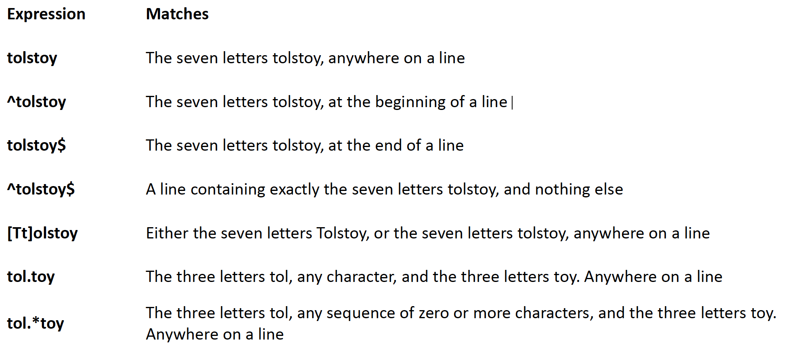
regex contd…

Slide 15
Parentheses
Parentheses allow you to apply quantifiers to sequences of characters
Example : ..

Slide 16
BRE vs ERE
Basic Regular Expression (BRE) is the standard mode for sed and grep
Extended Regular Expression (ERE) is an optional flag you can use with the commands
BRE tends to take things more literally
In BRE ‘ ? ’, ‘ + ’, ‘ { ’, ‘ } ’, ‘ ( ’, and ‘ ) ’ lose their special meanings
-E : Uses extended regular expressions

Slide 17
sed ( Stream Editor )
Modifies the input as specified by the command(s)
Can be used for:
Printing specific lines or address ranges
sed –n ‘1p’ sedFile.txt
sed –n ‘1,5p’ sedFile.txt
sed –n ‘1~2p’ sedFile.txt
Deleting text
sed '1~2d' sedFile.txt
Substituting text - s/regex/replacement/flags
sed 's/cat/dog/' file.txt
sed 's/cat/dog/g' file.txt
sed 's/<[^>]*>//g' a.html
sed ‘s/regExpr/replText/’ filename
Notes:
first~step
Match every step'th line starting with line first. For example, sed -n 1~2p will print all the odd-numbered lines in the input stream, and the address 2~5 will match every fifth line, starting with the second. first can be zero; in this case, sed operates as if it were equal to step. (This is an extension.)

Slide 18
sed
Substitution Flags
g: Replaces all matches
Number: replaces only the Number^{th} match of every line
Regexes used with sed:
^ $ . * []
Use sed –r to evaluate ? Or +

Slide 19
sed contd..
sed –n 12,18p file.txt
sed 12,18d file.txt
sed ‘1~3d’ file.txt
sed ‘1,5 s/line/Line/g’ file.txt
sed ‘/pattern/d’ file.txt
sed ‘/regexp/!d’ file.txt

Slide 20
grep
A Unix command to search files/text for the occurrence of a string of characters that matches a specified pattern
Usage:
grep [option(s)] pattern [file(s)]
grep –r ‘*.txt’ *
grep –c ‘line’ file.txt
grep –n ‘line’ file.txt
ls –l | grep *txt
Notes:
R = recursive
C = count
N = output is preceded by its relative line number

Slide 21
grep
grep –E or egrep switches to a special mode so as to evaluate the expression as an extended regex.
grep will be default search for patterns within the files.
If you want to search for files, then cat the grep with ll or ls
Notes:
Egrep ‘abc*’ regularPatternSearch.txt
egrep '(abc){2}.' regularPatternSearch.txt
Egrep ‘(abc)*’ regularPatternSearch.txt
egrep 'abc$' regularPatternSearch.txt

Slide 22
awk
awk is more than a command; it’s a programming language by itself
Utility/language for data extraction
awk views a text file as records and fields
Usage:
awk ‘/search pattern/ {Actions}’ file
Examples:
awk ‘{print;}’ file.txt // print the file line by line; default behaviour
awk ‘/Hello/ {print;}’ file.txt // prints lines which matches Hello
awk ‘{print $1,$2;}’ file.txt // prints only specific fields
awk –F’Hello’ ‘{print $2}’ // prints second column in between the occurrences of the specified pattern

Slide 23
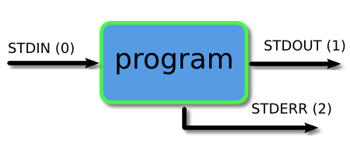
Piping and Redirection
Every program we run on the command line automatically has three data streams connected to it.
STDIN (0) - Standard input (data fed into the program)
STDOUT (1) - Standard output (data printed by the program, defaults to the terminal)
STDERR (2) - Standard error (for error messages, also defaults to the terminal)
Piping and redirection is the means by which we may connect these streams between programs and files to direct data in useful ways.

Slide 24
More About Piping and Redirection
Basic I/O Redirection
Most programs read from stdin
Write to stdout
Send error messages to stderr
Task: Piping and Redirection
Create a file test.txt with numbers 1-5 in descending order in each line
Delete all the new line characters (with tr command and redirection) and redirect output to test1.txt
Now, first sort the file and then repeat the above step; but instead of redirection, now append the output to test1.txt

Slide 25
Useful grep Options
• -l and -L
Suppress normal output; instead print the name of each input file from
which output would normally have been printed. The scanning will stop
on the first match.
Uppercase: prints all complementary filenames (no
output would have been printed from those files without option)
• -v
Invert sense of matching

Slide 26
Lab Assignment 2
hwnwdseng.htm -> buildwords -> hwords
Buildwords
Read from STDIN and perform work on input
Store the output in hwords
E.g. cat hwnwdseng.htm | sh buildwords > hwords

Slide 27
Lab Assignment 2 contd…
How to construct buildwords?
Extract lines which contain words (both English and Hawaiian) (Hint: <td> tag)
Get lines with Hawaiian words
Even numbered lines
sed 's/<[^>]*>//g' a.html to remove all HTML tags
Remove leading space
sed 's/^\s*//g’
Substitute space in between words to newline
Delete all commas
Delete entries which have any character other than Hawaiian
Sort unique

