Slide 1
CS35L Software Construction Laboratory Lab 1: Nandan Parikh Week 2; Lecture 2

Slide 2
Lab 2 Assignment Approach..
What is the problem with the approach mentioned in the last class slides?

Slide 3
Compiled Languages v/s Scripting Languages
Compiled Languages
Examples?
C,C++,Java
First Compiled
Source code to object code; then executed
Run faster
Applications:
Typically run inside a parent program like scripts, more compatible during integration, can be compiled and used on any platform (eg. Java)
Scripting Languages
Examples?
Python, JavaScript, Shell Scripting
No compilation required. Directly interpreted!
Interpreter reads program, translates into internal form and executes
Runs slower than a high level lang
Applications:
Automation, Extracting information from a data set, Less code intensive

Slide 4
Shell Script
A computer program designed to be run on a shell (UNIX/Linux)
All shell commands can be executed inside a script
Why use a shell script?
Simplicity
Portability
Ease of development

Slide 5
Basic Shell Constructs
Shell recognizes three fundamental kinds of commands:
Built-in commands: Commands that the shell itself executes (e.g.: echo)
Shell functions: Self-contained chunks of code, written in shell language
External Commands: mainly external utilities; backtick often associated
number=`ll | wc -l` // This is an external command
echo $number

Slide 6
Self-Contained Scripts: The #! First Line
When the shell runs a program, it asks the kernel to start a new process and run the given program in that process.
It knows how to do this for compiled programs but for a script, the kernel will fail, returning a “not executable format file” error so it’ll start a new copy of /bin/sh (the standard shell) to run the program.
But if there is more than one shell installed on the system, we need a way to tell the kernel which shell to use for a script
#! /bin/csh –f
#! /bin/awk –f
#! /bin/sh

Slide 7
Understanding a Shell Script
Create a file testFile.sh
Write a statement to print “Anything” inside it
Run the File with ‘./testFile.sh’. What do you observe? Why?
Change and execute
Now, add #!/bin/sh to the first line and repeat the above step
Explanation

Slide 8
Variable in shell script
Start with a letter or underscore and may contain any number of following letters, digits, or underscores
Hold string variables
$ myvar=this_is_a_long_string_that_does_not_mean_much //Assign value
$ echo $myvar //Print the value
this_is_a_long_string_that_does_not_mean_much
first=firstName middle=s last=lastName Multiple assignments allowed on one line
fullname="$first $middle $last" Double quotes required here, for concatenating
fullname=“abc xyz mno" Use quotes for whitespace in value
oldname=$fullname Quotes not needed to preserve spaces in value

Slide 9
Variables in shell script contd…
Escape Character \ - Literal value of following character
echo \|
Single Quote - Literal Meaning of all within ‘ ’
$hello=1
$str=‘$hello’
echo $str -> $hello
Double Quote - Literal meaning except for $, ` and \.
$hello=1
$str=“abc$hello”
echo $str -> abc1

Slide 10
Variables in shell script contd…
Special Variables: certain characters reserved as special variables
$: PID of current shell
#: number of arguments the script was invoked with
n: nth argument to the script
?: exit status of the last command executed
echo $$; echo $#; echo $2; echo $?;
scalar variable vs array variable:
array_name[index]=value; echo ${array_name[index]}

Slide 11
Loops
ALL=`ls -a $dir | sort`
declare -a ARRAY
count=0
for FILE in $ALL
do
ARRAY[$count]=$FILE
…..
done
for var in list_values
do
command 1
..
command n
done
while condition
do
command 1
..
command n
done
for i in "${ARRAY[@]}”
do
…
done

Slide 12
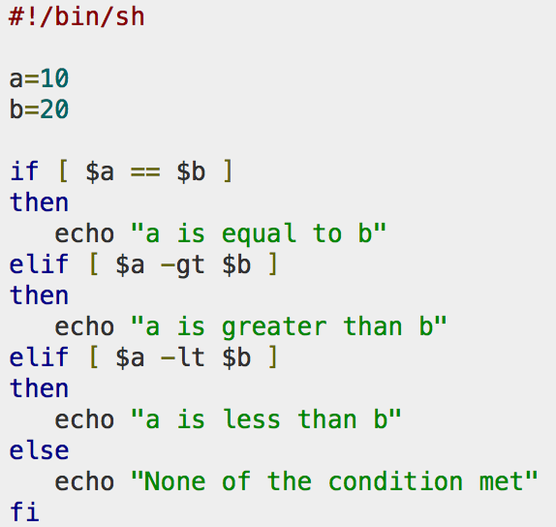
Conditional and Unconditional Statements
Conditional
if…then…fi
if…then…else…fi
if…then…elif..then…fi
case…esac
Unconditional
break
continue

Slide 13
Task
Create file with following text (singers.txt):
1, Justin Timberlake
2, Taylor Swift
3, Mick Jagger
4, Lady Gaga
5, Johnny Trash
6, Elvis Presley
7, John Lennon
Print all singers having first name as ‘John’
Ans: sed -n '/John /p’ singers.txt > john.txt
Change all , to ) in the file
Ans: sed 's/,/)/' singers.txt
Append a fullstop to the last
Ans: sed 's/$/./' singers.txt

Slide 14
Task
Create a file f1.txt with the following content
UPPER CASE LINE
Lower case line
Break;
empty LINE
Last line
Check for the given string ‘line/LINE’ in text files which start with ‘f’ and end with a number.txt
Replace all upper case letters to lower case using tr
Ans: tr ‘[:upper:]’ ‘[:lower:]’ < f*[1-9].txt
Repeat the same using sed
Ans: sed 's/.*/\L&/g' f*[1-9].txt

Slide 15
Task
Write a regex to validate an email with the following rules
It should start with a lower case letter only
It should have the domain name as gmail.com (string representation is @gmail.com)
Ans: ^[a-z].*@gmail\.com

Slide 16
Given the RegEx: ((do*t) \2)+ Which of the following would match A. doot doot B. doot doot doot C. doot D. doot doot Mr. Someone

Slide 17
Given the Line: LEEEEEEEEEEROY JENKINS Which of the following regular expressions would match this
LE{3}ROY JENKINS
LE{2,30}ROY JENKINS
LE?ROY JENKINS
L[a-z]*ROY JENKINS

Slide 18
HINTS for HW

