Slide 1
CS35L Software Construction Laboratory Lab 1: Nandan Parikh Week 3; Lecture 1

Slide 2
QUESTIONS?

Slide 3
Useful Links
Exit Status :
https://www.tldp.org/LDP/abs/html/exit-status.html
Redirection :
https://www.brianstorti.com/understanding-shell-script-idiom-redirect/

Slide 4
Week 10 Logistics
Groups of 2 ( At most )
Starting from Week 5 Thursday
Max 10 minutes
Slides must contain the article and date of article
Two groups cannot present the same topic
Sign up on this sheet mentioning Week and Team Members name(s)
Priority for people who sign up first
2-3 presentations each week
No presentation in the week of 27th May

Slide 5
Presentation Rubric ( 40 % )
Organization
Subject Knowledge
Graphics
Mechanics
Eye Contact
Elocution
Both group members may not get same presentation grade.

Slide 6
Report Rubric ( 40 % )
No specific standard/format
Only one submission per team
Must contain the team members names and IDs
500 – 1200 words
Report must be divided in sections
<= 12 font size only

Slide 7
Leftover( 20 % )
Questions asked during presentation
Interaction during class
…

Slide 8
Modifying and Rewriting Software

Slide 9
How to Install Software
Windows
Install shield
Microsoft/Windows Installer
OS X
Drag and drop from .dmg mount -> Applications folder
Linux
rpm(Redhat Package Management)
RedHat Linux (.rpm)
apt-get(Advanced Package Tool)
Debian Linux, Ubuntu Linux (.deb)
Good old build process
configure, make, make install

Slide 10
Decompressing Files
Generally, you receive Linux software in the tarball format (.tgz) or (.gz)
Decompress file in current directory:
$ tar –xzvf filename.tar.gz
Option –x: --extract
Option –z: --gzip
Option –v: --verbose
Option –f: --file

Slide 11
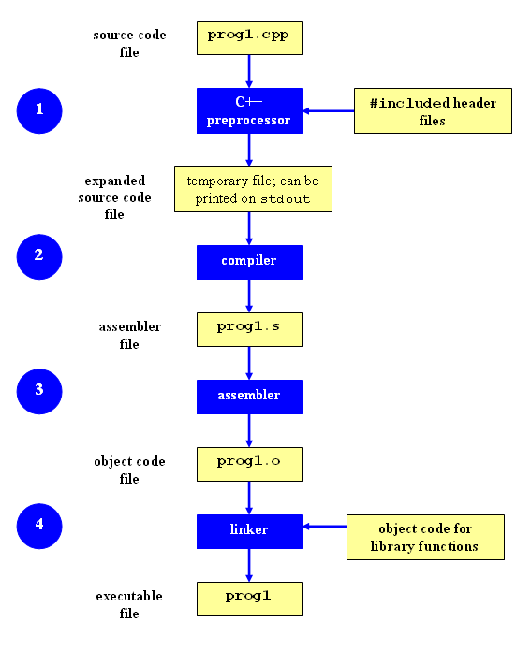
Compilation Process

Slide 12
Command-Line Compilation
shop.cpp
#includes shoppingList.h and item.h
shoppingList.cpp
#includes shoppingList.h
item.cpp
#includes item.h
How to compile?
g++ -Wall shoppingList.cpp item.cpp shop.cpp –o shop
Notes:
-Wall This enables all the warnings about constructions that some users consider questionable, and that are easy to avoid (or modify to prevent the warning), even in conjunction with macros.

Slide 13
What if…
We change one of the header or source files?
Rerun command to generate new executable
We only made a small change to item.cpp?
not efficient to recompile shoppinglist.cpp and shop.cpp
Solution: avoid waste by producing a separate object code file for each source file
g++ -Wall –c item.cpp… (for each source file)
g++ item.o shoppingList.o shop.o –o shop (combine)
Less work for compiler, saves time but more commands

Slide 14
What if…
We change item.h?
Need to recompile every source file that includes it & every source file that includes a header that includes it. Here: item.cpp and shop.cpp
Difficult to keep track of files when project is large
=> Make

Slide 15
Make
Utility for managing large software projects
Compiles files and keeps them up-to-date
Efficient Compilation (only files that need to be recompiled)
https://www.gnu.org/software/make/manual/html_node/Introduction.html#Introduction

Slide 16
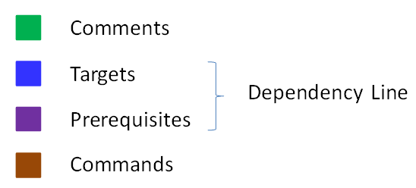
Makefile Example
# Makefile - A Basic Example
all : shop #usually first
shop : item.o shoppingList.o shop.o
g++ -g -Wall -o shop item.o shoppingList.o shop.o
item.o : item.cpp item.h
g++ -g -Wall -c item.cpp
shoppingList.o : shoppingList.cpp shoppingList.h
g++ -g -Wall -c shoppingList.cpp
shop.o : shop.cpp item.h shoppingList.h
g++ -g -Wall -c shop.cpp
clean :
rm -f item.o shoppingList.o shop.o shop
Rule

Slide 17
Build Process
configure
Script that checks details about the machine before installation
Dependency between packages
Creates ‘Makefile’
make
Requires ‘Makefile’ to run
Compiles all the program code and creates executables in current temporary directory
make install
make utility searches for a label named install within the Makefile, and executes only that section of it
executables are copied into the final directories (system directories)

Slide 18
Lab 3
Coreutils 8.29 has a problem
$ la –A is equivalent to ls -a –A
if the current directory has two files named .foo and bar, the command la -A outputs four lines, one each for ., .., .foo, and bar.
These users want la -A to output just two lines instead, one for .foo and one for bar
Why?
the -a option always overrides the -A option regardless of which option is given first
Want the flag that comes later to take effect
Fix the ls program

Slide 19
Getting Set Up (Step 1)
Download coreutils-8.29 to your home directory
Use ‘wget’
Untar and Unzip it
tar –xJvf coreutils-8.29.tar.xz
Make a directory ~/coreutilsInstall in your home directory (this is where you’ll be installing coreutils)
mkdir ~/coreutilsInstall

Slide 20
Building coreutils (Step 2)
Go into coreutils-8.29 directory. This is what you just unzipped.
Read the INSTALL file on how to configure “make”, especially --prefix flag
Run the configure script using the prefix flag so that when everything is done, coreutils will be installed in the directory ~/coreutilsInstall
Compile it: make
Install it: make install (won’t work on Linux server without proper prefix!)
Why?

Slide 21
Reproduce Bug (Step 3)
Reproduce the bug by running the version of ‘ls -a -A ’ in coreutils 8.29
If you just type $ ls at CLI it won’t run ‘ls’ in coreutils 8.29
Why? Shell looks for /bin/ls
To use coreutils 8.29: $ ./ls
This manually runs the executable in this directory

Slide 22
Patching
A patch is a piece of software designed to fix problems with or update a computer program
It’s a diff file that includes the changes made to a file
A person who has the original (buggy) file can use the patch command with the diff file to add the changes to their original file

Slide 23
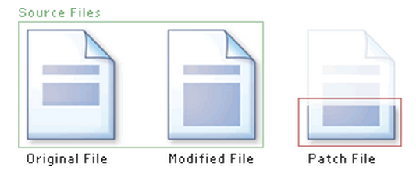
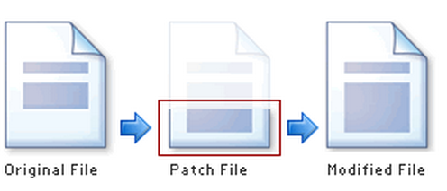
Applying a Patch

Slide 24
diff Unified Format
diff –u original_file modified_file
--- path/to/original_file
+++ path/to/modified_file
@@ -l,s +l,s @@
@@: beginning of a hunk
l: beginning line number
s: number of lines the change hunk applies to for each file
A line with a:
- sign was deleted from the original
+ sign was added to the original
stayed the same

Slide 25
EXAMPLE…

Slide 26
Patching and Building (Steps 4 & 5)
cd coreutils-8.29
vim or emacs patch_file: copy and paste the patch content
patch –pnum < patch_file
‘man patch’ to find out what pnum does and how to use it
cd into the coreutils-8.29 directory and type make to rebuild patched ls.c.
Don’t install!!

Slide 27
Testing Fix (Step 6)
Test the following:
Modified ls works
Installed unmodified ls does NOT work
Test on:
Empty directory
Directory containing a hidden file
With just –a, with just –A
With –aA
With –Aa
Answer Q1 and Q2

