Slide 1
CS35L Software Construction Laboratory Lab 1: Nandan Parikh Week 3; Lecture 2

Slide 2
QUESTIONS?

Slide 3
Links
Sign up on this sheet mentioning Week and Team Members name(s)
Link for codes discussed in class

Slide 4
What is Python?
Not just a scripting language
Object-Oriented language
Classes
Member functions
Compiled and interpreted
Python code is compiled to bytecode
Bytecode interpreted by Python interpreter
Not as fast as C but easy to learn, read and use

Slide 5
Why is it popular?
Uses English keywords frequently where other use different punctuation symbols
Fewer Syntactical Constructions
Automatic Garbage Collection
Easy integration with other programming languages

Slide 6
Different Modes
Interactive:
Run commands on the python shell without actually writing a script/program.
Script Mode:
Type a set of commands into a script
Execute all the commands at once by running the script

Slide 7
Python Variables
Case sensitive
Start with _ (underscore) or letters followed by other letters, underscores or digits
Other special characters are not allowed as part of the variable name
Certain reserved words may not be used as variable names on their own unless concatenated with other words

Slide 8
Example: Python Variables
Python Script:
#!/usr/bin/python
counter = 100 # An integer assignment
miles = 1000.0 # A floating point
name = "John" # A string
print counter
print miles
print name

Slide 9
Python Lines and Indentation
No braces to indicate blocks of code for class and function definitions or flow control
Blocks of code are denoted by line indentation, which is why it is strictly enforced
Number of spaces for indentation may be variable but all the statements within the same block must be equally indented
Hence, a single space has the ability to change the meaning of the code

Slide 10
Python Decision Making
#!/usr/bin/python
var = 100
if ( var == 100 ) :
print ”Correct”
print "Good bye!"

Slide 11
Python List
Common data structure in Python
A python list is like a C array but much more:
Dynamic (mutable): expands as new items are added
Heterogeneous: can hold objects of different types
How to access elements?
List_name[index]

Slide 12
Example
>>> t = [123, 3.0, ‘hello!’]
>>> print t[0]
123
>>> print t[1]
3.0
>>> print t[2]
hello!

Slide 13
Example – Merging Lists
>>> list1 = [1, 2, 3, 4]
>>> list2 = [5, 6, 7, 8]
>>> merged_list = list1 + list2
>>> print merged_list
Output: [1, 2, 3, 4, 5, 6, 7, 8]

Slide 14
Python Dictionary
Essentially a hash table
Provides key-value (pair) storage capability
Instantiation:
dict = {}
This creates an EMPTY dictionary
Keys are unique, values are not!
Keys must be immutable (strings, numbers, tuples)

Slide 15
Example
dict = {}
dict[‘france’] = “paris”
dict[‘japan’] = “tokyo”
print dict[‘france’]
dict[‘germany’] = “berlin”
if (dict[‘france’] == ”paris”):
print “Correct!”
else:
print “Wrong!”
del dict[‘france’]
del dict

Slide 16
for loops
list1 = [‘Mary’, ‘had’, ‘a’, ‘little’, ‘lamb’]
for i in list1:
print i
Result:
Mary
had
a
little
lamb
for i in range(len(list1)):
print i
Result:
0
1
2
3
4

Slide 17
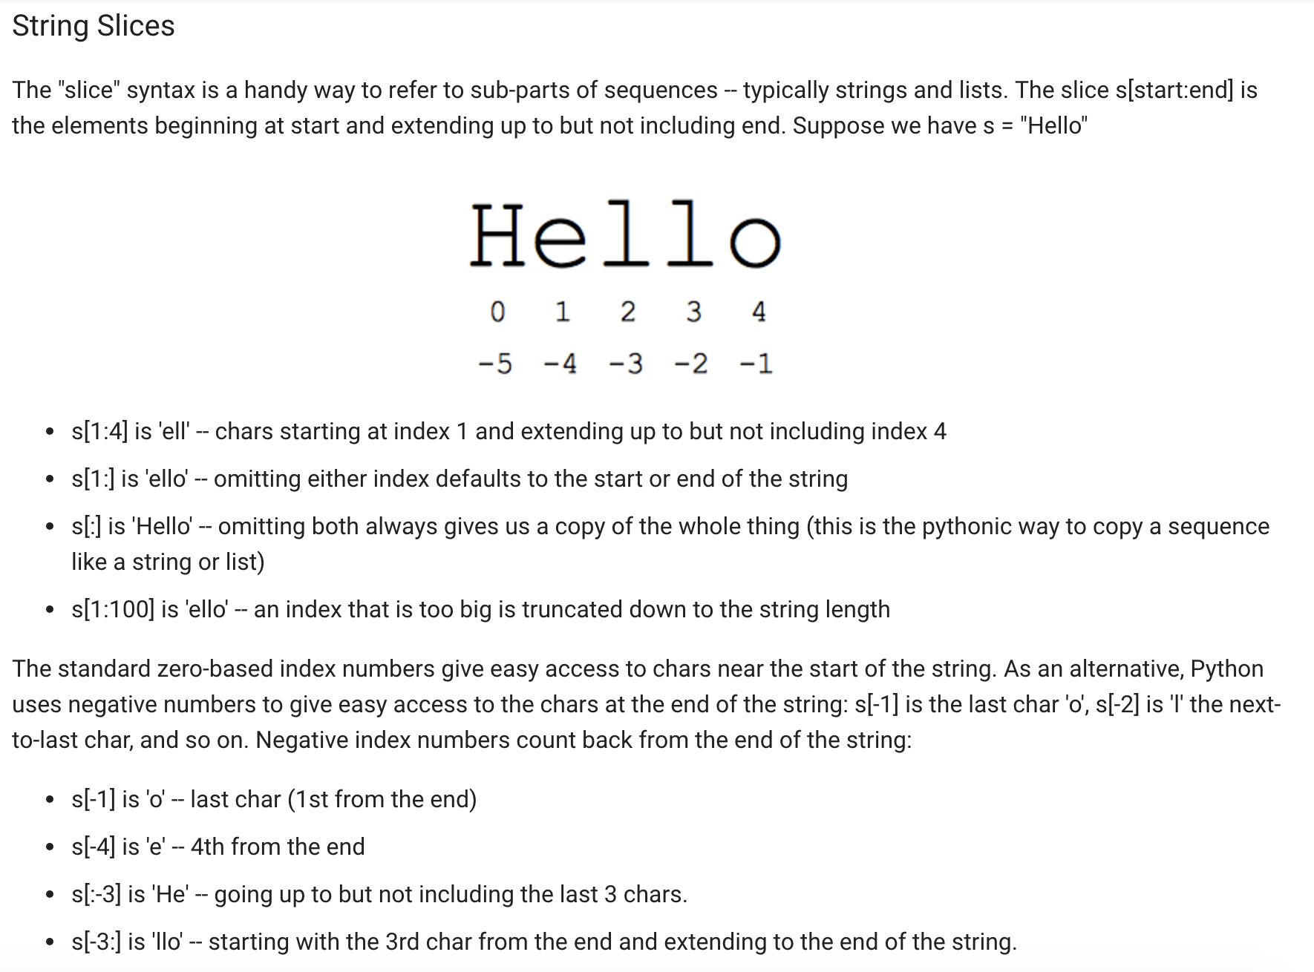

Slide 18
Python Split
Python split using delimiter:
>>> x = “blue, red, green”
>>> x.split(“,”) #”,” is a delimiter here
Output: [‘blue’, ‘red’, ‘green’]
>>> a, b, c = x.split(“,”)
>>> a
‘blue’
>>> b
‘red’
>>> c
‘green’

Slide 19
Functions
A function is a block of organized, reusable code that is used to perform a single, related action. They provide better modularity for your application and a high degree of code reusing.
Syntax:
def function_name( parameters ):
#code inside the function

Slide 20
Functions examples
Example 1:
def printme(new_string): #string is a parameter
#This prints a passed string into this function
print new_string
return
Example 2: To print sum of numbers in a list
def find_sum(new_list):
sum=0 #initialize variable*
for element in new_list:
sum = sum + element
return sum #returns the computed sum
answer_variable=find_sum([2,3,4,5]) #function call
print answer_variable
* # are used for putting comments

Slide 21
Optparse Library
Powerful library for parsing command-line options
Argument:
String entered on the command line and passed in to the script
Elements of sys.argv[1:] (sys.argv[0] is the name of the program being executed)
Option:
An argument that supplies extra information to customize the execution of a program
Option Argument:
An argument that follows an option and is closely associated with it. It is consumed from the argument list when the option is

Slide 22
ArgParse module
https://www.pythonforbeginners.com/argparse/argparse-tutorial

Slide 23
Homework 3
randline.py script
Input: a file and a number n
Output: n random lines from file
Get familiar with language + understand what code does
Answer some questions about script (Q3, Q4)
Implement shuf utility in python

Slide 24
Running randline.py
Run it
./randline.py –n 3 filename (need execute permission)
python randline.py –n 3 filename (no execute permission)
randline.py has 3 command-line arguments:
filename: file to choose lines from
argument to script
n: specifies the number of lines to write
option
3: number of lines
option argument to n
Output: 3 random lines from the input file

Slide 25
shuf.py
Support the options for shuf
--input-range (-i)
--head-count (-n)
--repeat (-r)
--help
Support all type of arguments
File names and ‘–’ for stdin
Any number of non-option arguments
Error handling

Slide 26
Homework 3
shuf.py – this should end up working almost exactly like the utility ‘shuf’
Check $ man shuf for extensive documentation
Use randline.py as a starting point!
Modify to accomplish logical task of shuf
shuf C source code (Optional) :
Present in coreutils
This will give you an idea of the logic behind the operation that shuf executes
Python argparse module instead of optparse:
How to add your own options to the parser
-e -n --repeat --echo etc

Slide 27
Homework 3 Hints
If you are unsure of how something should be output, run a test using existing shuf utility!
Important : Create your own test inputs
Debug!
Q4: Python 3 vs. Python 2
Python 3 is installed in /usr/local/cs/bin
export PATH=/usr/local/cs/bin:$PATH

Slide 28
Python Walk-Through
#!/usr/bin/python
import random, sys
from optparse import OptionParser
class randline:
def __init__(self, filename):
f = open (filename, 'r')
self.lines = f.readlines()
f.close ()
def chooseline(self):
return random.choice(self.lines)
def main():
version_msg = "%prog 2.0"
usage_msg = """%prog [OPTION]...
FILE Output randomly selected lines from FILE."""
Tells the shell which interpreter to use
Import statements, similar to include statements
Import OptionParser class from optparse module
The beginning of the class statement: randline
The constructor
Creates a file handle
Reads the file into a list of strings called lines
Close the file
The beginning of a function belonging to randline
Randomly select a number between 0 and the size of lines and returns the line corresponding to the randomly selected number
The beginning of main function
version message
usage message

Slide 29
Python Walk-Through
parser = OptionParser(version=version_msg, usage=usage_msg) parser.add_option("-n", "--numlines", action="store", dest="numlines", default=1, help="output NUMLINES lines (default 1)")
options, args = parser.parse_args(sys.argv[1:])
try:
numlines = int(options.numlines)
except:
parser.error("invalid NUMLINES: {0}". format(options.numlines))
if numlines < 0:
parser.error("negative count: {0}". format(numlines))
if len(args) != 1:
parser.error("wrong number of operands")
input_file = args[0]
try:
generator = randline(input_file)
for index in range(numlines):
sys.stdout.write(generator.chooseline())
except IOError as (errno, strerror):
parser.error("I/O error({0}): {1}". format(errno, strerror))
if __name__ == "__main__":
main()
Creates OptionParser instance
Start defining options, action “store” tells optparse to take next argument and store to the right destination which is “numlines”. Set the default value of “numlines” to 1 and help message.
options: an object containing all option args
args: list of positional args leftover after parsing options
Try block
get numline from options and convert to integer
Exception handling
error message if numlines is not integer type, replace {0} w/ input
If numlines is negative
error message
If length of args is not 1 (no file name or more than one file name)
error message
Assign the first and only argument to variable input_file
Try block
instantiate randline object with parameter input_file
for loop, iterate from 0 to numlines – 1
print the randomly chosen line
Exception handling
error message in the format of “I/O error (errno):strerror
In order to make the Python file a standalone program

