Slide 1
CS35L Software Construction Laboratory Lab 1: Nandan Parikh Week 7; Lecture 1

Slide 2
QUESTIONS?

Slide 3
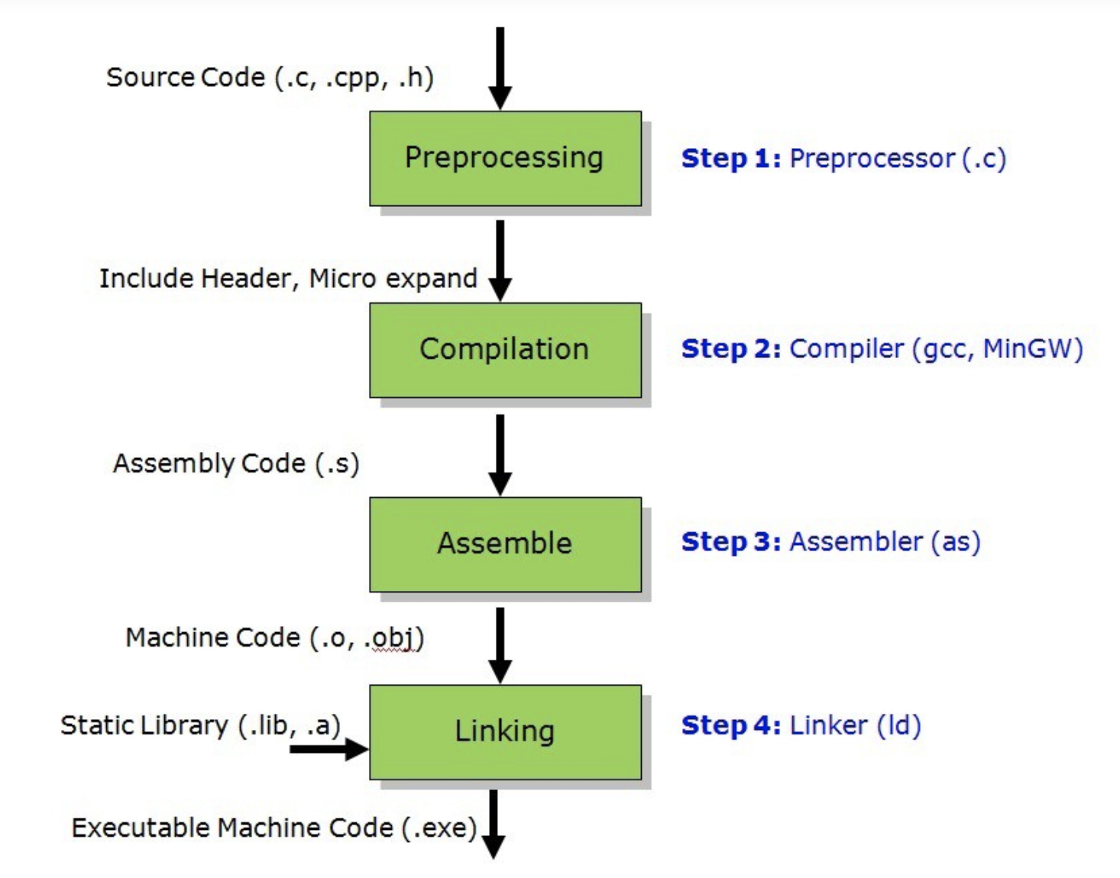
http://binaryupdates.com/introduction-of-c/

Slide 4
source
code
compiler
object
code
linker
executable
file
object
code
library
A previously compiled
collection of standard
program functions

Slide 5
Static Linking
Carried out only once to produce an executable file
If static libraries are called, the linker will copy all the modules referenced by the program to the executable
Static libraries are typically denoted by the .a file extension

Slide 6
Dynamic Linking
Allows a process to add, remove, replace or
relocate object modules during its execution.
If shared libraries are called:
Only copy a little reference information when the executable file is created
Complete the linking during loading time or running time
Dynamic libraries are typically denoted by the .so file extension
.dll on Windows

Slide 7
Linking and Loading
Linker collects procedures and links together the object modules into one executable program
Why isn't everything written as just one big program, saving the necessity of linking?
Efficiency: if just one function is changed in a 100K line program, why recompile the whole program? Just recompile the one function and relink.
Multiple-language programs
Other reasons?

Slide 8
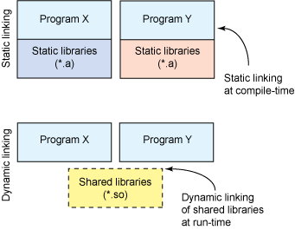

Slide 9
Dynamic linking
Unix systems: Code is typically compiled as a dynamic shared object (DSO)
Dynamic vs. static linking resulting size $ gcc -static hello.c -o hello-static $ gcc hello.c -o hello-dynamic $ ls -l hello 80 hello.c 13724 hello-dynamic 1688756 hello-static
Pros and cons?

Slide 10
Advantages of dynamic linking
The executable is typically smaller
When the library is changed, the code that references it does not usually need to be recompiled
The executable accesses the .so at run time; therefore, multiple programs can access the same .so at the same time
Memory footprint amortized across all programs using the same .so

Slide 11
Smaller is more efficient
object
file
object
file
static linking
function
library
function
library
executable
files
object
file
object
file
dynamic linking
function
library
pointer
shared
function
library

Slide 12
Disadvantages of dynamic linking
Performance hit
Need to load shared objects (at least once)
Need to resolve addresses (once or every time)
Remember back to the system call assignment…
What if the necessary dynamic library is missing?
What if we have the library, but it is the wrong version?

Slide 13
Useful Links for creating static/dynamic libraries
http://www.yolinux.com/TUTORIALS/LibraryArchives-StaticAndDynamic.html
http://tldp.org/HOWTO/Program-Library-HOWTO/index.html
https://www.ibm.com/developerworks/library/l-dynamic-libraries/
For getting started with concepts :
https://medium.com/@tyastropheus/s-is-for-static-the-abcs-of-the-c-static-library-cdc4109c30a6

Slide 14
Lab 7
Build the code simpgmp.c
Use ldd to investigate which dynamic libraries your program loads
Use strace to investigate which system calls your program makes
Use “ls /usr/bin | awk ‘NR%101==nnnnnnnnn%101’” to find ~12 linux commands to use ldd on
Record output for each one in your log and investigate any errors you might see
From all dynamic libraries you find, create a sorted list
Remember to omit the duplicates!

