Slide 1
CS35L Software Construction Laboratory Lab 1: Nandan Parikh Week 8; Lecture 1

Slide 2
SECURITY & PRIVACY

Slide 3
Communication Over the Internet
What type of guarantees do we want?
Confidentiality
Message secrecy
Data integrity
Message consistency
Authentication
Identity confirmation
Authorization
Specifying access rights to resources

Slide 4
Encryption Types
Symmetric Key Encryption
a.k.a shared/secret key
Key used to encrypt is the same as key used to decrypt
Asymmetric Key Encryption: Public/Private
2 different (but related) keys: public and private
Only creator knows the relation. Private key cannot be derived from public key
Data encrypted with public key can only be decrypted by private key and vice versa
Public key can be seen by anyone
Never publish private key!!!

Slide 5
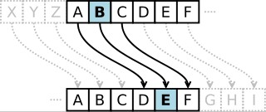
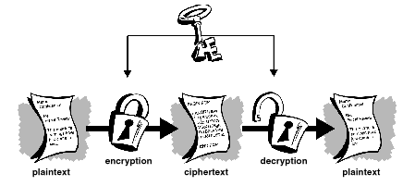
Symmetric-key Encrption
●
Same secret key used for encryption and decryption
●
Example : Data Encryption Standard (DES)
●
Caesar's cipher
–
Map the alphabet to a shifted version
●
ABCDEFGHIJKLMNOPQRSTUVWXYZ DEFGHIJKLMNOPQRSTUVWXYZABC
●
–
Plaintext – SECRET. Ciphertext – VHFUHW Key is 3 (number of shifts of the alphabet)
–
●
Key distribution is a problem
Image Source: wikipedia
–
The secret key has to be delivered in a safe way to the recipient Chance of key being compromised
–
Image Source: gpgtools.org

Slide 6
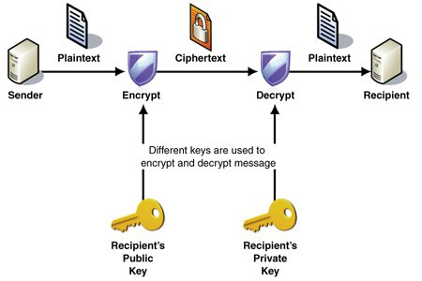
Public-key Encryption (Asymmetric)
●
Uses a pair of keys for encryption
–
Public key – Published and known to everyone
Private key – Secret key known only to the owner
–
●
Encryption
–
Use public key to encrypt messages
Anyone can encrypt message, but they cannot decrypt the ciphertext
–
●
Decryption
–
Use private key to decrypt messages
●
Example : RSA – Rivest, Shamir & Adleman
–
Property used - Difficulty of factoring large
integers to prime numbers
http://en.wikipedia.org/wiki/RSA_Factoring_Challenge
–
Image Source: MSDN

Slide 7
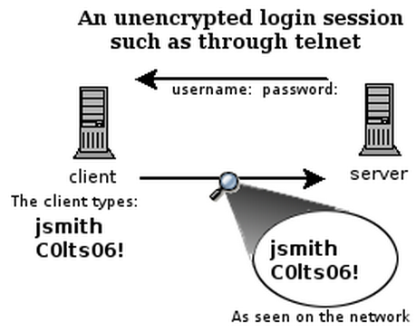
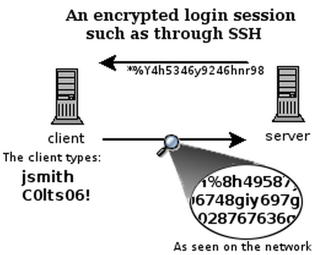
What is SSH?
Secure Shell
Used to remotely access shell
Successor of telnet
Encrypted and better authenticated session
CONFIDENTIAL
Notes:
SSH, also known as Secure Shell or Secure Socket Shell, is a network protocol that gives users, a secure way to access a computer over an unsecured network.

Slide 8
High-Level SSH Protocol
Client ssh’s to remote server
$ ssh username@somehost
If first time talking to server -> host validation
The authenticity of host 'somehost (192.168.1.1)' can't be established. RSA key fingerprint is 90:9c:46:ab:03:1d:30:2c:5c:87:c5:c7:d9:13:5d:75. Are you sure you want to continue connecting (yes/no)? yes Warning: Permanently added 'somehost' (RSA) to the list of known hosts.
ssh doesn't know about this host yet
shows hostname, IP address and fingerprint of the server’s public key, so you can be sure you're talking to the correct computer
After accepting, public key is saved in ~/.ssh/known_hosts

Slide 9
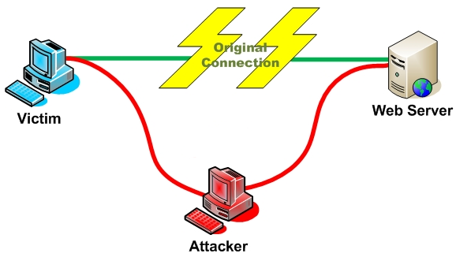
Host Validation
Next time client connects to server
Check host’s public key against saved public key
If they don’t match
$ ssh username@somehost @@@@@@@@@@@@@@@@@@@@@@@@@@@@@@@ @ WARNING: REMOTE HOST IDENTIFICATION HAS CHANGED! @ @@@@@@@@@@@@@@@@@@@@@@@@@@@@@@@ IT IS POSSIBLE THAT SOMEONE IS DOING SOMETHING NASTY! Someone could be eavesdropping on you right now (man-in-the-middle attack)! It is also possible that the RSA host key has just been changed. The fingerprint for the RSA key sent by the remote host is 90:9c:46:ab:03:1d:30:2c:5c:87:c5:c7:d9:13:5d:75. Please contact your system administrator. Add correct host key in /home/user/.ssh/known_hosts to get rid of this message. Offending key in /home/user/.ssh/known_hosts:1 Password authentication is disabled to avoid man-in-the-middle attacks. Agent forwarding is disabled to avoid man-in-the-middle attacks. X11 forwarding is disabled to avoid man-in-the-middle attacks. Permission denied (publickey,password,keyboard-interactive).

Slide 10
Host Validation (cont’d)
Client asks server to prove that it is the owner of the public key using asymmetric encryption
Encrypt a message with public key
If server is true owner, it can decrypt the message with private key
If everything works, host is successfully validated
AUTHENTICATION

Slide 11
Session Encryption
Client and server agree on a symmetric encryption key (session key)
All messages sent between client and server
encrypted at the sender with session key
decrypted at the receiver with session key
anybody who doesn't know the session key (hopefully, no one but client and server) doesn't know any of the contents of those messages

Slide 12
User Authentication
Password-based authentication
Prompt for password on remote server
If username specified exists and remote password for it is correct then the system lets you in
Key-based authentication
Generate a key pair on the client
Copy the public key to the server (~/.ssh/authorized_keys)
Server authenticates client if it can demonstrate that it has the private key
The private key can be protected with a passphrase
Every time you ssh to a host, you will be asked for the passphrase (inconvenient!)

Slide 13
ssh-agent (passphrase-less ssh)
A program used with OpenSSH that provides a secure way of storing the private key
ssh-add prompts user for the passphrase once and adds it to the list maintained by ssh-agent
Once passphrase is added to ssh-agent, the user will not be prompted for it again when using SSH
OpenSSH will talk to the local ssh-agent daemon and retrieve the private key from it automatically

Slide 14
X Window System
Windowing system that forms the basis for most GUIs on UNIX
X is a network-based system. It is based upon a network protocol such that a program can run on one computer but be displayed on another (X Session Forwarding)

Slide 15
Lab 7
Securely log in to each others’ computers
Use ssh (OpenSSH)
Use key-based authentication
Generate key pairs
Make logins convenient
type your passphrase once and be able to use ssh to connect to any other host without typing any passwords or passphrases
Use port forwarding to run a command on a remote host that displays on your host

Slide 16
Lab Environment Setup
Debian
Make sure you have openssh-server and openssh-client installed
$ dpkg --get-selections | grep openssh should output:
openssh-server install
openssh-client install
If not:
$ sudo apt-get install openssh-server
$ sudo apt-get install openssh-client

Slide 17
Server Steps
Generate public and private keys
$ ssh-keygen (by default saved to ~/.ssh/is_rsa and id_rsa.pub) – don’t change the default location
Create an account for the client on the server
$ sudo useradd –d /home/<homedir_name> –m <username>
$ sudo passwd <username>
Create .ssh directory for new user
$ cd /home/<homedir_name>
$ sudo mkdir .ssh
Change ownership and permission on .ssh directory
$ sudo chown –R username .ssh
$ sudo chmod 700 .ssh
Notes:
Optional: disable password-based authentication <<< Is this causing to get locked out of root
$ emacs /etc/ssh/sshd_config
change PasswordAuthentication option to no

Slide 18
Client Steps
SSH to server
$ ssh UserName@server_ip_addr
$ ssh –X UserName@server_ip_addr (X11 session forwarding)
Run a command on the remote host
$ xterm, $ gedit, $ firefox, etc.

Slide 19
Client Steps – Make logins convenient
Generate public and private keys
$ ssh-keygen
Copy your public key to the server for key-based authentication (~/.ssh/authorized_keys)
$ ssh-copy-id –i UserName@server_ip_addr
Add private key to authentication agent (ssh-agent)
$ ssh-add
SSH to server
$ ssh UserName@server_ip_addr
$ ssh –X UserName@server_ip_addr (X11 session forwarding)
Run a command on the remote host
$ xterm, $ gedit, $ firefox, etc.

Slide 20
How to Check IP Addresses
$ ifconfig
configure or display the current network interface configuration information (IP address, etc.)
$ hostname –I
gives the IP address of your machine directly
$ ping <ip_addr>(packet internet groper)
Test the reachability of a host on an IP network
measure round-trip time for messages sent from a source to a destination computer
Example: $ ping 192.168.0.1, $ ping google.com

Slide 21
Beaglebone Setup
Piazza Post!

