Slide 1
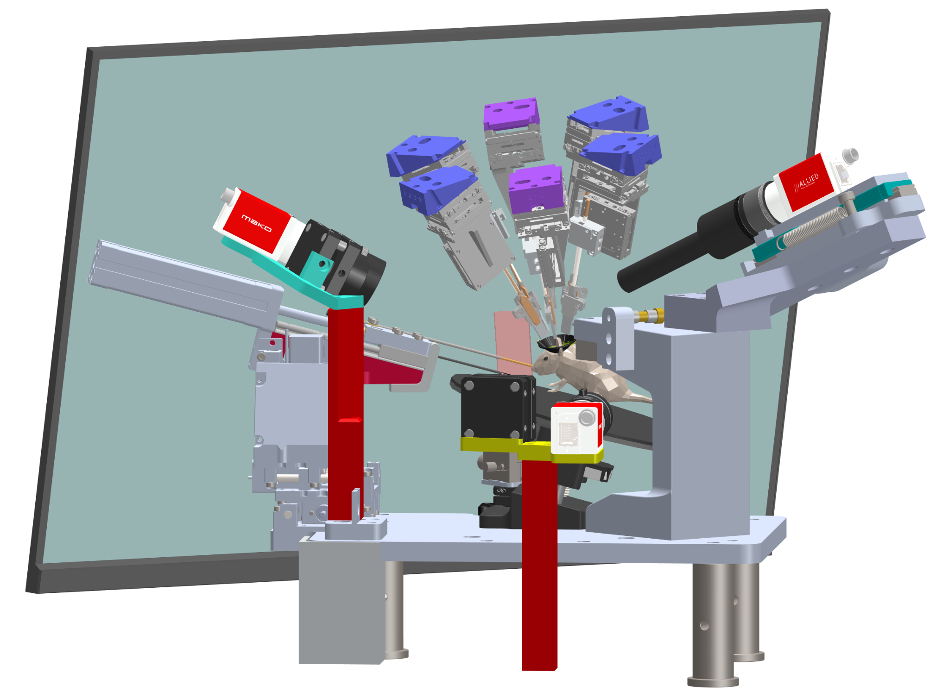
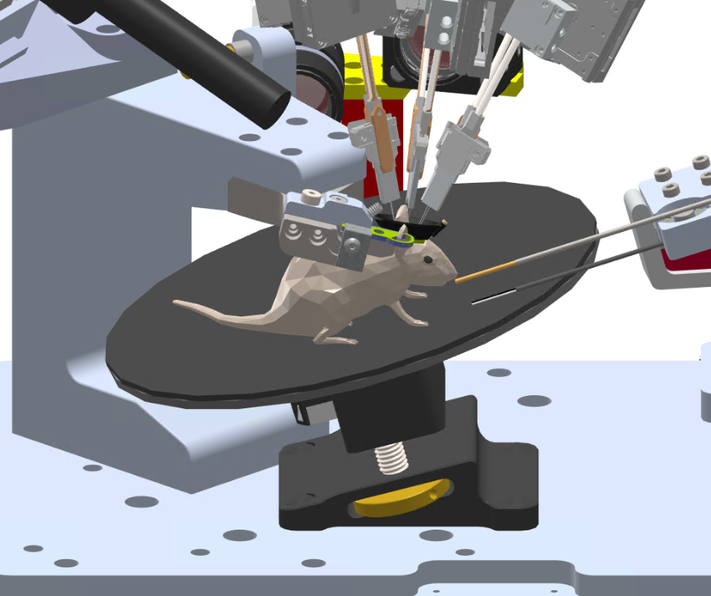
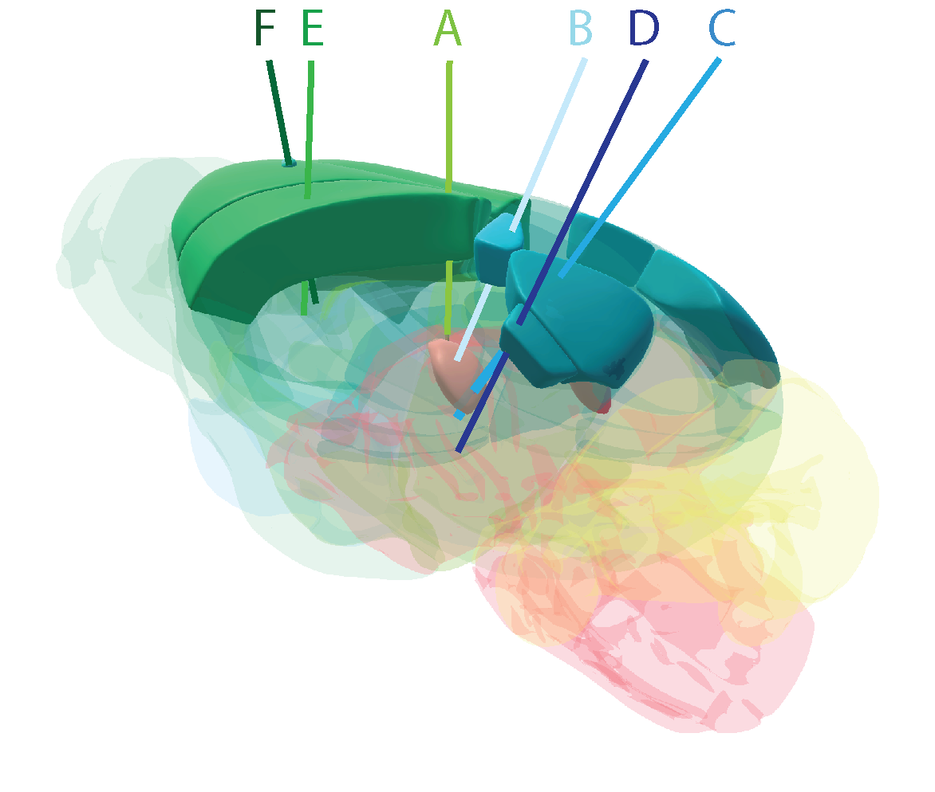
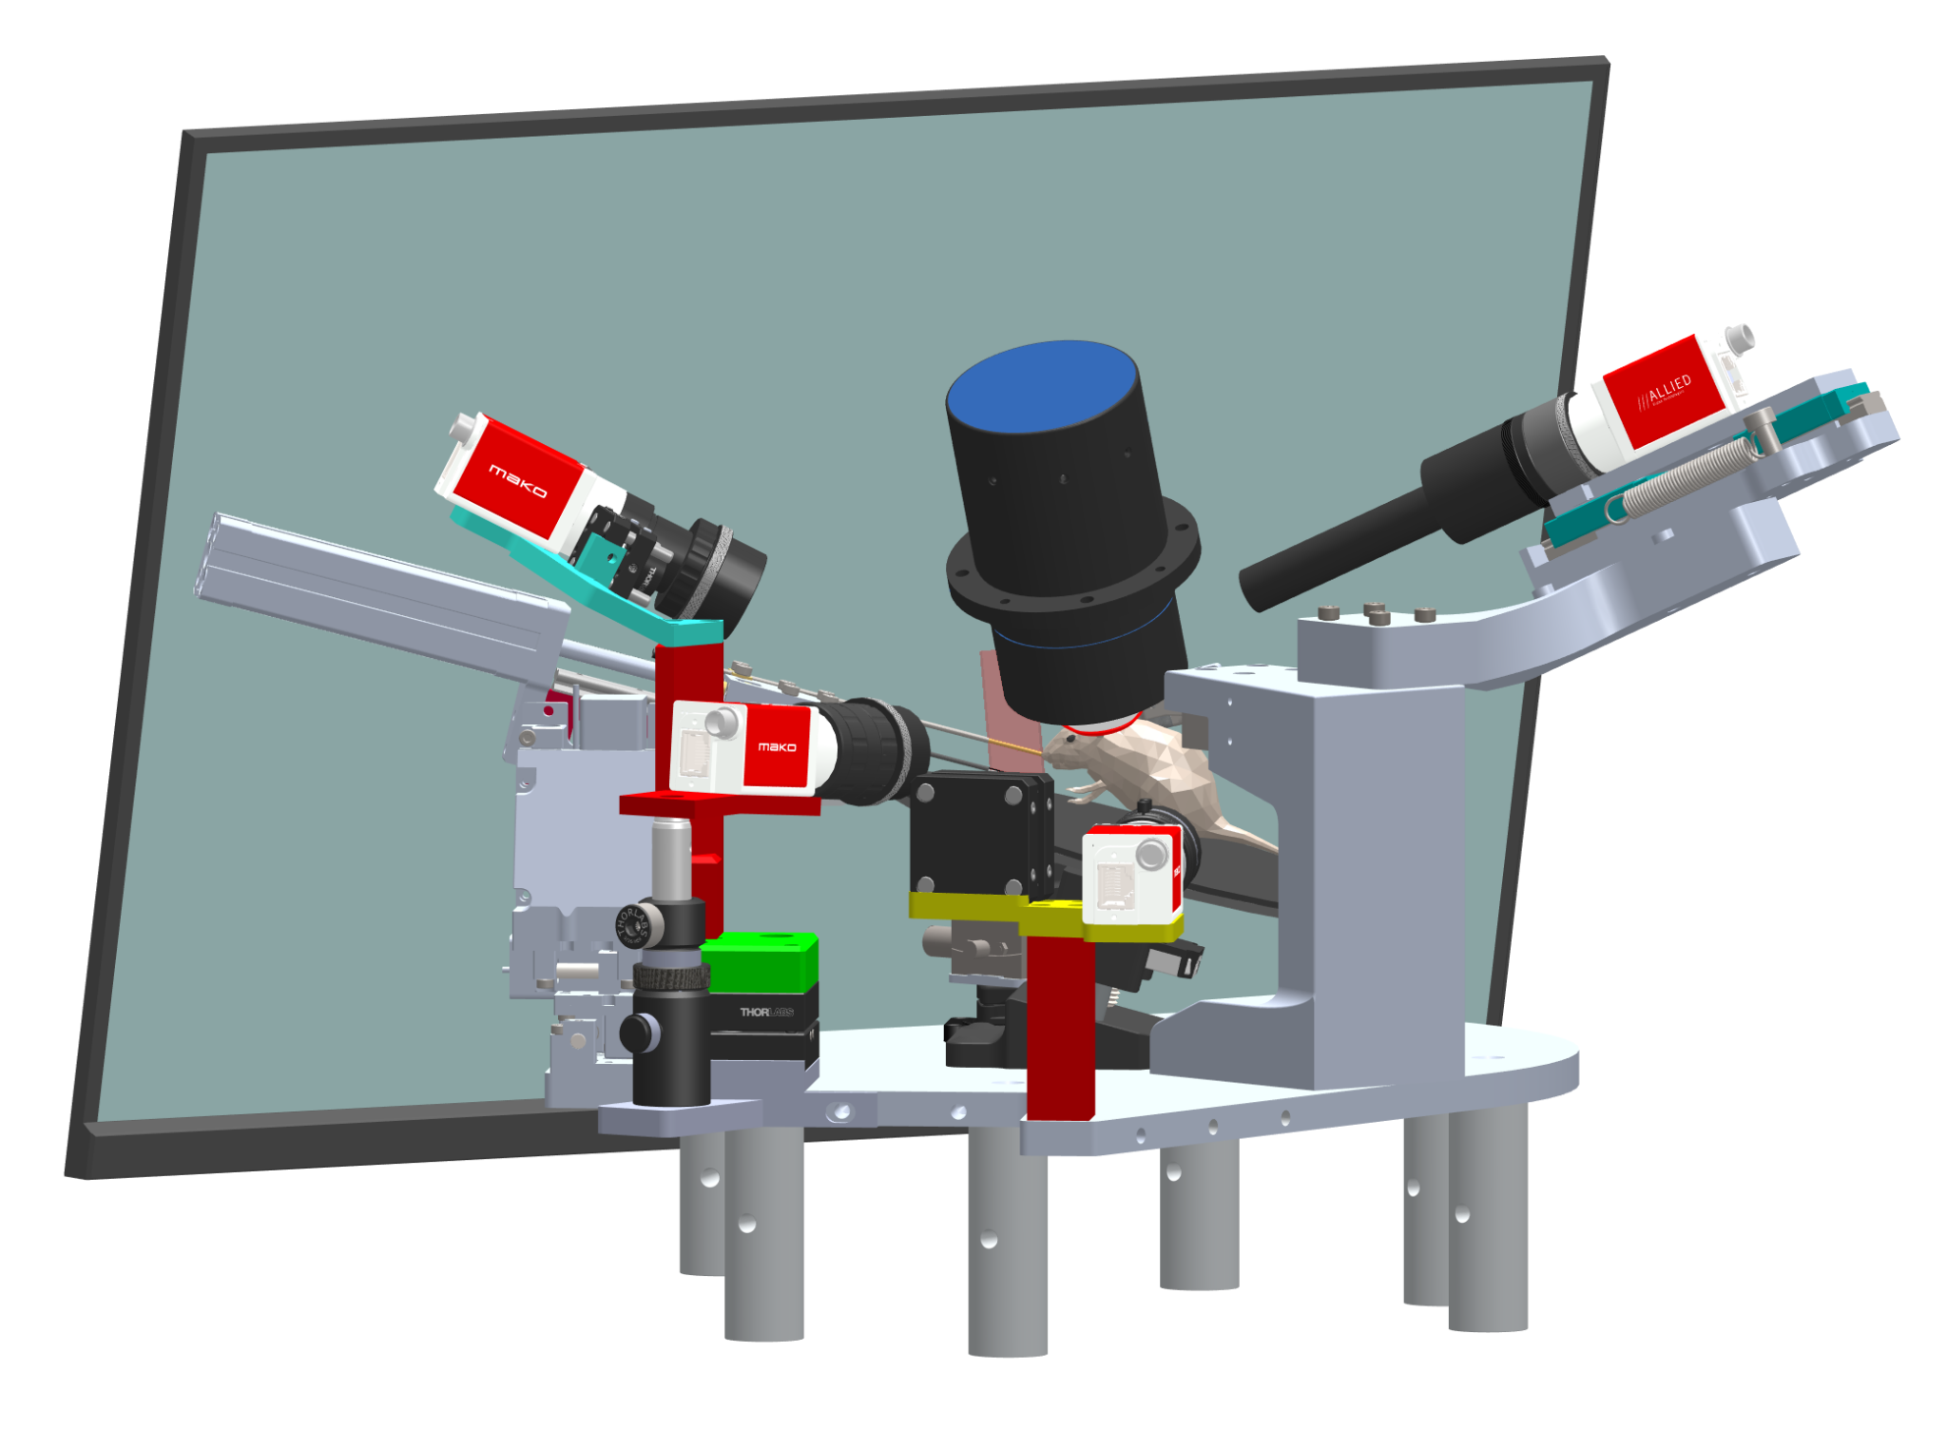
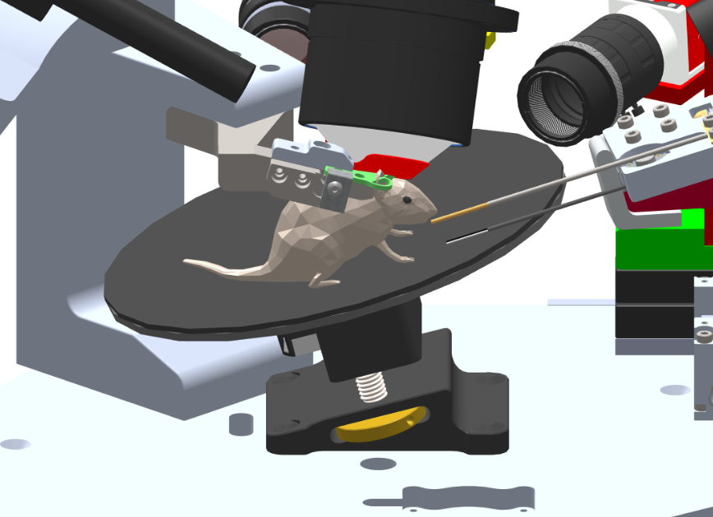
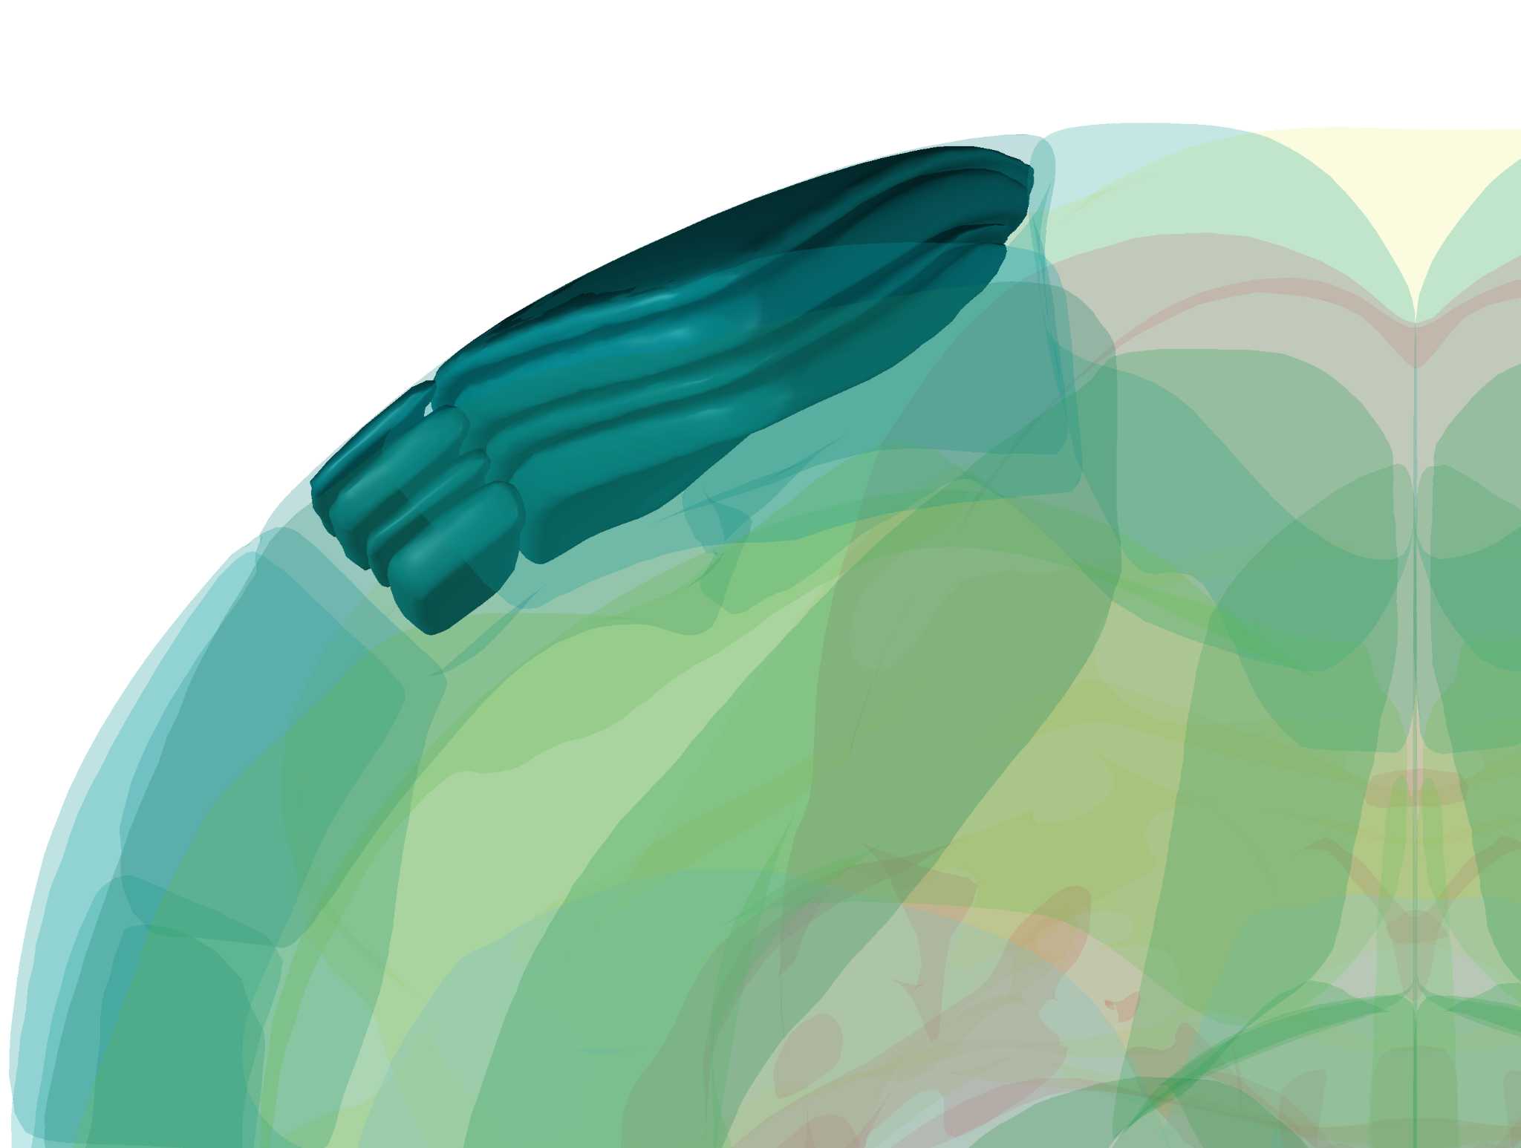
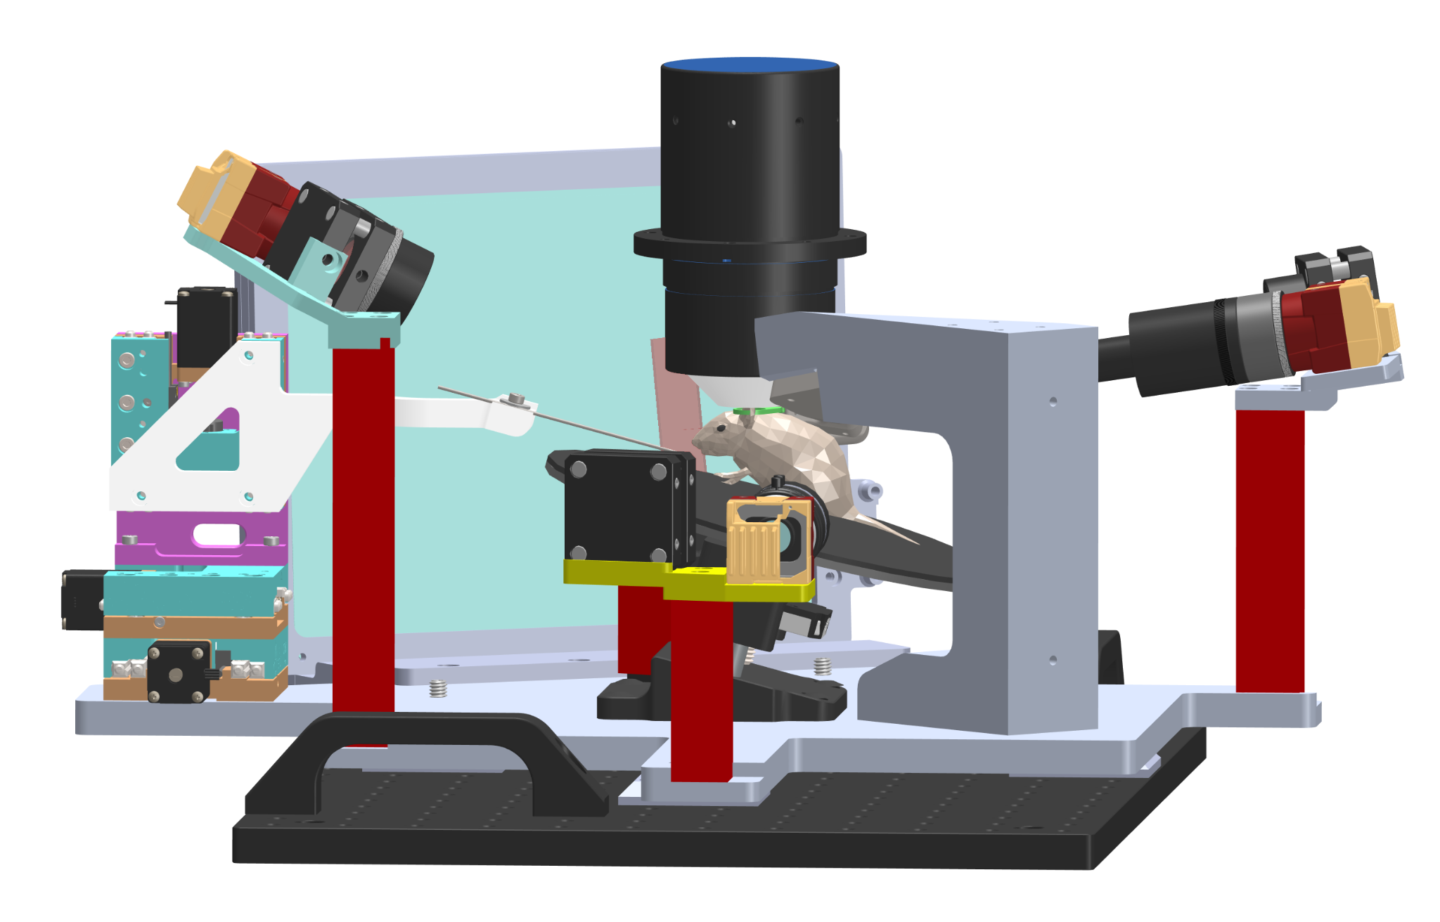
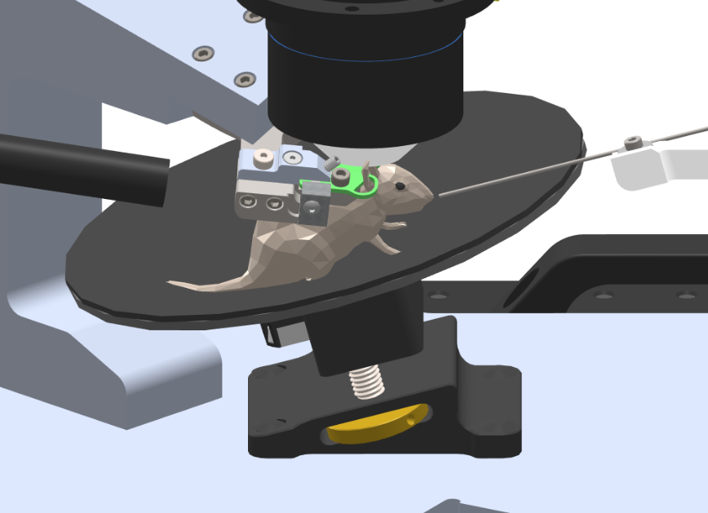
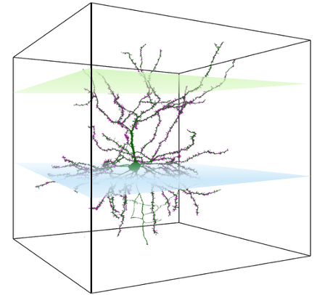
Rig geometry
Mouse platform
Brain targetting
6 Neuropixels probes simultaneously record across the brain
Layer I
Layer II/III
Layer IV
Layer V
VISlm
VISp
8 simultaneously imaged planes pan-neuronal calcium imaging
Apical plane
Proximal plane
Dual planes high-speed dendritic imaging of VISp Layer II/III pyramidal cell

