Slide 1
MACHINE LEARNING PROJECT
Duplicate Question Detection
Q1
Using a Siamese Manhattan LSTM
same meaning?
A simple system for deciding whether two questions ask the same thing
Q2
Presented to: Professor
Project presentation
Duplicate Question Detection | 1/5

Slide 2
02
Problem, dataset, and preprocessing
The task
•
Input: a pair of natural-language questions
Preprocessing
•
Output: duplicate (1) or different (0)
Lowercase text
Remove stopwords
Porter stemming
Tokenize and pad
to 20 words
•
Goal: capture meaning, even when the words are different
The data
•
Quora question-pair dataset with question1, question2, and is_duplicate
•
75% training, 10% validation from training, and 25% test
•
101,073 saved test pairs; stratified split with seed 42
Duplicate Question Detection | 2/5

Slide 3
03
Siamese MaLSTM model
Both questions use the same network weights
Question 1
Shared LSTM
Similarity
Prediction
Question 2
Similarity = exp(− Manhattan distance)
300d embeddings | 50 LSTM units | threshold 0.5
Duplicate Question Detection | 3/5

Slide 4
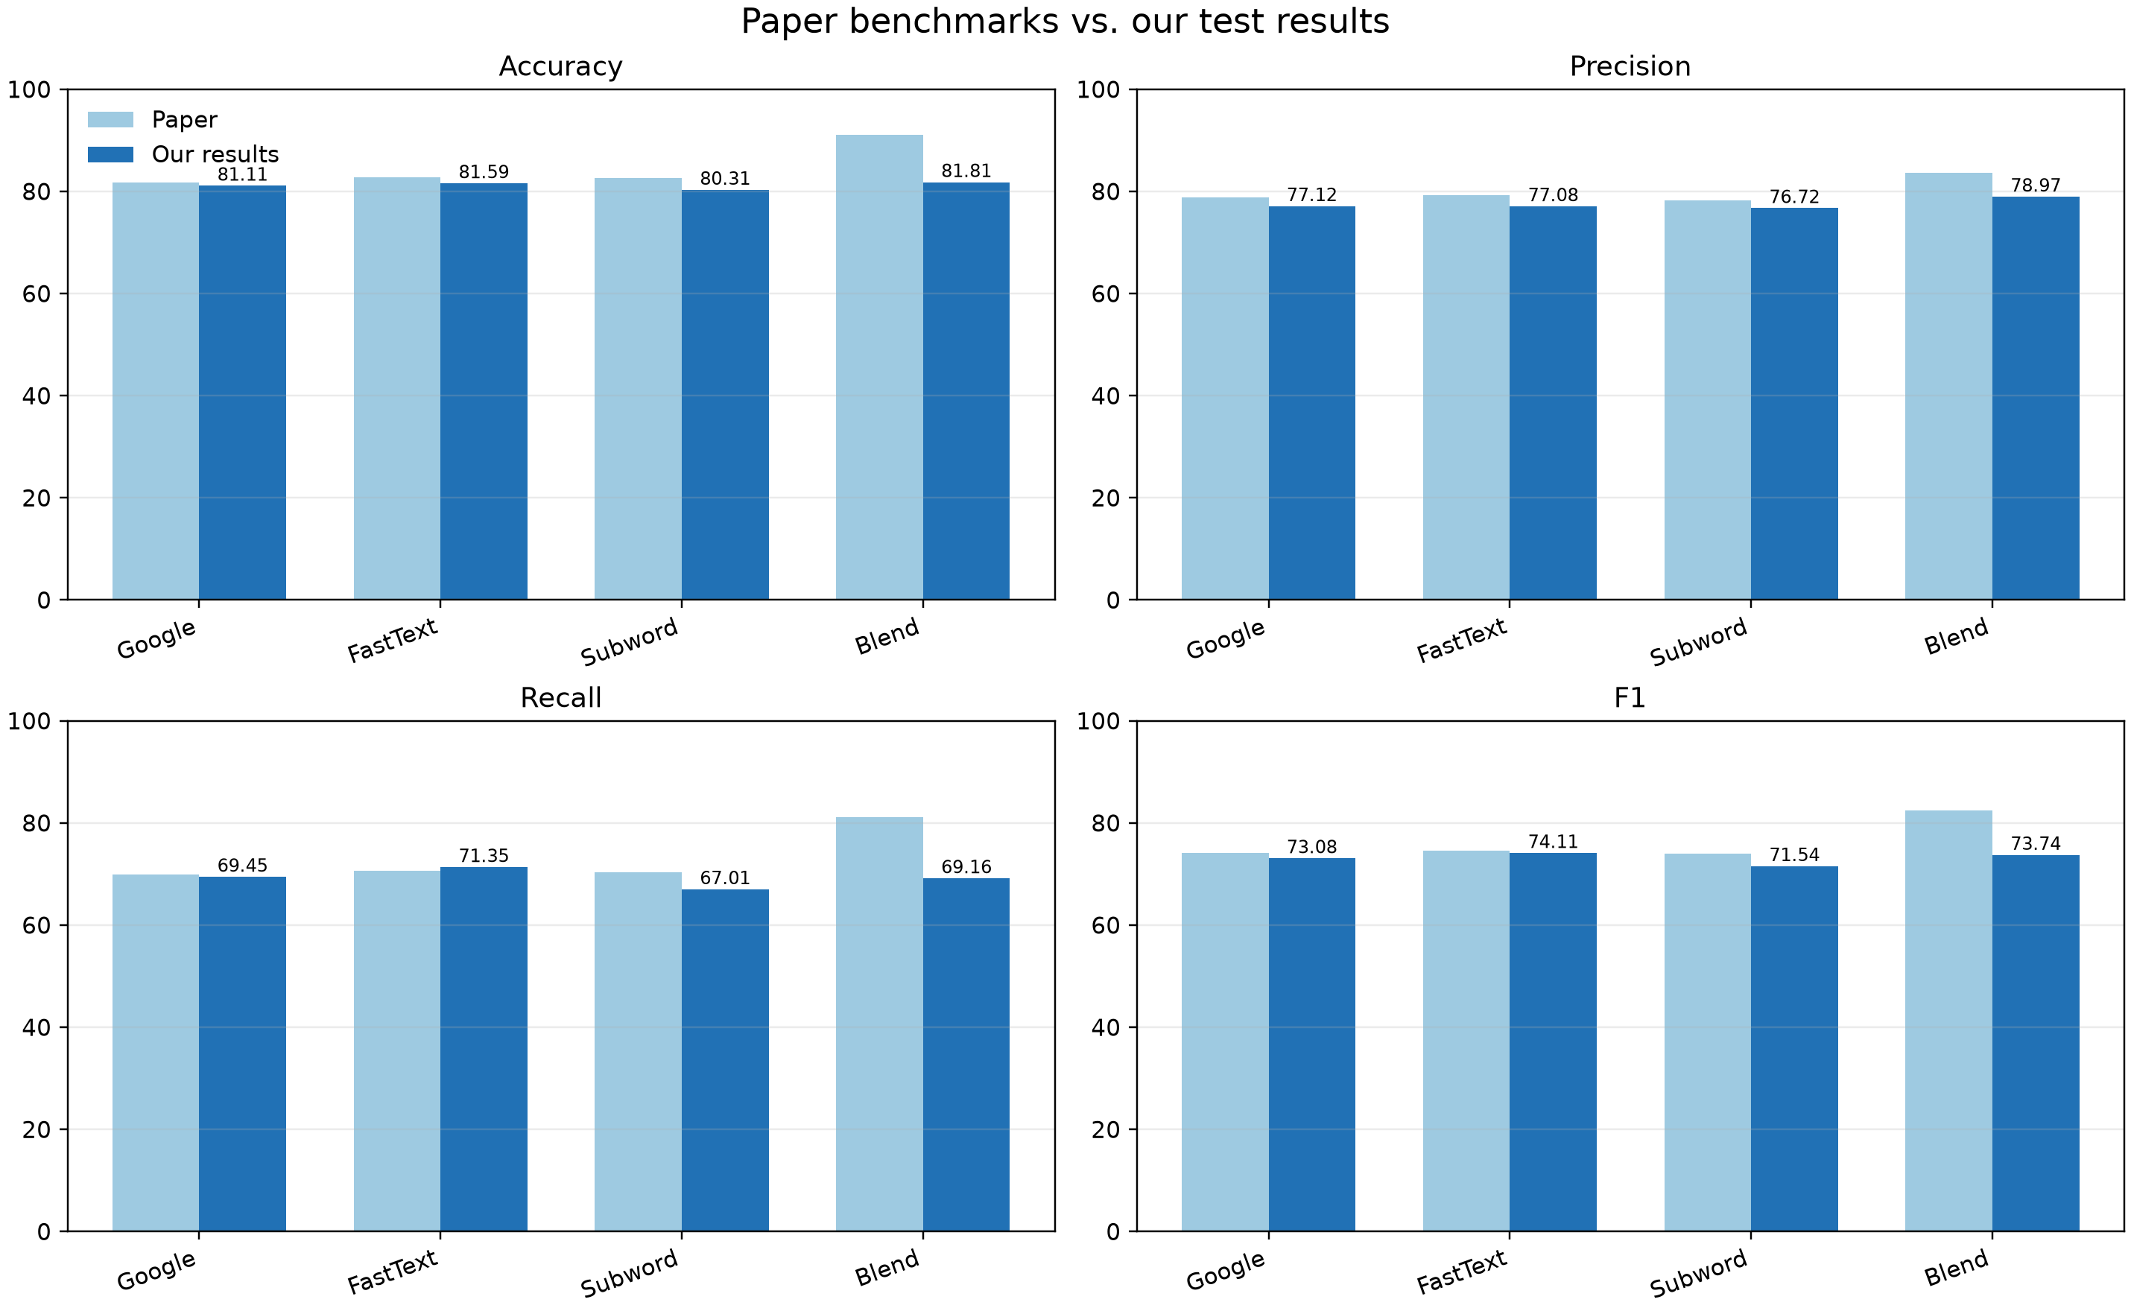
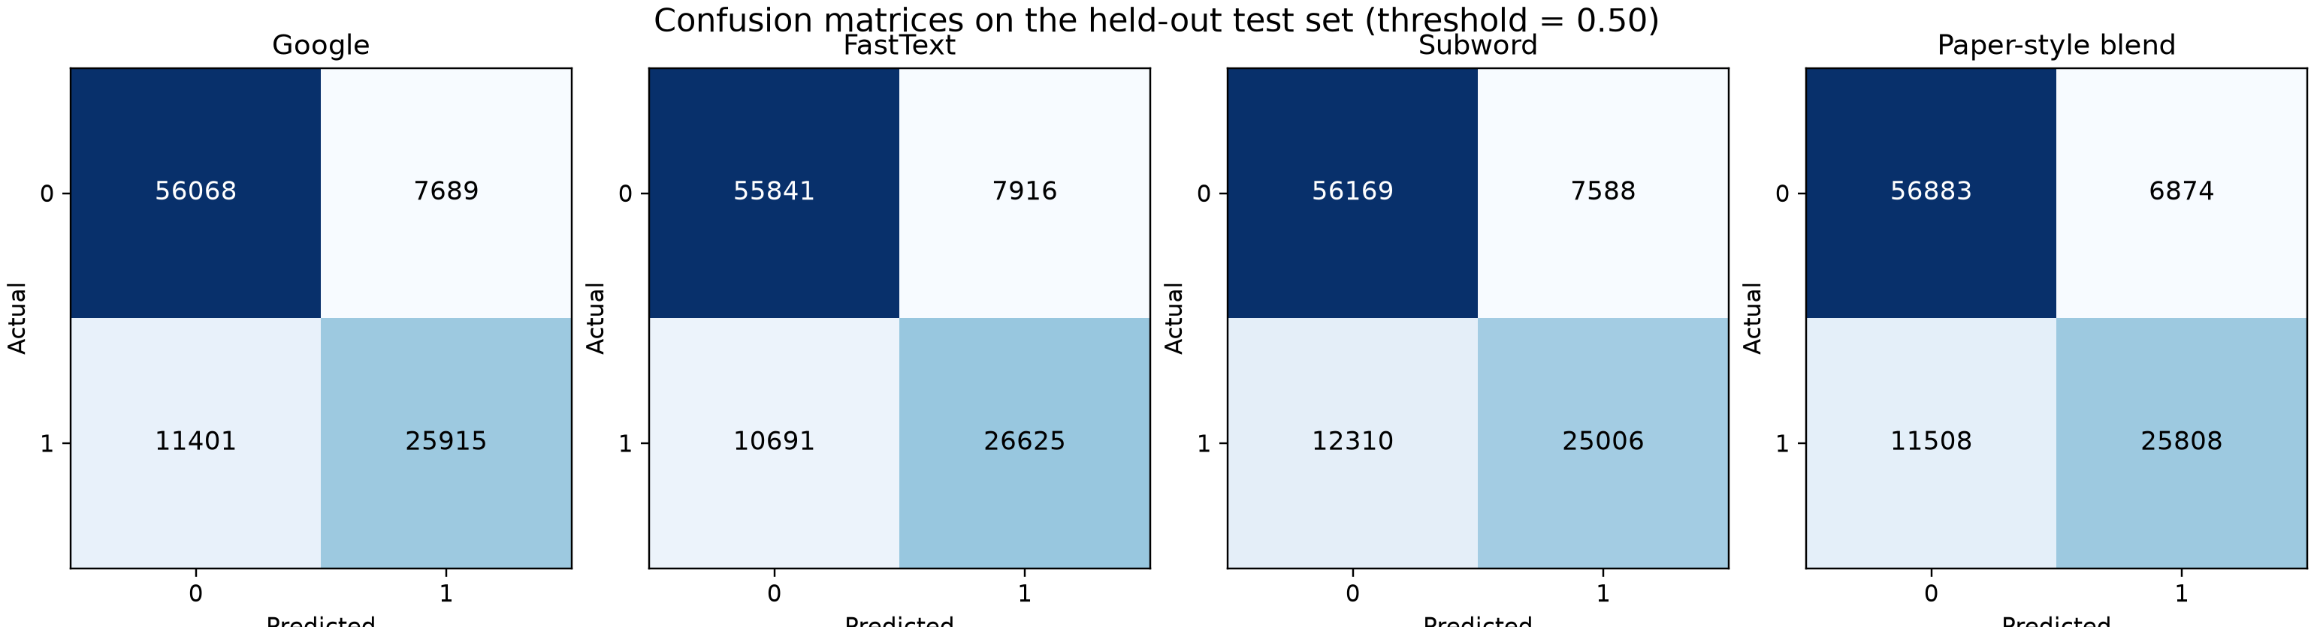
04
Results and evaluation
Held-out test accuracy
Google News
81.11%
FastText
81.59%
Subword
80.31%
Original ensemble
81.81%
Isotonic blend
82.35%
What we measure
•
Accuracy: overall correct predictions
•
Precision, recall, and F1: quality of duplicate detection
•
Confusion matrix and calibration: where errors occur and how reliable scores are
Duplicate Question Detection | 4/5

Slide 5
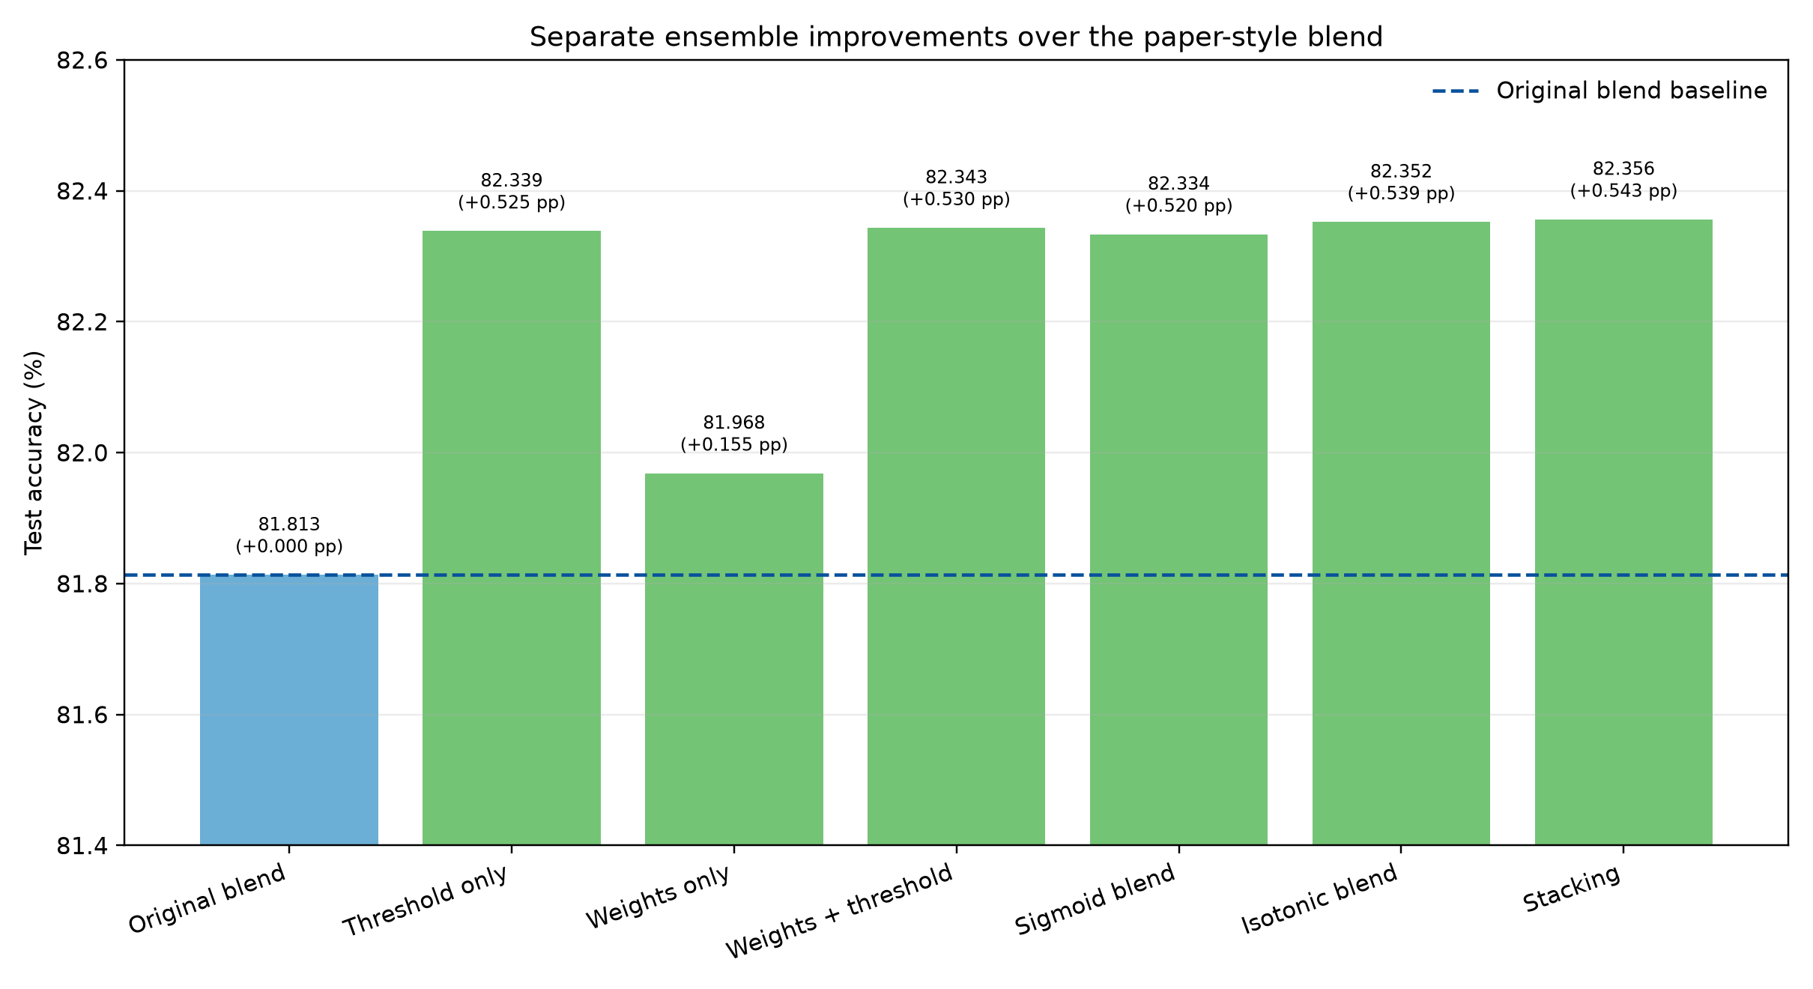
05
Ensemble improvement and conclusion
Why combine models?
•
Each embedding sees language in a different way
Conclusion
•
A weighted blend can reduce the weaknesses of one model
• Siamese MaLSTM compares question meaning
• FastText gives the best single-model accuracy
• The ensemble improves the final result
• Future work: test more architectures
•
Calibration and threshold tuning improve the balance of errors
Key finding
Original ensemble: 81.81%
Selected isotonic blend: 82.35%
Improvement: +0.54 percentage points
A useful baseline for duplicate-question detection.
Duplicate Question Detection | 5/5

