Slide 1
A Summarize of the Transformer Study
WANG PIAO HONG

Slide 2
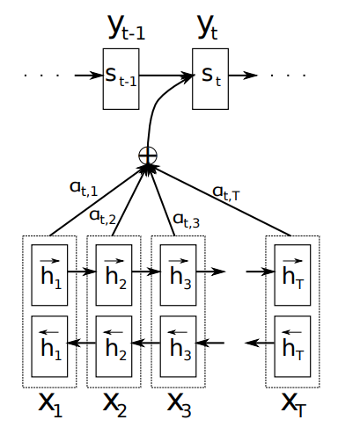


NEURAL MACHINE TRANSLATION BY JOINTLY LEARNING TO ALIGN AND TRANSLATE ( ICLR 2015)
The introduction of Attention
The first paper about the attention idea.
Use the encoder-decoder architect
For the traditional translation method:
For the method mentioned in the paper:

Slide 3
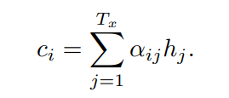

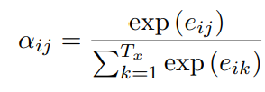

How to get the C_{i} ?
Ci is a weighted sum of annotations h
H is the hidden state of BiRNN
a is a feedforward neural network

Slide 4
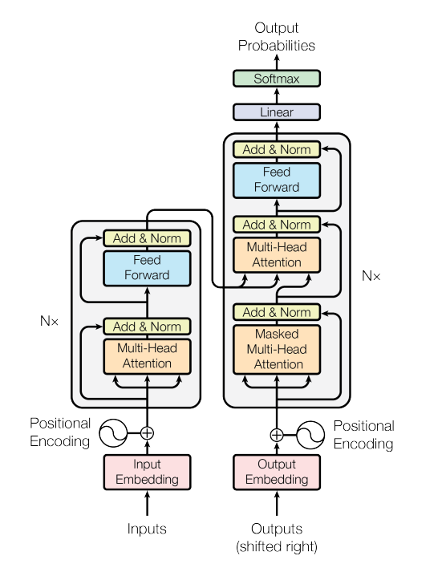
The origin architect of transformer (Attention is all your need)

Slide 5
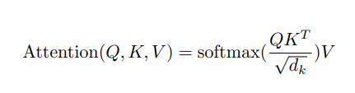
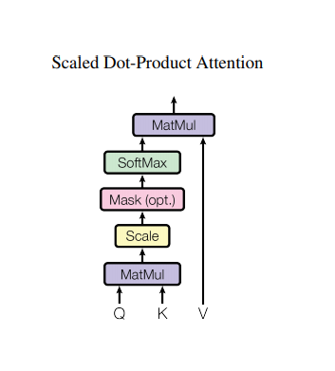
Q is the matrix of queues. Each queue is the vector of a source word
K is the matrix of keys. Each key is the vector of a target word
V is the matrix of values. Each value is assigned to a queue.
Dk is the dimension of queue and key
The SoftMax result of the scaling product of Q and K can be used to calculate the similarity of Q and K, and the similarity is used as the weight of assigning different keys’ value. It is called
Dot attention.

Slide 6
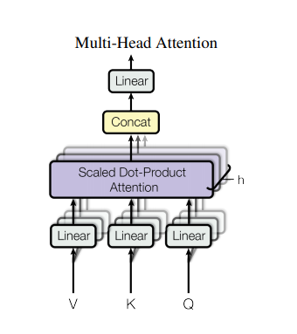
The parallel version of last one.
Project the queries, keys and values to certain dimensions before calculating the attention.
Because there are 8 parallel units, the number of dimension will be divided by eight after projection.
After the attention calculation, the result of each parallel attention will be concated together
After the concat of each parallel unit , there will be another linearly project to project the result to certain dimension.
Self-attention layer: the keys ,queues and values come from the same place.
Cross-attention layer: the queries and keys come from different places.

Slide 7
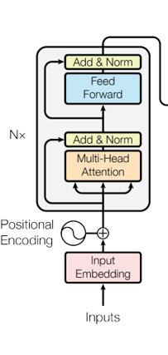

The architect of encoder:
The encoder is composed of a stack of N=6 identical layers.
Each layer has two sub-layers.
The first is a multi-head self-attention mechanism, and the second is a simple, position-wise fully connected feed-forward network.
The author employ a residual connection around each of the two sub-layers, followed by layer normalization.
The inputs are word vector matrix . Each word in the sentence is transformed to a vector.
Input Embedding is a linear transformation operation.
The positional encoding supply the information about the position of each word.

Slide 8
The architect of encoder:
The Q,V,F inputs for Multi-Head Attention are same, the attention mechanism renew the input matrix based on the correlation of each vector.
The self attention layer help each word find the relationship with others in one sentence. In other word, it can help the whole model understand the word’s dependence in certain sentence .
The feed forward neural network is responsible for encoding the matrix in each layers. Since other modules are only linear projection and neural network can bring non-linear transform.
There are six identical encoding layers. All the attention mechanism in encoding layers are self-attention.
The residual network can help avoid the vanish gradient in deep network.

Slide 9
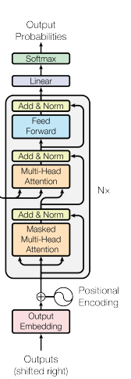
The architect of decoder:
The decoder is also composed of 6 identical layers.
The former one’s output will be used as the input for next layer.
The embedding and positional parts are almost the same as the encoder.
The Masked Multi-Head Attention can avoid bringing the dependence on later words for present one. The former outputs are the vector matrix for former output sentence. Like the self attention part in encoder, it can renew the input matrix based on the correlation of each vector.
The Multi-Head Attention’s key and value come from the encoder and queries come from the decoder. It is cross-attention. The Multi-head attention can help the model find the relationship between words from the words’ dependence in last sentence.
The output probability is the translation probability for each word.

Slide 10
DETR(End-to-End Object Detection with Transformers)

Slide 11
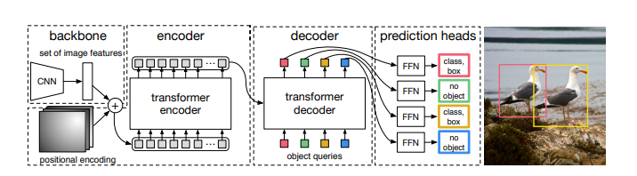
Backbone-Transformer-Final Detect
CNN extract the features from the image and import the features to transformer. The output of the transformer will be
imported into two different FFN to get class label and the coordinate of bounding box.
CNN backbone will generate a lower resolution feature map with 2048 channels, there will be a 1X1 convolution to reduce the channels before entering into the encoder and the feature maps will be flattened and become a matrix.
The architect is end-to-end, in my opinion end to end means you can directly get the class label of certain object in the image without post-treatment.

Slide 12
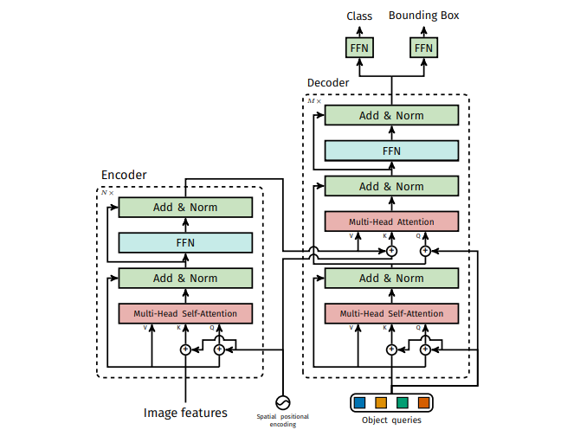
The main structure of DETR is almost the same as transformer.
The spatial positional encoding are fixed embeddings.
The object queries are learned positional embeddings .The N object queries may refer to the coordinates of N different boxes.
But I still don’t know why the author need to double the Q and K of queries.

Slide 13
DEFORMABLE DETR(DEFORMABLE DETR: DEFORMABLE TRANSFORMERS FOR END-TO-END OBJECT DETECTION)

