Slide 1
Project Title : NYC School Performance

Slide 2
Project Description :
What are some of the most likely major impacts on school performance.
- Study the correlation between New York City school safety and performance records to socio-economic census data
1. Is there a correlation between school safety records and school performance?
Does a higher income increase the likelihood of safer schools?
3. What is the impact of school crime rates to school performance?
4. What is the correlation between income and school performance?

Slide 3
Data Sets Used
Set A - NYC School Safety Report (NYC Open data 2013-2014)
Set B - NYC DOE High School Performance Directory (NYC Open data 2013-2014)
Set C - Demographics and profiles at the Neighborhood Tabulation Area (NTA) level
(NYC Open data from the 2008-2012 American Community Survey)
Set D - Crime by Precincts
School Performance 2013-14
Census Data
School Safety 2013-14
Link together by NTA

Slide 4
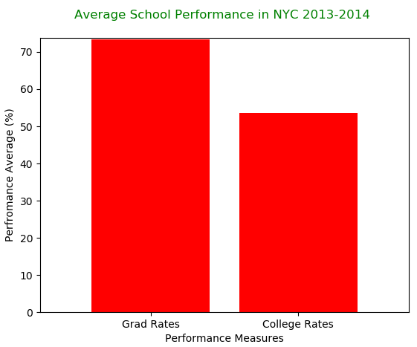
What is the Overall Average School Performance in NYC vs School Safety numbers for 2013 & 2014
For the Neighborhood Tabulation Area ( NTA) in NYC the total number of incidents for the year 2013-2014 near 10K
For the NTA the Average High School Graduation rate is 75% and the students that make it to college is 55%

Slide 5
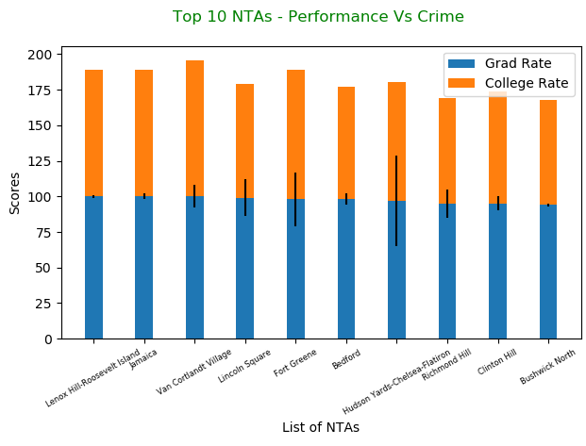
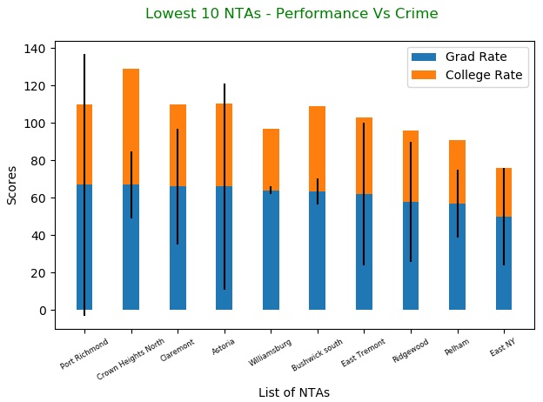
What is the correlation between school performance and crime incidents in schools?
For the Neighborhood Tabulation Area ( NTA) in NYC the Top 10 performing schools with high graduation rate the no. of incidents were low.
For 10 lowest performing schools with low rates of graduation the number of incidents are high.

Slide 6
How does the Overall education attainment of a NTA stack up against school Performance

