Slide 1
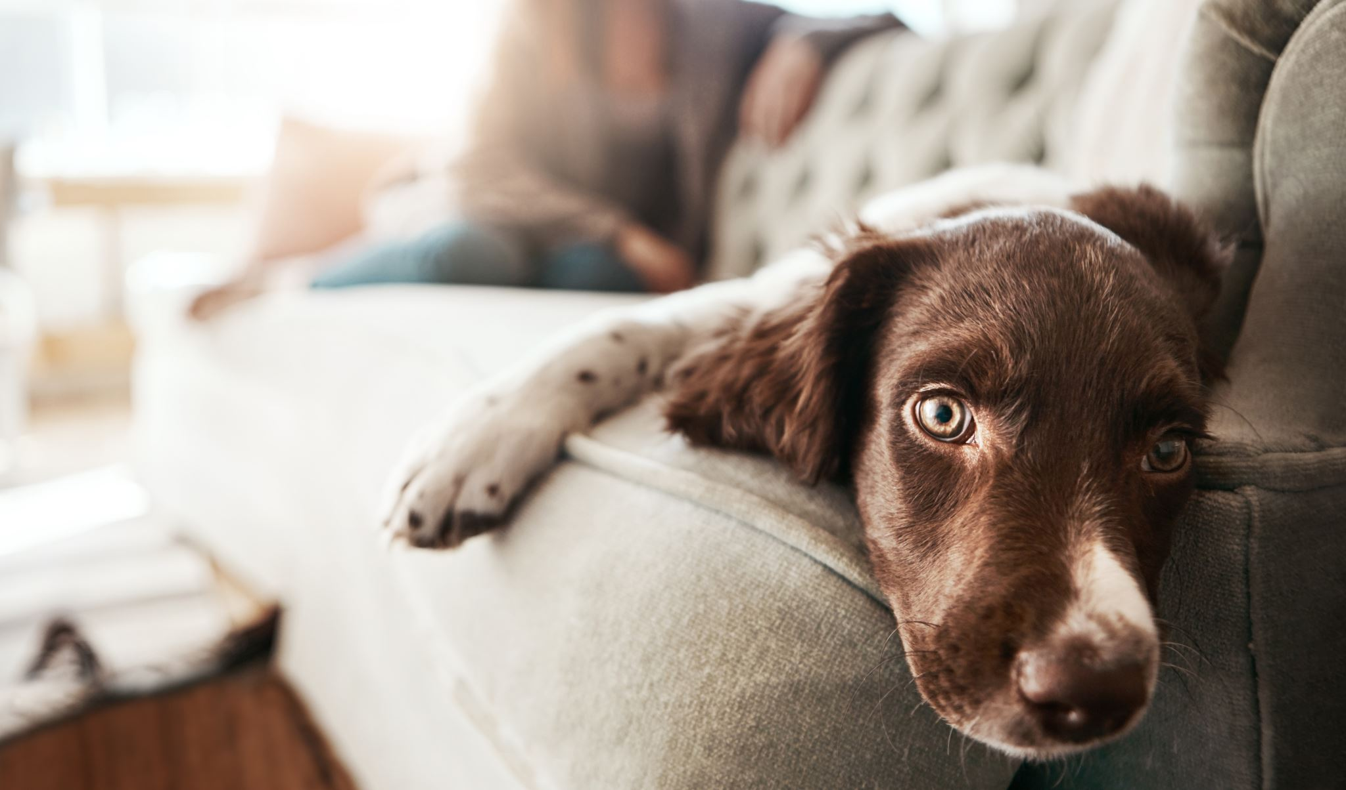
Pet Adoption Website
CSE2102-Fall24-Team25

Slide 2


Samatha Guzman
  Motivation: She had a family dog growing up but unfortunately it has passed away. Now with her two kids, one of her kids cannot see well and She needs an good application that works and doesn't confuse her while getting a trained dog for her kid to walk around.
  Age = 28
  Job works in Tech at home!
  Married with 2 kids! They Live in CT, Fairfield.
  *Her child has an a problem visually and she needs a service dog*
  App – needs to be easy to use. Not overwhelming. Details on where the application is and who to contact.
  Bio: Samatha loves animals and works hard, especially in her job. Her family comes first and she's always there for them. In addition to learning, she's passionate about animals and how to take care of them. As well as her hobbies include cooking, reading, and swimming. She loves tech and is always excited about new things, but she's also very strict about whether it's a good idea or not.

Slide 3

Daniel Miller
Motivation
  Daniel is a driven photographer who loves to takes photos of landscapes, birds, and people. He is a very simple man who loves animals.
Frustrations
  He's simple so he gets overwhelmed if there are too many options for pets
  Wants a dog that’s perfect for him
Bio
Daniel is a 25 year old man who is a photographer for a company and travels occasionally for his work. He often spends his day to work out and socialize with his friends. He loves to take photos of landscapes, birds, and people. He would like to have a pet dog who is calm and playful.
  ​
Age : 25
Family: Married
Location: Boston, Massachusetts

Slide 4

Motivation: Wants a dog to motivate him to get around and to fill up his day. He needs a simple and easy to use app that doesn't confuse him.
Bio:
Jacob Keys is a retired man who lives his days at his house. He often sits at home watching TV going on the patio and looking outside. He not that use to technology and can't seem to buy a dog without being confused or thinking it’s a scam. He would love a dog to have that low maintenance but would force him to get active.
Goals:
-Accessibility Options for the app
-Easy Onboarding so he doesn't get confused
-Filters to choose a low maintenance pet
Family: Married and kids already moved out
Location: Syracuse New York
Age: 65

Slide 5
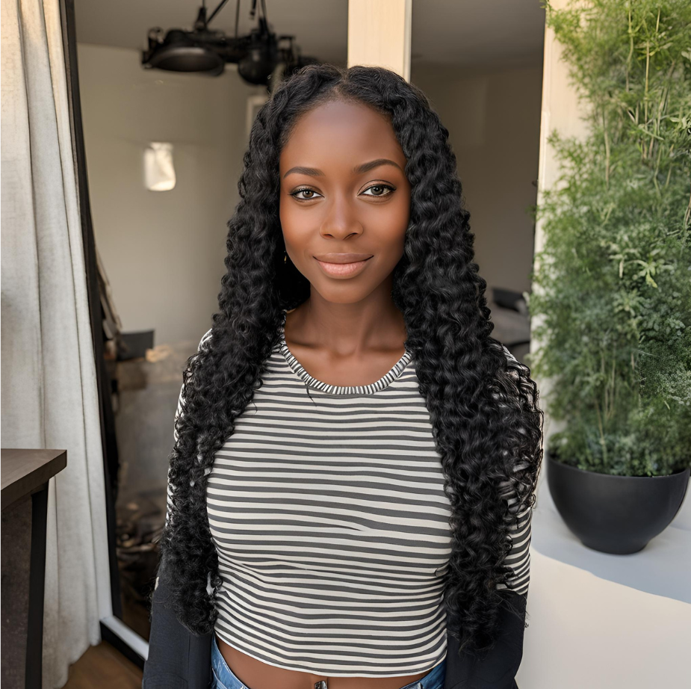
Unique Jones
Motivation
To find a dog that best suits a college student lifestyle and to keep her company. She wants something that would help her to figure out what kind of dog she wants.
Age 20 – 26
Pre-med College Student
From: Boston, MA
College Location: New Jersey
Goals
- Wants a easy to maneuver website
- Doesn’t have to fill out to many applications
- Reminded of any important deadlines
Preferred Channels:
- Mostly uses Google Chrome
- Sometimes uses Safari
- Has a mac computer
Bio
Unique is a pre-med college student who lives far from home. She lives at an off-campus apartment with two friends one who is allergic to dogs. She isn’t home a lot during the day and stays up late to study. She also loves to work out on the weekend and is active.

