Slide 1
ICS QUIZ SOL
Signals, I/O & Virtual Memory
Notes:
You've already taken the mock under exam conditions. This walkthrough covers Problems 2 and 3 - the signal/I-O integration problem and the VM problem. Frame: these two problems integrate weeks 7-8 (signals + Unix I/O) and the VM lectures (2-17, 2-18).

Slide 2
ROADMAP
What we'll walk through
PROBLEM 2 — SIGNAL & I/O · 30 PTS
PROBLEM 3 — VIRTUAL MEMORY · 39 PTS
2.1 The three-table model — where does fd 1 point after Dup2 + Fork? (6 pts)
2.2 Race condition — find the hang, then fix it with sigsuspend (14 pts)
2.3 Async-signal safety (G0/G1/G2) + O_APPEND atomicity (10 pts)
3.1 Bit-width fundamentals (8 pts)
3.2 Page-table memory: regular vs. 2 MB huge pages (15 pts)
3.3 VIPT cache constraint: CI + CO ≤ VPO (8 pts)
3.4 Why mmap beats read + write (8 pts)
Goal: not just the answers — the reusable mental models behind them.
ICS Quiz Walkthrough · 2

Slide 3
PROBLEM 2 · 30 PTS
Signal & I/O:
a logger that hangs
ICS Quiz Walkthrough · 3

Slide 4
PROBLEM 2 · SETUP
logger.c — the whole problem in 14 lines
2 volatile sig_atomic_t reaped = 0;
5 void chld_handler(int sig) {
7 while ((pid = waitpid(-1,NULL,WNOHANG)) > 0) {
8 printf("reaped pid %d (total=%d)\n", ...);
10 reaped++; } }
19 logfd = Open("/tmp/run.log",
20 O_WRONLY|O_CREAT|O_APPEND, 0644);
21 Dup2(logfd, STDOUT_FILENO);
23 Signal(SIGCHLD, chld_handler);
24 Sigprocmask(SIG_BLOCK, &mask, &prev);
26 for (i = 0; i < 3; i++)
27 if (Fork() == 0) { printf(...); exit(0); }
33 printf("parent: forked 3 children\n");
34 Sigprocmask(SIG_SETMASK, &prev, NULL);
36 while (reaped < 3)
37 Pause();
2.1
Lines 19–21, 27
Open + Dup2 + Fork: who shares the open file table entry?
2.2
Lines 34, 36–37
Unblock, then test-and-Pause: a lost-wakeup race
2.3
Lines 5–12
printf in a handler, errno clobbered, O_APPEND to the rescue
ICS Quiz Walkthrough · 4
Notes:
Highlighted lines are where the three sub-questions live. Launched as ./logger from a shell, original stdout = terminal.

Slide 5
PROBLEM 2 · 2.1 (A)
After Dup2 (line 21): who points at run.log?
Parent descriptor table
Open file table (system-wide)
v-node table
severed by Dup2
fd 1
tty (shell's stdout)
refcnt 1 lower (shell still holds it)
v-node:
terminal
logfd = 3
(fd 0 / fd 2: unchanged,
still → terminal)
/tmp/run.log O_APPEND
refcnt = 2
v-node:
/tmp/run.log
ANSWER
COMMON TRAP
Refcount = 2.
The two slots are parent.logfd (Open, line 19) and parent.fd 1 (re-aimed by Dup2, line 21).
“Dup2 allocates a new OFT entry.” No — Dup2(old, new) closes what new pointed at, then aliases new onto old's existing entry.
ICS Quiz Walkthrough · 5
Notes:
Hint progression: (1) Before any Fork, how many fds in the parent point at the log file's OFT entry? (2) Walk Dup2: tears down fd1->tty, aliases fd1 onto logfd's entry. tty refcount drops by 1; run.log refcount 1 -> 2.

Slide 6
PROBLEM 2 · 2.1 (B)
After three Forks: count the arrows
Parent
ANSWER
fd 1 ▸ logfd ▸
8 slots
2 (parent)
+ 3 × 2 (children)
Child 0
OFT entry: /tmp/run.log
refcnt = 8
fd 1 ▸ logfd ▸
COMMON TRAP
Child 1
“Each child gets its own OFT entry.” No — Fork copies the descriptor table, not the OFT. All 8 slots alias one entry.
fd 1 ▸ logfd ▸
each process contributes 2 refs (fd 1 + logfd)
Child 2
fd 1 ▸ logfd ▸
Fork() duplicates the descriptor table: every child inherits fd 1 and logfd, still aimed at the same OFT entry.
ICS Quiz Walkthrough · 6
Notes:
Blackboard move: draw 4 descriptor tables side by side, all arrows into the single shared OFT entry, then literally count arrows = 8.

Slide 7
PROBLEM 2 · 2.1 (C)
Why does the terminal see zero bytes?
printf in parent
+ all 3 children
/tmp/run.log
(every byte lands here)
tty OFT entry
zero descriptors in these
4 processes reference it
fd 1
ANSWER
Dup2 re-aimed fd 1 at /tmp/run.log before any printf ran; children inherit that table, so no descriptor in any of the four processes references the terminal's OFT entry.
What if line 21 (Dup2) were deleted? run.log refcount = 1, fd 1 still → terminal, and all printf output appears interleaved on screen. Dup2 is the load-bearing piece of redirection.
ICS Quiz Walkthrough · 7

Slide 8
PROBLEM 2 · 2.2 (A)
The race: a SIGCHLD lands in the gap
3rd child exits → SIGCHLD delivered → handler reaps, sets reaped = 3, pending bit cleared
load reaped == 2
test 2 < 3 ✓
Pause()
THE GAP
sleeps forever — no 4th signal is coming
state: reaped 2 → 3 SIGCHLD pending 0 → 1 → 0 (consumed before Pause runs)
ANSWER
COMMON TRAP
Concrete hang trace:
1. reaped == 2: loop test passes, body entered.
2. Before Pause(): child 3 exits, handler runs to completion.
3. Pause() now waits for a signal that will never arrive.
“Pause() is sleep-until-signal.” It waits for the NEXT signal after it's called. One that fired a microsecond earlier is simply lost.
ICS Quiz Walkthrough · 8
Notes:
Hints: (1) Between evaluating reaped<3 and entering Pause(), can a signal arrive? (2) What does it do to the pending bit by the time Pause runs? Build this timeline on the board, then trace the fix through the SAME scenario on the next slides.

Slide 9
PROBLEM 2 · 2.2 (B)
The fix: wait with sigsuspend
BUGGY
FIXED
34 Sigprocmask(SIG_SETMASK,
&prev, NULL);
/* SIGCHLD now unblocked */
36 while (reaped < 3)
37 Pause();
34 /* deleted: stay blocked */
36 while (reaped < 3)
37 sigsuspend(&prev);
38 Sigprocmask(SIG_SETMASK,
&prev, NULL);
Delete the unblock on line 34 — SIGCHLD stays blocked across every test of reaped, so the handler cannot fire between test and wait.
sigsuspend(&prev) = unblock + sleep + re-block, as one atomic step. No extra local variable needed.
Grading note: full credit if sigsuspend(&prev) is in the loop and SIGCHLD is blocked between iterations; restoring the mask afterward (line 38) is good practice but optional here.
ICS Quiz Walkthrough · 9

Slide 10
PROBLEM 2 · 2.2 (C)
Why sigsuspend closes the race
process mask over time →
ATOMIC — swap + sleep happen as one step w.r.t. signal delivery
BLOCKED
test reaped < 3
UNBLOCKED — asleep inside sigsuspend
signal delivered here → handler runs
BLOCKED again
before sigsuspend returns
loop:
re-test
ANSWER
sigsuspend(&prev) atomically:
(i) swaps the mask to prev (SIGCHLD unblocked), (ii) sleeps until a signal is delivered, (iii) restores the blocking mask before returning.
A SIGCHLD that fires between loop iterations is held pending — it cannot be delivered and lost. The test and the wait are no longer separated by an unsafe window.
ICS Quiz Walkthrough · 10
Notes:
Trace the 2.2(a) scenario through this fix: SIGCHLD blocked at the test, so even if child 3 exits 'early', the signal stays pending; sigsuspend opens the mask and the pending signal is delivered immediately - sigsuspend returns, loop re-tests, reaped==3, exit.

Slide 11
PROBLEM 2 · 2.2 (D)
Why polling with usleep(100) is strictly worse
while (reaped != 3)
usleep(100); /* poll */
1 · BURNS CPU
2 · ADDS LATENCY
The parent wakes every 100 µs to re-check, whether or not anything happened — thousands of pointless wakeups per second. sigsuspend sleeps until the event, spending zero CPU waiting.
Even when the handler runs mid-sleep, the parent doesn't notice until the 100 µs timer expires — bounded but nonzero delay on every child exit. sigsuspend returns the instant the handler finishes.
Either objection alone earns full credit.
ICS Quiz Walkthrough · 11

Slide 12
PROBLEM 2 · 2.3 (A)
Grade the handler against G0 / G1 / G2
G1
G2
G0
VIOLATED · LINE 8
VIOLATED · errno
ALSO ACCEPTED
printf is not async-signal-safe
errno never saved / restored
Does more than the minimum
It takes the stdio lock and writes a user-space buffer. If main is mid-printf (line 33/39) when SIGCHLD fires, the handler deadlocks on the lock or corrupts the buffer.
waitpid (line 7) sets errno = ECHILD when no children remain. If main was mid-syscall, its errno check afterwards sees the handler's stale value.
Formatting a running total (reaped + 1) is non-essential bookkeeping inside a handler — and that count was racy anyway.
Exam answers must name the guideline, the line number, and what's wrong — two violations required.
ICS Quiz Walkthrough · 12
Notes:
Misconception to surface: 'printf in handlers is fine, I've done it.' It is fine until it deadlocks. Anchor with the lock scenario. Also: 'errno doesn't matter, single-threaded' - the handler runs concurrently with main.

Slide 13
PROBLEM 2 · 2.3 (B)
The safe rewrite
void chld_handler(int sig) {
int saved_errno = errno;
pid_t pid;
while ((pid = waitpid(-1, NULL,
WNOHANG)) > 0) {
sio_puts("reaped pid ");
sio_putl((long)pid);
sio_puts("\n");
reaped++;
}
errno = saved_errno;
}
G2 — SNAPSHOT + RESTORE
errno saved on entry, restored on exit; main's view is undisturbed.
G1 — SIO ONLY
sio_puts / sio_putl are bare write(2) calls: on the async-signal-safe list, no locks, no malloc.
G0 — MINIMUM WORK
Reap, count, log the pid. The racy running total is gone.
Any equivalent earns credit: sio_* only, save/restore errno, no printf / snprintf / malloc.
ICS Quiz Walkthrough · 13

Slide 14
PROBLEM 2 · 2.3 (C)
Handler writes vs. main's printf: safe?
handler:
sio_puts → write(2)
O_APPEND file
each write(2) = atomic
seek-to-EOF + write
writes are sequenced at EOF,
never split mid-write
main:
printf flush → write(2)
ANSWER
Yes — safe per write. Each sio_puts is a single write(2), and O_APPEND makes every write(2) an atomic seek-to-EOF + write in the kernel, so concurrent writers' bytes never intermix within one call. (Week 8: O_APPEND write atomicity.)
Subtlety worth flagging: the full line “reaped pid X\n” spans three sio_* calls. Main's flush can land between them and garble the line — but no single write is ever split.
ICS Quiz Walkthrough · 14

Slide 15
PROBLEM 2 · TAKEAWAYS
Four rules to carry into the Final Exam
1
Count arrows, not files — Dup2 aliases descriptors onto existing OFT entries; Fork copies whole descriptor tables. Refcount = number of slots pointing in.
2
Races live in gaps — Any test-then-wait without blocking has a window where the event fires and is lost. Name the gap, drop a signal in it.
3
sigsuspend = atomic unblock + sleep + re-block — Keep the signal blocked everywhere except inside the wait itself.
4
Handlers: safe functions only + save errno — write/sio_* yes, printf no; snapshot errno on entry, restore on exit; O_APPEND makes each write(2) atomic at EOF.
ICS Quiz Walkthrough · 15

Slide 16
PROBLEM 3 · 39 PTS
Virtual memory:
page tables, caches, mmap
ICS Quiz Walkthrough · 16
Notes:
These specs apply to every sub-problem - simplified x86-64 from lecture. 3.2 is the arithmetic core; 3.3 and 3.4 are conceptual.

Slide 17
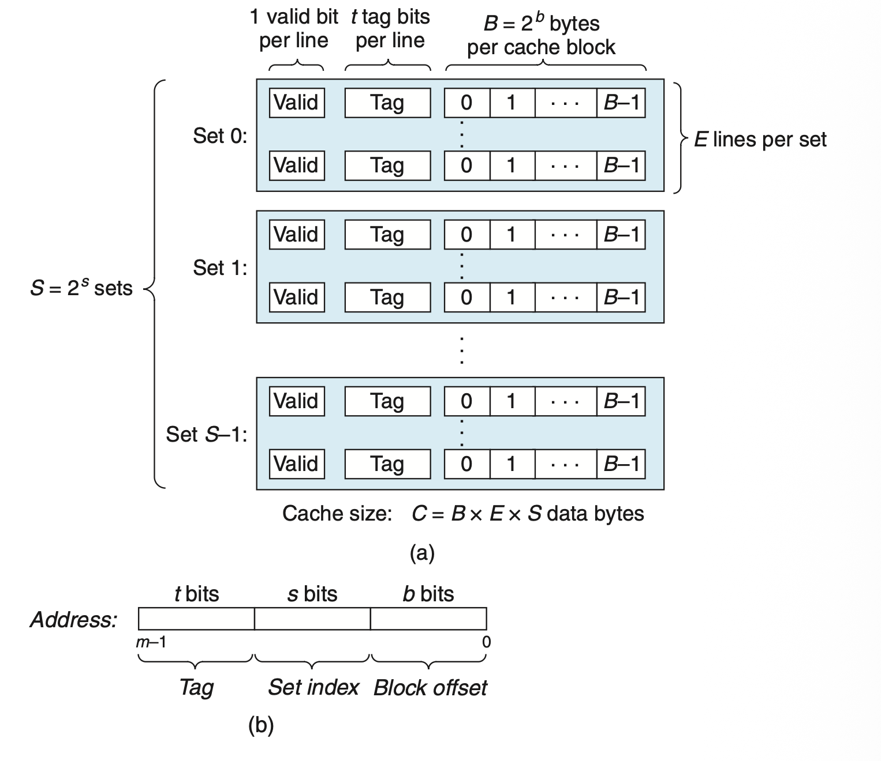
PROBLEM 3 · 3.1
Bit-width fundamentals
Quantity | Value | Where it comes from
VPO / PPO | 12 | log₂ 4096 — page offset
VPN | 36 | 48 − 12
PPN | 40 | 52 − 12
Entries per page-table page | 512 | 4096 B ÷ 8 B per PTE
Index bits per level | 9 | log₂ 512
Cache offset (CO) | 6 | log₂ 64-byte line
Cache index (CI) | 6 | log₂ 64 sets
Cache tag (CT) | 40 | 52 − 6 − 6 (physical)
ICS Quiz Walkthrough · 17
Notes:
Quick fill-in - read these aloud fast. The two numbers students mix up: PPN (52-12=40, not 36) and CT (taken from the PHYSICAL address: 52-6-6=40).

Slide 18
PROBLEM 3 · 3.2 SETUP
Decompose the 8 MB region's addresses first
L1 : 9
L2 : 9
L3 : 9
L4 : 9
VPO : 12
bits 47–39
bits 38–30
bits 29–21
bits 20–12
bits 11–0
L1
L2
L3
L4
START
0x0000_0000_0040_0000
= 2²² (4 MB)
0
0
2
0
END
0x0000_0000_00BF_FFFF
= start + 8 MB − 1
0
0
5
511
ANSWER
Each L3 entry covers 2⁹ × 2¹² = 2 MB (one full L4 table). The 8 MB region spans L3 indices {2, 3, 4, 5} — four L3 entries, each needing its own L4 page.
ICS Quiz Walkthrough · 18
Notes:
Hints: (1) Each L3 entry covers how much VA? So how many L3 entries span 8MB? (2) Start -> L3 index 2 ((0x400000>>21)&0x1FF = 2), end -> L3 index 5. Write the decomposition bar on the board first - everything in 3.2 reads off it.

Slide 19
PROBLEM 3 · 3.2 (A)
4 KB pages: count pages at each level
L4 table #1
512 PTEs → 2 MB
L1 (PML4)
index {0}
L2 (PDPT)
index {0}
L3 (PD)
indices {2,3,4,5}
L4 table #2
512 PTEs → 2 MB
1 page
1 page
1 page
L4 table #3
512 PTEs → 2 MB
Each populated L3 entry → one L4 table beneath it. Indices 2–5 → four L4 tables.
L4 table #4
512 PTEs → 2 MB
4 pages
ANSWER
COMMON TRAP
1 + 1 + 1 + 4 = 7 pages × 4 KB = 28 KB
Don't compute 2³⁶ entries × 8 B = 512 GB — that's a FLAT table. Count populated pages per level.
ICS Quiz Walkthrough · 19
Notes:
Walkthrough: draw this 4-level tree, count NODES = 7. The trap card is the #1 misconception: 'the page table is one big array of 2^36 entries'.

Slide 20
PROBLEM 3 · 3.2 (B)
2 MB huge pages: prune the L4 level
2 MB frame #1
L1 (PML4)
index {0}
L2 (PDPT)
index {0}
L3 (PD) {2,3,4,5}
PS = 1 in each entry
2 MB frame #2
2 MB frame #3
L3 entries with the PS bit set map a 2 MB physical frame directly — no L4 table beneath.
2 MB frame #4
L4 level: eliminated ✔
ANSWER
COMMON TRAP
1 + 1 + 1 + 0 = 3 pages × 4 KB = 12 KB
Saved vs (a): 28 − 12 = 16 KB — exactly the four pruned L4 tables.
“Huge pages eliminate ALL page-table overhead.” No — L1, L2, L3 still exist. They only prune the L4 level (which is where most of the overhead lives).
Bonus: TLB reach also improves — one TLB entry now covers 2 MB instead of 4 KB.
ICS Quiz Walkthrough · 20

Slide 21
PROBLEM 3 · 3.2 (C)
Why multi-level tables save memory
ANSWER
Lower-level tables are allocated only for VA regions that are actually mapped. For the vast unmapped middle of a typical 48-bit address space, no L2/L3/L4 tables exist at all — savings proportional to the unused VA space.
THE SAME IDEA AT SCALE — A 2 GB CONTIGUOUS MAPPING
4 KB pages: 2¹⁹ pages ÷ 512 per table = 1024 L4 tables ≈ 4 MB of page-table memory
2 MB huge pages: 0 L4 tables → 3–4 page-table pages ≈ 12–16 KB total
Flat single-level table for 48-bit VA: 2³⁶ entries × 8 B = 512 GB — more than your RAM, for one process
ICS Quiz Walkthrough · 21

Slide 22
PROBLEM 3 · 3.3 SETUP
VIPT: index virtually, tag physically
VA
VPN : 36 (translated by TLB)
VPO : 12
PA
PPN : 40 (after translation)
PPO : 12 = VPO
cache
CT : 40 (physical tag)
CI : 6
CO : 6
CI + CO must fit inside the page offset — the only bits where VA = PA
ANSWER
COMMON TRAP
Feasibility condition: CI + CO ≤ VPO
Then the set index read from the VA equals the one the PA would give → index the cache in parallel with the TLB, tag-check with the PPN after.
“VIPT = the cache is virtual.” Only the INDEX is virtual. The tag is physical, from the PPN after TLB translation.
ICS Quiz Walkthrough · 22
Notes:
Hints: (1) Which bits does the cache use for the set index? Which bits are identical between VA and PA? (2) In a 4KB page, bits 0-11 are the offset; VPO=PPO. Anything above bit 11 differs between VA and PA.

Slide 23
Cute Trick for Speeding Up L1 Access (VIPT)
CT
Tag Check
36
6
6
Physical
address
(PA)
CT
CI
CO
PPN
PPO
Address
Translation
No
Change
Virtual
address
(VA)
CI
VPN
VPO
L1 Cache
Observation
Bits that determine CI identical in virtual and physical address
Can index into cache while address translation taking place
Generally we hit in TLB, so PPN bits (CT bits) available next
“Virtually indexed, physically tagged”
Cache carefully sized to make this possible
36
12

Slide 24
PROBLEM 3 · 3.3 (A)
Is VIPT feasible with our 32 KB L1?
CO
CI
VPO
6 + 6 = 12
≤ 12 ✓
6
6
12
log₂ 64 B line
log₂ 64 sets
log₂ 4 KB page
ANSWER
VIPT is feasible. CI and CO are drawn entirely from bits 0–11 — the page-offset bits, identical in VA and PA. The virtual index equals the physical index, so the CPU can:
select the cache set from the VA while the TLB translates VPN → PPN — then compare physical tags.
ICS Quiz Walkthrough · 23

Slide 25
PROBLEM 3 · 3.3 (B) — DESIGN A
128 sets × 8-way × 64 B: VIPT breaks
address bits used by the index:
CI = log₂ 128 = 7
CO = 6
7 + 6 = 13 > 12 ✗
12
11
10
9
8
7
6
bit 12 is the lowest VPN bit — outside the page offset. It can differ between two VAs that map to the same physical page.
ANSWER
Cache aliasing: two virtual addresses for the same physical page can land in different cache sets → two copies of one physical line, and a write to one is invisible via the other.
Fix without changing the cache: VPO ≥ 13 ⇒ minimum page size 2¹³ = 8 KB.
(Other escape hatches exist — OS page-coloring — but the exam asks for page size.)
ICS Quiz Walkthrough · 24

Slide 26
PROBLEM 3 · 3.3 (B) — DESIGN B
64 sets × 16-way × 64 B: VIPT survives
CI = log₂ 64 = 6
CO = 6
6 + 6 = 12 ≤ 12 ✓
Same 64 KB capacity, different shape. Doubling associativity doubles capacity without adding sets, so CI stays at 6 — entirely inside the page offset. No aliasing.
COMMON TRAP
Real-world check: this is how big L1s stay VIPT — e.g. 128 KB at 64 sets × 32-way still gives CI + CO = 12. High associativity is the escape hatch real CPUs (Apple M-series) use.
“Doubling cache size always breaks VIPT.” Only if you double the SETS (CI grows). Growing ways or line size keeps the index bits put.
ICS Quiz Walkthrough · 25

Slide 27
PROBLEM 3 · 3.4 (A)
Copying a file to stdout: count the copies
APPROACH 1 — read() + write(): two CPU copies
disk
kernel page cache
user buffer buf[N]
kernel output buffer
copy 1: read()
copy 2: write()
APPROACH 2 — mmap() + write(): one CPU copy
disk
kernel page cache = mapped region (PTEs point straight at it)
kernel output buffer
copy 1: write()
ANSWER
COMMON TRAP
mmap copies faster: 1 copy vs 2. mmap copies no data — it installs PTEs aimed at the page-cache frames, so the read()-to-user-buffer copy disappears.
“mmap wins by avoiding syscalls.” No — write() is still a syscall. The win is the eliminated copy.
ICS Quiz Walkthrough · 26
Notes:
Hints: (1) After read() returns, where does the data live? After mmap()? (2) read copies page cache -> user buf; mmap maps the page cache directly into user VA. Use the four required terms: disk, kernel page cache, user buffer, kernel output buffer.

Slide 28
PROBLEM 3 · 3.4 (B)
Read a 4 KB header from a 1 GB file
the 1 GB file as pages:
...
touched → 1 page fault → 4 KB read from disk
never touched → never loaded (99.99% of the file)
read(fd, buf, 1 GB)
mmap + touch the header
Kernel must fault in and copy the ENTIRE 1 GB into the user buffer before you can look at byte 0.
Costs: 1 GB of user memory + 1 GB of disk I/O.
Demand paging: only pages you touch are faulted in. Reading the header faults exactly one 4 KB page.
Costs: 4 KB of memory + 4 KB of I/O.
COMMON TRAP
“mmap reads the whole file into memory.” No — mmap is lazy. mmap() itself loads nothing; pages arrive one fault at a time.
ICS Quiz Walkthrough · 27

Slide 29
PROBLEM 3 · TAKEAWAYS
Four rules to carry into the Final Exam
1
Count pages per level, not total entries — Decompose start & end addresses, find populated indices at each level, sum the tables. 7 × 4 KB = 28 KB here.
2
Huge pages prune exactly one level — PS bit in L3 → no L4 tables. L1/L2/L3 remain. 28 KB → 12 KB.
3
VIPT lives or dies by CI + CO ≤ VPO — Index bits must stay inside the page offset. More sets breaks it; more ways doesn't.
4
mmap = copy elimination + demand paging — PTEs point at the page cache (one copy, not two), and only touched pages are ever loaded.
ICS Quiz Walkthrough · 28

Slide 30
THAT'S THE WALKTHROUGH
Questions?
If you only remember two things:
sigsuspend closes the test–wait gap atomically
CI + CO ≤ VPO (and mmap copies once, lazily)
Good luck on the Final Exam.
ICS Quiz Walkthrough · 29

