Slide 1
Clean Code

Slide 2
What is clean code?
Not messy?
Organized?
Easy to read?
Easy to maintain?
Simple?
Slick, efficient, refined, elegant, beautiful, clear, well-written, crisp, stylish, direct, and possibly more positive adjectives

Slide 3
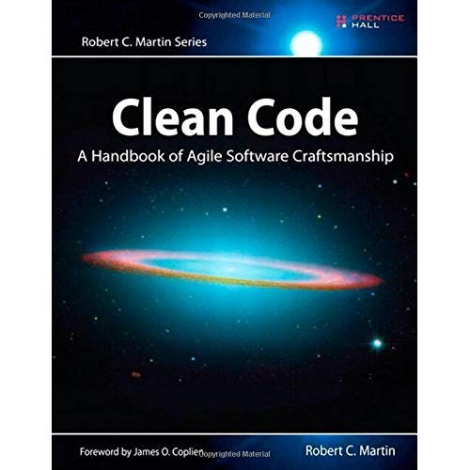
It’s a book
Not about how to write code, but how to write readable code
Code you (or someone else!) can easily modify later

Slide 4
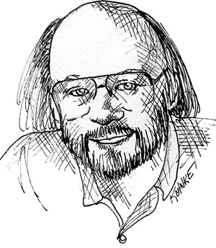
What is clean code? Bjarne Stroustrup
Creator of C++ and author of The C++ Programming Language
“I like my code to be elegant and efficient. The logic should be straightforward to make it hard for bugs to hide, the dependencies minimal to ease maintenance, error handling complete according to an articulated strategy, and performance close to optimal so as not to tempt people to make the code messy with unprincipled optimizations. Clean code does one thing well.”

Slide 5
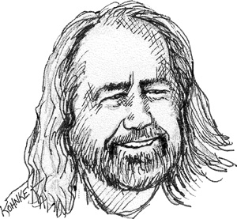
What is clean code? Grady Booch
Author of Object Oriented Analysis and Design with Applications
“Clean code is simple and direct. Clean code reads like well-written prose. Clean code never obscures the designer’s intent but rather is full of crisp abstractions and straightforward lines of control.”

Slide 6
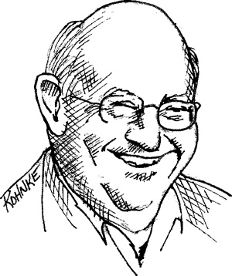
What is clean code? “Big” Dave Thomas
Founder of Object Technology International, co-author of The Pragmatic Programmer, coiner of the phrase “Don’t Repeat Yourself” (as it relates to code)
“Clean code can be read, and enhanced by a developer other than its original author. It has unit and acceptance tests. It has meaningful names. It provides one way rather than many ways for doing one thing. It has minimal dependencies, which are explicitly defined, and provides a clear and minimal API. Code should be literate since depending on the language, not all necessary information can be expressed clearly in code alone.”

Slide 7

What is clean code? Michael Feathers
Why did you write that code? There is ALWAYS a reason.
Even if that reason is “I don’t know how to do it any better.”
Or, “I just didn’t care to do it better.”
Author of Working Effectively with Legacy Code
“I could list all of the qualities that I notice in clean code, but there is one overarching quality that leads to all of them. Clean code always looks like it was written by someone who cares. There is nothing obvious that you can do to make it better. All of those things were thought about by the code’s author, and if you try to imagine improvements, you’re led back to where you are, sitting in appreciation of the code someone left for you—code left by someone who cares deeply about the craft.”

Slide 8
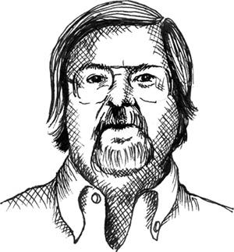
What is clean code? Ron Jeffries
Author of Extreme Programming Installed and Extreme Programming Adventures in C#
Simple Code:
• Contains no duplication;
• Minimizes the number of entities such as classes, methods, functions, and the like.
When the same thing is done over and over, it’s a sign that there is an idea in our mind that is not well represented in the code. I try to figure out what it is. Then I try to express that idea more clearly.
Expressiveness to me includes meaningful names, and I am likely to change the names of things several times before I settle in.
Don’t get it right and perfect the first time? No problem!

Slide 9
So… what exactly is clean code?
A lot of things!
Or… maybe a lot of synonyms for the same thing?
Subjective?
Developing a “code-sense” is key
Can you tell if code is unclean?
If so, great! If not… how do you learn?

Slide 10
Question: How do you learn to write clean code?
Answer: Practice
Also: Write a lot of messy code first
Like, a lot

Slide 11
How to clean code?
Easiest way to clean is to keep it from getting dirty
If that’s not possible… you can clean in it on two different levels
Macro cleaning and micro cleaning
Macro: High-level organization, program flow, systems design
Micro: Variable/function names, code style
Analogy: Writing (novel, essay, etc)
Macro cleaning
Chapter level, paragraph level, what’s the flow of this thing OVERALL?
Micro cleaning
Sentence, punctuation level – how does each section work, down to the little details?
We can have programs that are like this:
Good code, bad program
Bad code, but good program
Have perfect sentence structure, but your ideas are a mess?
What about a great train of thought, but grammar/word choices make the end result a bit clumsy?

Slide 12
Micro cleaning – Easy to do!
Variable names
What’s the purpose of this chunk of memory?
Why do I want this?
What should this piece of information be named?
How can I name this so that it’s easily identifiable?
Function names
What does this process DO?
Comments
Explanations, when the code itself is insufficient
Code style – any guiding rules for all of this stuff?
All of these work toward this goal:
MAKE YOUR CODE EASY(ISH) TO READ

Slide 13
Micro cleaning - pretty simple
Make variable names pronounceable, easily identified
int pc; // Player count
int numd; // Number of days
int mturn; // Maximum turns
float hgt; // Height
int playerCount;
int numDays;
int maxTurns;
float height;

Slide 14
Names – Make them distinct
Does it copy from location 1 to location 2?
// Copy memory from one location to another
memcpy(void* memLoc1, void* memLoc2, size_t size);
Or copy from location 2 to location 1?
How do these two variables work?
// A better option
memcpy(void* dest, void* src, size_t size);
Reduce the confusion, make it easier to use this function!
Destination: Where to copy TO
Source: Where to copy FROM

Slide 15
Exceptions can/do exist
Math Equations
Ordered Data
Vector a, b, c;
c = Math.Cross(a, b);
struct Matrix4X4
{
float _11, _12, _13, _14;
float _21, _22, _23, _24;
float _31, _32, _33, _34;
float _41, _42, _43, _44;
}
Math doesn’t care what you use these values for, and basic names are often preferable
Normally, _41 would be a terrible variable name, but…
As the 4th row, 1st column of a matrix, it’s perfect!

Slide 16
Code style encapsulates lots of things
Naming conventions – What to call something
Capitalization style
Camel-case: int ThisIsAVariable
Lower camel-case: int thisIsAVariable
Tab style
Use tabs. Don’t be a barbarian.
(Or the equivalent in spaces, if that’s your preference)
INDENDATION, is really what we’re talking about here (put down the pitchforks!)
Brace style (always a fun conversation!)

Slide 17
Brace Style – Wars have been waged over this one
int main() {
vector<Foo> fighters;
for (int i = 0; i < 10; i++) {
Foo fighter;
fighter.Initialize();
fighters.push_back(fighter);
}
return 0;
}
int main()
{
vector<Foo> fighters;
for (int i = 0; i < 10; i++)
{
Foo fighter;
fighter.Initialize();
fighters.push_back(fighter);
}
return 0;
}
Same-line braces?
Next-line braces?
Neither of these is correct. Neither of these is incorrect.
Your compiler doesn’t care.

Slide 18
Braces – combination of the two
Functions start braces on the next line
// K&R brace style
int main()
{
vector<Foo> fooFighters;
for (int i = 0; i < 10; i++) {
Foo fighter;
fighter.Initialize();
fooFighters.push_back(fighter);
}
return 0;
}
Blocks within the function start on the same line
Pick a style, and stick with it. Consistency is key.

Slide 19

Braces - The “I don’t care at all” style
int main()
{
vector<Foo> fooFighters;
for (int i = 0; i < 10; i++)
{
Foo fighter;
fighter.Initialize();
fooFighters.push_back(fighter);
}
return 0;
}
int main () {
vector<Foo> fooFighters;
for (int i = 0; i < 10; i++)
{
Foo fighter;
fighter.Initialize();
fooFighters.push_back(fighter);
}
return 0;
}
There’s no excuse for this. Many/MOST IDEs have an auto-format feature!
Your coworkers, teachers… →

Slide 20
Context can make a difference
float zPos; // Might be confusing, or make sense to…
Game programmers
Someone writing a math library
auto dB = GetDBFromThing(); // Might be obvious to…
Someone doing database work? dB == database
Audio programmer? dB = decibels
Or, might need clarification

Slide 21
Example – from Clean Code
What are you getting?
vector<int*>* getThem()
{ vector<int*>* list1 = new vector<int *>();
for (int* x : theList) if (x[0] == 4) list1.push_back(x);
return list1; }
Better than no name at all…
theList? OHH… THE list? Why didn’t you say so?!
Magic numbers? Not good. Why 4? Why not 3, or 17?

Slide 22
Example
vector<int*>* GetFlaggedCells()
{ vector<int*>* cells = new vector<int*>();
for (int* x : theList) if (x[0] == 4) cells.push_back(x);
return cells; }
Change the names

Slide 23
Encapsulate data for ease of use/understanding
vector<Cell>* GetFlaggedCells()
{ vector<Cell>* flaggedCells = new vector<Cell>();
for (Cell cell : gameBoard) if (cell[0] == 4) flaggedCells.push_back(x);
return flaggedCells; }
More descriptive variable names

Slide 24
vector<Cell>* GetFlaggedCells()
{
vector<Cell>* flaggedCells = new vector<Cell>();
for (Cell cell : flaggedCells)
if (cell.isFlagged())
flaggedCells.push_back(cell);
return flaggedCells;
}
Provide meaningful interfaces
Hide the “magic” (numbers or otherwise) from the outside world
HOW does a cell determine if it’s flagged or not? In this function, who cares?
Often you don’t need to know the process—you just want to know the result

Slide 25
Generic function
Readable, meaningful code
vector<int*> * getThem()
{ vector<int*> * list1;
list1 = new vector<int*>();
for (int* x : theList) if (x[0] == 4) list1.push_back(x);
return list1; }
vector<Cell>* GetFlaggedCells()
{
vector<Cell>* flaggedCells;
flaggedCells = new vector<Cell>();
for (Cell cell : gameBoard)
if (cell.isFlagged())
flaggedCells.push_back(cell);
return flaggedCells;
}

Slide 26
Macro cleaning – Not nearly as easy
Ideally, before development starts—like an architect creating blueprints
Systems architecture
Systems design
Class organization
Flowcharts
UML
Design patterns
General code/algorithm flow
In practice…
Plan, then develop
Plan some more, develop some more
AKA fix the old, busted plan you didn’t realize was busted until weeks/months into development…

Slide 27
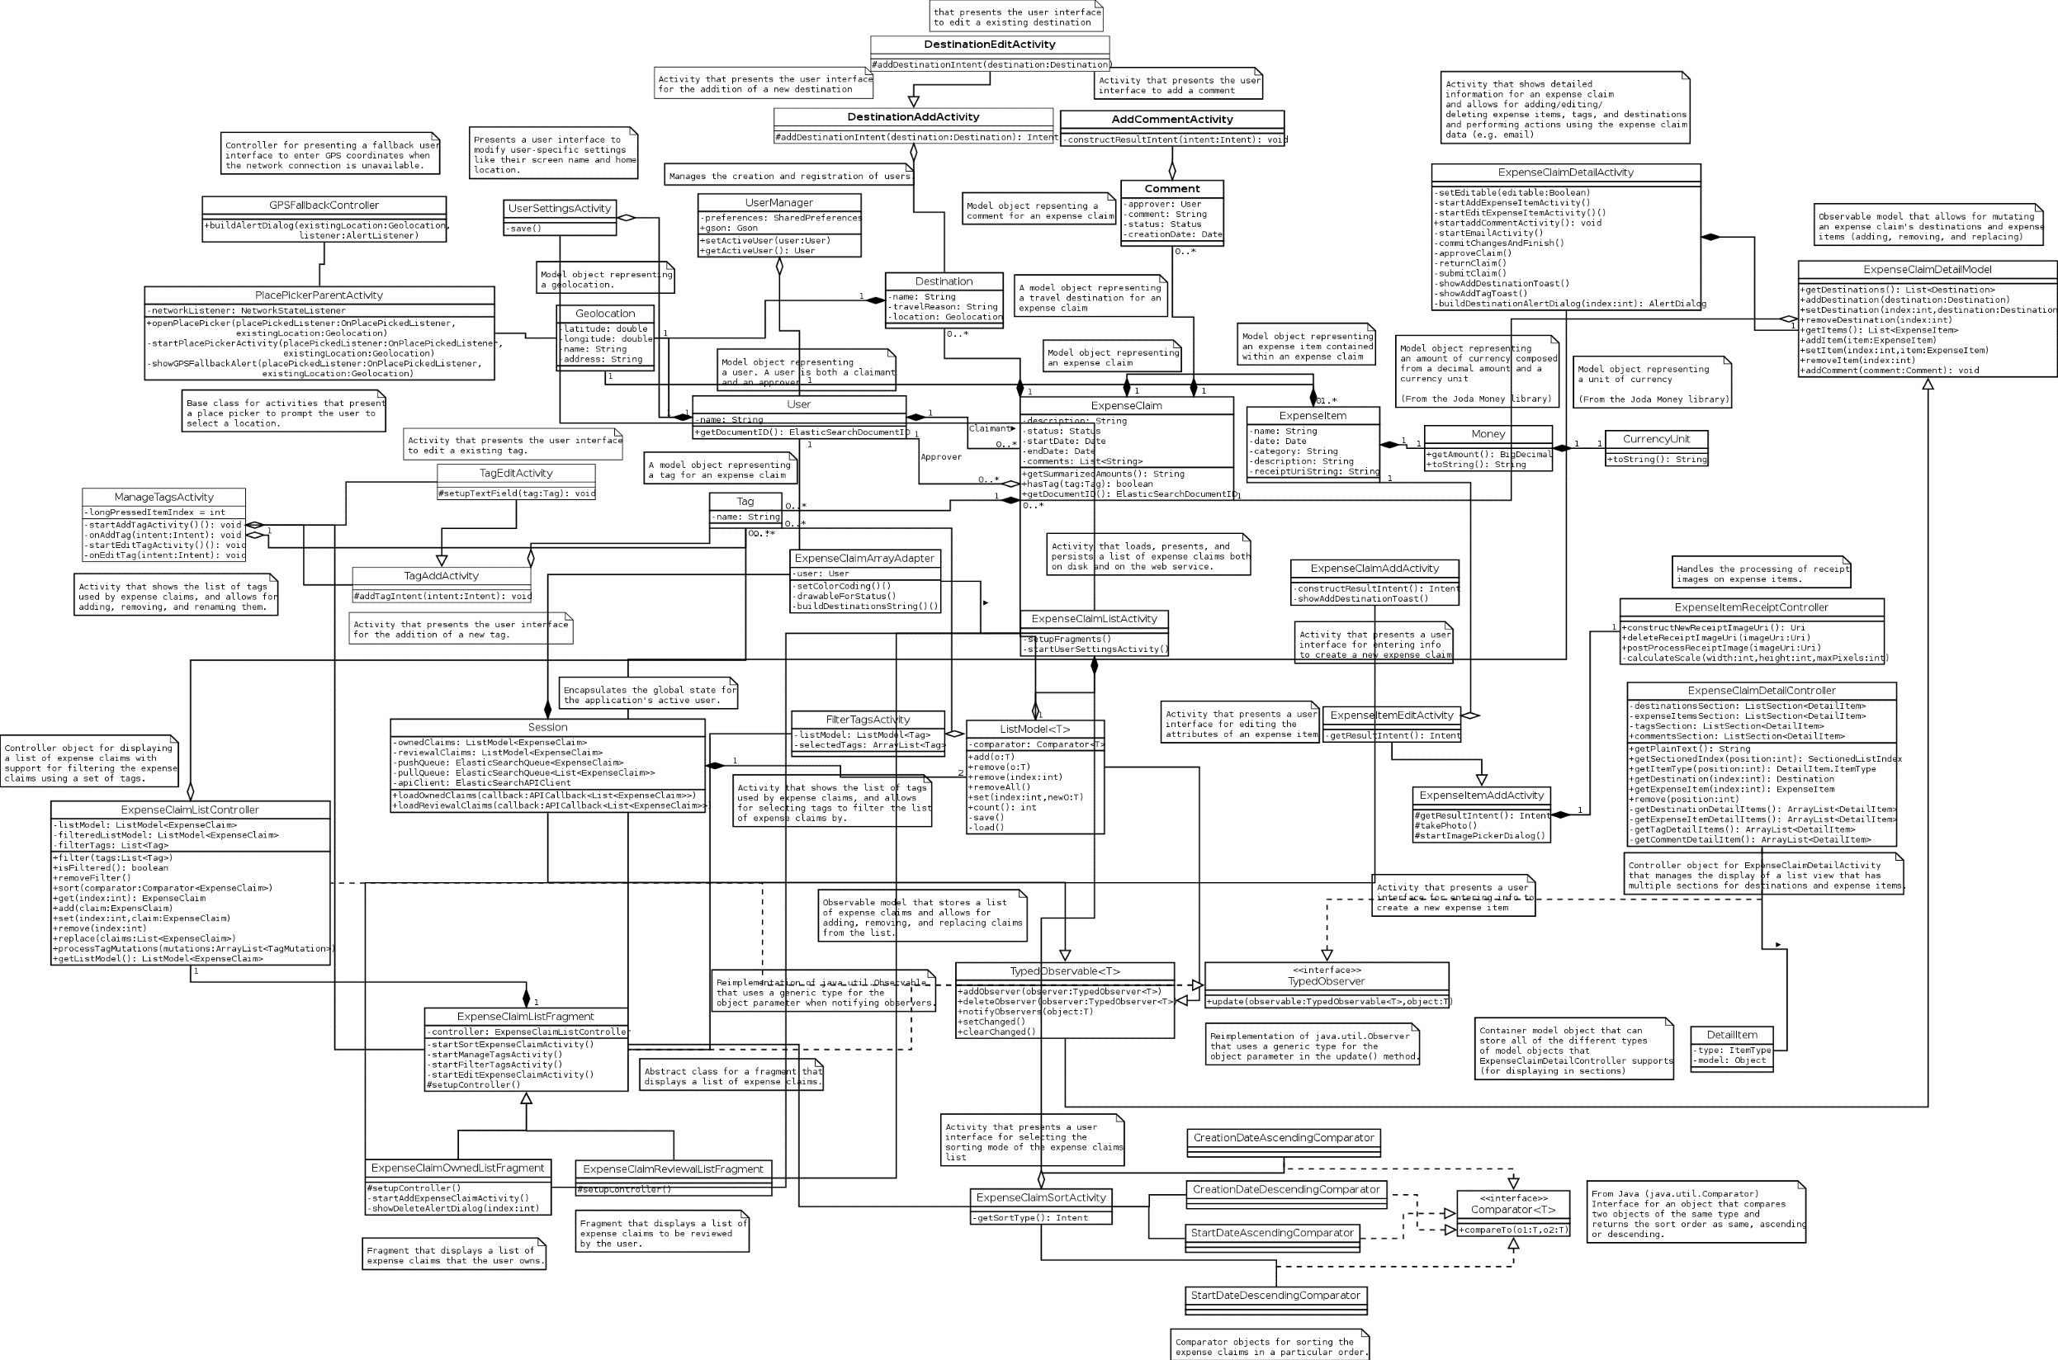
Macro cleaning Not always easy…
Trying to understand large numbers of classes and their relationships takes a lot of time and practice

Slide 28
Move code into functions
There’s a lot of stuff happening here, but it’s really for one purpose:
Get a number from a user
int value1;
while (true) {
cout << "Enter an numeric value: " << endl;
cin >> value1;
if (!cin) {
cout << "Bad value entered." << endl;
cin.clear();
cin.ignore(numeric_limits<streamsize>::max(), '\n');
}
else
break;
}
int value2;
while (true) {
cout << "Enter an numeric value: " << endl;
cin >> value2;
if (!cin) {
cout << "Bad value entered." << endl;
cin.clear();
cin.ignore(numeric_limits<streamsize>::max(), '\n');
}
else
break;
}
Why not turn it into a function?

Slide 29
Move code into functions
Refactor into a function
int value1;
while (true) {
cout << "Enter an numeric value: " << endl;
cin >> value1;
if (!cin) {
cout << "Bad value entered." << endl;
cin.clear();
cin.ignore(numeric_limits<streamsize>::max(), '\n');
}
else
break;
}
int value2;
while (true) {
cout << "Enter an numeric value: " << endl;
cin >> value2;
if (!cin) {
cout << "Bad value entered." << endl;
cin.clear();
cin.ignore(numeric_limits<streamsize>::max(), '\n');
}
else
break;
}
int NumericInput()
{
int value;
while (true) {
cout << "Enter an numeric value: " << endl;
cin >> value2;
if (!cin) {
cout << "Bad value entered." << endl;
cin.clear();
cin.ignore(numeric_limits<streamsize>::max(), '\n');
}
else
break;
}
return value;
}
int value1 = NumericInput();
int value2 = NumericInput();
Same results, but your code is more readable
Also… these two lines are much easier to write! Ever need to do this again, elsewhere? Easy!

Slide 30
Another Example
Student student("J. Kirk", 41, 3.6);
Student student2("S. Pock", 162, 4.12);
Student student3("J. Picard", 58, 3.94);
// Etc… So many variables…
// Vector to the rescue—one course to hold them all!
vector<Student> cop3503;
cop3503.push_back(Student("J. Kirk", 41, 3.6));
cop3503.push_back(Student("S. Pock", 162, 4.12));
cop3503.push_back(Student("J. Picard", 58, 3.94));
// What about more courses?
vector<Student> cop3502; // Another course
vector<Student> cen3031; // ANOTHER course
// Ugh, so many variables! Time for another vector!

Slide 31
Another Example
// Much nicer! One variable for all the courses
vector<vector<Student>> courses_Sciences;
vector<vector<Student>> courses_Arts;
vector<vector<Student>> courses_Engineering;
// Math, psychology, philosophy… ugh, too many variables!
// #problemsolved
vector<vector<vector<Student>>> university_MIT;
vector<vector<vector<Student>>> university_UF;
vector<vector<vector<Student>>> university_UCF;
// So many universities… too many variables!
// Time for another vector!

Slide 32
#pleasemakeitstop
vector<vector<vector<vector<Student>>>> universities_UnitedStates;
vector<vector<vector<vector<Student>>>> universities_Germany;
vector<vector<vector<vector<Student>>>> universities_France;
// So many countries… so many variables… ☹
// #muchbetter
vector<vector<vector<vector<vector<Student>>>>> universities_Earth;
vector<vector<vector<vector<vector<Student>>>>> universities_Mars;
vector<vector<vector<vector<vector<Student>>>>> universities_Moon;
// Now, what was J. Picard’s GPA?
float gpa = universities_Earth[0][1][2][0][2].GPA();
Engineering
UF
COP3503
3rd student on the roster
The United States
// Easy!
(ish)
(not really…)
(please don’t code like this…)

Slide 33
Sanity Check…
Why would you ever write code like that?
Answer: You wouldn’t. You SHOULDN’T. It’s atrocious.
Solution: Encapsulation – Wrap the data up!
// This is ugly, gross, and probably should be avoided
vector<vector<vector<vector<vector<Student>>>>> universties_Earth;
vector<Student>
vector<vector<Student>>
vector<Course>
vector<vector<Course>>
vector<College>
vector<vector<College>>
// Etc etc…
class Course { vector<Student>; };
vector<Course> college_Engineering;
class College { vector<Course>; };
vector<College> colleges_UF;
class University { vector<College>; };
vector<University> universities_SouthEast;

Slide 34
Identifiers make code easier to read
// User-defined identifiers specifically for your program
enum UNIVERSITIES { UF = 0, MIT = 1, HARVARD = 2 };
enum COLLEGES {ENG = 0, ART = 1, MED = 2, JOURN = 3};
Fundamentally they’re both doing the same type of operation:
Which of these is easier to read?
vector<College> engineering = unis_Earth[1].GetCollege(0);
Retrieving some object from a particular index
Invoking a function of that object, retrieving additional data
-VS-
vector<College> engineering = unis_Earth[UNIVERSITIES::MIT].GetCollege(COLLEGES::ENG);
None of this matters to your compiler. This is to help you, the human being writing (or READING) the code.

Slide 35
Google’s Style Guide
https://google.github.io/styleguide/cppguide.html
Recommendations for all aspects of writing your code
Braces, naming conventions, things to use, things to avoid, etc
Not the ultimate, gospel, be-all and end-all style guide that you should memorize and follow Or Else™
You may encounter style guides on a job
Everyone will follow that same style, like it or not

Slide 36
Clarity is the key
Can someone else EASILY understand your code?
Without an interpreter, translation chart, decoder ring, etc?
Can you understand your own code days (or weeks, or months…) later?
Consistency is more important than any one style
If you open a code file you haven’t seen before, does the style make it easier or harder to read?
What if every class had a different style? Every function? Every file? Not fun.

Slide 37
Comments – Use them? Waste of time?
Different schools of thought:
1. Document EVERYTHING – all code should have plain language descriptions
2. Document NOTHING – code should be self-documenting
A mix of the two: write code in such a way that it’s easy to understand (for yourself, and someone else later), AND…
Use comments to explain certain process that might not be intuitive or require external information
Why 3? What is this magic number? Do I need to look that up?
Does this comment NEED to be here? Does it hurt, or help?

Slide 38
Self-Documenting Comments
Code written in such a way that its intent is clear
Point3D position = targetObject.GetPosition();
Point3D destination = currentLevel.Exit().GetPosition();
UnitPath pathOut = NavSystem::FindShortestPath(position, destination);
targetObject.SetPath(pathOut);
If someone had never seen this code before, could they make sense of it at all?
You don’t need to know the inner workings of each function or class object
What would comments for this look like?

Slide 39
Self-Documenting Comments
// Get the current position of the target
Point3D position = targetObject.GetPosition();
// Get the location of the level exit
Point3D destination = currentLevel.Exit().GetPosition();
// Find a path between the target and the exit
UnitPath pathOut = NavSystem::FindShortestPath(position, destination);
// Set the target's path
targetObject.SetPath(pathOut);
Point3D position = targetObject.GetPosition();
Point3D destination = currentLevel.Exit().GetPosition();
UnitPath pathOut = NavSystem::FindShortestPath(position, destination);
targetObject.SetPath(pathOut);
Clean, straight-forward, easily readable;
comments get in the way, in this case.

Slide 40
Function comment blocks
/*==========================================================
Name: Foo
Description: Does some stuff
Inputs: bar - number representing etc etc etc...
baz - value used to determine if the coefficient
of the something something, etc…
Outputs: Whether or not some operation was successful
==========================================================*/
bool Foo(int bar, double baz)
{
}
Arguably this is useful… or it may be overkill
Depends on the team, the project, coding standards, etc

Slide 41

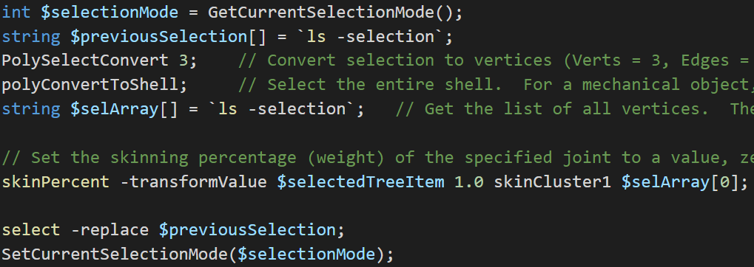
Comments as algorithm planners
Write comments describing the steps
Evaluate those steps – reorder as needed
Write code to coincide with those steps
Erase comments (if code no longer requires additional explanation)
Which of these is easier to debug?

Slide 42


Algorithm exercise - PBJ
How to make a peanut butter and jelly sandwich? What are the steps?
1. Put peanut butter on bread
2. Put jelly on bread
3. Eat sandwich
Perhaps a bit more complicated than that…
What would the actual steps be?
#nailedit

Slide 43
Algorithm exercise - PBJ
There’s a lot that goes into “simple” tasks
Get ingredients from pantry
Get plate
Get spreading utensil
Open jars/containers
Put 2 slices of bread on plate
Get peanut butter from jar with spreading utensil
Spread on bread
OPTIONAL: Clean off knife? (Or just mix PB&J like some sort of barbarian…?)
Repeat steps 6 and 7 with jelly on other piece of bread
Put pieces of bread together (jelly/PB side IN, why do I have to specify this?)
Possible Problems
What if you don’t have one or more ingredients?
What if you don’t have a plate?
Add additional steps as required. A finished algorithm can go through lots of revisions (you’ve all certainly experienced this by now)

Slide 44
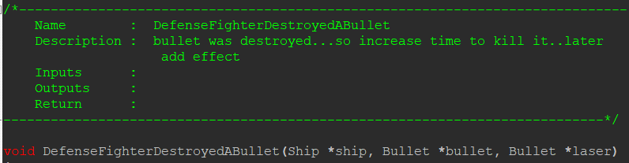
Out of date comments
All comments run the risk of becoming outdated
Sometimes this is referred as going stale
// Initialize to 5
int x = 5;
Later…
// Initialize to 5
int x = 12;
Broken code? Or broken comment?
(The real question: Why even put that comment there in the first place?)

Slide 45
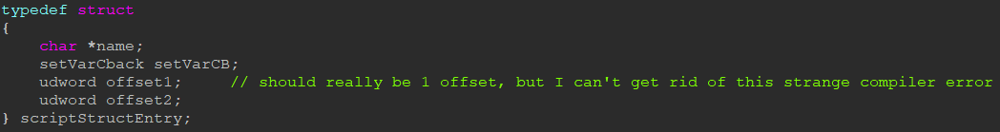
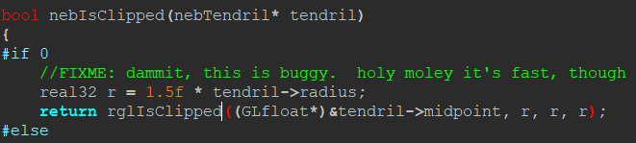
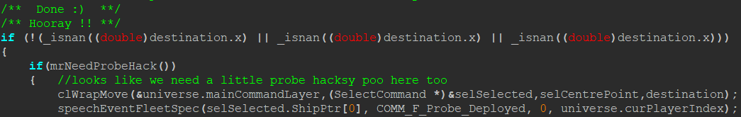
Random comments from Homeworld code
Some of these comments may be more helpful than others…

Slide 46
Behavioral code vs Structural Code
Structural code is what your program DOES – the overall steps
Behavioral code is what various things IN your program do
Writing out the steps for your program can be the structural code:
For each file to load, do something
For each object currently stored, call some function
Based on user input, do option 1 or 2
Etc
Figuring out the details of each of those steps, those are the behavioral parts
Typically “behavior” is used in connection with objects – classes, structures, etc
Write THAT code somewhere else—leave main() for high-level operations
Building a structure FIRST can help determine the rest of your code.
The implementation details (the “behavior” of your program) has to support its structure.

Slide 47
Structure
HOW does the “myGame” variable do these different things?
sf::RenderWindow window(sf::VideoMode(1920, 1080), "Game of the Year");
Game myGame;
myGame.Initialize();
while (window.isOpen())
{
sf::Event event;
while (window.pollEvent(event)) {}
myGame.Update();
myGame.Draw(window);
}
myGame.Shutdown();
return 0;
As far as the STRUCTURE of this program (and the Game class), it doesn’t matter
1. Start the program
2. Do the thing (in 2 steps, update then draw)
3. Stop doing the thing, clean up whatever needs cleaning (free dynamic memory, write data to a file, etc)

Slide 48
Recap
Code cleanliness can be a little bit subjective
A little bit of thought and effort goes a long way
Think about code structure before you just dive in
What do you want your program to DO?
How can you achieve that in a way that’s easy to read or easy to modify later?
What kinds of choices can you make before you even write code that can help make that code easier to write, or easier to read later on?

