Slide 1
Integrating and Decomposition Manipulations for Generalized EEG-based Emotion Recognition
518021910645 Xinyu Xu

Slide 2
目录 Contents
1
Overview
2
Unsupervised Learning Scheme
3
LSTM Classification
4
Experiment
5
Discussion

Slide 3
Motivation
Learn a whitened data space for emotion recognition.
Minimize distribution difference of multiple domains in the whitened data space.
Domain generalization problem. Agnostic to target domain data distribution.

Slide 4
Two Stage Learning Pipeline
whitened data space
EEG-feature
label
feature mapping
classification

Slide 5
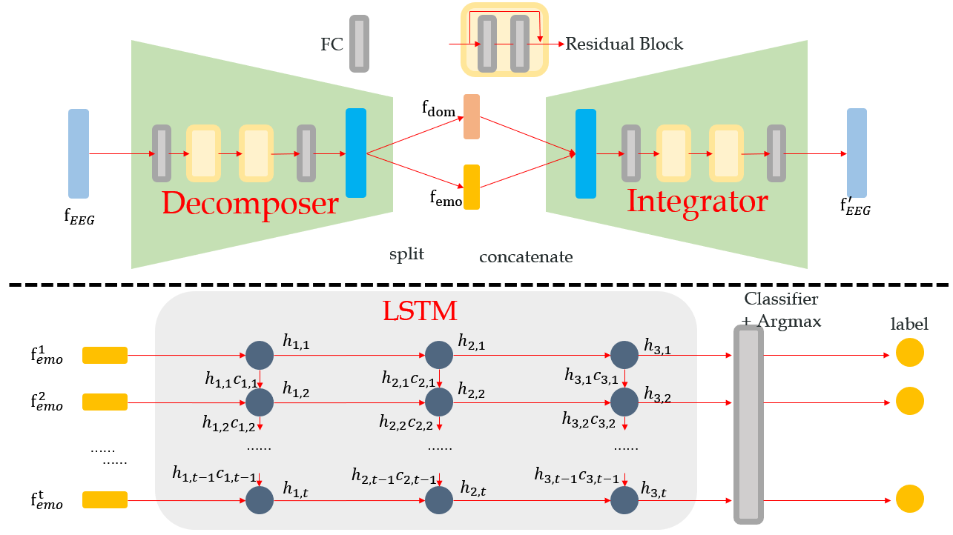


Two Stage Learning Pipeline
An auto-encoder style unsupervised Integrating Decomposing Network (IDN) to manipulate feature
LSTM for modeling temporal sequence and classification

Slide 6
目录 Contents
1
Overview
2
Unsupervised Learning Scheme
3
LSTM Classification
4
Experiment
5
Discussion

Slide 7
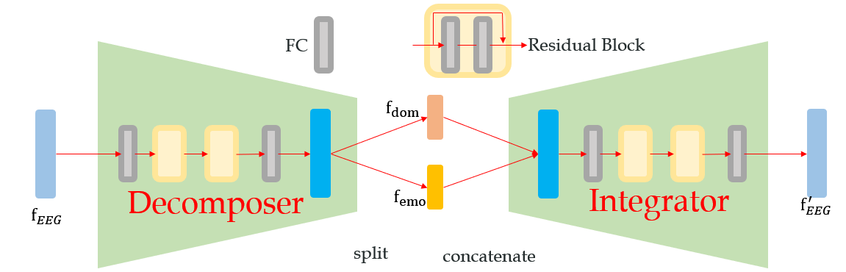
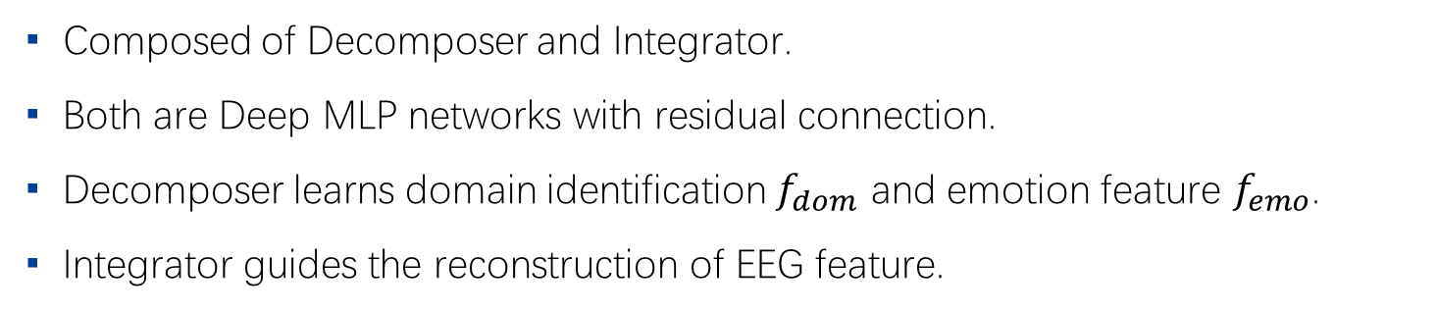
IDN Architecture
Composed of Decomposer and Integrator.
Both are Deep MLP networks with residual connection.
Decomposer learns domain identification $f_{dom}$ and emotion feature $f_{emo}$.
Integrator guides the reconstruction of EEG feature.

Slide 8
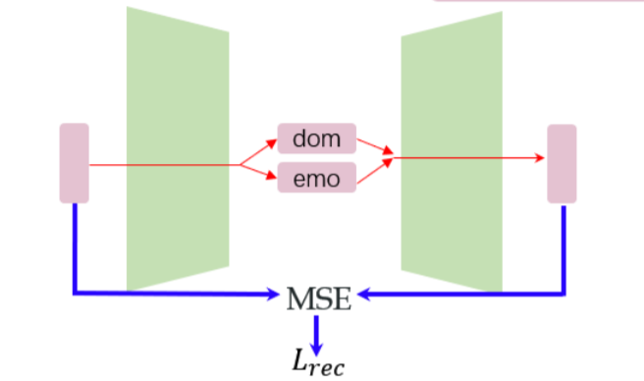
Unsupervised Learning
Ⅰ Reconstruction Loss

Slide 9
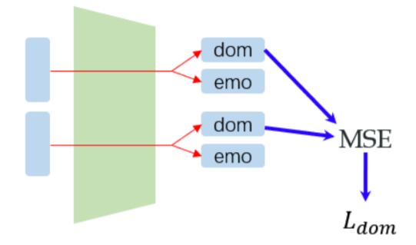
Unsupervised Learning
Ⅱ Domain Consistency Loss

Slide 10
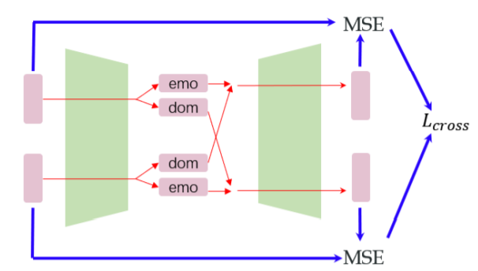
Unsupervised Learning
Ⅲ Cross Loss

Slide 11

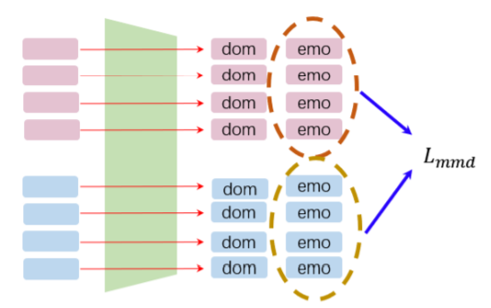
Unsupervised Learning
Ⅳ Maximum Mean Discrepancy Loss

Slide 12

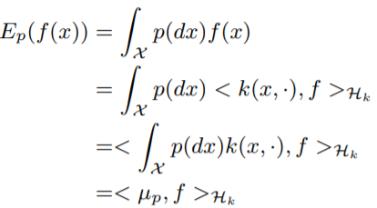
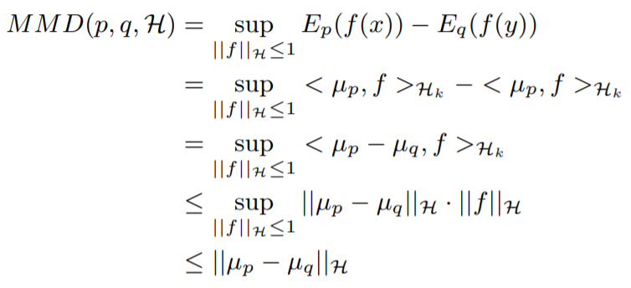
Maximum Mean Discrepancy

Slide 13

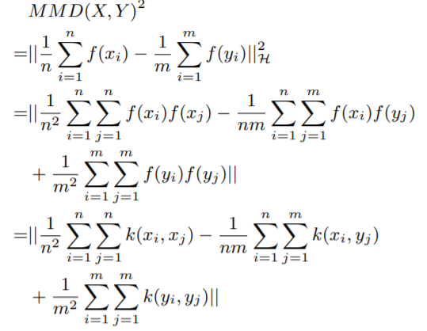
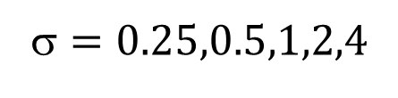
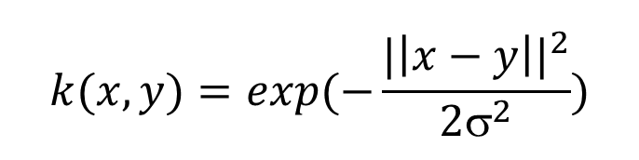
Maximum Mean Discrepancy
Multi-RBF-Kernel
$$k(x,y)=exp(−\frac{{|\left|x−y\right||}^{2}}{2σ^{2}})$$
$$=0.25,0.5,1,2,4$$

Slide 14
Unsupervised Learning

Slide 15
目录 Contents
1
Overview
2
Unsupervised Learning Scheme
3
LSTM Classification
4
Experiment
5
Discussion

Slide 16
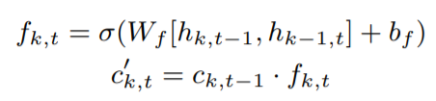
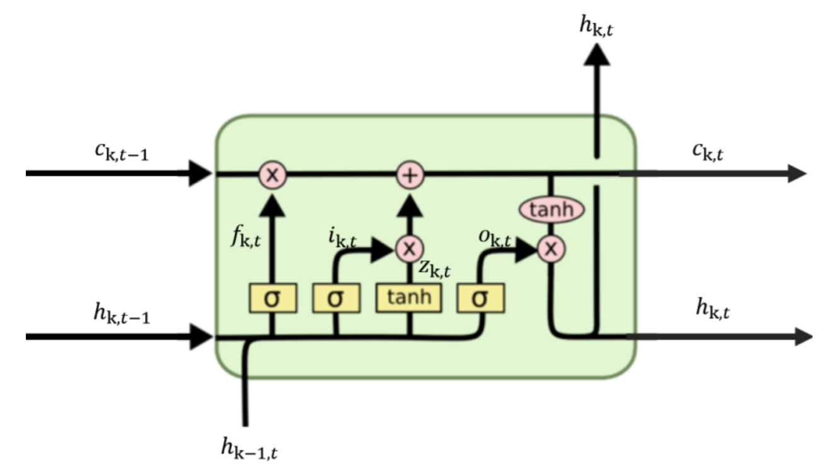
LSTM unit
Forget

Slide 17
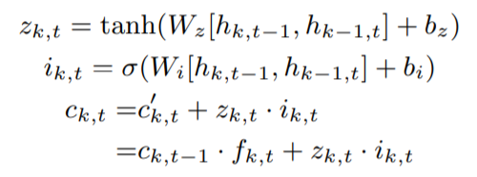
LSTM unit
Memorize

Slide 18

LSTM unit
Output

Slide 19
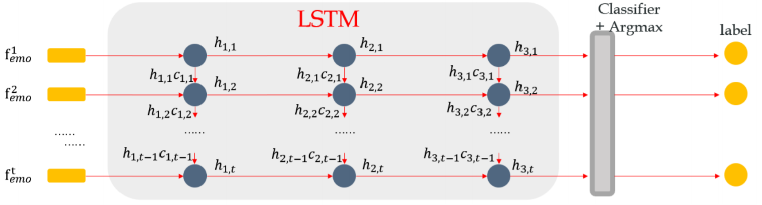
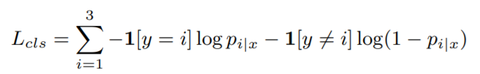
Classification
Cross Entropy Loss

Slide 20
目录 Contents
1
Overview
2
Unsupervised Learning Scheme
3
LSTM Classification
4
Experiment
5
Discussion

Slide 21
Experiment Setting
Dataset: SEED
15 human subjects
3394 time steps
310-dimensional EEG feature
3 emotion categories
Metric: Accuracy
15-Fold Cross Validation

Slide 22
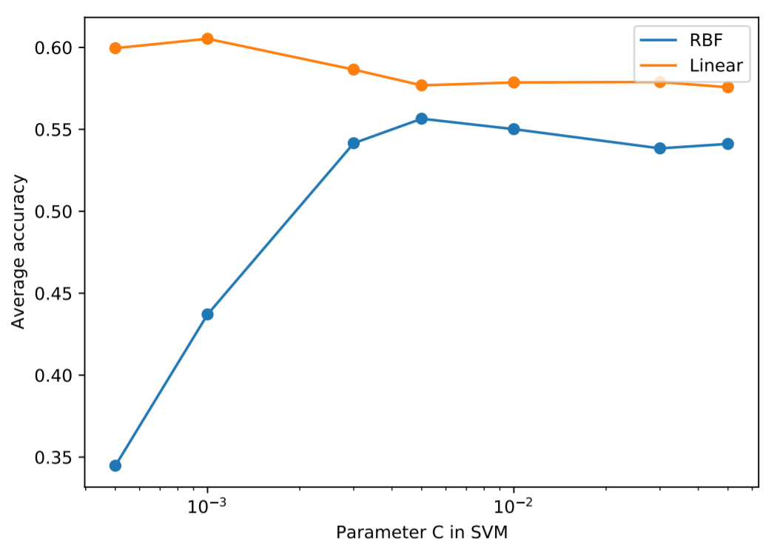
SVM baseline
Implement by scikit-learning
Best Accuracy ≈ 60%

Slide 23

IDN+LSTM Implementation
PyTorch
Single NVIDIA 1080-Ti
Each hidden dimension is 256.
ReLU activation.
Adam optimizer
IDN: $_{1}=1e−3$ (for $L_{rec}$) $_{2}=1e−2$ (for $L_{dom}$)
$_{3}=1e−2$ (for $L_{cross}$) $_{4}=1$ (for $L_{mmd}$)
Stage 1: 100 epochs
Stage 2: 300 epochs for maximum，early stopping when $L_{cls}<1e−3$

Slide 24
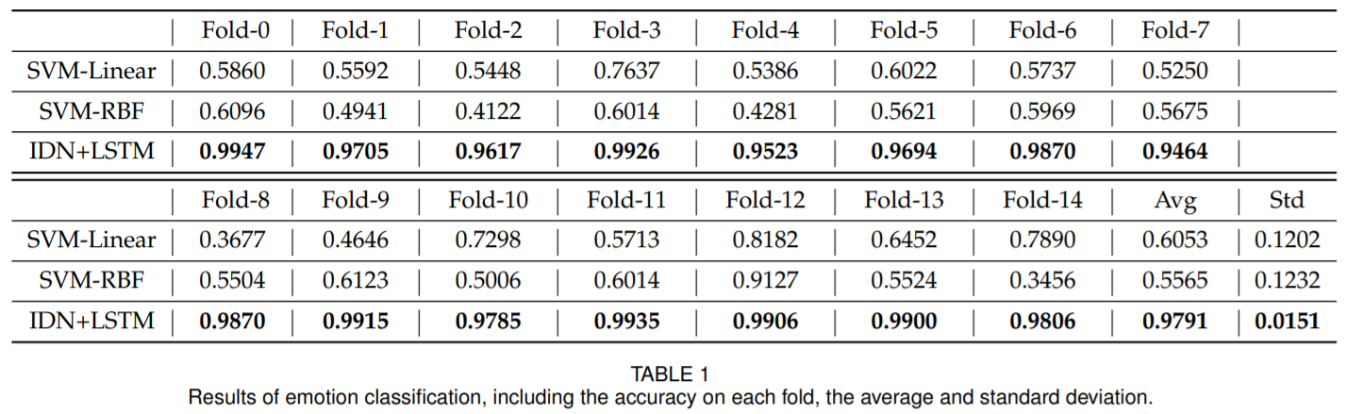
Results

Slide 25
目录 Contents
1
Overview
2
Unsupervised Learning Scheme
3
LSTM Classification
4
Experiment
5
Discussion

Slide 26
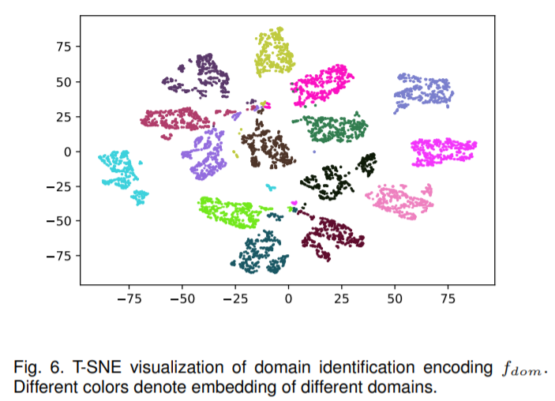
Visualization of Domain Identification

Slide 27
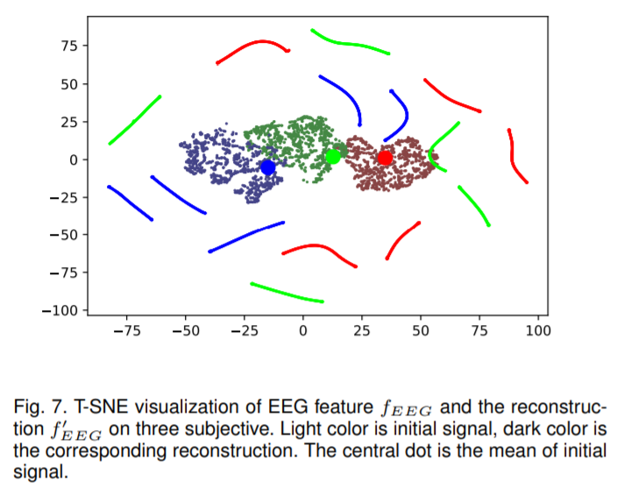
Visualization of Reconstruction

Slide 28
Advantages
Domain generalization. Agnostic to target domain data distribution.
Unsupervised learning scheme. Free of labels in whitening feature.
Modeling temporal information.

Slide 29
Some tricks on this benchmark (not used in my main experiment)
Plain deep MLP works very well with normalization (BatchNorm or LayerNorm).
Data are EEG feature collected during watching movies and are labeled in the temporal order. You can add positional embedding to augment feature.

Slide 30
谢谢！

