Slide 1
Chapter 11
Applications of Digital Signal Processing

Slide 2
Spectral Analysis of Signals
Spectral analysis is concerned with the determination of frequency contents of a continuous-time signal g_{a}(t) using DSP methods
It involves the determination of either the energy spectrum or the power spectrum of the signal
If g_{a}(t) is sufficiently bandlimited, spectral characteristics of its discrete-time equivalent g[n] should provide a good estimate of spectral characteristics of g_{a}(t)

Slide 3
Spectral Analysis of Signals
In most cases, g_{a}(t) is defined for-∞<t<∞
Thus, g[n] is of infinite extent, and defined for -∞<n<∞
Hence, g_{a}(t) is first passed through an analog anti-aliasing filter whose output is then sampled to generate g[n]
Assumptions: (1) Effect of aliasing can be ignored, (2) A/D conversion noise can be neglected

Slide 4
Spectral Analysis of Signals
Three types of spectral analysis -
1) Spectral analysis of stationary sinusoidal signals
2) Spectral analysis of of nonstationary signals with time-varying parameters
3) Spectral analysis of random signals

Slide 5
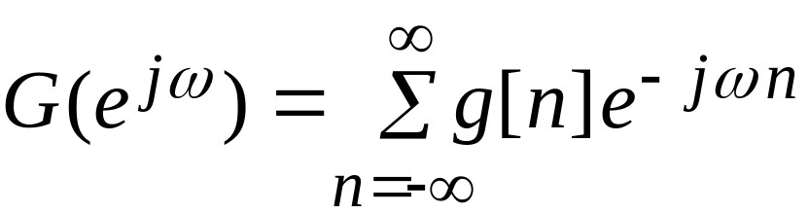
Spectral Analysis of
Sinusoidal Signals
Assumption - Parameters characterizing sinusoidal signals, such as amplitude, frequencies, and phase, do not change with time
For such a signal g[n], the Fourier analysis can be carried out by computing the DTFT

Slide 6
Spectral Analysis of Sinusoidal Signals
In practice, the infinite-length sequence g[n] is first windowed by multiplying it with a length-N window w[n] to convert it into a length-N sequence γ[n]
DTFT Γ(e^{jω}) of γ[n] then is assumed to provide a reasonable estimate of G(e^{jω})
Γ(e^{jω}) is evaluated at a set of R ( R≥N) discrete angular frequencies equally spaced in the range 0≤ω≤2π by computing the R-point FFT Γ(k) of γ[n]

Slide 7
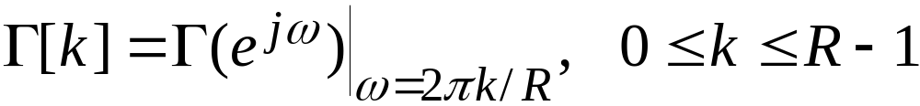
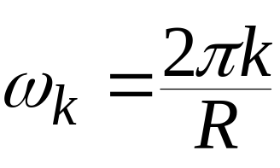
Spectral Analysis of Sinusoidal Signals
We analyze the effect of windowing and the evaluation of the frequency samples of the DTFT via the DFT
Now
The normalized discrete-time angular frequency ωk corresponding to the DFT bin number k (DFT frequency) is given by

Slide 8
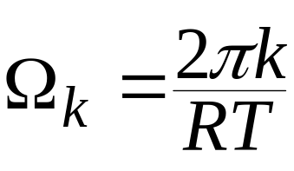
Spectral Analysis of Sinusoidal Signals
The continuous-time angular frequency corresponding to the DFT bin number k (DFT frequency) is given by
To interpret the results of DFT-based spectral analysis correctly we first consider the frequency-domain analysis of a sinusoidal signal

Slide 9
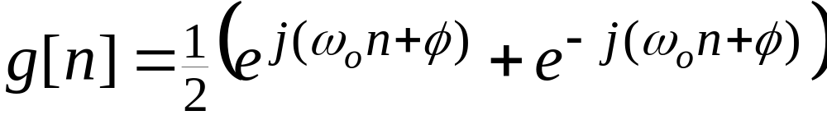
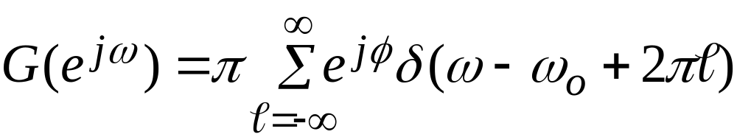
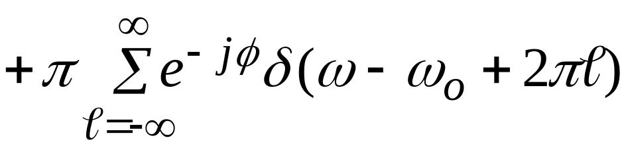
Spectral Analysis of Sinusoidal Signals
Consider
It can be expressed as
Its DTFT is given by

Slide 10
Spectral Analysis of Sinusoidal Signals
G(e^{jω}) is a periodic function of ω with a period 2π containing two impulses in each period
In the range -π≤ω≤π , there is an impulse at ω=ω₀ of complex amplitude πe^{jφ} and an impulse at ω=-ω₀ of complex amplitude πe^{-jφ}
To analyze g[n] using DFT, we employ a finite-length version of the sequence given by

Slide 11
Spectral Analysis of Sinusoidal Signals
Example - Determine the 32-point DFT of a length-32 sequence g[n] obtained by sampling at a rate of 64 Hz a sinusoidal signal g_{a}(t) of frequency 10 Hz
Since F_{T}=64 Hz is much larger than the Nyquist frequency of 20 Hz, there is no aliasing due to sampling

Slide 12
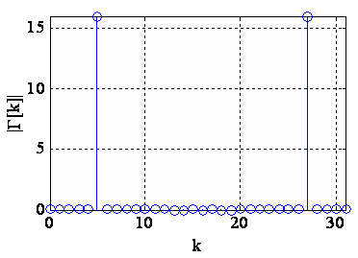
Spectral Analysis of Sinusoidal Signals
DFT magnitude plot
Since g[n] is a pure sinusoid, its DTFT Γ(e^{j2πf}) contains two impulses at f =±10Hz and is zero everywhere else

Slide 13
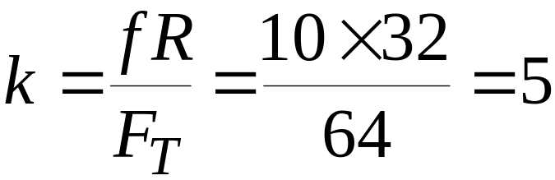
Spectral Analysis of Sinusoidal Signals
Its 32-point DFT is obtained by sampling Γ(e^{j2πf}) at f = 64X2/32=2kHz, 0≤k≤31
The impulse at f = 10 Hz appears as G[5] at the DFT frequency bin location
and the impulse at f = -10Hz appears as G[27] at bin location k=32-5 = 27

Slide 14
Spectral Analysis of Sinusoidal Signals
Note: For an N-point DFT, first half DFT samples for k = 0 to k = (N/2)-1 corresponds to the positive frequency axis from f = 0 to f = F_{T}/2 excluding the point f=F_{T}/2 and the second half for k = N/2 to k=N-1 corresponds to the negative frequency axis from f = -F_{T}/2 to f = 0 excluding the point f = 0

Slide 15
Spectral Analysis of Sinusoidal Signals
Example - Determine the 32-point DFT of a length-32 sequence g[n] obtained by sampling at a rate of 64 Hz a sinusoidal signal x_{a}(t) of frequency 11 Hz
Since g[n] is a pure sinusoid, its DTFT Γ(e^{j2πf}) contains two impulses at f =±11Hz and is zero everywhere else

Slide 16
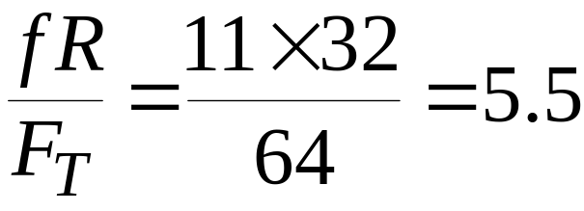
Spectral Analysis of Sinusoidal Signals
Since
the impulse at f = 11 Hz of the DTFT appear between the DFT bin locations k = 5 and k = 6
Likewise, the impulse f = -11 Hz of the DTFT appear between the DFT bin locations k = 26 and k = 27

Slide 17
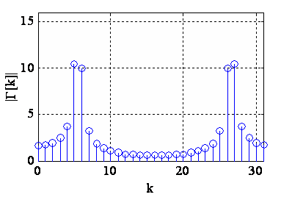
Spectral Analysis of Sinusoidal Signals
DFT magnitude plot
Note: Spectrum contains frequency components at all bins, with two strong components at k = 5 and k = 6, and two strong components at k = 26 and k = 27

Slide 18
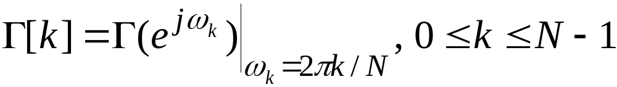
Spectral Analysis of Sinusoidal Signals
The phenomenon of the spread of energy from a single frequency to many DFT frequency locations is called leakage
To understand the cause of leakage, recall that the N-point DFT G[k] of a length-N sequence g[n] is given by the samples of its DTFT Γ(e^{jω}) :

Slide 19
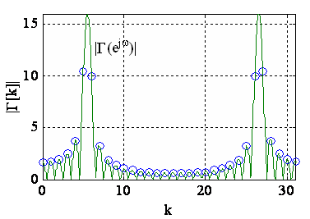
Spectral Analysis of Sinusoidal Signals
Plot of the DTFT of the length-32 sinusoidal sequence of frequency 11 Hz sampled at 64 Hz is shown below along with its 32-point DFT

Slide 20
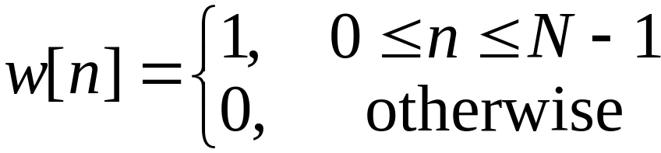
Spectral Analysis of Sinusoidal Signals
The DFT samples are indeed obtained by the frequency samples of the DTFT
Now the sequence
has been obtained by windowing the infinite-length sinusoidal sequence g[n] with a rectangular window w[n]:

Slide 21
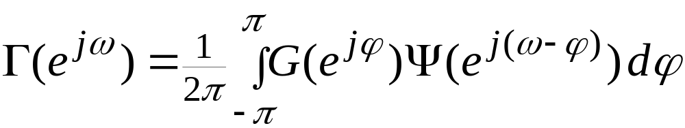

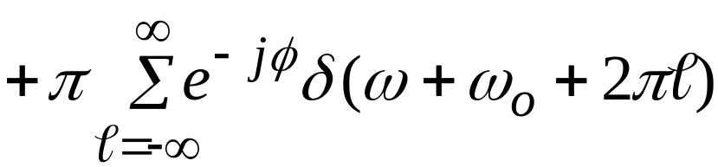
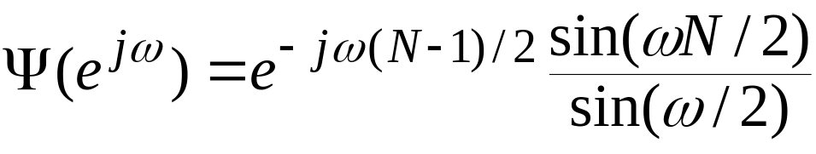
Spectral Analysis of Sinusoidal Signals
The DTFT Γ(e^{jω}) of g[n] is given by
where G(e^{jω}) is the DTFT of g[n]:
and Ψ(e^{jω}) is the DTFT of w[n]:

Slide 22
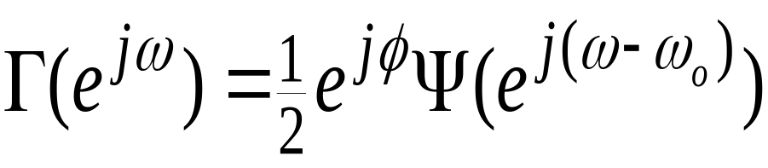
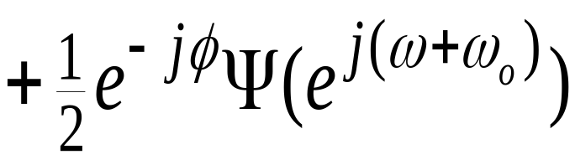
Spectral Analysis of Sinusoidal Signals
Hence
Thus, Γ(e^{jω}) is a sum of frequency shifted and amplitude scaled DTFT Ψ(e^{jω}) with the amount of shifts given by ±ω₀
For the length-32 sinusoid of frequency 11 Hz sampled at 64 Hz, normalized angular frequency of the sinusoid is 11/64 = 0.172

Slide 23
Spectral Analysis of Sinusoidal Signals
Its DTFT Γ(e^{jω}) is obtained by frequency shifting the DTFT Ψ(e^{jω}) to the right and to the left by the amount 0.172X2π= 0.344π , adding both shifted versions and scaling the sum by a factor of 1/2
In the frequency range 0≤ω≤2π , which is one period of the DTFT, there are two peaks, one at 0.344π and the other at 2π(1-0.172)=1.656π

Slide 24
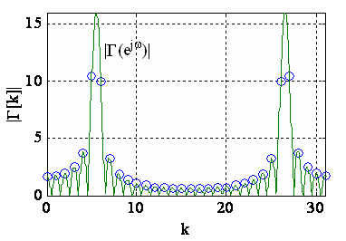
Spectral Analysis of Sinusoidal Signals
Plot of |Γ(e^{jω})| and the 32-point DFT |Γ[k]|

Slide 25
Spectral Analysis of Sinusoidal Signals
The two peaks of |G[k]| located at bin locations k = 5 and k = 6 are frequency samples on both sides of the main lobe located at 0.172
The two peaks of |G[k]| located at bin locations k = 26 and k = 27 are frequency samples on both sides of the main lobe located at 0.828

Slide 26
Spectral Analysis of Sinusoidal Signals
All other DFT samples are given by the samples of the sidelobes of Ψ(e^{jω}) causing the leakage of the frequency components at to other bin locations with the amount of leakage determined by the relative amplitudes of the main lobe and the sidelobes
Since the relative sidelobe level A_{sl} of the rectangular window is very high, there is a considerable amount of leakage to the bin locations adjacent to the main lobes

Slide 27
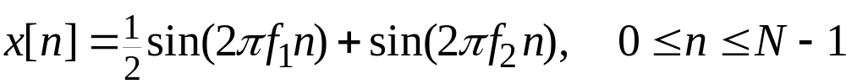
Spectral Analysis of Sinusoidal Signals
Problem gets more complicated if the signal being analyzed has more than one sinusoid
We now examine the effects of the length R of the DFT, the type of window being used, and its length N on the results of spectral analysis
Consider

Slide 28
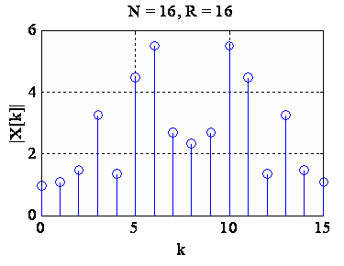
Spectral Analysis of Sinusoidal Signals
Example – N=16, f₁=0.22, f₂=0.34
From the above plot it is difficult to determine whether there is one or more sinusoids in x[n] and the exact locations of the sinusoids

Slide 29
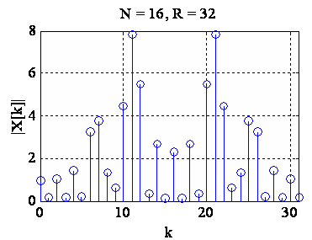
Spectral Analysis of Sinusoidal Signals
An increase in the DFT length to R = 32 leads to some concentrations around k = 7 and k = 11 in the normalized frequency range from 0 to 0.5

Slide 30
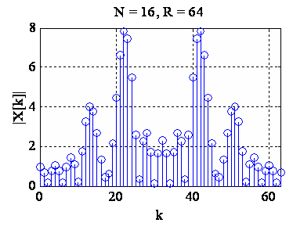
Spectral Analysis of Sinusoidal Signals
There are two clear peaks when R = 64

Slide 31
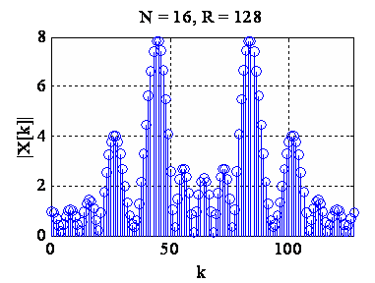
Spectral Analysis of Sinusoidal Signals
An increase in the accuracy of the peak locations is obtained by increasing DFT length to R = 128 with peaks occurring at k = 27 and k =45

Slide 32
Spectral Analysis of Sinusoidal Signals
However, there are a number of minor peaks and it is not clear whether additional sinusoids of lesser strengths are present
General conclusion - An increase in the DFT length improves the sampling accuracy of the DTFT by reducing the spectral separation of adjacent DFT samples

Slide 33
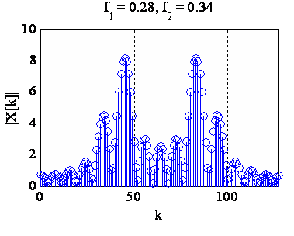
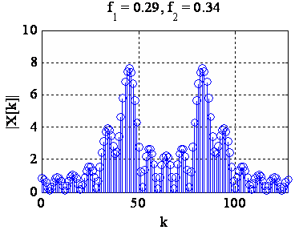
Spectral Analysis of Sinusoidal Signals
Example – N=16, R=128, f₂=0.34
f₁ varied from 0.28 to 0.31
The two sinusoids are clearly resolved in both cases

Slide 34
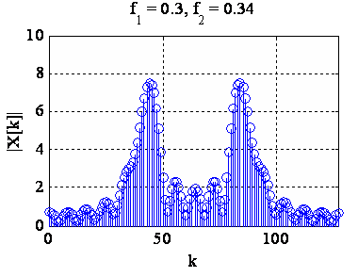
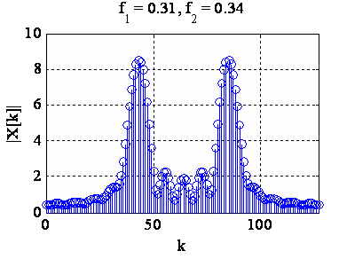
Spectral Analysis of Sinusoidal Signals
The two sinusoids cannot be resolved in both cases

Slide 35
Spectral Analysis of Sinusoidal Signals
Reduced resolution occurs when the difference between the two frequencies becomes less than 0.4
The DTFT Γ(e^{jω}) is obtained by summing the DTFTs of the two sinusoids
As the difference between the two frequencies get smaller, the main lobes of the individual DTFTs get closer and eventually overlap

Slide 36
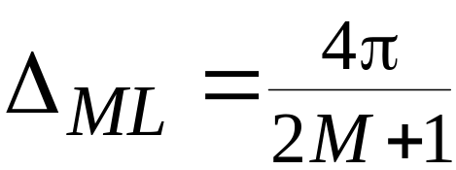
Spectral Analysis of Sinusoidal Signals
If there is significant overlap, it will be difficult to resolve the two peaks
Frequency resolution is determined by the width ΔML of the main lobe of the DTFT of the window
For a length-N rectangular window
In terms of normalized frequency, for N = 16, main lobe width is 0.125

Slide 37
Spectral Analysis of Sinusoidal Signals
Thus, two closely spaced sinusoids windowed by a length-16 rectangular window can be resolved if the difference in the frequencies is about half the main lobe width, i.e., 0.0625
Rectangular window has the smallest main lobe width and has the smallest frequency resolution

Slide 38
Spectral Analysis of Sinusoidal Signals
But the rectangular window has the largest sidelobe amplitude causing considerable leakage
From the previous two examples, it can be seen that the large amount of leakage results in minor peaks that may be identified falsely as sinusoids
Leakage can be reduced by using other types of windows

Slide 39
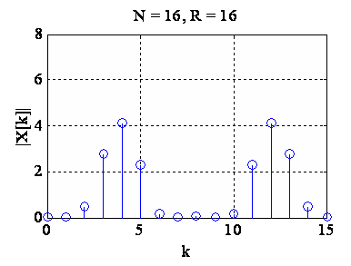
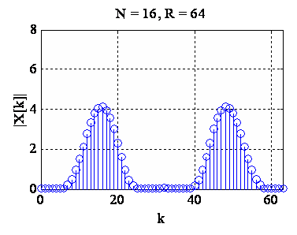
Spectral Analysis of Sinusoidal Signals
Example -
windowed by a length-R Hamming window
Leakage has been reduced considerably, but it is difficult to resolve the two sinusoids

Slide 40
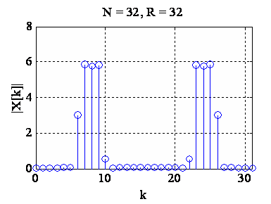
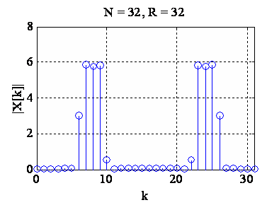
Spectral Analysis of Sinusoidal Signals
An increase in the DFT length results in a substantial reduction of leakage, but the two sinusoids still cannot be resolved

Slide 41
Spectral Analysis of Sinusoidal Signals
The main lobe width ΔML of a length-N Hamming window is 8π/N
For N = 16, normalized main lobe width is 0.25
Two frequencies can thus be resolved if their difference is of the order of half of the main lobe width, i.e., 0.125
In the example considered, the difference is 0.04, which is much smaller

Slide 42
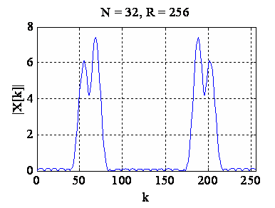
Spectral Analysis of Sinusoidal Signals
To increase the resolution, increase the window length to R = 32 which reduces the main lobe width by half
There now appears to be two peaks

Slide 43
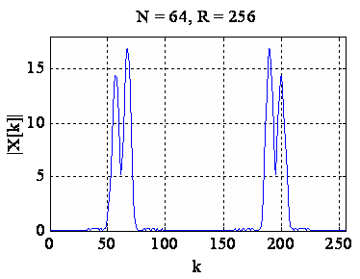
Spectral Analysis of Sinusoidal Signals
An increase of the DFT size to R = 64 clearly separates the two peaks
Separation is more visible for R = 256

Slide 44
Spectral Analysis of Sinusoidal Signals
General conclusions - Performance of DFT-based spectral analysis depends on three factors: (1) Type of window, (2) Window length, and (3) Size of the DFT
Frequency resolution is increased by using a window with a very small main lobe width
Leakage is reduced by using a window with a very small relative sidelobe level

Slide 45
Spectral Analysis of Sinusoidal Signals
Main lobe width can be reduced by increasing the window length
An increase in the accuracy of locating peaks is obtained by increasing the DFT length
It is preferable to use a DFT length that is a power of 2 so that very efficient FFT algorithms can be employed
An increase in DFT size increases the computational complexity

Slide 46
Spectral Analysis of Sinusoidal Signals
DFT can be employed for spectral analysis of a length-N sinusoidal signal composed of sinusoidal signals as long as the frequency, amplitude and phase of each sinusoidal component are time-invariant and independent of N
There are situations where the signal being analyzed is instead nonsationary, for which these parameters are time-varying

Slide 47
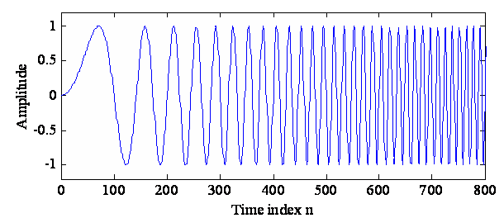
Spectral Analysis of Sinusoidal Signals
An example of a time-varying signal is the chirp signal x[n]=Acos(ω₀n²) and shown below for ω₀= 10πX10⁻⁵
The instantaneous frequency of x[n] is 2ω₀n

Slide 48
Spectral Analysis of Nonstationary Signals
Other examples of such nonstationary signals are speech, radar and sonar signals
DFT of the complete signal will provide misleading results
A practical approach would be to segment the signal into a set of subsequences of short length with each subsequence centered at uniform intervals of time and compute DFTs of each subsequence

Slide 49
Spectral Analysis of Nonstationary Signals
The frequency-domain description of the long sequence is then given by a set of short-length DFTs, i.e., a time-dependent DFT
To represent a nonstationary x[n] in terms of a set of short-length subsequences, x[n] is multiplied by a window w[n] that is stationary with respect to time and move x[n] through the window

Slide 50
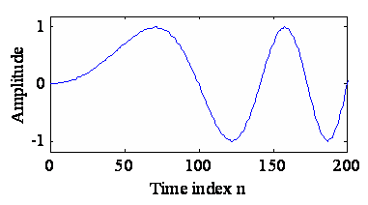
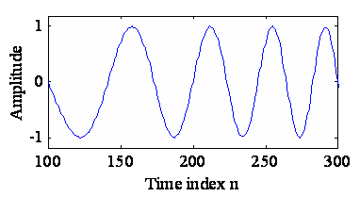
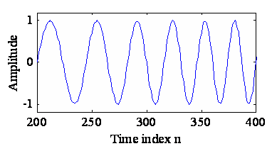
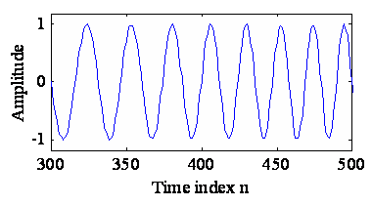
Spectral Analysis of Nonstationary Signals
Four segments of the chirp signal as seen through a stationary length-200 rectangular window

Slide 51
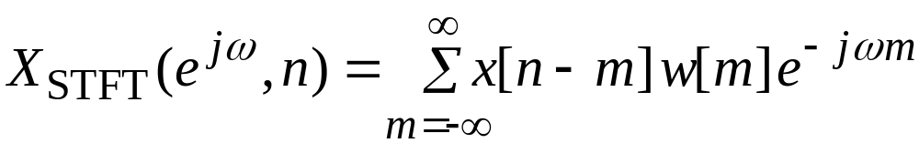
Short-Time Fourier Transform
Short-time Fourier transform (STFT), also known as time-dependent Fourier transform of a signal x[n] is defined by
where w[m] is a suitably chosen window sequence

Slide 52
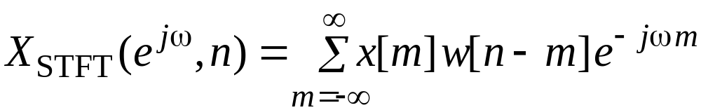
Short-Time Fourier Transform
The STFT is also defined as given below:
Here, if w[n] = 1 for all values of n, the STFT reduces to DTFT of x[n]

Slide 53
Short-Time Fourier Transform
Even though DTFT of x[n] exists under certain well-defined conditions, windowed x[n] being of finite length ensures the existence of any x[n]
Function of w[n] is to extract a finite-length portion of x[n] such that the spectral characteristics of the extracted section are approximately stationary

Slide 54
Short-Time Fourier Transform
X_{STFT}(e^{jω},n) is a function of 2 variables: integer variable time index n and continuous frequency variable ω
X_{STFT}(e^{jω},n) is a periodic function of ω with a period 2π
Display of |X_{STFT}(e^{jω},n)| is usually referred to as spectrogram
Display of spectrogram requires normally three dimensions

Slide 55
Short-Time Fourier Transform
Often, STFT magnitude is plotted in two dimensions with the magnitude represented by the darkness of the plot
Plot of STFT magnitude of chirp sequence
x[n]=Acos(ω₀n²) with ω₀=10πX10⁻⁵ for a length of 20,000 samples computed using a Hamming window of length 200 shown next

Slide 56
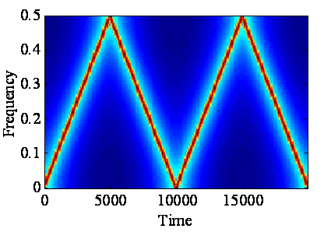
Short-Time Fourier Transform
STFT for a given value of n is essentially the DFT of a segment of an almost sinusoidal sequence

Slide 57
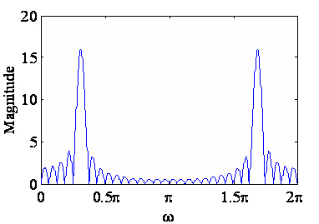
Short-Time Fourier Transform
Shape of the DFT of such a sequence is similar to that shown below
Large nonzero-valued DFT samples around the frequency of the sinusoid
Smaller nonzero-valued DFT samples at other frequency points

Slide 58
Short-Time Fourier Transform
In the spectrogram plot, large-valued DFT samples show up as narrow very short dark vertical lines
Other DFT samples show up as points
As the instantaneous frequency of the chirp signal increases linearly with n, short dark line move up in the vertical direction
Because of aliasing, dark line starts moving down in the vertical direction
Spectrogram appears in a triangular shape

Slide 59
Short-Time Fourier Transform
In practice, the STFT is computed at a finite set of discrete values of ω
The STFT is accurately represented by its frequency samples as long as the number of frequency samples N is greater than window length R
The portion of the sequence x[n] inside the window can be fully recovered from the frequency samples of the STFT

Slide 60
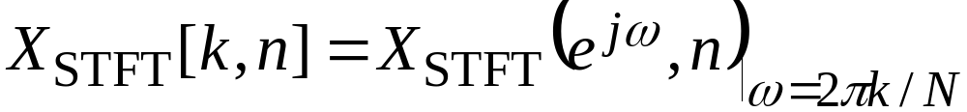
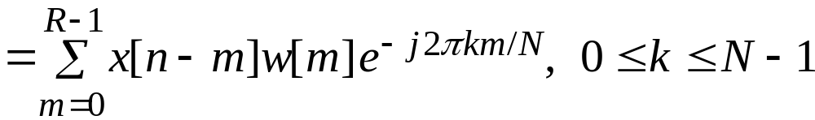
Short-Time Fourier Transform
Sampling X_{STFT}(e^{jω},n) at N equally spaced frequencies ω_{k}=2πk/N, with N≥R we get
If w[m]≠0, X_{STFT}[k, n] is simply the R-point DFT of x[n-m]w[m]

Slide 61
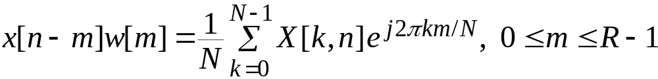
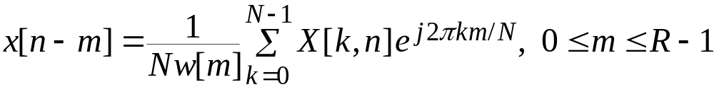
Short-Time Fourier Transform
X_{STFT}(k,n) is a 2-D sequence and periodic in k with a period N
Applying the IDFT we get
or
Thus the sequence inside the window can be fully recovered from

Slide 62
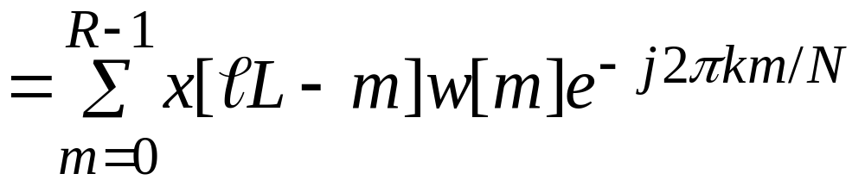
Short-Time Fourier Transform
The sampled STFT for a window defined in the region 0≤m≤R-1 is given by
where l and k are integers such that -∞< l <∞ and 0≤k≤N-1

Slide 63

Short-Time Fourier Transform
Figure below shows lines in the (ω,n)-plane corresponding to X_{STFT}(e^{jω},n) for N = 9 and L = 4

Slide 64



Short-Time Fourier Transform
Figure below shows the grid of sampling points in (ω,n)-plane for N = 9 and L = 4
k
4
3
2
1
0
0
1
2
3

Slide 65

Short-Time Fourier Transform
As we have shown it is possible to uniquely reconstruct the originl signal from such a 2-D discrete representation provided
where N is the DFT length, R is the window length and L is the sampling period in time

Slide 66
STFT Window Selection
The function of the window w[n] is to extract a portion of the signal x[n] and ensure that the extracted section is approximately stationary
To the end, the window length L should be small, in particular for signals with widely varying spectral parameters

Slide 67
STFT Window Selection
A decrease in the window length increases the time resolution property of the STFT
On the other hand, the frequency resolution property of the STFT increases with an increase in the window length
A shorter window provides a wideband spectrogram, whereas, a longer window results in a narrowband spectrogram

Slide 68
STFT Window Selection
Parameters characterizing the DTFT of a window are the main lobe width Δ_{ML} and the relative sidelobe amplitude A_{sl}
Δ_{ML} determines the ability of the window to resolve two sinusoidal components in the vicinity of each other
A_{sl} controls the degree of leakage of one component into a nearby signal component

Slide 69
STFT Window Selection
In order to obtain a reasonably good estimate of the frequency spectrum of a time-varying signal, the window should be chosen to have very small A_{sl} with a length R chosen based on the acceptable accuracy of the frequency and time resolutions

Slide 70

STFT Computation Using MATLAB
The M-file specgram can be used to compute the STFT of a signal
The application of specgram is illustrated next
A speech signal of duration 4001 samples

Slide 71

STFT Computation Using MATLAB
Using Program 11_4 we compute the narrowband spectrogram of this speech signal

Slide 72

STFT Computation Using MATLAB
The wideband spectrogram of the speech signal is shown below
The frequency and time resolution tradeoff between the two spectrograms can be seen

