Slide 1
Chapter 3
Transform-Domain Representation of
Discrete-Time Signals

Slide 2
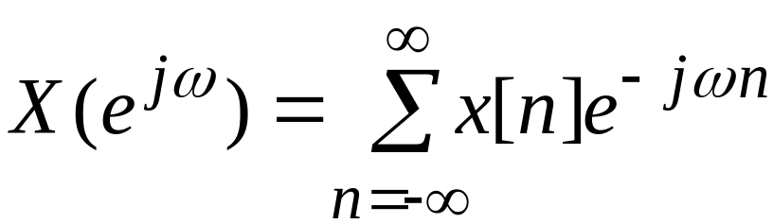
§3.1 Discrete-Time Fourier Transform
Definition - The Discrete-time Fourier Transform (DTFT) X(e^{jω}) of a sequence x[n] is given by
In general, X(e^{jω}) is a complex function of the real variable ω and can be written as
X(e^{jω}) = X_{re}(e^{jω}) + j X_{im}(e^{jω})

Slide 3
§3.1 Discrete-Time Fourier Transform
X(e^{jω}) can alternately be expressed as
X(e^{jω}) = | X(e^{jω}) |e^{jθ(ω)}
where
θ(ω) = arg{X(e^{jω}) }
| X(e^{jω}) | is called the magnitude function
θ(ω) is called the phase function
Both quantities are, again, real functions of ω
In many applications, the DTFT is called the Fourier spectrum
Likewise, | X(e^{jω}) | and θ(ω) are called the magnitude and phase spectra

Slide 4
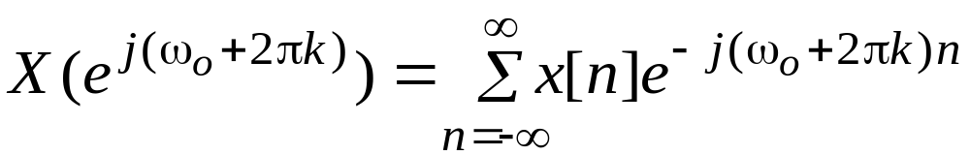
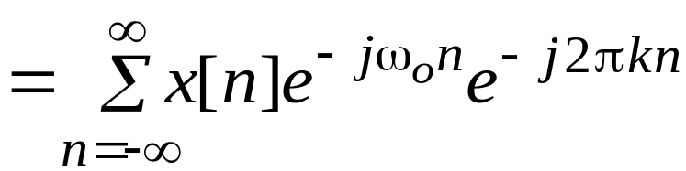
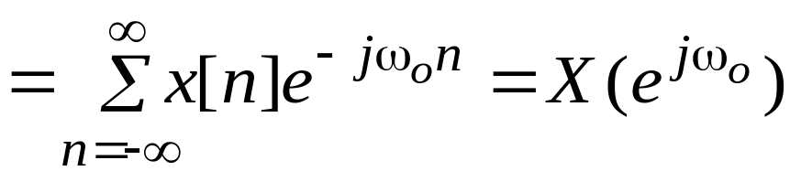
§3.1 Discrete-Time Fourier Transform
The DTFT X(e^{jω}) of a sequence x[n] is a continuous function of ω
It is also a periodic function of ω with a period 2π:

Slide 5
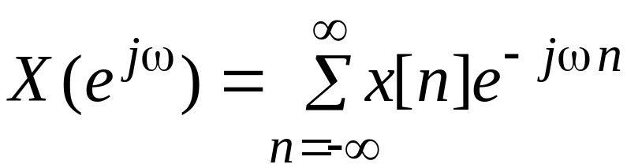
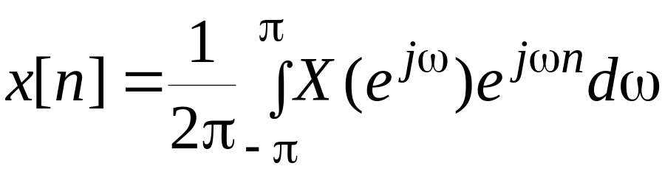
§3.1 Discrete-Time Fourier Transform
Therefore
represents the Fourier series representation of the periodic function
As a result, the Fourier coefficients x[n] can be computed from X(e^{jω}) using the Fourier integral

Slide 6
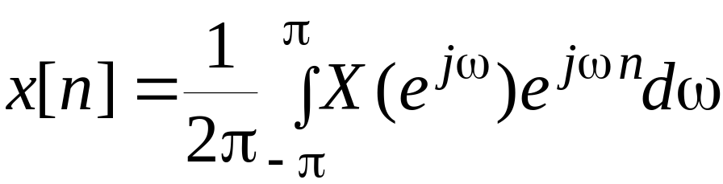
§3.1 Discrete-Time Fourier Transform
Inverse Discrete-Time Fourier Transform:

Slide 7





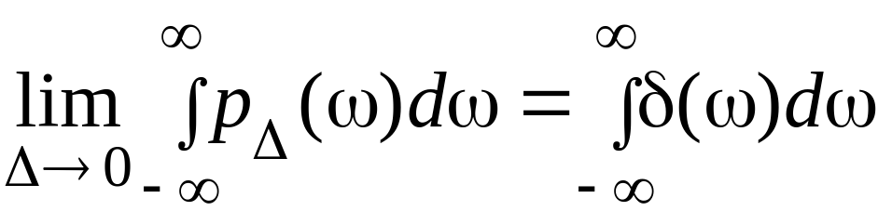
§3.1 Discrete-Time Fourier Transform
A Dirac delta function δ(ω) is a function of ω with infinite height, zero width, and unit area
It is the limiting form of a unit area pulse function p_{Δ}(ω) as Δ goes to zero satisfying
ω

Slide 8
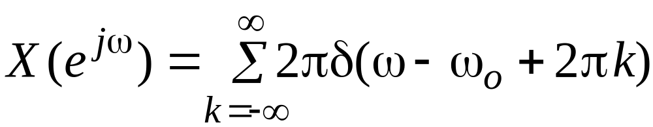
§3.1 Discrete-Time Fourier Transform
The function
is a periodic function of ω with a period 2π and is called a periodic impulse train or impulse train

Slide 9

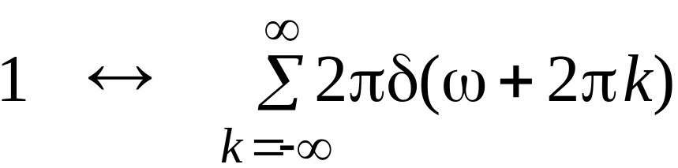
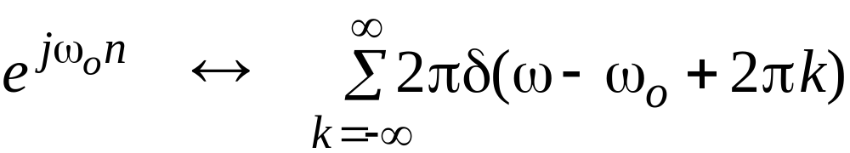
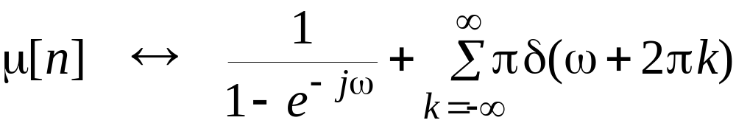
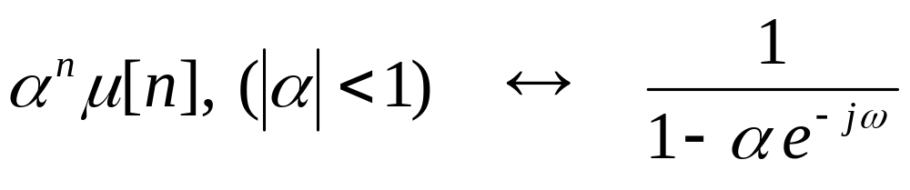
Commonly Used DTFT Pairs
  Sequence DTFT

Slide 10
§3.2 DTFT Properties
There are a number of important properties of the DTFT that are useful in signal processing applications
These are listed here without proof
Their proofs are quite straightforward
We illustrate the applications of some of the DTFT properties

Slide 11
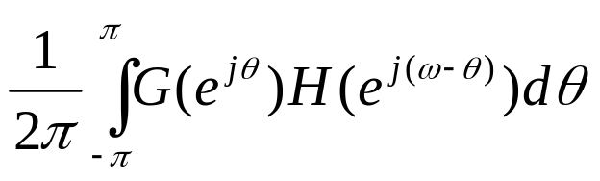
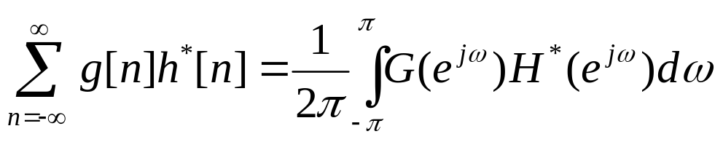
§3.2 DTFT Properties
Type of Property Sequence DTFT
g[n] G(e^{jω})
h[n] H(e^{jω})
Linearity ag[n]+bh[n] aG(e^{jω})+bH(e^{jω})
Time-shifting g[n-n₀] e^{-jωn0}G(e^{jω})
Frequency-shifting e^{-jω0n}g[n] G(e^{j(ω- ω0)})
Differentiation ng[n] jdG(e^{jω})/dω
Convolution g[n]*h[n] G(e^{jω})H(e^{jω})
Modulation g[n]h[n]
Parseval’s relation

Slide 12
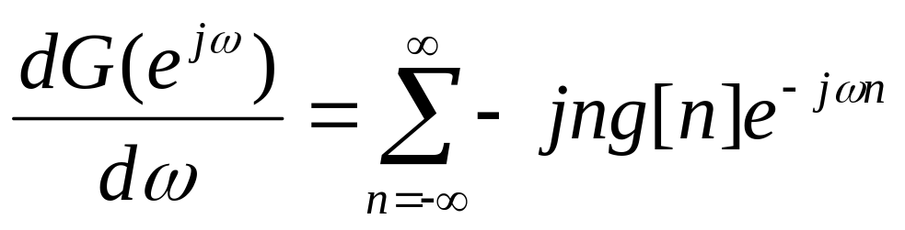
§3.2 DTFT Properties
g[n]←→G(e^{jω})
Use the definition of G(e^{jω})and differentiate both sides, we obtain
The right-hand side of this equation is the Fourier transform of –jng[n]. Therefore, multiplying both sides by j, we see
ng[n]←→jdG(e^{jω})/dω

Slide 13
§3.3 Discrete Fourier Transform (DFT)
DTFT is the Fourier Transform of discrete-time sequence. It is discrete in time domain and its spectrum is periodical, but continue which cannot be processed by computer which could only process digital signals in both sides, that means the signals in both sides must be both discrete and periodical.

Slide 14
§3.3 Discrete Fourier Transform (DFT)
Time domain Frequency domain
Continue aperiodical ← FT → Continue aperiodical
Periodical ← FST → discrete spectrum
Discrete ← DTFT → periodical spectrum
Discrete periodical ← DFT → periodical discrete

Slide 15
Typical DFT Pair δ_{T}(t) ←→ ω₀δω₀(ω)
δ_{T}(t)
ω₀ = 2π/T
ω₀δ_{ω0}(ω)
←→
-2T
-T
0
T
2T
t
-2ω₀
- ω₀
0
ω₀
2ω₀
ω
In DFT, the signals in both sides are discrete, so it is the only transform pair which can be processed by computer.
The signals in both sides are periodical, so the processing could be in one period, which is important because (1) the number of calculation is limited, which is necessary for computer; (2) all of the signal information could be kept in one period, which is necessary for accurate processing.

Slide 16
Make a signal discrete and periodical
The engineering signals are often continue and aperiodical. If we want to process the signals with DFT, we have to make the signals discrete and periodical.
Sampling to make the signal discrete
Make the signal periodical:
If x[n] is a limited length N-point sequence, see it as one period of a periodical signal that means extend it to a periodical
If x[n] is an infinite length sequence, cut-off its tail to make a N-point sequence, then do the periodic extending. The tail cutting-off will introduce distortion. We must develop truncation algorithm to reduce the error, which is windowing.

Slide 17


Make a signal discrete and periodical
x(t)
X(jω)
FT
P(t)
P(jω)
…
…
ω₀=2π/T_{s}
T_{s}
ω₀
x[nT]
X(jω)
DTFT
q(t)
Q(jω)
Q(jω)
…
…
…
…
Ω₀= 2π/T
Ω₀= 2π/T
T
Ω₀
Ω₀
DFT

Slide 18
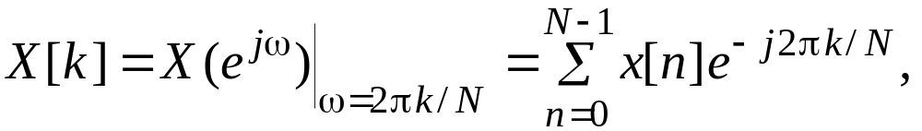

§3.3 Discrete Fourier Transform (DFT)
Definition - The simplest relation between a length-N sequence x[n], defined for 0≤n ≤N-1, and its DTFT X(e^{jω}) is obtained by uniformly sampling X(e^{jω}) on the ω-axis between 0≤ω ≤2π at ω_{k}=2πk/N , 0≤k≤N-1
From the definition of the DTFT have

Slide 19
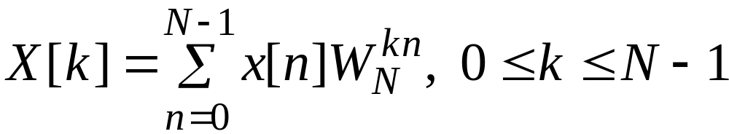
§3.3 Discrete Fourier Transform (DFT)
Note: X[k] is also a length-N sequence in the frequency domain
The sequence X[k] is called the Discrete Fourier Transform (DFT) of the sequence x[n]
Using the notation W_{N}=e^{-j2 π/N} the DFT is usually expressed as:

Slide 20
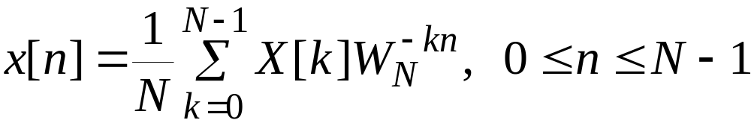
§3.3 Discrete Fourier Transform (DFT)
The Inverse Discrete Fourier Transform (IDFT) is given by

Slide 21
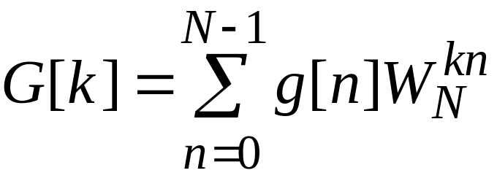
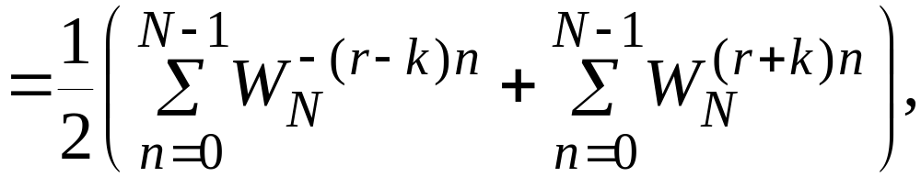
§3.3 Discrete Fourier Transform (DFT)
The N-point DFT of g[n] is thus given by

Slide 22
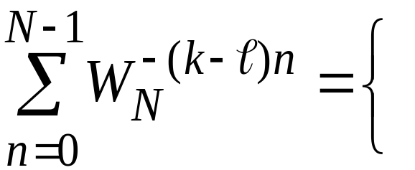



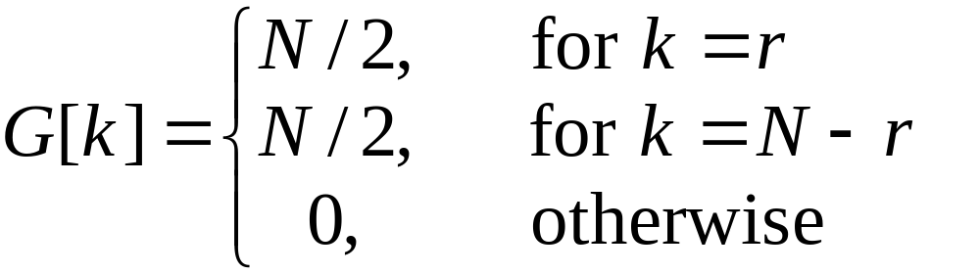
§3.3 Discrete Fourier Transform (DFT)
Making use of the identity
r an integer
we get

Slide 23
§3.5 Circular Shift of a Sequence
This property is analogous to the time-shifting property of the DTFT , but with a subtle difference
Consider length-N sequences defined for
0≤n≤N-1
Sample values of such sequences are equal to zero for values of n < 0 and
n≥N

Slide 24
§3.5 Circular Shift of a Sequence
If x[n] is such a sequence, then for any arbitrary integer n₀ , the shifted sequence
x₁[n] = x[n – n₀]
is no longer defined for the range 0≤n≤N-1
We thus need to define another type of a shift that will always keep the shifted sequence in the range 0≤n≤N-1

Slide 25
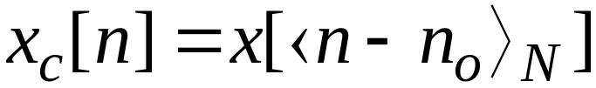
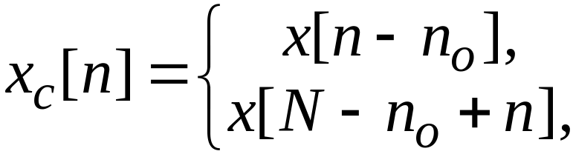
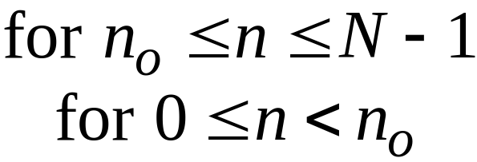
§3.5 Circular Shift of a Sequence
The desired shift, called the circular shift, is defined using a modulo operation:
For n₀>0 (right circular shift), the above equation implies

Slide 26
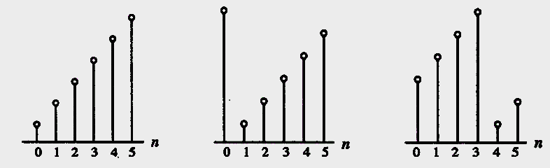
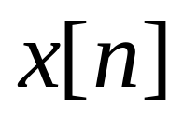
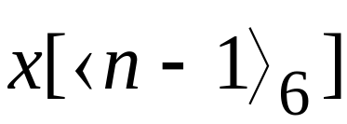
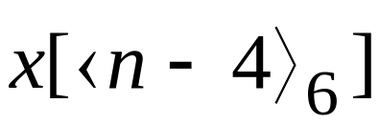
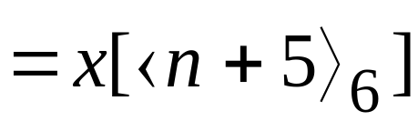
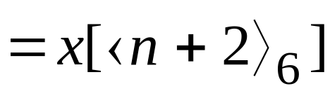
§3.5 Circular Shift of a Sequence
Illustration of the concept of a circular shift

Slide 27
§3.5 Circular Shift of a Sequence
As can be seen from the previous figure, a right circular shift by n₀ is equivalent to a left circular shift by N-n₀ sample periods
A circular shift by an integer number greater than N is equivalent to a circular shift by ⟨n₀⟩ _{N}

Slide 28
§3.5 Circular Shift of a Sequence
Non-circular shift
circular shift
x[n]
x[n-1]

Slide 29
Modulo operation
In mathematics, modular arithmetic (sometimes called clock arithmetic) is a system of arithmetic for integers, where numbers "wrap around" after they reach a certain value—the modulus.
A familiar use of modular arithmetic is in the 12-hour clock, in which the day is divided into two 12-hour periods. If the time is 7:00 now, then 8 hours later it will be 3:00.

Slide 30
Modulo operation
Usual addition would suggest that the later time should be 7 + 8 = 15, but this is not the answer because clock time "wraps around" every 12 hours; in 12-hour time, there is no "15 o'clock". Likewise, if the clock starts at 12:00 (noon) and 21 hours elapse, then the time will be 9:00 the next day, rather than 33:00. Since the hour number starts over after it reaches 12, this is arithmetic modulo 12. 12 is congruent not only to 12 itself, but also to 0, so the time called "12:00" could also be called "0:00", since 0 ≡ 12 mod 12.

Slide 31
Modulo operation
In computing, the modulo operation finds the remainder of division of one number by another.
Given two positive numbers, a (the dividend) and n (the divisor), a modulo n (abbreviated as a mod n) can be thought of as the remainder, on division of a by n.

Slide 32
Modulo operation
For instance, the expression “5 mod 4” would evaluate to 1 because 5 divided by 4 leaves a remainder of 1；
“9 mod 3” would evaluate to 0 because the division of 9 by 3 leaves a remainder of 0;

Slide 33
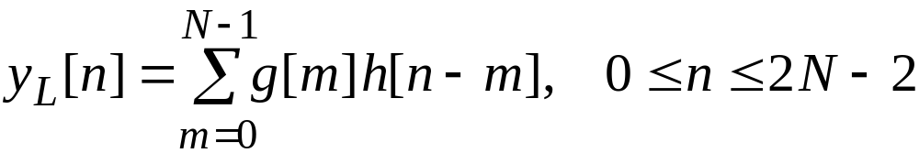
§3.6 Circular Convolution
This operation is analogous to linear convolution, but with a subtle difference
Consider two length-N sequences, g[n] and h[n], respectively
Their linear convolution results in a length-(2N-1) sequence y_{L}[n] given by

Slide 34
§3.6 Circular Convolution
In computing y_{L}[n] we have assumed that both length-N sequences have been zero-padded to extend their lengths to 2N-1
The longer form of y_{L}[n] results from the time-reversal of the sequence h[n] and its linear shift to the right
The first nonzero value of y_{L}[n] is y_{L}[n]=g[0]h[0], and the last nonzero value is
y_{L}[2N-2]=g[N-1]h[N-1]

Slide 35
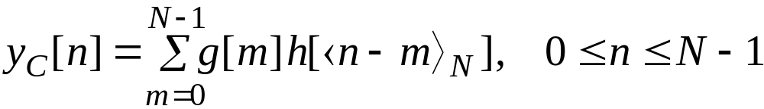
§3.6 Circular Convolution
To develop a convolution-like operation resulting in a length-N sequence y_{C}[n], we need to define a circular time-reversal, and then apply a circular time-shift
Resulting operation, called a circular convolution, is defined by

Slide 36
§3.6 Circular Convolution
Since the operation defined involves two length-N sequences, it is often referred to as an N-point circular convolution, denoted as
y[n] = g[n] h[n]
N
The circular convolution is commutative, i.e.
g[n] h[n] = h[n] g[n]
N
N

Slide 37







§3.6 Circular Convolution
Example - Determine the 4-point circular convolution of the two length-4 sequences:
as sketched below
n
n

Slide 38
g[n] = δ[n] + 2δ[n-1] + δ[n-3]
h[n] = 2δ[n] + 2δ[n-1] + δ[n-2] + δ[n-3]
g[k]
g[k]
g[k]
g[k]
g[k]
h[k]
h[1-k]
h[2-k]
h[3-k]
h[-k]
y[0]
y[1]
7
y[2]
y[3]
6
6
5
y[n]=6δ[n]+7δ[n-1]+6δ[n-2]+5δ[n-3]

Slide 39
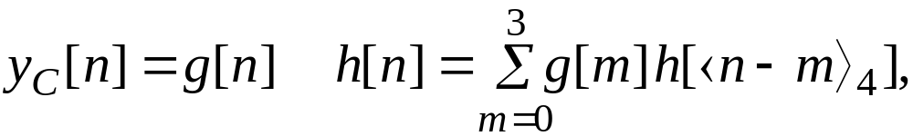

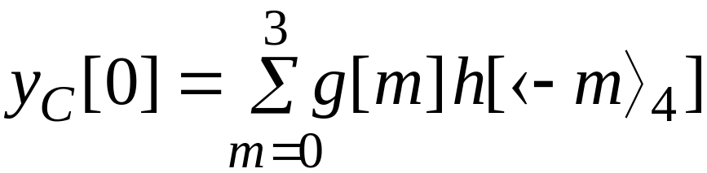
§3.6 Circular Convolution
The result is a length-4 sequence y_{C}[n] given by
4
From the above we observe

Slide 40
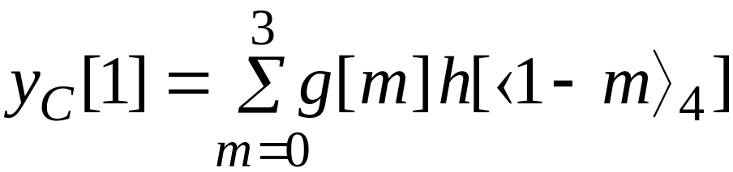

§3.6 Circular Convolution
Likewise

Slide 41

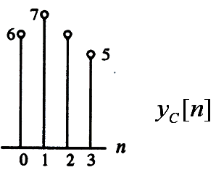
§3.6 Circular Convolution
The circular convolution can also be computed using a DFT-based approach

Slide 42
Homework
Read textbook from p.117 to 155
Problems
3.1, 3.4, 3.6, 3.12, 3.17, 3.21

Slide 43
§3.7 z-transform
The DTFT provides a frequency-domain representation of discrete-time signals and LTI discrete-time systems
Because of the convergence condition, in many cases, the DTFT of a sequence may not exist
As a result, it is not possible to make use of such frequency-domain characterization in these cases

Slide 44
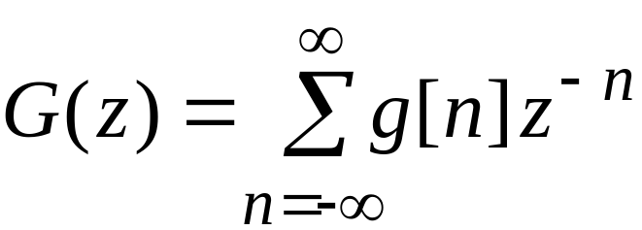
§3.7 z-transform
For a given sequence g[n], its z-transform G(z) is defined as
where z = Re(z) + jIm(z) is a complex variable

Slide 45
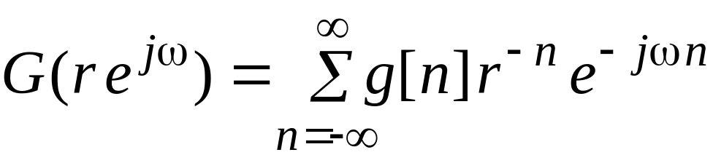
§3.7 z-transform
let z=re^{jω}, the z-transform reduces to
The above can be interpreted as the DTFT of the modified sequence{g[n]r^{-n}}
For r = 1 (i.e., |z| = 1), z-transform reduces to its DTFT, provided the latter exists

Slide 46
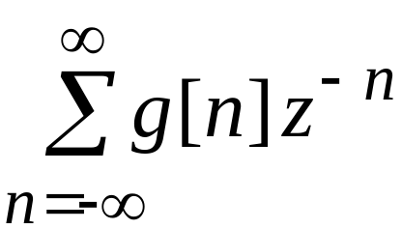
§3.7 z-transform
|z| = 1 is unit circle
Like the DTFT, there are conditions on the convergence of the infinite series
For a given sequence, the set R of values of z for which its z-transform converges is called the region of convergence (ROC)

Slide 47
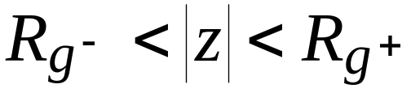
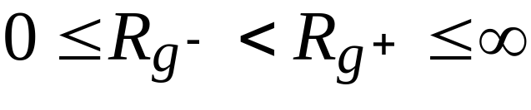
§3.7 z-transform
In general, the ROC of a z-transform of a sequence g[n] is an annular region of the z-plane:
where
Note: The z-transform is a form of a Laurent series and is an analytic function at every point in the ROC

Slide 48
§3.7 z-transform
The DTFT G(e^{jω}) of a sequence g[n] converges uniformly if and only if the ROC of the z-transform G(z) of g[n] includes the unit circle
The existence of the DTFT does not always imply the existence of the z-transform

Slide 49
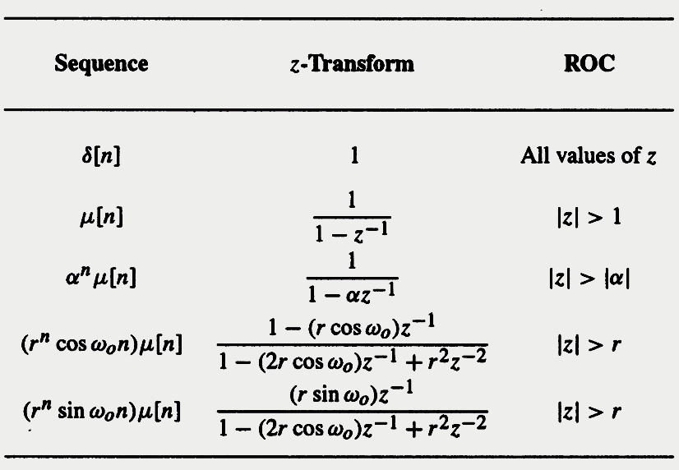
§3.7.1 Commonly Used z-transform

Slide 50
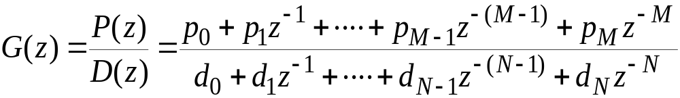
§3.7.2 Rational z-transform
In the case of LTI discrete-time systems in this course, all pertinent z-transforms are rational functions of z⁻¹
That is, they are ratios of two polynomials in z⁻¹ :

Slide 51
§3.7.2 Rational z-transform
At a root z=ξ_{l} of the numerator polynomial G(ξ_{l})=0 and as a result, these values of z are known as the zeros of G(z)
At a root z= λ_{l} of the denominator polynomial G(λ_{l})→∞, and as a result, these values of z are known as the poles of G(z)

Slide 52
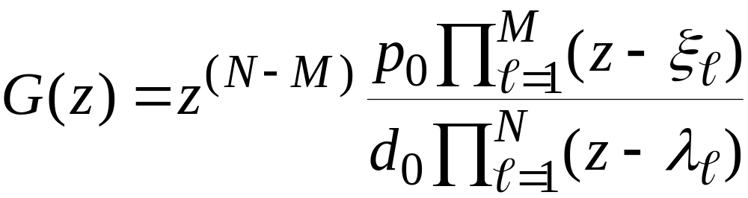
§3.7.2 Rational z-transform
Consider
Note G(z) has M finite zeros and N finite poles
If N > M there are additional N - M zeros at
z = 0 (the origin in the z-plane)
If N < M there are additional M - N poles at z = 0

Slide 53
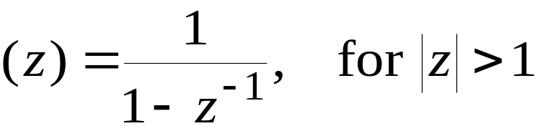
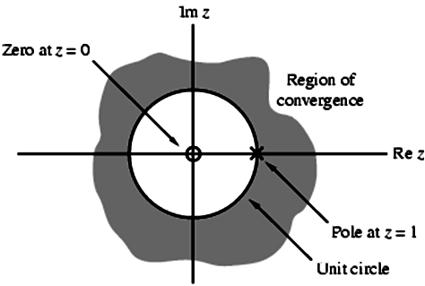
§3.7.2 Rational z-transform
Example - The z-transform
μ
has a zero at z = 0 and a pole at z = 1

Slide 54
§3.7.3 ROC of a Rational z-transform
ROC of a z-transform is an important concept
Without the knowledge of the ROC, there is no unique relationship between a sequence and its z-transform
Hence, the z-transform must always be specified with its ROC

Slide 55
§3.7.3 ROC of a Rational z-transform
Moreover, if the ROC of a z-transform includes the unit circle, the DTFT of the sequence is obtained by simply evaluating the z-transform on the unit circle
There is a relationship between the ROC of the z-transform of the impulse response of a causal LTI discrete-time system and its BIBO(Bounded-Input, Bounded-Output) stability

Slide 56
§3.7.3 ROC of a Rational z-transform
The ROC of a rational z-transform is bounded by the locations of its poles
To understand the relationship between the poles and the ROC, it is instructive to examine the pole-zero plot of a z-transform
Consider again the pole-zero plot of the z-transform μ(z)

Slide 57

§3.7.3 ROC of a Rational z-transform
In this plot, the ROC, shown as the shaded area, is the region of the z-plane just outside the circle centered at the origin and going through the pole at z = 1

Slide 58
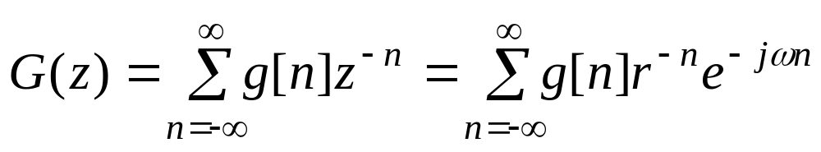
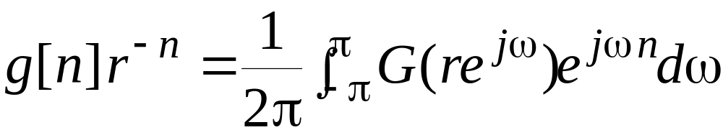
§3.7.4 Inverse z-Transform
General Expression: Recall that, for z=re^{jω}, the z-transform G(z) given by
is merely the DTFT of the modified sequence g[n]r^{-n}
Accordingly, the inverse DTFT is thus given by

Slide 59
§3.7.5 Inverse Transform by
Partial-Fraction Expansion
A rational z-transform G(z) with a causal inverse transform g[n] has an ROC that is exterior to a circle
Here it is more convenient to express G(z) in a partial-fraction expansion form and then determine g[n] by summing the inverse transform of the individual simpler terms in the expansion

Slide 60


§3.7.5 Inverse Transform by
Partial-Fraction Expansion
A rational G(z) can be expressed as
If M≥N then G(z) can be re-expressed as
where the degree of P₁(z) is less than N

Slide 61


§3.7.5 Inverse Transform by
Partial-Fraction Expansion
The rational function P₁(z)/D(z) is called a proper fraction
Example - Consider
By long division we arrive at

Slide 62

§3.7.5 Inverse Transform by
Partial-Fraction Expansion
Simple Poles: In most practical cases, the rational z-transform of interest G(z) is a proper fraction with simple poles
Let the poles of G(z) be at z=λ_{k},1≤ k ≤N
A partial-fraction expansion of G(z) is then of the form

Slide 63

§3.7.5 Inverse Transform by
Partial-Fraction Expansion
The constants ρ_{l} in the partial-fraction expansion are called the residues and are given by
Each term of the sum in partial-fraction expansion has an ROC given by |z|>|λ_{l}| and, thus has an inverse transform of the form ρ_{l} (λ_{l})^{n}μ[n]

Slide 64

§3.7.5 Inverse Transform by
Partial-Fraction Expansion
Therefore, the inverse transform g[n] of G(z) is given by
Note: The above approach with a slight modification can also be used to determine the inverse of a rational z-transform of a noncausal sequence

Slide 65
§3.7.5 Inverse Transform by
Partial-Fraction Expansion
Multiple Poles: If G(z) has multiple poles, the partial-fraction expansion is of slightly different form
Let the pole at z = ν be of multiplicity L and the remaining N-L poles be simple and at z= λ_{l}, 1 ≤ l ≤N-L

Slide 66


§3.7.5 Inverse Transform by
Partial-Fraction Expansion
Then the partial-fraction expansion of G(z) is of the form
where the constants γ_{i} are computed using
The residues ρ_{l} are calculated as before

Slide 67

§3.8 z-Transform Properties

Slide 68


§3.9 Discrete Fourier Transform Computation
The N-point DFT X[k] of a length-N sequence x[n], 0≤n≤N-1, is defined by
where
Direct computation of all N samples of {X[k]} requires N² complex multiplications and N(N-1) complex additions

Slide 69
§3.9 Discrete Fourier Transform Computation
J.W.Cooley and J.W.Tukey are given credit for bringing the FFT to the world in their paper :“An algorithm for the machine calculation of complex Fourier Series”, Mathematics Computation, Vol.19, 1965. In retrospect, others had discovered the technique many years before. For instance, the great German mathematician K. F. Gauss(1777-1855) had used the method more than a century earlier. This early work was largely forgotten because it lacked the tool to make it practical: the digital computer. Cooley and Tukey are honored because they discovered the FFT at the right time, the beginning of the computer revolution.

Slide 70
§3.9 Discrete Fourier Transform Computation
If we reexamine the twiddle factor W_{N}:
W_{N}= e^{-j(2π/N)}
We can see that the same values of W_{N} are calculated many times during the DFT since W_{N} is a periodic function with a limited number of distinct values. The aim of the FFT and its inverse, the IFFT, is to use this redundancy to reduce the number of calculation.

Slide 71


§3.9 Discrete Fourier Transform Computation
The definition of DFT:

Slide 72
Split N-point sequence into two N/2-point sequences
x₁[n] = x[2n]
x₂[n] = x[2n+1]

Slide 73

Split N-point sequence into two N/2-point sequences

Slide 74

Split N-point sequence into two N/2-point sequences
The last step of above equation comes from

Slide 75
Split N-point sequence into two N/2-point sequences
We already divided the N-point DFT into two N/2-point DFT
There are N-point in X(k), but there are only N/2-point both in X₁(k) and X₂(k), so we got only first half N/2-point result of X(k)

Slide 76


Split N-point sequence into two N/2-point sequences
With the second half N/2-point result of X(k), we have
Because

Slide 77
Split N-point sequence into two N/2-point sequences
So, we need only calculate the X₁(k) and X₂(k) in the range [0, N/2-1], and it is conveniently to calculate the X(k) in range [0, N-1], which will greatly reduce the computation.

Slide 78

Split N-point sequence into two N/2-point sequences

Slide 79



§3.9.1 Decimation-in-Time FFT Algorithm
Consider a sequence x[n] of length N=2^{k}
Using a 2-band polyphase decomposition we can express its z-transform as
where

Slide 80

§3.9.1 Decimation-in-Time FFT Algorithm
Evaluating on the unit circle at N equally spaced points
we arrive at the N-point DFT of x[n]:
where X₀[k] and X₁[k] are the (N/2)-point DFTs of the (N/2)-length sequences x₀[n] and x₁[n]

Slide 81




§3.9.1 Decimation-in-Time FFT Algorithm

Slide 82

§3.9.1 Decimation-in-Time FFT Algorithm
Flow-graph representation

Slide 83
§3.9.1 Decimation-in-Time FFT Algorithm
Direct computation of the N-point DFT requires N² complex multiplications and
N²-N≈N² complex additions
Computation of the N-point DFT using the modified scheme requires the computation of two (N/2)-point DFTs that are then combined with N complex multiplications and N complex additions resulting in a total of (N²/2)+N complex multiplications and approximately (N²/2)+N complex additions

Slide 84

§3.9.1 Decimation-in-Time FFT Algorithm
For N≥3, (N²/2)+N <N²
Continuing the process we can express X₀[k] and X₁[k] as a weighted combination of two (N/4)-point DFTs
For example, we can write
where X₀₀[k] and X₀₁[k] are the (N/4)-point DFTs of the (N/4)-length sequences
x₀₀[n]= x₀[2n] and x₀₁[n]= x₀[2n+1]

Slide 85

§3.9.1 Decimation-in-Time FFT Algorithm

Slide 86



§3.9.2 Decimation-in-Frequency FFT Algorithm
Consider a sequence x[n] of length N=2^{k}
Its z-transform can be expressed as
where

Slide 87





§3.9.2 Decimation-in-Frequency FFT Algorithm
Evaluating X(z) on the unit circle at
we get
which can be rewritten using the identity as

Slide 88




§3.9.2 Decimation-in-Frequency FFT Algorithm
For k even
For k odd

Slide 89




§3.9.2 Decimation-in-Frequency FFT Algorithm
We can write
where

Slide 90

§3.9.2 Decimation-in-Frequency FFT Algorithm
Thus X[2l] and X[2l+1] are the (N/2)-point DFTs of the length-(N/2) sequences x₀[n] and x₁[n]
Flow-graph of the first-stage of the DFT algorithm is shown right

Slide 91
§3.9.2 Decimation-in-Frequency FFT Algorithm
Complete flow-graph of the decimation-in-frequency FFT computation scheme for N = 8

Slide 92

§3.9.3 Inverse DFT Computation
An FFT algorithm for computing the DFT samples can also be used to calculate efficiently the inverse DFT (IDFT)
Consider a length-N sequence x[n] with an N-point DFT X[k]
Recall

Slide 93

§3.9.3 Inverse DFT Computation
Multiplying both sides by N and taking the complex conjugate we get
Right-hand side of above is the N-point DFT of a sequence X*[k]

Slide 94
Homework
Problems
3.83, 3.85, 3.93, 3.98, 8.27, 8.29

