Slide 1
Chapter 5
Digital Processing of Continuous-Time Signals

Slide 2
§5.1 Digital Processing of Continuous-Time Signals
Digital processing of a continuous-time signal involves the following basic steps:
(1) Conversion of the continuous-time signal into a discrete-time signal,
(2) Processing of the discrete-time signal,
(3) Conversion of the processed discrete-time signal back into a continuous-time signal

Slide 3
§5.1 Digital Processing of Continuous-Time Signals
Complete block-diagram
Anti-
S/H
A/D
DSP
D/A
Reconstruction
aliasing
filter
filter
Since both the anti-aliasing filter and the reconstruction filter are analog lowpass filters, we review first the theory behind the design of such filters
Also, the most widely used IIR digital filter design method is based on the conversion of an analog lowpass prototype

Slide 4
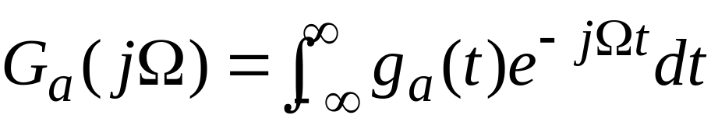
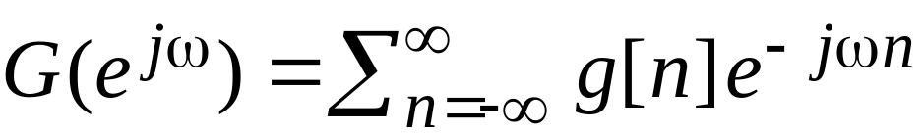
§5.2 Sampling of
Continuous-time Signals
The frequency-domain representation of g_{a}(t) is given by its continuos-time Fourier transform (CTFT):
The frequency-domain representation of g[n] is given by its discrete-time Fourier transform (DTFT):

Slide 5
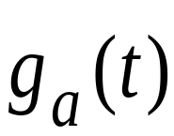
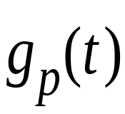
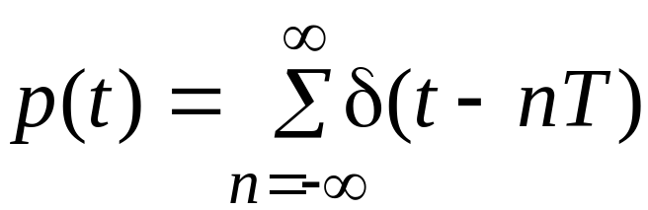

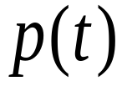
§5.3 Effect of Sampling in the Frequency Domain
To establish the relation between G_{a}(jΩ) and G(e^{jω}) , we treat the sampling operation mathematically as a multiplication of g_{a}(t) by a periodic impulse train p(t):

Slide 6
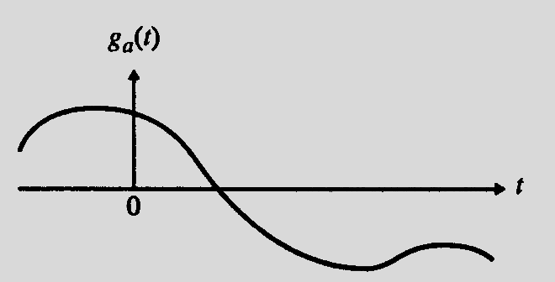
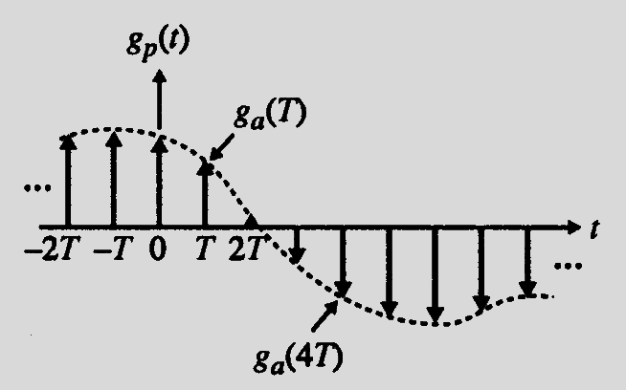
§5.3 Effect of Sampling in the Frequency Domain
g_{p}(t) is a continuous-time signal consisting of a train of uniformly spaced impulses with the impulse at t = nT weighted by the sampled value g_{a}(nT) of g_{a}(t) at that instant t=nT

Slide 7
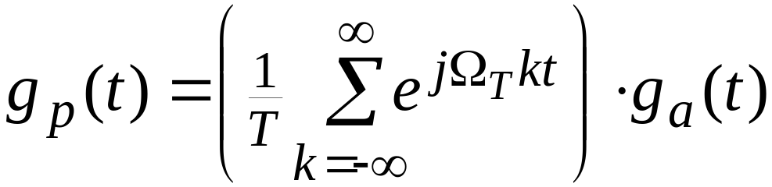
§5.3 Effect of Sampling in the Frequency Domain
The impulse train g_{p}(t) can be expressed as
From the frequency-shifting property of the CTFT, the CTFT of e^{jΩTkt}g_{a}(t) is given by G_{a}(j(Ω - kΩ_{T}))

Slide 8
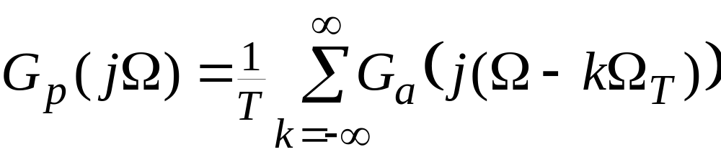
§5.3 Effect of Sampling in the Frequency Domain
Hence, the CTFT of g_{p}(t) is given by
Therefore, G_{p}(jΩ) is a periodic function of Ω consisting of a sum of shifted and scaled replicas of G_{a}(jΩ) , shifted by integer multiples of Ω_{T} and scaled by 1/T

Slide 9
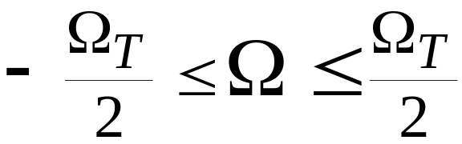
§5.3 Effect of Sampling in the Frequency Domain
The term on the RHS of the previous equation for k = 0 is the baseband portion of G_{p}(jΩ) , and each of the remaining terms are the frequency translated portions of G_{p}(jΩ)
The frequency range
is called the baseband or Nyquist band

Slide 10
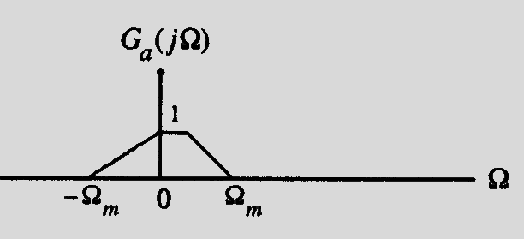
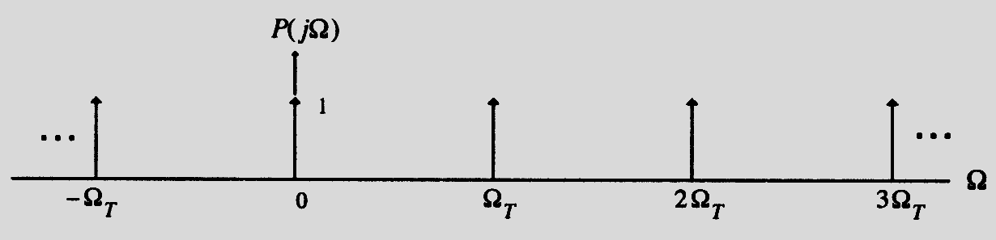
§5.3 Effect of Sampling in the Frequency Domain
Assume g_{a}(t) is a band-limited signal with a CTFT G_{a}(jΩ) as shown below
The spectrum P(jΩ) of p(t) having a sampling period T=2π/Ω_{T} is indicated below

Slide 11
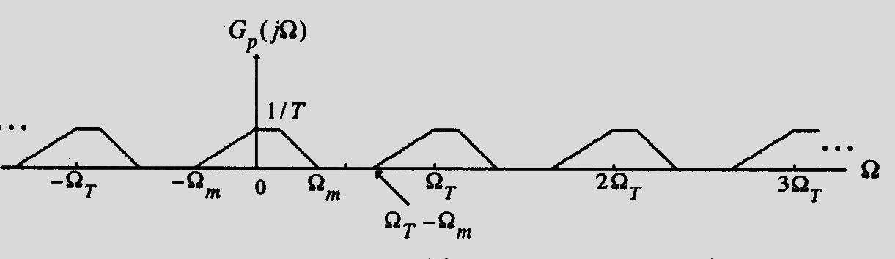
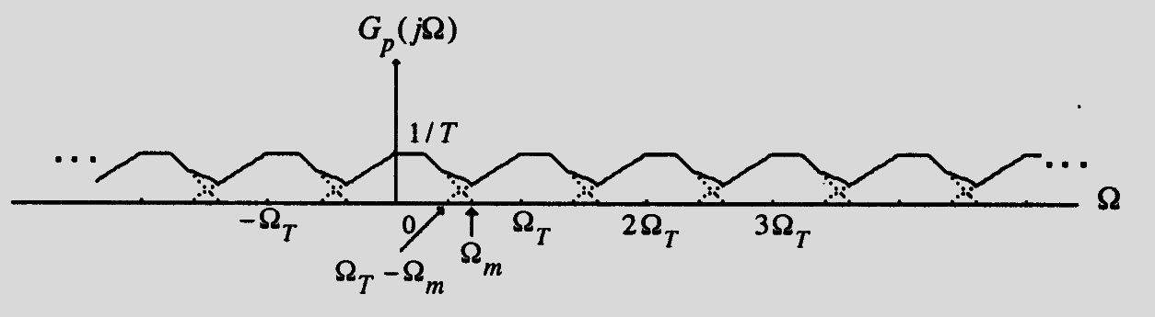
§5.3 Effect of Sampling in the Frequency Domain
Two possible spectra of G_{p}(jΩ) are shown below

Slide 12
§5.3 Effect of Sampling in the Frequency Domain
It is evident from the top figure on the previous slide that if Ω_{T}>2 Ω_{m} , there is no overlap between the shifted replicas of G_{a}(jΩ) generating G_{p}(jΩ)
On the other hand, as indicated by the figure on the bottom, if Ω_{T}<2 Ω_{m} , there is an overlap of the spectra of the shifted replicas of G_{a}(jΩ) generating G_{p}(jΩ)

Slide 13
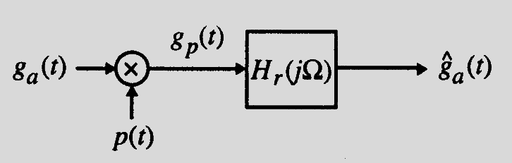
§5.3 Effect of Sampling in the Frequency Domain
If Ω_{T}>2 Ω_{m} , g_{a}(t) can be recovered exactly from g_{p}(t) by passing it through an ideal lowpass filter H_{r}(jΩ) with a gain T and a cutoff frequency Ω_{c} greater than Ω_{m} and less than Ω_{T} - Ω_{m} as shown below

Slide 14
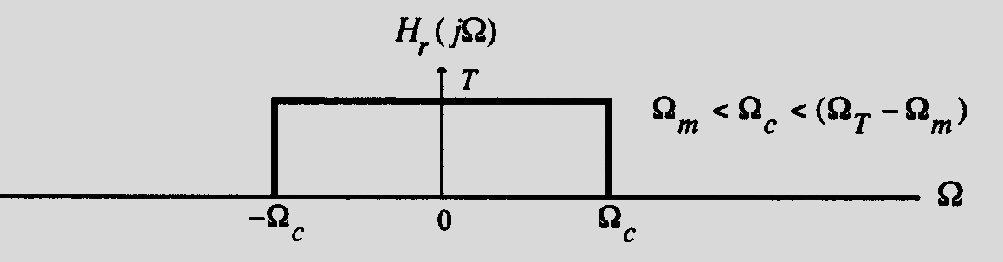
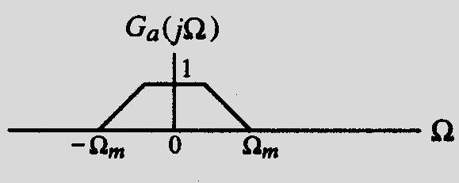
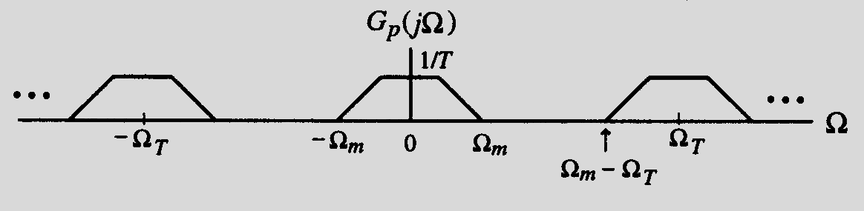
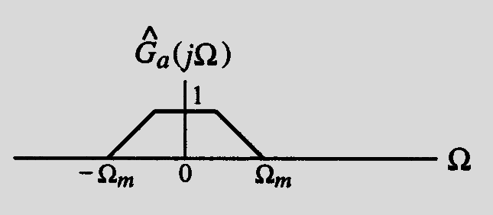
§5.3 Effect of Sampling in the Frequency Domain
The spectra of the filter and pertinent signals are shown below

Slide 15
§5.3 Effect of Sampling in the Frequency Domain
Sampling theorem - Let g_{a}(t) be a band-limited signal with CTFT G_{a}(jΩ)=0 for
| Ω|> Ω_{m}
Then g_{a}(t) is uniquely determined by its samples g_{a}(nT) , -∞≤n≤∞ if
Ω_{T} ≥ 2 Ω_{m}
where Ω_{T}=2π/T

Slide 16
§5.3 Effect of Sampling in the Frequency Domain
The condition Ω_{T} ≥ 2 Ω_{m} is often referred to as the Nyquist condition
The frequency Ω_{T}/2 is usually referred to as the folding frequency

Slide 17
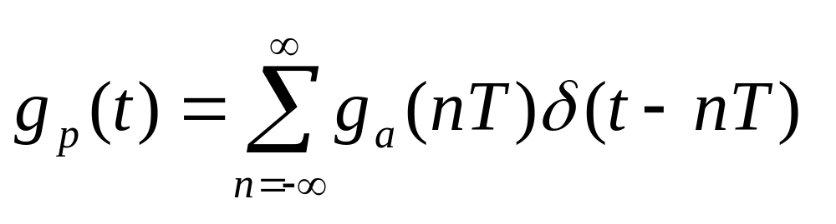
§5.3 Effect of Sampling in the Frequency Domain
Given {g_{a}(nT)}, we can recover exactly g_{a}(t) by generating an impulse train
and then passing it through an ideal lowpass filter H_{r}(jΩ) with a gain T and a cutoff frequency Ω_{c} satisfying
Ω_{m} < Ω_{c} < (Ω_{T} - Ω_{m} )

Slide 18
§5.3 Effect of Sampling in the Frequency Domain
The highest frequency Ω_{m} contained in g_{a}(t) is usually called the Nyquist frequency since it determines the minimum sampling frequency Ω_{T} =2Ω_{m} that must be used to fully recover g_{a}(t) from its sampled version
The frequency 2Ω_{m} is called the Nyquist rate

Slide 19
§5.3 Effect of Sampling in the Frequency Domain
Oversampling - The sampling frequency is higher than the Nyquist rate
Undersampling - The sampling frequency is lower than the Nyquist rate
Critical sampling - The sampling frequency is equal to the Nyquist rate
Note: A pure sinusoid may not be recoverable from its critically sampled version

Slide 20
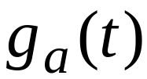
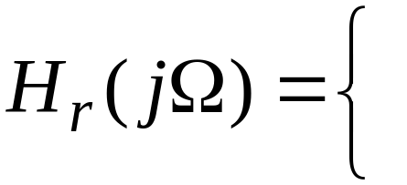
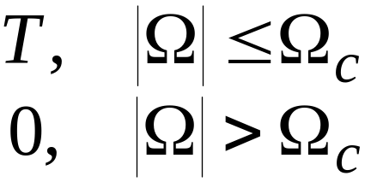
§5.4 Recovery of the Analog Signal
We now derive the expression for the output of the ideal lowpass reconstruction filter H_{r}(jΩ) as a function of the samples g[n]
^
The impulse response h_{r}(t) of the lowpass reconstruction filter is obtained by taking the inverse DTFT of H_{r}(jΩ)

Slide 21
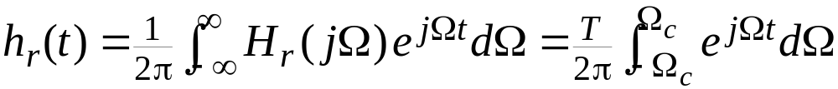
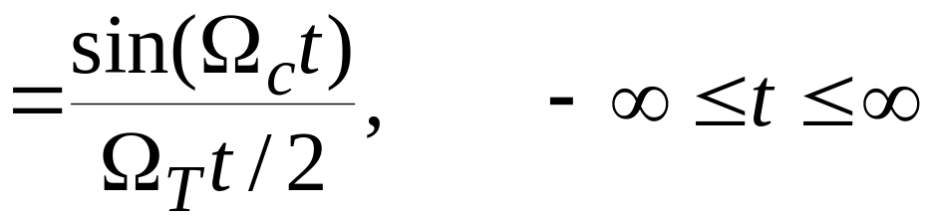
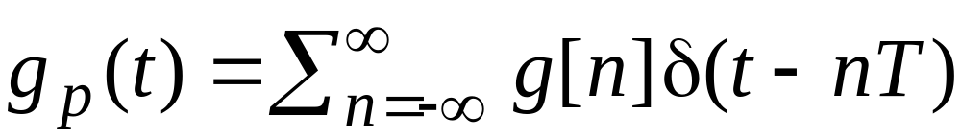
§5.4 Recovery of the Analog Signal
Thus, the impulse response is given by
The input to the lowpass filter is the impulse train g_{p}(t):

Slide 22
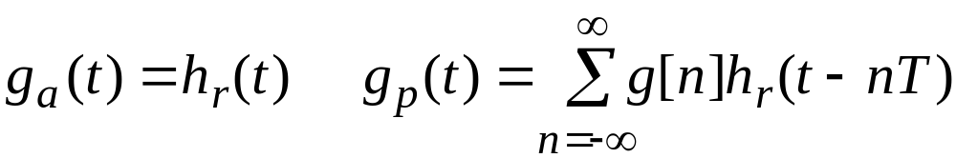
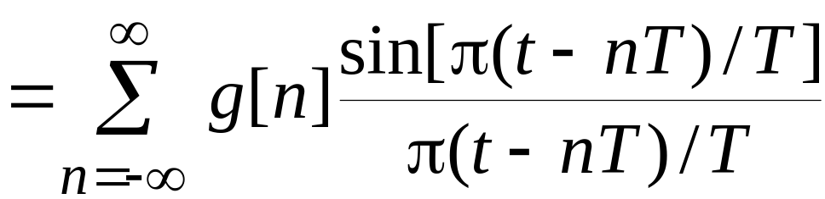
§5.4 Recovery of the Analog Signal
^
Therefore, the output of the ideal lowpass filter is given by:
^
*
Substituting h_{r}(t)=sin(Ω_{c}t)/(Ω_{T}t/2) in the above and assuming for simplicity
Ω_{c}= Ω_{T}/2= π/T , we get
^
which is called Poisson sum formula

Slide 23
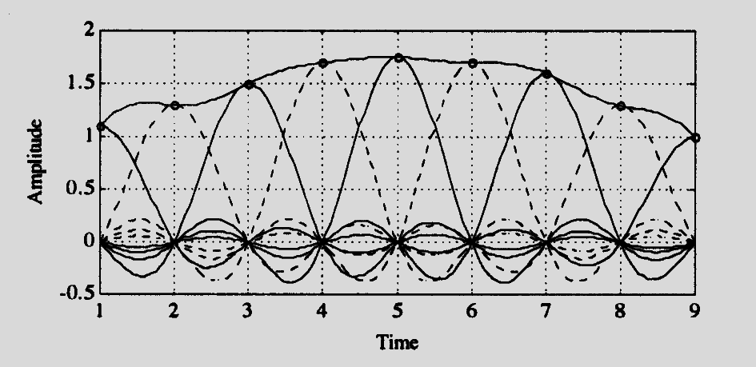
§5.4 Recovery of the Analog Signal
The ideal bandlimited interpolation process is illustrated below
Illustration of Poisson sum formula

Slide 24
§5.6 Sampling of Bandpass Signals
The conditions developed earlier for the unique representation of a continuous-time signal by the discrete-time signal obtained by uniform sampling assumed that the continuous-time signal is bandlimited in the frequency range from DC to some frequency Ω_{m}
Such a continuous-time signal is commonly referred to as a lowpass signal

Slide 25
§5.6 Sampling of Bandpass Signals
There are applications where the continuous-time signal is bandlimited to a higher frequency range Ω_{L}≤ |Ω| ≤ Ω_{H} with Ω_{L} >0
Such a signal is usually referred to as the bandpass signal
To prevent aliasing a bandpass signal can of course be sampled at a rate greater than twice the highest frequency, i.e. by ensuring
Ω_{T} ≥2 Ω_{H}

Slide 26
§5.6 Sampling of Bandpass Signals
However, due to the bandpass spectrum of the continuous-time signal, the spectrum of the discrete-time signal obtained by sampling will have spectral gaps with no signal components present in these gaps
Moreover, if Ω_{H} is very large, the sampling rate also has to be very large which may not be practical in some situations

Slide 27
§5.6 Sampling of Bandpass Signals
A more practical approach is to use under-sampling
Let ΔΩ= Ω_{H} - Ω_{L} define the bandwidth of the bandpass signal
Assume first that the highest frequency Ω_{H} contained in the signal is an integer multiple of the bandwidth, i.e.,
Ω_{H} = M(ΔΩ)

Slide 28
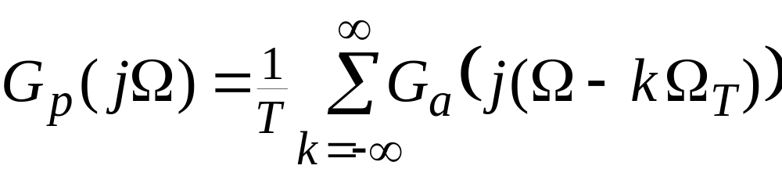
§5.6 Sampling of Bandpass Signals
We choose the sampling frequency Ω_{T} to satisfy the condition
Ω_{T} = 2(ΔΩ) = 2Ω_{H}/M
which is smaller than 2Ω_{H} , the Nyquist rate
Substitute the above expression in

Slide 29
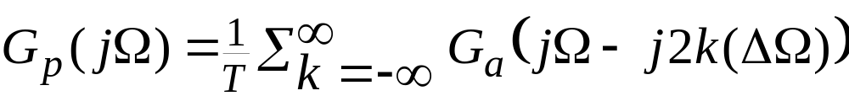
§5.6 Sampling of Bandpass Signals
This leads to
As before, G_{p}(jΩ) consists of a sum of G_{a}(jΩ) and replicas of G_{p}(jΩ) shifted by integer multiples of twice the bandwidth ΔΩ and scaled by 1/T
The amount of shift for each value of k ensures that there will be no overlap between all shifted replicas
no aliasing

Slide 30







§5.6 Sampling of Bandpass Signals
Figure below illustrate the idea behind
0
0

Slide 31
§5.6 Sampling of Bandpass Signals
As can be seen, g_{a}(t) can be recovered from g_{p}(t) by passing it through an ideal bandpass filter with a passband given by Ω_{L}≤ |Ω| ≤ Ω_{H} and a gain of T
Note: Any of the replicas in the lower frequency bands can be retained by passing through bandpass filters with passbands
Ω_{L}- k(ΔΩ) ≤ |Ω| ≤ Ω_{H} - k(ΔΩ) , 1 ≤ k ≤ M-1 providing a translation to lower frequency ranges

Slide 32
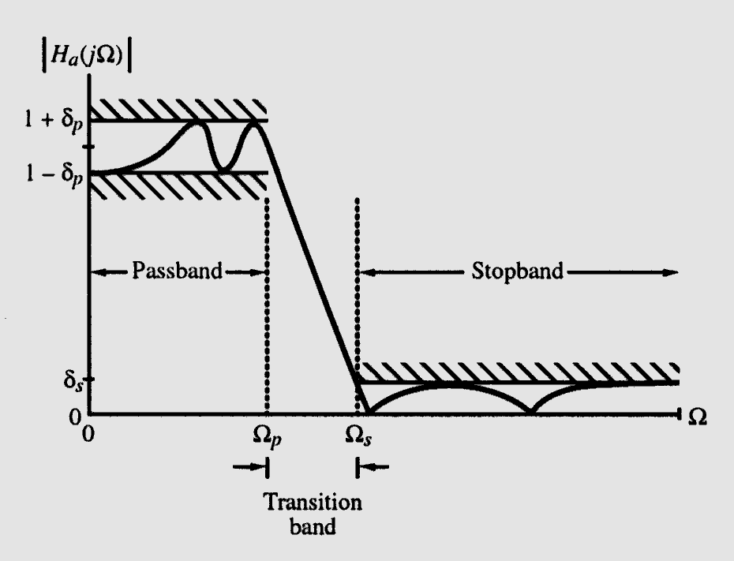
§5.7 Analog Lowpass Filter Specifications
Typical magnitude response |H_{a}(jΩ)| of an analog lowpass filter may be given as indicated below

Slide 33
§5.7 Analog Lowpass Filter Specifications
In the passband, defined by 0≤ Ω ≤ Ω_{p} , we require
1-δ_{p} ≤ |H_{a}(jΩ)| ≤ 1+ δ_{p} , |Ω| ≤ Ω_{p}
i.e., |H_{a}(jΩ)| approximates unity within an error of ±δ_{p}
In the stopband, defined by Ω_{s} ≤ Ω ≤ ∞, we require
|H_{a}(jΩ)| ≤ δ_{s} Ω_{s} ≤ Ω ≤ ∞
i.e., |H_{a}(jΩ)| approximates zero within an error of δ_{s}

Slide 34
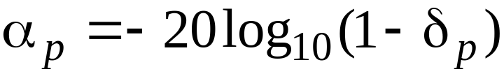

§5.7 Analog Lowpass Filter Specifications
Ω_{p} - passband edge frequency
Ω_{s} - stopband edge frequency
δ_{p} - peak ripple value in the passband
δ_{s} - peak ripple value in the stopband
Peak passband ripple
dB
Minimum stopband attenuation
dB

Slide 35
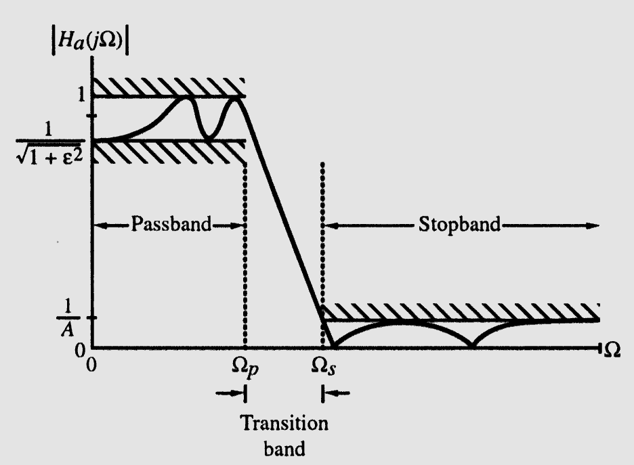
§5.7 Analog Lowpass Filter Specifications
Magnitude specifications may alternately be given in a normalized form as indicated below

Slide 36
§5.7 Analog Lowpass Filter Specifications
Here, the maximum value of the magnitude in the passband assumed to be unity
1 / √(1 + ε²) - Maximum passband deviation, given by the minimum value of the magnitude in the passband
1/A - Maximum stopband magnitude

Slide 37
§5.8 Analog Lowpass Filter Design
Two additional parameters are defined -
(1) Transition ratio k = Ω_{p}/ Ω_{s}
For a lowpass filter k<1
(2) Discrimination parameter k₁ = ε/ √(A² -1)
Usually k₁<<1

Slide 38
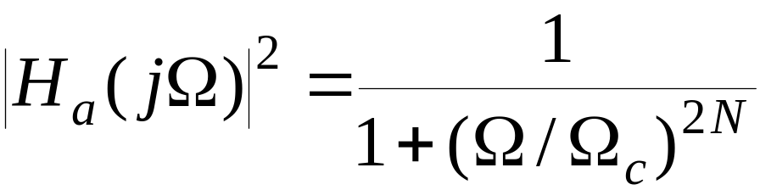
§5.8.1 Butterworth Approximation
The magnitude-square response of an N-th order analog lowpass Butterworth filter is given by
First 2N - 1 derivatives of |H_{a}(jΩ)|² at Ω = 0 are equal to zero
The Butterworth lowpass filter thus is said to have a maximally-flat magnitude at Ω = 0

Slide 39
§5.8.1 Butterworth Approximation
Gain in dB is
G(Ω)=10log₁₀|H_{a}(jΩ)|²
As G(0)=0 and
G(Ω_{c})=10log₁₀(0.5)=-3.0103≅-3 dB
Ω_{c} is called 3-dB cutoff frequency

Slide 40
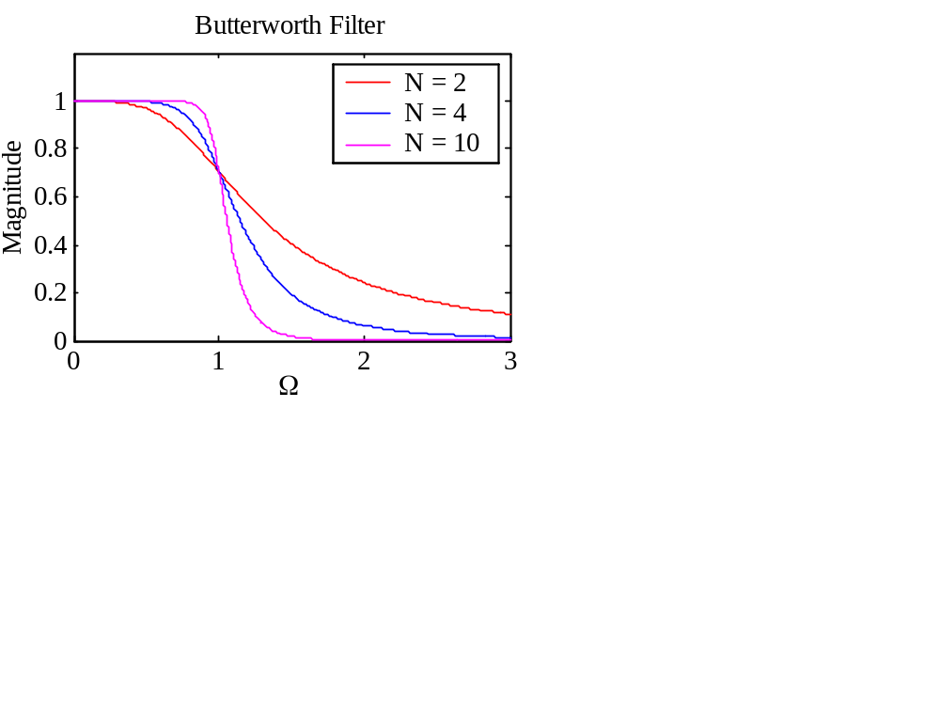
§5.8.1 Butterworth Approximation
Typical magnitude responses with Ω_{c} =1

Slide 41
§5.8.1 Butterworth Approximation
Two parameters completely characterizing a Butterworth lowpass filter are Ω_{c} and N
These are determined from the specified bandedges Ω_{p} and Ω_{s} , and minimum passband magnitude 1/√(1 + ε²) , and maximum stopband ripple 1/A

Slide 42
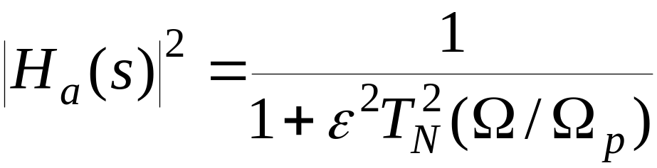
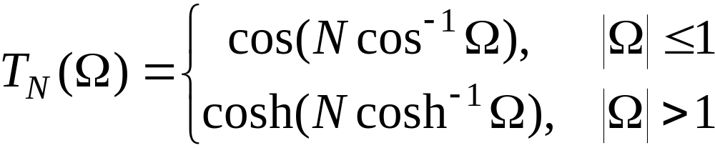
§5.8.2 Chebyshev Approximation
The magnitude-square response of an N-th order analog lowpass Type 1 Chebyshev filter is given by
where T_{N}(Ω) is the Chebyshev polynomial of order N:

Slide 43
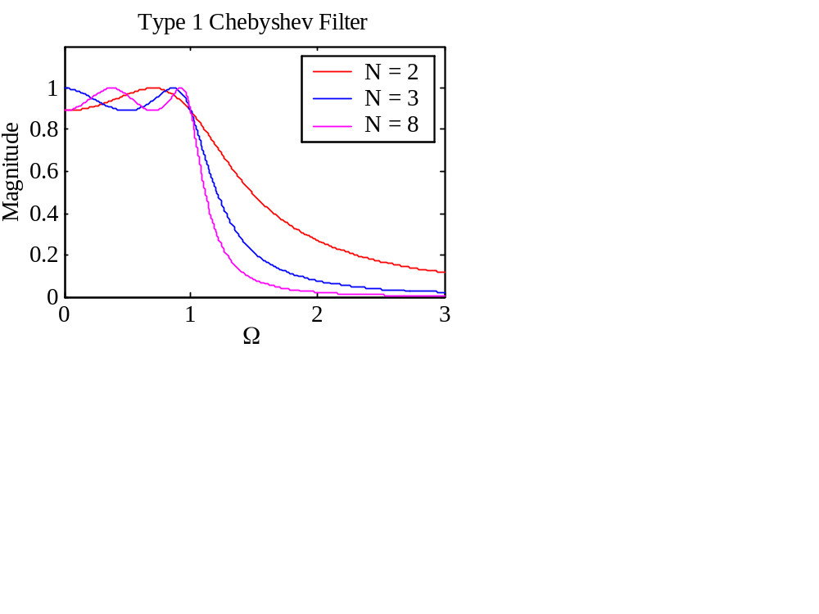
§5.8.2 Chebyshev Approximation
Typical magnitude response plots of the analog lowpass Type 1 Chebyshev filter are shown below

Slide 44
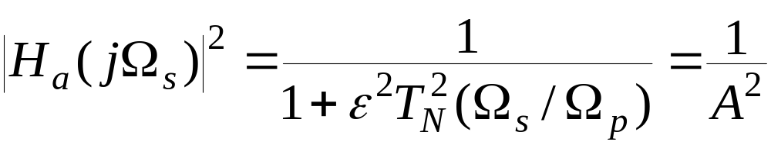
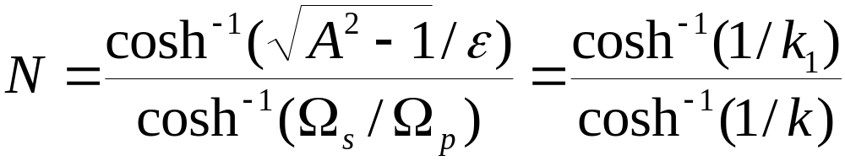
§5.8.2 Chebyshev Approximation
If at Ω = Ω_{c} the magnitude is equal to 1/A, then
Solving the above we get
Order N is chosen as the nearest integer greater than or equal to the above value

Slide 45
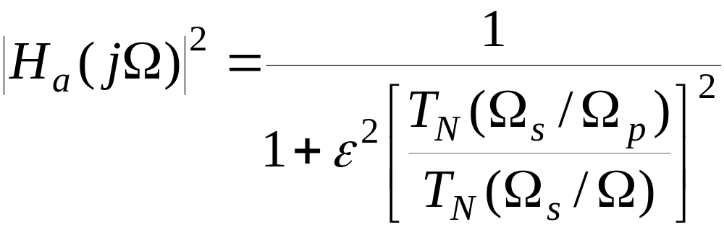
§5.8.2 Chebyshev Approximation
The magnitude-square response of an N-th order analog lowpass Type 2 Chebyshev (also called inverse Chebyshev) filter is given by
where T_{N}(Ω) is the Chebyshev polynomial of order N

Slide 46
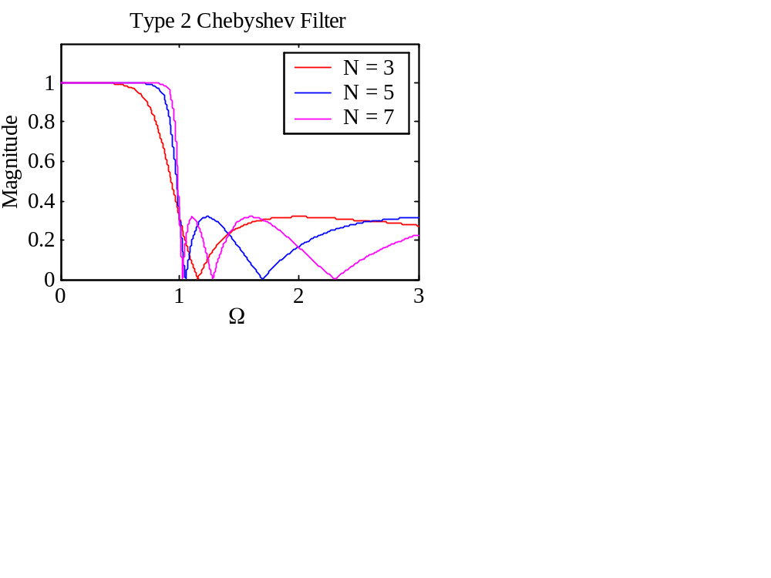
§5.8.2 Chebyshev Approximation
Typical magnitude response plots of the analog lowpass Type 2 Chebyshev filter are shown below

Slide 47
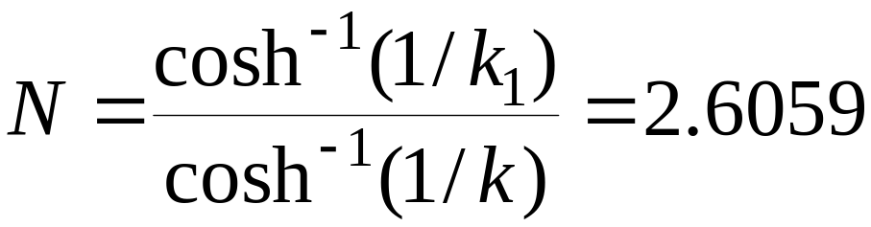
§5.8.2 Chebyshev Approximation
The order N of the Type 2 Chebyshev filter is determined from given ε, Ω_{s}, and A using
Example - Determine the lowest order of a Chebyshev lowpass filter with a 1-dB cutoff frequency at 1 kHz and a minimum attenuation of 40 dB at 5 kHz -

Slide 48
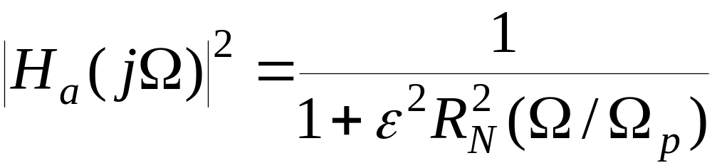
§5.8.3 Elliptic Approximation
The square-magnitude response of an elliptic lowpass filter is given by
where R_{N}(Ω) is a rational function of order N satisfying R_{N}(1/Ω)=1/ R_{N}(Ω) , with the roots of its numerator lying in the interval 1< Ω<1 and the roots of its denominator lying in the interval 1< Ω < ∞

Slide 49
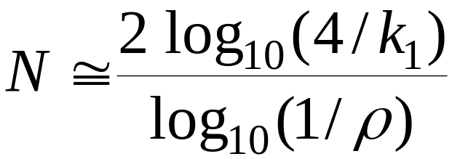
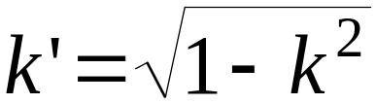
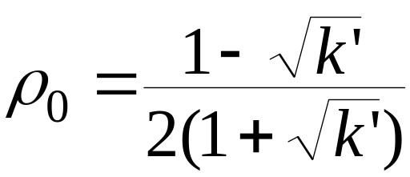
§5.8.3 Elliptic Approximation
For given Ω_{p}, Ω_{s}, ε, and A, the filter order can be estimated using
where

Slide 50
§5.8.3 Elliptic Approximation
Example - Determine the lowest order of a elliptic lowpass filter with a 1-dB cutoff frequency at 1 kHz and a minimum attenuation of 40 dB at 5 kHz
Note: k = 0.2 and 1/k₁=196.5134
Substituting these values we get
k’=0.979796, ρ₀=0.00255135,
ρ=0.0025513525
and hence N = 2.23308
Choose N = 3

Slide 51
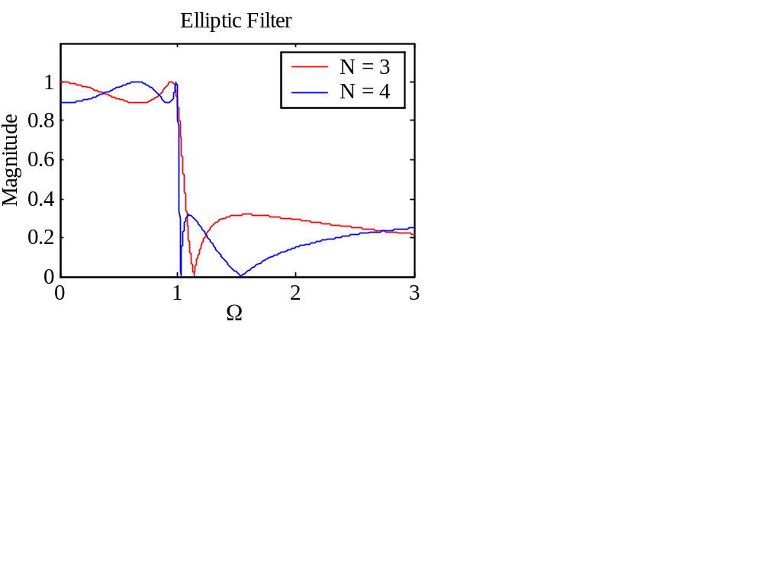
§5.8.3 Elliptic Approximation
Typical magnitude response plots with are shown below

Slide 52


Design of Other Analog Filter
(Spectral transformation in analog frequency)
Type
Spectral transformation
^
LP LP
^
LP HP
^
^
S = Ω / S
c
^
^
LP BP
^
^
^

Slide 53
Homework
Problems
5.2, 5.4, 5.5, 5.8, 5.11, 5.17, 5.25

